Slide 1

Searching
Thoughts and Prayers
Monday 8th January – Friday 12th January

Slide 2


MORNING PRAYER IN THE CHAPEL THIS WEEK
Tuesday 9th January - 11R
Wednesday 10th January - 11A
Thursday 11th January - 11I
Friday 12th January - 11N

Slide 3

Friday Mass
Who?
Mass this week will be led by 7Y
When?
Friday Morning at 8.20am
Where?
In the School Chapel. See you there!
ALL ARE MOST WELCOME.
ALL WORDS ARE DISPLAYED ON THE SCREEN.

Slide 4
Searching
Thoughts and Prayers
Monday 8th January – Friday 12th January

Slide 5

Welcome Back Everyone!
The New Year is an opportunity to reflect on the year gone by and to approach the year ahead with purpose and intention.
With the New Year comes a sense of new beginnings and of looking to the future. It’s a time and space for reflecting back on the previous year.
With the person next to you, discuss the highlight of 2023 and why it was the best part of your year!
.

Slide 6


It's a new year!
Let's start our return to school by thinking about objectives and goals we want to achieve in 2024
On a piece of paper, draw the numbers of the new year and fill it with realistic and achievable aims and new year's resolutions

Slide 7

Join a new club
Have fun!
Help out more at home
Be Kind
Exercise
Work harder in lessons

Slide 8

Let Us Pray
Dear God,
Thank you for new beginnings. What an incredible day this is with a fresh year's potential stretched out before me.
I want to be found faithful this year in each and every opportunity you bring to me. Thank you, Lord, for new beginnings.
I pray this in Jesus' name.
Amen.

Slide 9
Searching
Thoughts and Prayers
Monday 8th January – Friday 12th January

Slide 10

The theme this week is Searching
What does the theme 'Searching' mean to you personally?
Share a moment with the person next to you when you felt a strong need to search for something, either physically or metaphorically
Reflect on the value of searching in personal growth and learning

Slide 11

Searching
The things people search for in life vary greatly from person to person. Some seek happiness, love, success, meaning, fulfillment, knowledge, experiences, or a sense of belonging.
It often boils down to what brings personal fulfillment and purpose.
Take a moment of silent reflection to think about what it is you are personally searching for

Slide 12

Let Us Pray
Dear Lord,
Grant us the wisdom to seek purpose, the strength to pursue fulfillment, the courage to embrace love, and the resilience to find happiness.
May our journeys be guided by meaning, and may we find contentment in our pursuits
Amen

Slide 13
Searching
Thoughts and Prayers
Monday 8th January – Friday 12th January

Slide 14

Can you search and find Wally on the next slide?

Slide 15
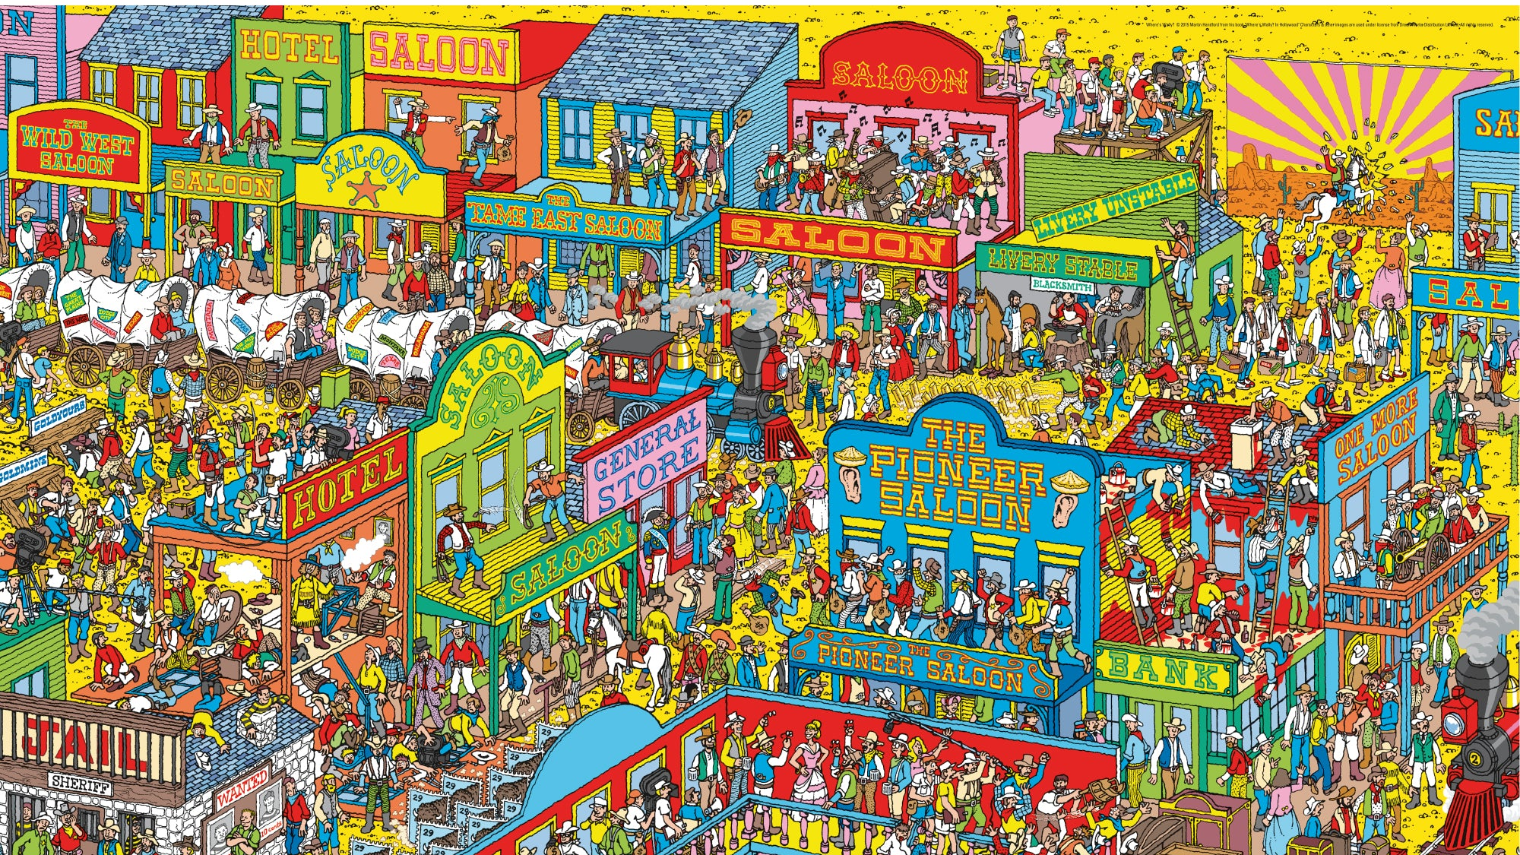

Slide 16
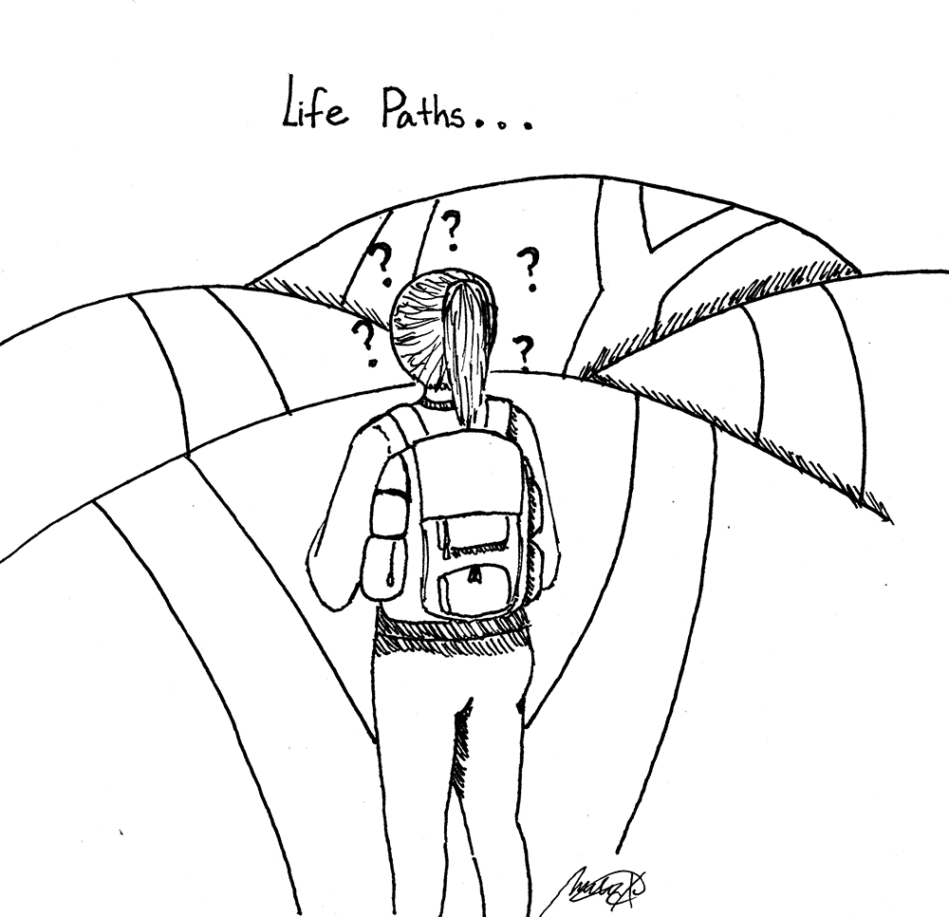
Searching for answers
Searching for answers or solutions can be an illuminating journey. It's often not just about finding the solution but also about the discoveries made along the way.
The process can reveal new perspectives, knowledge, and sometimes unexpected insights that enrich the search itself.
It's the exploration and the process of seeking that can be as valuable as the answers found.

Slide 17

Class Discussion
What motivates you to seek answers or solutions to a problem?
Have you ever experienced unexpected insights while searching for an answer? How did it change your perspective?
How do you approach a situation when you can't find an immediate answer?
Is there a specific instance where the journey of searching for an answer was more valuable than the answer itself?
Have you ever found an answer in an unexpected place or through an unconventional method?
How does the process of searching for answers contribute to personal growth and development?
Is there a balance between seeking answers and embracing uncertainty? How do you strike that balance?

Slide 18

Let Us Pray
Dear Lord,
In the pursuit of understanding and clarity, Grant me the patience to explore with curiosity.
The wisdom to cherish the journey of seeking,
And the grace to embrace the lessons within.
As I search for answers and solutions, May I find not only what I seek but also unexpected insights and discoveries
Guide me through uncertainty, letting the quest for knowledge deepen my understanding of the world and nurture the growth in my soul.
Grant me the courage to accept ambiguity, knowing that sometimes, the journey itself holds greater treasures than the destination
Amen

Slide 19
Searching
Thoughts and Prayers
Monday 8th January – Friday 12th January

Slide 20
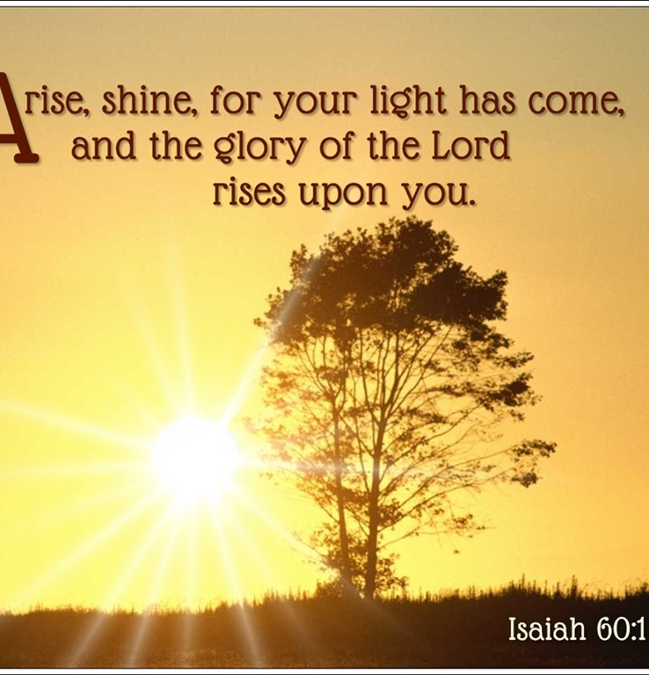
The Scripture this week
The scripture this week is taken from The Book of Isaiah. Isaiah was known for his prophecies concerning Israel, Judah, and the surrounding nations
This part of the book contains prophecies about a future time of restoration and blessing for Jerusalem. It speaks of a time when God's light will shine upon the city, drawing nations and kings to its brightness.
Isaiah 60:1 specifically calls for Jerusalem to arise and shine, as the glory of the Lord will be upon it. This passage is about the spiritual and physical restoration of Jerusalem and the people of Israel, foreseeing a time when they will experience divine favor and prosperity.
It is a combination of prophecies, warnings, and messages of hope and restoration for the people of Israel, offering guidance and reassurance during times of turmoil and exile.

Slide 21

Arise and Shine
Isaiah 60:1 can be linked to the theme of searching through the idea of seeking spiritual enlightenment or guidance. The verse encourages people to "arise and shine," suggesting an active movement, a purposeful rising from darkness into light. This can be seen as a metaphor for seeking truth, understanding, or a deeper connection with God.
The act of "arising" implies a journey—a search for something greater. The call to shine, to embrace the light that has come, can represent a quest for spiritual awakening or knowledge. In this context, the verse might inspire individuals to actively seek enlightenment, wisdom, or a deeper understanding of their faith, thus intertwining with the theme of searching.

Slide 22

Listen to the music and individually and in silence reflect on the following questions
What does it mean for me to "arise and shine" in my life? How can I actively step into a brighter or more purposeful existence?
In what areas of my life do I seek light or guidance? How might this verse encourage me in my search for spiritual understanding or enlightenment?
How can I apply the idea of embracing divine light to dispel personal darkness or challenges I might be facing?
What steps can I take to align myself with the "glory of the Lord" in my daily life? How can I reflect this light to those around me?
Do I actively seek opportunities for growth and spiritual development? How can this verse inspire me to continue or intensify that search?

Slide 23

Let US Pray
Lord,
As I journey through life, I seek Your guiding presence. Grant me the strength to rise above darkness, to step into the brilliance of Your wisdom and grace.
May Your light illuminate my path, leading me to greater understanding and spiritual awakening. Help me embrace Your glory and reflect it in my thoughts, actions, and interactions with others.
Grant me the courage to actively seek truth, to pursue growth, and to shine brightly in a world that often feels dim. Let Your light dispel any shadows within me, filling my heart with hope, peace, and purpose.
May I be a beacon of Your love, sharing Your radiance with those around me. Empower me to embody the message of Isaiah 60:1—arising and shining in Your divine presence.
Amen

