Slide 1
Resources
1. Using and understand the Present tense = page 7 - 10
2. Using and understand the Preterit tense = page 12 - 13
3. Using and understand the Near Future tense = page 15
https://languagesonline.org.uk/Spanish/Immediate_Future/Index.htm#gsc.tab=0
4. Understanding the comparative and how to use them = https://www.bbc.co.uk/bitesize/guides/zr742sg/revision/1
5. Identifying the difference between tenses = https://languagesonline.org.uk/Spanish/Presente/index.htm#gsc.tab=0
https://languagesonline.org.uk/Spanish/Immediate_Future/Index.htm#gsc.tab=0
https://languagesonline.org.uk/Spanish/preterite/index.htm#gsc.tab=0
https://www.bbc.co.uk/bitesize/guides/z7kgjhv/revision/1
https://www.bbc.co.uk/bitesize/guides/znmwhbk/revision/1
6. Using a varied range of vocabulary in written tasks = pages 46-51
7. Checking a 90-word written work for accuracy and grammatical errors = page 38
8. Spelling of commonly used key words and vocabulary from KS3 to now = pages 46 – 51
9. Learning key vocabulary from Theme 3 successfully = pages 58-61
10. Revising content of lessons as part of homework to prepare for speaking / writing tasks = Resources on Teams tile

Slide 2




SPANISH GCSE STUDENT HANDBOOK
NOMBRE__________________________ APELLIDO __________________________
KNOW THE BASICS
2 | The alphabet
3 | Numbers
4 | Dates, months, days, seasons, colours
5 | Small but important words - a, the, my, to the, from the, my, your, this, that, whose etc
6 | Grammar terms explained
VERBS & TENSES EXPLAINED
7 | Regular present tense verbs, irregular first person singular verbs
8 | Radical-changing verbs in the Present Tense
9 | Reflexive verbs in the Present Tense
10 | Irregular Present tense verbs
11 | Present & Imperfect continuous tenses
12 | Preterite tense of regular & radical-changing verbs
13 | Irregular Preterite tense verbs
14 | Imperfect tense
15 | Future & Conditional tenses
16 | Perfect & Pluperfect tenses
17 | Impersonal verbs like gustar
18 | Table of regular verb endings for all tenses
SPEAKING & WRITING SPANISH
19-20 | 14 common errors to avoid
21 | Linking words, giving structure, intensifiers, time phrases
22 | Opinions, adjectives, negatives
23 | Developing answers: LOVE IT
24 | SPANISH STARS
25 | 10 essential must learn verbs in 3 tenses
26 | Infinitive structures & future expressions
27 | The subjunctive mood
SPEAKING EXAM PREPARATION
28-29 |  | Key to success in the role play
30 |  | Example role plays
31 |  | Key to success in the photo card
32 |  | Photo card chatty mat (PAWS)
33 |  | Key to success in the conversation
WRITING EXAM PREPARATION
34 | FQ1: Write 4 sentences
35 | FQ2-40 word task
36 | F&H Q3 Translation into Spanish general advice & VAN strategy
37 | FQ3-translate into Spanish example & advice
38 | FQ4 & HQ1-90 word task
39 | 25 word bullet point strategy & 10 Spanish Stars for grade 5+
40 | HQ2 -150 word task
41 | HQ3 Higher-translate into Spanish example & advice
LISTENING & READING EXAM PREPARATION
42-43 |  | Listening & Reading exam advice
44 |  | Synonyms & vocabulary learning strategies
45 |  | Common features of the translation into English question
VOCABULARY LISTS & STRUCTURES IN THEMES
46-61 |  | THEME 1: IDENTITY & CULTURE
Me, my friends & family Technology |  |  |  |  | Free time Customs/festivals
52-57 |  | THEME 2: LOCAL, NATIONAL, INTERNATIONAL & GLOBAL AREAS OF INTEREST
Home, town, neighbourhood, region |  |  |  | Social & global issues Travel & tourism
58-61 |  | THEME 3: CURRENT & FUTURE STUDY & EMPLOYMENT
My studies Life at school |  |  | Education post 16 Jobs, career choices & ambitions
62 | EXAM REVISION CHECKLIST SKILL BY SKILL
63 | Useful websites for learning & revising Spanish
64 | GCSE course content, KERBOODLE units, grammar corrections checklist

Slide 3
EL ALFABETO ESPAÑOL
 | written form | pronunciation guide
a | a | a
b | be | bay
c | ce | thay
d | de | day
e | e | eh
f | efe | e fay
g | ge | Hay (sore throat!)
h | ache | a chay
i | i | ee
j | jota | ho ta (sore throat!)
k | ka | ka
l | ele | e lay
m | eme | e may
n | ene | e nay
ñ | eñe | eny ay
o | o | o
p | pe | pay
q | cu | koo
r | erre | e ray
s | ese | e say
t | te | tay
u | u | oo
v | uve | oo bay
w | uve doble | oo bay dob lay
x | equis | eh kiss
y | ye | yay
z | ceta | thay ta

Slide 4
LOS NÚMEROS
1 uno | 20 veinte | 100 cien
2 dos | 21 veintiuno | 101 ciento uno
3 tres | 22 veintidós | 102 ciento dos
4 cuatro | 23 veintitrés | 110 ciento diez
5 cinco | 24 veinticuatro | 151 ciento cincuenta y uno
6 seis | 25 veinticinco | 162 ciento sesenta y dos
7 siete | 26 veintiséis | 190 ciento noventa
8 ocho | 27 veintisiete | 200 doscientos
9 nueve | 28 veintiocho | 300 trescientos
10 diez | 29 veintinueve | 400 cuatrocientos
11 once | 30 treinta | 500 quinientos
12 doce | 31 treinta y uno | 600 seiscientos
13 trece | 32 treinta y dos | 700 setecientos
14 catorce | 40 cuarenta | 800 ochocientos
15 quince | 50 cincuenta | 900 novecientos
16 dieciséis | 60 sesenta | 1 000 mil
17 diecisiete | 70 setenta | 2 000 dos mil
18 dieciocho | 80 ochenta | 1 000 000 un millón (de)
19 diecinueve | 90 noventa | 2 000 000 dos millones (de)
Remember the “and” is between the 10s and the units: treinta y dos
Follow the link to help you pronounce the numbers correctly:
http://www.donquijote.org/spanishlanguage/numbers/numbers1.asp

Slide 5
LA FECHA: THE DATE
¿Qué día es (hoy)?/ ¿Cuál es la fecha? What’s the date (today)?
Hoy es lunes, cinco de septiembre
Los meses The Months Los días The days
enero January lunes Monday
febrero February martes Tuesday
marzo March miércoles Wednesday
abril April jueves Thursday
mayo May viernes Friday
junio June sábado Saturday
julio July domingo Sunday
agosto August
septiembre September
octubre October
noviembre November
diciembre December
Las estaciones The seasons
primavera spring
verano summer
otoño autumn
invierno winter
mil novecientos noventa y ocho = 1998
el dos mil doce = 2012
Los colores The colours
rojo red rosa pink
amarillo yellow marrón brown
verde green naranja orange
azul blue gris grey
blanco white morado purple
negro black azul claro light blue
azul oscuro dark blue azul marino navy blue

Slide 6
Treat like you would an ADJECTIVE These words AGREE with the NOUN they describe
 | masc (s) | fem (s) | masc (p) | fem (p)
a/ some | un | una | unos | unas
any | algún | alguna | algunos | algunas
none | ningún | ninguna | ningunos | ningunas
the | el | la | los | las
to the | al | a la | a los | a las
of/ from the | del | de la | de los | de las
too much/many | demasiado | demasiada | demasiados | demasiadas
another/other | otro | otra | otros | otras
few/little | poco | poca | pocos | pocas
lots of | mucho | mucha | muchos | muchas
so much/many | tanto | tanta | tantos | tantas
this/ these | este | esta | estos | estas
that/ those | ese | esa | esos | esas
that/ those (over there) | aquel | aquella | aquellos | aquellas
my | mi |  | mis
your | tu |  | tus
his/ her | su |  | sus
our | nuestro | nuestra | nuestros | nuestras
your | vuestro | vuestra | vuestros | vuestras
their | su |  | sus
mine | el mío | la mía | los míos | las mías
yours | el tuyo | la tuya | los tuyos | las tuyas
his/ hers | el suyo | la suya | los suyos | las suyas
ours | el nuestro | la nuestra | los nuestros | las nuestras
yours | el vuestro | la vuestra | los vuestros | las vuestras
theirs | el suyo | la suya | los suyos | las suyas
whose | cuyo | cuya | cuyos | cuyas

Slide 7
GRAMMAR TERMS EXPLAINED
Term | Its job |  |  | Example
noun (n) | names a person, place, animal, thing |  |  | Luis, España, un gato, un libro
nm nf | masculine noun feminine noun |  |  | un lápiz, una goma
definite articles | the (singular noun) the (plural noun) |  |  | el, la los, las
indefinite articles | a some |  |  | un, una unos , unas
adjective (adj) | describes a noun, usually placed after noun |  |  | azul un boli azul
verb (vt) | describes an action |  |  | me llamo, tengo
adverb (adv) | describes a verb |  |  | muy, demasiado, lentamente
subject pronouns | word used in place of a noun (not often used in Spanish) 4 WAYS OF EXPRESSING “YOU” Tú = singular Usted = singular, polite Vosotros/ as = plural Ustedes = plural, polite |  |  | Yo Tú Él Ella Usted Nosotros/ as Vosotros/ as Ellos /as Ustedes |  | I You He She You We You They You
TENSES EXPLAINED
Tense |  | Meaning | Example with the verb to sing CANTAR
Conditional (El Condicional) |  | would | I would sing |  | Cantaría
Future ( El futuro) |  | will/ shall | I will sing |  | Cantaré
Present (El presente) |  | is | I sing/ I do sing |  | Canto
Present continuous ( El presente continuo) |  | am ...ing | I am singing |  | Estoy cantando
Imperfect (El imperfecto) |  | was/ used to | I was singing/ used to sing |  | Cantaba
Imperfect continuous (El imperfecto continuo) |  | was ...ing | I was singing |  | Estaba cantando
Preterite (El pretérito) |  | did | I sang |  | Canté
Perfect (El perfecto) |  | has/ have | I have sung |  | He cantado
Pluperfect (El pluscuamperfecto) |  | had | I had sung |  | Había cantado

Slide 8
THE PRESENT TENSE OF REGULAR VERBS
To talk about actions in the present, you need to change the infinitive verb by taking off the last 2 letters (either –AR, -ER, or –IR) and adding different endings.
The endings tell you who is doing the action of the verb. E.g. hablo = I speak, bailan = they dance.
In Spanish you usually leave out the subject pronoun (I, you, he, she…) because the endings show which person is the subject of the verb (doing the action).
Look at the table below to see which endings you need to add to the regular –AR, -ER and –IR verbs to make the present tense.
NB: Use the tú and vosotros forms of ‘you’ when talking to friends, relations or children. Use the Usted and Ustedes forms when talking to an adult who you would not call by their first name.
THE PRESENT TENSE ENDINGS FOR REGULAR VERBS
 | (AR) hablar to speak | (ER) aprender to learn | (IR) vivir to live
yo (I) | hablo | aprendo | vivo
tú (you) | hablas | aprendes | vives
él/ella/Usted (he/she/you) | habla | aprende | vive
nosotros (we) | hablamos | aprendemos | vivimos
vosotros | habláis | aprendéis | vivís
ellos/ellas/Ustedes (they/you) | hablan | aprenden | viven
SOME VERBS ARE IIREGULAR IN THE “I” FORM & HAVE TO BE LEARNED | conocer | conozco | I know (a person/place)
 | coger | cojo | I catch
 | dar | doy | I give
 | decir | digo | I say
 | estar | estoy | I am
 | hacer | hago | I do
 | ir | voy | I go
 | oír | oigo | I hear
 | poner | pongo | I put
 | producir | produzco | I produce
 | saber | sé | I know (a fact)
 | salir | salgo | I go out; I leave
 | ser | soy | I am
 | tener | tengo | I have
 | ver | veo | I see

Slide 9
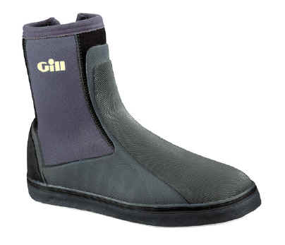
RADICAL-CHANGING VERBS IN THE PRESENT TENSE
These verbs change their vowel in the root or stem of the verb, except in the nosotros and vosotros parts of the verb. These verbs can also be called ‘boot’ verbs - you can see why below!
There are 4 types of change:
e → ie
e → i
o → ue & u → ue
pienso |  | pensamos
piensas |  | pensáis
piensa |  | piensan
e→ie preferir – to prefer | e→i decir – to say | o→ue or u→ue dormir – to sleep
prefiero | digo (irregular) | duermo
prefieres | dices | duermes
prefiere | dice | duerme
preferimos | decimos | dormimos
preferís | decís | dormís
prefieren | dicen | duermen
e→ie pensar (to think), cerrar (to close) despertarse (to wake up) encender (to switch on) empezar (to begin) entender (to understand) comenzar (to begin) divertirse (to enjoy oneself) tener (to have) perder (to lose) querer (to want) recomendar (to recommend) sentarse (to sit down) | e→i pedir (to ask for), repetir (to repeat) seguir (to follow) vestirse (to get dressed) elegir (to choose) pedir prestado (to borrow) reír (to laugh) servir (to serve) sonreír (to smile) | o→ue acostarse (to go to bed) contar (to tell) costar (to cost) encontrar (to find) mostrar (to show) morir (to die) poder (to be able to) recordar (to remember) soler (to usually do) volver (to return) u→ue jugar (to play)

Slide 10
REFLEXIVE VERBS IN THE PRESENT TENSE
Some verbs need an extra part because they are reflexive, (when the action is being done to your self, like waking up, having a wash.)
AN EXAMPLE OF A REFLEXIVE VERB
Levantarse-To get up
Because it is an AR verb, it takes the AR endings.
Because it is reflexive, it needs the reflexive pronoun (me, te, se, nos, os, se)
Reflexive verbs have infinitives that end in “se”.
LEVANTARSE | TO GET UP
Me levanto | I get up
Te levantas | You get up
Se levanta | He, she gets up, you get up
Nos levantamos | We get up
Os levantáis | You get up
Se levantan | They, you get up
Some common reflexive verbs:
despertarse-to wake up (also radical-changing-me despierto)
lavarse-to get washed
ducharse-to have a shower
bañarse-to have a bath
relajarse-to relax
vestirse-to get dressed (also radical-changing-me visto)

Slide 11
IRREGULAR PRESENT TENSE VERBS
Some verbs do not follow the regular pattern and you need to learn these by heart.
NB: Hay = There is / There are
The 2 verbs ‘to be’ |  |  | SER is for describing permanent or unchanging characteristics e.g. nationality, professions, physical appearances, time ESTAR is for locations & temporary conditions e.g. mood, state of health, weather, location & position, states that might change. It is also used for the present & imperfect continuous tenses to express is/am/was/were doing
 | SER To be | ESTAR To be
yo (I) | Soy | Estoy
tú (you, 1 pers fam) | Eres | Estás
él/ella (he, she) Usted (you, 1 pers, formal) | Es | Está
nosotros (we) | Somos | Estamos
vosotros (you, pl, fam) | Sois | Estáis
ellos/ellas (they) Ustedes (you, pl, formal) | Son | Están
2 MORE IRREGULAR VERBS IN THE PRESENT TENSE
 | IR To go | OÍR To hear
yo (I) | Voy | Oigo
tú (you, 1 pers familiar) | Vas | Oyes
él/ella (he, she) Usted (you, 1 pers, formal) | Va | Oye
nosotros (we) | Vamos | Oímos
vosotros (you, pl, familiar) | Vais | Oís
ellos/ellas (they) Ustedes (you, pl, formal) | Van | Oyen

Slide 12
THE PRESENT CONTINUOUS TENSE
You use this tense to describe an action that is repeated in the present, something that is happening now, (I am singing; you are talking.)
FORMATION
To begin with you need the present tense of estar.
You then add the gerund of the verb.
HOW TO FORM THE GERUND
Take off the ending, (AR, ER or IR.)
Add ANDO to AR verbs, (comprando, hablando,etc.)
Add IENDO to ER or IR verbs, (abriendo, viviendo, comiendo,etc.)
The spelling of the gerund does not change, no matter who is doing the action, (I, you he, she, we or they.)
Estoy hablando | I am speaking
Estás bailando | You are dancing
Está comprando | He, she is; you are buying
Estamos comiendo | We are eating
Estáis charlando | You are chatting
Están escribiendo | They are; you are writing
THE IMPERFECT CONTINUOUS TENSE
Estaba hablando | I was speaking
Estabas bailando | You were dancing
Estaba comprando | He, she was; you were buying
Estábamos comiendo | We were eating
Estabais charlando | You were chatting
Estaban escribiendo | They were; you were writing
SOME IRREGULAR GERUNDS
durmiendo | sleeping | mintiendo | lying | oyendo | hearing
pidiendo | asking for | repitiendo | repeating | creyendo | believing
prefiriendo | preferring | leyendo | reading | yendo | going

Slide 13
THE PRETERITE (PAST) TENSE OF REGULAR VERBS
We use the preterite to describe events and actions in the past that are finished.
The preterite is formed by adding the following endings to the stem of the verb. (NB: stem = infinitive minus -AR, -ER or -IR ending)
 |  | ER & IR have the same endings!
AR Comprar– to buy |  | ER Comer – to eat |  | IR Vivir – to live
compré | I bought | comí | I ate | viví | I lived
compraste | You bought | comiste | You ate | viviste | You lived
compró | He/she/you bought | comió | He/she/you ate | vivió | He/she/ you lived
compramos | We bought | comimos | We ate | vivimos | We lived
comprasteis | You bought | comisteis | You ate | vivisteis | You lived
compraron | They, you bought | comieron | They/you ate | vivieron | They/you lived
RADICAL-CHANGING VERBS IN THE PRETERITE TENSE
Unlike the present tense, the only radical-changing verbs that have a stem change in the preterite tense are those that end in “IR”.
Below are some common verbs in this category. Where the spelling change occurs the verb has been written in CAPITAL LETTERS.
 | lied | felt | asked for | preferred | slept
I | Mentí | Me sentí | Pedí | Preferí | Dormí
You | Mentiste | Te sentiste | Pediste | Preferiste | Dormiste
He, she, you | MINTIÓ | SE SINTIÓ | PIDIÓ | PREFIRIÓ | DURMIÓ
We | Mentimos | Nos sentimos | Pedimos | Preferimos | Dormimos
You | Mentisteis | Os sentisteis | Pedisteis | Preferisteis | Dormisteis
They, you | MINTIERON | SE SINTIERON | PIDIERON | PREFIRIERON | DURMIERON

Slide 14
IRREGULAR VERBS IN THE PRETERITE TENSE
Some verbs are not regular in the Preterite and need to be learnt! Here are some common verbs (N.B. NO ACCENTS!)
 | IR (went) SER (was/were) | HACER (did) | DAR (gave) | ESTAR (was/were)
I | fui | hice | di | estuve
You | fuiste | hiciste | diste | estuviste
He/she | fue | hizo | dio | estuvo
We | fuimos | hicimos | dimos | estuvimos
You | fuisteis | hicisteis | disteis | estuvisteis
They | fueron | hicieron | dieron | estuvieron
 | TENER (had) | PODER (could) | QUERER (wanted) | VENIR (came)
I | tuve | pude | quise | vine
You | tuviste | pudiste | quisiste | viniste
He/she | tuvo | pudo | quiso | vino
We | tuvimos | pudimos | quisimos | vinimos
You | tuvisteis | pudisteis | quisisteis | vinisteis
They | tuvieron | pudieron | quisieron | vinieron
 | DECIR (said) | PONER (put) | ANDAR (walked) | SABER (knew)
I | dije | puse | anduve | supe
You | dijiste | pusiste | anduviste | supiste
He/she | dijo | puso | anduvo | supo
We | dijimos | pusimos | anduvimos | supimos
You | dijisteis | pusisteis | anduvisteis | supisteis
They | dijeron | pusieron | anduvieron | supieron

Slide 15
THE IMPERFECT TENSE (WAS/ WERE DOING; USED TO DO)
The imperfect is used to describe things we did regularly in the past and where we do not know the beginning and end of the action. It also sets the scene in a narrative, describing places, objects, people, time and the weather in the past. The imperfect is formed by removing the infinitive endings (-AR, -ER, -IR) and adding the following endings:
 |  | ER & IR verbs have the same endings!
 | (AR) comprar to buy | (ER) comer to eat | (IR) vivir to live
yo (I) | compraba | comía | vivía
tú (you, 1 pers fam) | comprabas | comías | vivías
él/ella (he, she) Usted (you, 1 pers, formal) | compraba | comía | vivía
nosotros (we) | comprábamos | comíamos | vivíamos
vosotros (you, pl, fam) | comprabais | comíais | vivíais
ellos/ellas (they) Ustedes (you, pl, formal) | compraban | comían | vivían
ONLY 3 IRREGULAR VERBS | SER to be | IR to go | VER to see
yo (I) | era | iba | veía
tú (you, 1 pers fam) | eras | ibas | veías
él/ella (he, she) Usted (you, 1 pers, formal) | era | iba | veía
nosotros (we) | éramos | íbamos | veíamos
vosotros (you, pl, fam) | erais | ibais | veíais
ellos/ellas (they) Ustedes (you, pl, formal) | eran | iban | veían
Había -There was/ were

Slide 16
THE FUTURE & CONDITIONAL TENSES
FORMATION
The endings for all 3 types of verbs (AR/ER/IR) are the same.
You add the ending to the infinitive.
There are some irregular stems but the endings are regular.
2 very useful verbs:
Habrá = There will be; Habría = There would be
THE FUTURE TENSE ENDINGS
Yo |  | compraré |  |  | I will buy
Tú |  | comprarás |  |  | You will buy
Él, ella, usted |  | comprará |  |  | He/she/you will buy
Nosotros/as |  | compraremos |  |  | We will buy
Vosotros/as |  | compraréis |  |  | You will buy
Ellos, ellas, ustedes |  | comprarán |  |  | They/you will buy
THE CONDITIONAL TENSE ENDINGS
Yo |  | compraría |  |  | I would buy
Tú |  | comprarías |  |  | You would buy
Él, ella, usted |  | compraría |  |  | He/she/you would buy
Nosotros/as |  | compraríamos |  |  | We would buy
Vosotros/as |  | compraríais |  |  | You would buy
Ellos, ellas, ustedes |  | comprarían |  |  | They/you would buy
SOME COMMON IRREGULAR STEMS (SAME ENDINGS AS ABOVE!)
DECIR | Diré |  | I will say | Diría |  | I would say
HACER | Haré |  | I will do | Haría |  | I would do
PODER | Podré |  | I will be able to | Podría |  | I could
SABER | Sabré |  | I will know | Sabría |  | I would know
SALIR | Saldré |  | I will go out | Saldría |  | I would go out
TENER | Tendré |  | I will have | Tendría |  | I would have

Slide 17
THE PERFECT TENSE (HAS/ HAVE DONE)
FORMATION
Present tense of haber + past participle
He, has, ha, hemos, habéis, han
AR past participle = stem + ado (comprado = bought)
ER & IR past participle = stem + ido (vendido = sold) (vivido = lived)
He comprado | I have bought
Has comprado | You have bought
Ha comprado | He, She has, you have bought
Hemos comprado | We have bought
Habéis comprado | You have bought
Han comprado | They, you have bought
THE PLUPERFECT TENSE (HAD DONE)
FORMATION
Imperfect tense of haber + past participle
Había comprado | I had bought
Habías comprado | You had bought
Había comprado | He. She, you had bought
Habíamos comprado | We had bought
Habíais comprado | You had bought
Habían comprado | They, you had bought
IRREGULAR PAST PARTICIPLES
abierto opened | descubierto discovered | dicho said | escrito written | hecho done
muerto died | puesto put | roto broken | visto seen | vuelto returned

Slide 18
GUSTAR
Me gusta el/la … | Me gustan los/las … |  | I like …
Te gusta el/la … | Te gustan los/las … |  | You like …
Le gusta el/la … | Le gustan los/las … |  | He/she likes …
A mi madre le gusta el/la; le gustan los/las … |  |  | My mum likes …
Nos gusta el/la … | Nos gustan los/las … |  | We like …
A mis amigos y a mí nos gusta el/la; nos gustan los/las … |  |  | My friends & I like
Os gusta el/al … | Os gustan los/las … |  | You like …
Les gusta el/la … | Les gustan los/las … |  | They like …
A mis amigos les gusta el/la; les gustan los/las … |  |  | My friends like …
OTHER IMPERSONAL VERBS LIKE GUSTAR
INSTEAD OF GUSTA/ GUSTAN interesa/ interesan encanta/ encantan chifla/ chiflan mola/ molan molesta/ molestan fastidia/ fastidian preocupa/ preocupan importan/ importan |  | INSTEAD OF (I) LIKE (I’m) interested in (I) love (I) love (I) love (I’m) annoyed about (I’m) annoyed about (I’m) worried about (I’m) bothered about
PAST TENSE OPINIONS
Me gustó el/la … | Me gustaron los/las … |  | I liked …
Te gustó el/la … | Te gustaron los/las … |  | You liked …
Le gustó el/la … | Le gustaron los/las … |  | He/she liked …
A mi madre le gustó el/la; le gustaron los/las … |  |  | My mum liked …
Nos gustó el/la … | Nos gustaron los/las … |  | We liked …
A mis amigos y a mí nos gustó el/la; nos gustaron los/las… |  |  | My friends & I liked
Os gustó el/al … | Os gustaron los/las … |  | You liked …
Les gustó el/la … | Les gustaron los/las … |  | They liked …
A mis amigos les gustó el/la; les gustaron los/las … |  |  | My friends liked …

Slide 19
REGULAR VERB ENDINGS FOR ALL TENSES (AR, ER, IR)
SUBJECT PRONOUNS |  |  |  | PRESENT TENSE (I buy, eat, live) |  |  |  |  | IMMEDIATE FUTURE (I am going to …)
Yo = I Tú = You Él, ella, usted = He// she/ it, you Nosotros, nosotras = We Vosotros, vosotras = You Ellos, ellas, ustedes = They, you |  |  |  | COMPRAR Compr-o Compr-as Compr-a Compr-amos Compr-áis Compr-an |  | COMER Com-o Com-es Com-e Com-emos Com-éis Com-en | VIVIR Viv-o Viv-es Viv-e Viv-imos Viv-ís Viv-en |  | Voy a trabajar Vas a estudiar Va a leer Vamos a salir Vais a bailar Van a cantar |  |  |  | I am going to work You are going to study He/she is going to read We are going to leave You are going to dance They are going to sing
Subject pronouns are not usually used. |  |  |  | The present tense describes what you do or are doing: I buy/ I am buying. |  |  |  |  | The immediate future is used to say what is going to happen.
PRESENT CONTINUOUS (I am talking, drinking, writing) |  |  |  |  |  |  | FUTURE (I will swim, read, open)
Estoy hablando Estás hablando Está hablando Estamos hablando Estáis hablando Están hablando |  | Estoy bebiendo Estás bebiendo Está bebiendo Estamos bebiendo Estáis bebiendo Están bebiendo |  |  | Estoy escribiendo Estás escribiendo Está escribiendo Estamos escribiendo Estáis escribiendo Están escribiendo |  | Nadar-é Nadar-ás Nadar-á Nadar-emos Nadar-éis Nadar-án |  |  |  | Leer-é Leer-ás Leer-á Leer-emos Leer-éis Leer-án |  |  |  | Abrir-é Abrir-ás Abrir-á Abrir-emos Abrir-éis Abrir-án
The present continuous tense is used to indicate what is happening at a given moment in time: I am talking, drinking, writing. |  |  |  |  |  |  | The future tense is used say what you will do. There are only one set of endings added to the infinitive. Any irregulars are in the stem only: Tendré, saldré, haré.
PRETERITE TENSE (I asked, sold, opened) |  |  |  |  |  | CONDITIONAL TENSE (I would swim, understand, go)
Pregunt-é Pregunt-aste Pregunt-ó Pregunt-amos Pregunt-asteis Pregunt-aron | Vend-í Vend-iste Vend-ió Vend-imos Vend-isteis Vend-ieron |  | Abr-í Abr-iste Abr-ió Abr-imos Abr-isteis Abr-ieron |  |  | Nadar-ía Nadar-ías Nadar-ía Nadar-íamos Nadar-íais Nadar-ían |  | Comprender-ía Comprender-ías Comprender-ía Comprender-íamos Comprender-íais Comprender-ían |  |  |  |  |  | Ir-ía Ir-ías Ir-ía Ir-íamos Ir-íais Ir-ían
The preterite, sometimes known as the simple past, is used to talk about completed actions in the past: I asked, opened, sold. |  |  |  |  |  | The conditional tense is used say what you would do. There are only one set of endings added to the infinitive. Any irregulars are in the stem only: Tendría, saldría, haría.
IMPERFECT TENSE (I was singing, learning, writing) |  |  |  |  |  | PERFECT TENSE (I have downloaded, eaten, lived)
Cant-aba Cant-abas Cant-aba Cant-ábamos Cant-abais Cant-aban | Aprend-ía Aprend-ías Aprend-ía Aprend-íamos Aprend-íais Aprend-ían |  |  | Escrib-ía Escrib-ías Escrib-ía Escrib-íamos Escrib-íais Escrib-ían |  | He descargado Has descargado Ha descargado Hemos descargado Habéis descargado Han descargado |  |  |  | He comido Has comido Ha comido Hemos comido Habéis comido Han comido |  |  |  | He vivido Has vivido Ha vivido Hemos vivido Habéis vivido Han vivido
The Imperfect tense is used for things that used to happen or were happening: I used to learn. |  |  |  |  |  | The perfect tense in English always contains have or has with a past participle: I have spoken, she has spoken, they have lived.
Verbs in Spanish have 6 forms in the following order: Yo - I Tú - You (singular, familiar) Él, ella, usted - He, she, you (singular, polite) Nosotros/nosotras - We Vosotros/vosotras - You, (plural, familiar) Ellos, ellas, ustedes - They, you (plural, polite) There are 4 forms of YOU in Spanish. Use tú for 1 person, vosotros for a group of people, usted for an adult you don’t know & ustedes for a group of adults you don’t know. Remember: some verbs are reflexive and need an extra bit (reflexive pronoun): lavarse Me lavo Nos lavamos Te lavas Os laváis Se lava Se lavan |  |  |  |  |  | PLUPERFECT TENSE (I had downloaded, eaten, lived)
 |  |  |  |  |  | Había descargado Habías descargado Había descargado Habíamos descargado Habíais descargado Habían descargado |  |  |  | Había comido Habías comido Había comido Habíamos comido Habíais comido Habían comido |  |  |  | Había vivido Habías vivido Había vivido Habíamos vivido Habíais vivido Habían vivido
 |  |  |  |  |  | The pluperfect in English always contains had: We had eaten.
 |  |  |  |  |  | PRESENT PARTICIPLE (ing) -AR - ando (trabajando - working) -ER - iendo (aprendiendo - learning) -IR - iendo (vivendo - living) |  |  |  |  |  | PAST PARTICIPLE (ed) -AR - ado (trabajado - worked) -ER - ido (aprendido - learned) -IR - ido (vivido - lived)
 |  |  |  |  |  | To find the past participle in English, put I have in front of the verb: I have EATEN, I have SEEN, I have WRITTEN.

Slide 20
COMMON ERRORS TO AVOID!
1. On + days of the week
On Saturday |  | el sábado
On Tuesdays (i.e. every Tuesday) |  | los martes
2. In the morning / in the evening
in the morning |  | por la mañana
in the afternoon / evening |  | por la tarde
at 5 o’clock in the morning |  | a las 5 de la mañana
at 8 o’clock in the evening |  | a las 8 de la tarde
3. In Spanish the adjective comes after the noun.
the brown dog |  | el perro marrón
4. In Spanish the adjective changes its ending to match the noun it describes.
the small dog |  | el perro pequeño
the small house |  | la casa pequeña
the small dogs |  | los perros pequeños
the small houses |  | las casas pequeñas
5. Saying your age – use TENER not SER (I have 15 years)
I am 15 years old |  | Tengo 15 años
My mum is 40 years old |  | Mi madre tiene 40 años
6. ‘Is’ or ‘are’? Forgetting to make your verb match your subject.
I like comedies because they are funny. | Me gustan las comedias porque son graciosas.
7. I like going to the cinema – Me gusta + infinitive NOT me gusta voy = I like I go
Me gusta ir al cine. | I like going/ to go to the cinema.
8. Using “un otro” to mean another. Otro is one word, another is one word!
I want another book. | Quiero otro libro.
9. Using ‘’your’ or ‘my’ with parts of the body or clothing – Don’t do it! In Spanish just use ‘el’, ‘la’, ‘los’ or ‘las’
I put on my jumper. | Me pongo el jersey.

Slide 21
10. You have to know the genders of nouns. Lots can be correctly guessed. i.e. words ending in ‘o’ are usually masculine, words ending in ‘a’ are usually feminine. BUT these are the key exceptions to watch out for:
el día |  |  | day |  |  |  | el problema |  |  |  | problem
el programa |  |  | programme |  |  |  | el sistema |  |  |  | system
el poema |  |  | poem |  |  |  | el idioma |  |  |  | language
el tema |  |  | topic/theme |  |  |  | el clima |  |  |  | climate
el mapa |  |  | map |  |  |  | el planeta |  |  |  | planet
el sofá |  |  | sofa
And don’t forget these 4 unusual feminine nouns:
la radio | radio | la mano |  | hand | la foto |  |  | photo |  | la moto |  | motorbike
11. GUSTAR – means ‘to please’ not ‘to like’ so to use it to express liking you have to say ‘something pleases me’ or ‘something pleases her/him’ or, for plural things, ‘they please me’
I like chocolate (chocolate [it] pleases me) |  |  |  |  |  |  |  |  | Me gusta el chocolate
I like horror films (Horror films [they] please me) |  |  |  |  |  |  |  |  | Me gustan las películas de terror
She likes chocolate (chocolate [it] pleases her) |  |  |  |  |  |  |  |  | (A ella) le gusta el chocolate
My dad likes horror films (Horror films [they] please my dad) |  |  |  |  |  |  |  |  | A mi padre le gustan las películas de terror
12. Once you get GUSTAR right, there is the temptation to add ‘me’ to lots of other verbs that don’t need it: e.g. me prefiero = I prefer me/myself OR me odio = I hate me/myself. They don’t need ‘me’ in front. The “o” at the end tells us that I am doing the action REMEMBER: GUSTAR is different!
I prefer |  |  |  |  |  |  |  |  | Prefiero
I hate |  |  |  |  |  |  |  |  | Odio/ detesto
13. Using ‘un/una’ with jobs – Don’t do it!
I am a doctor |  |  |  |  |  |  |  |  | Soy médico
14. The verb ESTAR (SER & ESTAR = to be, but are used differently!) THINK! Twinkle, twinkle, little ESTAR-How you FEEL & WHERE you are
Estoy en Newcastle-I am in Newcastle. |  |  |  |  |  | Estoy contento/a-I am happy
Also: Present continuous tense |  |  |  |  |  | Estoy trabajando - I am working

Slide 22
LINKING WORDS
y también además/ asimismo o / incluso mientras que porque ya que/ puesto que dado que visto que en general gracias a no solo ... sino también por un lado... por otro lado/ por una parte ... por otra parte |  |  | and also furthermore or/ even whilst because since given that seeing that in general thanks to not only ... but also on the one hand ... on the other hand |  | sin duda por desgracia / desafortunadamente pero sin embargo/ no obstante por eso/ así que/ por lo tanto/ por consiguiente/ entonces aunque en cambio/ por otro lado como consecuencia a causa de/ debido a a pesar de sobre todo/ más que nada |  | without doubt unfortunately but however/ nevertheless therefore although on the other hand as a result because of/ due to despite above all
GIVING STRUCTURE/ ORDER |  |  |  |  | INTENSIFIERS
primero/ en primer lugar segundo/ en segundo lugar tercero/ en tercer lugar luego después finalmente/ por último en conclusión |  | firstly secondly thirdly then/ next after finally in conclusion |  |  | bastante casi demasiado muy realmente/ prácticamente tan al menos/ por lo menos | quite almost too very really/ practically so at least
TIME PHRASES
ahora ahora mismo hoy hoy en día por la mañana/ tarde/ la noche el fin de semana todos los días/ cada día todas las semanas una vez por semana cinco veces al mes todos los meses cada año cuanto antes los lunes /los martes / los miércoles /los jueves /los viernes /los sábados /los domingos siempre normalmente a menudo muchas veces de vez en cuando a veces casi nunca nunca pronto temprano | now straight away today nowadays in the morning/ afternoon/ at night at the weekend every day every week once a week five times a month every month every year as soon as possible on Mondays/ Tuesdays/Wednesdays /Thursdays / Fridays /Saturdays /Sundays always usually often many times from time to time sometimes hardly ever never soon early |  |  | tarde ayer anteayer ayer por la mañana/ tarde/ noche la semana pasada el fin de semana pasado el año/ mes/ verano pasado el lunes pasado hace una semana en 2010 (dos mil diez) de pequeño/a de niño/a esta mañana/ tarde esta noche esta semana/ este año mañana pasado mañana mañana por la mañana/ tarde/ noche la semana próxima/ que viene el mes próximo/ que viene el año próximo/ que viene el próximo lunes dentro de un mes en el futuro desde el … hasta el/ de ... a... ya |  | late yesterday the day before yesterday yesterday morning/ afternoon, evening/ night last week last weekend last year/ month/ summer last Monday a week ago en 2010 when I was little as a child this morning/ afternoon (evening)/ tonight this week/ this year tomorrow the day after tomorrow tomorrow morning/ afternoon, evening/ night next week next month next year next Monday in a month’s time in the future from… to… already

Slide 23
POSITIVE OPINIONS
Me encanta/ Me mola/ Me chifla Me gusta mucho Me gusta bastante Me interesa/ Me resulta interesante Prefiero/ Me gusta más Lo bueno es que Lo que más me gusta es que Lo mejor es que |  |  |  | I love I like a lot I quite like I’m interested in I prefer The good thing is that What I like most is that The best thing is that
NEGATIVE OPINIONS
No me gusta No me gusta nada Detesto/ Odio Me molesta/ Me fastidia Lo malo es que Lo que menos me gusta es Lo peor es que No aguanto/ No soporto Es un rollo/ Es una pérdida de tiempo Estoy enganchado /enganchada a (mi móvil) Estoy harto de Qué horror Qué pena/ qué lástima Me preocupa |  |  |  | I don’t like I don’t like ... at all I hate It annoys me The bad thing is that What I like least is The worst thing is that I can’t stand It’s a pain/ It’s a waste of time I’m hooked on (my phone) I’m sick of How awful What a pity/ what a shame I’m worried about
POSITIVE ADJECTIVES
interesante guay perfecto/ ideal fenomenal/ estupendo impresionante tremendo inolvidable flipante práctico activo | interesting cool perfect/ ideal great impressive tremendous unforgettable awesome practical active |  | útil divertido gracioso sociable genial increíble entretenido emocionante informativo precioso |  | useful fun funny sociable great incredible entertaining exciting informative beautiful
NEGATIVE ADJECTIVES
aburrido pesado/ molesto horroroso/ asqueroso impráctico inútil adictivo | boring annoying awful impractical useless addictive |  | peligroso poco interesante poco inteligente irritante decepcionante desagradable |  | dangerous boring stupid irritating disappointing unpleasant
OPINIONS IN GENERAL |  |  |  | NEGATIVES
Creo que/ Pienso que A mi juicio/ En mi opinión Tengo la impresión de que |  | I think that In my opinion I get the impression that |  | nunca/ jamás nada nadie ni … ni… | never nothing no one neither … nor …

Slide 24
Developing answers
LOVE IT!
When writing & speaking Spanish think LOVE IT.
LINKS (see page 21) Y (también, además), pero (sin embargo, no obstante), por eso (así que, por lo tanto), primero, luego, después, por último, a menudo, por desgracia, sobre todo, incluso, en cambio, a causa de, gracias a, a pesar de.
OPINIONS AND REASONS (see page 22) Creo que, pienso que, Me parece que (I think that) En mi opinión /A mi modo de ver/ Desde mi punto de vista / A mi juicio (In my opinion) Verbs of opinions referring to others: A mi madre le encanta… Verbs of opinion in the past: me gustó - I liked Lo que más me gusta es que - What I like most is that Lo que menos me gustó fue que- What I liked least was that
VARIETY OF STRUCTURES (see pages 21, 22, 24-27 & 44) Vary your links : y = tambien, además; pero = sin enbargo, no obstante (page 21) Vary because: porque = ya que, puesto que, dado que, visto que Vary your opinions (page 22) Use intensifiers with adjectives: muy grande, bastante ruidoso, demasiada gente Use adjectives/ adverbs with nouns: mucha polución, una pelicula divertida, una casa tan moderna Use negatives (page 22) Use comparisons (page 24-SPANISH STARS) Use infinitive structures (page 26) Use SPANISH STARS (page24) Use different verbs & adjectives (pages 26 & 44) Use a variety of ways to express future actions: Voy a, pienso, quiero ... (page 26)
EXTENDED SENTENCES (see pages 38-40) Sentences with more than one tense (e.g. antes... pero ahora ) Comparing/referring to self and others Contrasting two points of view: por un lado…por otro lado Complex sentences with: porque, ya que, dado que, aunque, cuando, donde, que, si (& some that need the subjunctive: e.g. Es importante que haya (It is important that there is/are), Cuando sea mayor (When I’m older), cuando termine mis estudios tengo la intención de ... (When I finish my studies I plan to ...)
INTERESTING VOCABULARY (see pages 22 & 44-61) A range of more unusual verbs and adjectives, and idioms
TENSES & TIME FRAMES (see pages 7-18, 21 & 27) Foundation & Higher Tiers: Present, present continuous (to describe the photo), preterite, near future, Higher Tier: Future, imperfect, imperfect continuous, perfect, pluperfect, subjunctive in set phrases: si fuera posible, me gustaría ...

Slide 25
SPANISH STARS (COMPLEX SPANISH SRUCTURES)
Dado que/puesto que/ya que … Given that/since -use instead of porque Eg. Me gusta el fútbol dado que es mi pasión -I like football because it’s my passion | Cuando … (+ subjunctive) - Whenever Eg. Cuando sea mayor-When I’m older Cuando tenga tiempo -When I have time
Ser/estar - To be (How you feel and where you always use the verb estar) Eg. Soy una persona amable -I’m a friendly person Estoy contento/a - I’m happy | Si … (+ imperfect subjunctive) - If… Eg. Si fuera posible/si tuviera la oportunidad/si pudiera + conditional (me gustaría) -If it were posible/if I had the chance/if I could I would…
Después de … /Antes de … + inf. - After/Before Eg. Después de jugar al fútbol… - After playing football Antes de ir al cine… - Before going to the cinema | No solo … sino también - Not only… but also… Eg. Mi insti no solo es moderno sino también bien equipado -My school is not only modern but also well equipped
Impersonal verbs + inf. - Verbs like gustar Eg. Me gusta/importa/interesa ir al cine -I like/it’s important to me/it interests me to go to the cinema | más /menos … que … - more/less… than Eg. El inglés es más fácil que el español -English is easier than Spanish
Para + inf. - In order to Eg. Voy al cine para ver una película -I go to the cinema in order to watch a film | tan…como - as … as Eg. El inglés es tan divertido como el español -English is as fun as Spanish
Soler + inf. - To usually… Eg. Suelo/Solemos ir al parque -I usually go to the park Solía/Solíamos ir al cine -I/We used to go to the cinema | Superlative - The most/best/worst Eg. Lo mejor/peor -the best/worst Lo que más/menos me gusta -What I like most/least
Me gustaría/quisiera + inf. - I would like to Eg. Me gustaría/quisiera jugar al fútbol -I would like to play football | Negative phrase(s) Eg. No estudio ni el inglés ni las mates –I study neither Engish nor maths No hay piscina, tampoco hay salón de actos –There is no pool, neither is there a drama studio Nunca voy al cine -I never go to the cinema Nadie piensa que… -No one thinks that…
Iba a + inf, pero decidí + inf - I was going to ... but I decided to + inf Eg. Iba a ver una película en casa, pero decidí ir al cine con mis amigos.-I was going to watch a film at home, but I decided to go to the cinema with my friends.
Se puede + inf. - You can Eg. En Newcastle se puede ir al estadio para ver un partido -In Newcastle you can go to the stadium to watch a match | Por una parte/ por otra parte … - On the one hand... on the other hand Eg. Por una parte es interesante, por otra parte lo encuentro difícil -On the one hand it’s interesting, on the other hand I find it difficult
Al + inf. - By ...ing Eg. Al estudiar mucho, saco buenas notas. -By studying a lot, I get good marks. | Aunque … - Although Eg. Aunque es difícil me gusta tanto -Although it’s difficult I like it so much
Si/cuando … (+ present tense) - If/when… Eg. Normalmente si/cuando llueve me quedo en casa -Normally if/when it rains I stay at home | Así que …/ Por eso …/ Entonces …/ Por lo tanto … - Therefore
Lo + adjective - The …. thing Eg. Lo importante/difícil/bueno/malo es que -The important/difficult/good/bad thing is that | Qué + adjective/noun – How/What…! Qué interesante -How interesting Qué rollo -What a pain

Slide 26
10 ESSENTIAL MUST LEARN VERBS IN 3 TENSES
Recientemente |  | Normalmente |  | En el futuro
There was | Había | There is | Hay | There will be | Habrá
 |  |  |  | There would be | Habría
It was | Era | It is | Es | It will be | Será
 |  |  |  | It would be | Sería
It had We had | Tenía Teníamos | It has We have | Tiene Tenemos | It is going to have We are going to have | Va a tener Vamos a tener
I went | Fui | I go | Voy | I’m going to go | Voy a ir
We went | Fuimos | We go | Vamos | We are going to go | Vamos a ir
I saw | Vi | I see | Veo | I’m going to see | Voy a ver
We saw | Vimos | We see | Vemos | We are going to see | Vamos a ver
I went out | Salí | I go out | Salgo | I’m going to go out | Voy a salir
We went out | Salimos | We go out | Salimos | We are going to go out | Vamos a salir
I played | Jugué | I play | Juego | I’m going to play | Voy a jugar
We played | Jugamos | We play | Jugamos | We are going to play | Vamos a jugar
I ate | Comí | I eat | Como | I’m going to eat | Voy a comer
We ate | Comimos | We eat | Comemos | We are going to eat | Vamos a comer
I had a great time | Lo pasé bomba | I have a great time | Lo paso bomba | I am going to have a great time | Lo voy a pasar bomba
We had a great time | Lo pasamos bomba | We have a great time | Lo pasamos bomba | We are going to have a great time | Lo vamos a pasar bomba
I liked (it) because it was | Me gustó porque fue | I like (it) | Me gusta | I’m going to like (it) We are going to like (it) | Me va a gustar Nos va a gustar
We liked (it) because it was | Nos gustó porque fue | We like (it) | Nos gusta | I would like We would like | Me gustaría Nos gustaría

Slide 27
INFINITIVES THE FOLLOWING STRUCTURES ARE FOLLOWED BY THE INFINITIVE |  |  |  |  |  | SOME COMMON INFINITIVES
 |  |  |  |  |  | TENER SER ESTAR IR VER HACER PRACTICAR JUGAR VISITAR DESAYUNAR ALMORZAR COMER CENAR LEER SALIR VIVIR BAILAR BEBER EMPEZAR COMENZAR TERMINAR COMPRAR TRABAJAR ESTUDIAR CORRER ANDAR NAVEGAR DESCARGAR SUBIR COLGAR COMPARTIR TOCAR ESCUCHAR AYUDAR COGER GANAR GASTAR PASAR |  | TO HAVE TO BE TO BE TO GO TO SEE TO DO TO DO TO PLAY TO VISIT TO BREAKFAST TO LUNCH TO EAT TO DINE TO READ TO GO OUT TO LIVE TO DANCE TO DRINK TO START TO START TO END TO BUY TO WORK TO STUDY TO RUN TO WALK TO SURF TO DOWNLOAD TO UPLOAD TO UPLOAD TO SHARE TO PLAY TO LISTEN TO TO HELP TO CATCH TO EARN/ WIN TO SPEND (MONEY) TO SPEND (TIME)
OPINIONS
Me gusta … Me encanta/ mola/ chifla … Prefiero … Me interesa … Me gustaría/ Quisiera … Lo que más me gusta es Lo que prefiero es Lo mejor es Odio/detesto … Me molesta/fastidia .. Lo que menos me gusta es Lo que odio/detesto es… Lo peor es |  |  |  | I like to … I love to … I prefer to … I’m interested in … I would like to … What I like most is to … What I prefer is to ... The best thing is to ... I hate to ... It annoys me to ... What I least like is to ... What I hate is to ... The worst thing is to ...
TALKING ABOUT FUTURE PLANS
Espero … Quiero … Tengo la intención de … Tengo ganas de … Pienso … Voy a … Me gustaría … Quisiera … Cuando termine mis estudios voy a … Cuando sea mayor voy a … |  |  | I hope to ... I want to ... I intend to ... I feel like …ing I’m thinking of …ing I am going to ... I would like to ... I would like to ... When I finish studying I am going to ... When I’m older I’m going to ...
OTHER VERBS
Puedo/ Se puede … Suelo / solemos… Debo/ debemos/ se debe … Deberíamos … Tengo que/ tenemos que … Hay que/ Hace falta … Está prohibido … Iba a … pero decidí … Acabo de …/Acababa de … |  | I can/ You can … I usually/ we usually … I must/ we must/ you must … We should … I have to/ we have to … You have to ... It is forbidden to ... I was going to .. but I decided to ... I have just .../ I had just (done)
AFTER A PREPOSITION |  |  |  |  | ES + ADJECTIVE
Al … Estoy harto/harta de … Después de/ antes de … Para | By (doing) … I am fed up with … After/ before … In order to … |  |  |  | Es importante … Es esencial … Es necesario … Es poco práctico … |  | It’s important to … It’s essential to … It’s necessary to … It’s impractical to …

Slide 28
THE SUBJUNCTIVE MOOD
When using the word cuando to talk about future plans you have to use a form of the verb called the subjunctive. Cuando gane dinero voy a visitar Australia. When I earn money I’m going to visit Australia. Cuando sea mayor, me gustaría vivir en el extranjero. When I’m older I would like to live abroad. Cuando vaya a la universidad quiero estudiar el español. When I go to university I want to study Spanish. To form the present subjunctive, start with the “I” form of the present tense, remove the “o” and add these endings:
 |  | AR verbs GANAR |  | ER & IR verbs VENDER/ VIVIR
(Yo) |  | gane |  | venda | viva
(Tú) |  | ganes |  | vendas | vivas
(Él, ella, usted) |  | gane |  | venda | viva
(Nosotros/as) |  | ganemos |  | vendamos | vivamos
(Vosotros/as) |  | ganéis |  | vendáis | viváis
(Ellos/ as, ustedes) |  | ganen |  | vendan | vivan
Verbs which are irregular in the present subjunctive include:
Ser (to be) = sea | Ir (to go) = vaya |  | Hay (there is/ are) = haya
USING THE SUBJUNCTIVE TO EXPRESS POINTS OF VIEW Es + adjective + que + subjunctive Es esencial que ahorremos energía. It is essential that we save energy. Es importante que cuidemos el planeta. It’s important that we look after the planet. Es imprescindible que hagamos ejercicio para llevar una vida sana. It’s essential that we do exercise to lead a healthy life.

Slide 29






THE KEY TO SUCCESS IN THE ROLE PLAY CARD (15 MARKS)
QUESTIONS
QUESTION WORDS |  | ? ASKING A QUESTION |  |  | ASKING FOR SOMETHING
¿Quién es? – Who is? ¿Qué? – What? ¿Dónde está(n)? – Where is(are)? ¿Adónde vas? – Where are you going? ¿Cuándo es? – When is? ¿Por qué? – Why? ¿Cómo? – How/What? ¿Cuál?/¿Cuáles? – Which? ¿Cuánto/a/os/as? – How many? ¿A qué hora? – At what time? |  | ¿Qué piensa(s) de…? – What do you think of? ¿Qué opina(s) de…? – What is your opinión of? ¿Cuál es tu opinión sobre…? – What is your opinión about ¿Te gusta? – Do you like? ¿Tienes…? – Do you have? ¿Se puede…? – Can you? ¿Quieres…? – Do you want? ¿Cómo es…? What is…like? ¿Se debería + inf? – Should you? ¿Que vas a + inf? – What are you going to….? |  |  | Quiero - I want Me gustaría - I would like Quisiera - I would like ¿Hay? - Is there/are there? ¿Tienes? - Do you have?
TIME EXPRESSIONS |  |  | REMEMBER! |  | OPINIONS
Ayer - Yesterday Hace + period of time - ….ago La semana pasada – last week El año pasado – last year La última vez - The last time |  |  | Make a statement about the information given. (This will be a response to a question asked by the teacher) ? You will have to ask a question ! You will have to respond to an unprepared question (in higher tier this will be a two part question) Aim to use a verb in each response. |  | Me gusta/No me gusta - I like/don’t like Lo bueno/lo malo – The good/bad thing Lo mejor/lo peor - The best/worst Prefiero - I prefer Porque/ya que/ dado que/ puesto que- Because/ since Fue/fueron - iI was/they were Es/son - It is/they are Será/serán - it will be/ they will be Sería/serían - It would be/They would be
Hoy - today Cada día – each day Siempre - always Nunca – never
El año próximo – next year La semana que viene – next week Mañana – tomorrow
Para + period of time = for…
KEY VERBS
PAST | PRESENT |  |  | FUTURE | ADJECTIVES
Jugué – I played Fui – I went Hice – I did Practiqué – I did Comí – I ate Trabajé – I worked Estudié – I studied Usé – I used Viví - I lived Compré – I bought | Juego – I play Voy - I go Hago – I do Practico – I do Como- I eat Trabajo – I work Estudio – I study Uso – I use Vivo –I live Compro – I buy |  |  | Voy a - I am going to Voy a jugar - …play Voy a ir - …go Voy a hacer - …do Voy a practicar - …do Voy a comer - …eat Voy a trabajar - …work Voy a estudiar - …study Voy a usar - …use Voy a vivir - …live Voy a comprar - …buy NB. VOY A = I’m going to and will always be followed by infinitive Me gustaría + Infinitive - I would like to | emocionante - exciting gracioso/a - funny rápido/a - fast delicioso/a - delicious molesto/a - annoying aburrido /a - boring difícil - difficult inútil - useless

Slide 30
LEARN YOUR QUESTION WORDS! BRIEF & RELEVANT ANSWERS! ONLY GIVE THE INFORMATION THAT YOU ARE ASKED TO! THINK OF SUITABLE RESPONSES/QUESTIONS FOCUS ON WHAT YOU CAN SAY, RATHER THAN WHAT YOU WANT TO SAY CAN YOU RECYCLE SOME OF THE WORDS FROM THE QUESTION?
EXAMPLES OF POSSIBLE QUESTIONS
? Mejor amigo/amiga ? Concierto-a qué hora ? La hora de comer ?Concierto-cuándo ? Asignatura favorita ?Opinión de hoteles ?Precio de comida ?Precio ?Comer-dónde ?Paro en España ?Atracciones turísticas cerca ?El futuro-qué | ¿Quién es tu mejor amigo? ¿A qué hora es el concierto? ¿A qué hora es la hora de comer? ¿Cuándo es el concierto? ¿Tienes una asignatura favorita? ¿Cuál es tu asignatura favorita? ¿Cuál es tu opinión de hoteles? ¿Cuánto es la comida? ¿Cuánto es? ¿Dónde te gustaría comer? ¿Hay paro en España? ¿Hay atracciones turísticas cerca? ¿Qué vas a hacer en el futuro? |  |  | Who is …? What time is …? When is …? Have you …? Which/ What is …? What is your opinion of …? How much is…? How much is it? Where would you like …? (+ INF) Is there …? Are there …? What are you going to …?
WHICH TENSE? |  | OPINIONS/REASONS
PRESENT TENSE ahora-now normalmente-usually PAST TENSE última vez-last time la semana pasada-last week ayer-yesterday último/a-last en el pasado-in the past reciente/recientemente-recent/recently FUTURE TENSE tus planes para-your plans for en el futuro-in the future el próximo año-next year el fin de semana que viene-next weekend |  | ¿Cuál es tu opinión de/ sobre-What is your opinion about? ¿Qué tipo de … prefieres?-What type of … do you prefer? ¿Cuál es tu … preferido?-What is your preferred…? ¿Qué quieres…?-What do you want…? ¿Por qué quieres hacer eso?-Why do you want to do that? ¿Crees que..?-Do you think that…? ¿Cómo quiere…? How do you want…? ¿Qué te gusta hacer…?-What do you like to do…? favorito/a-favourite preferido/a-preferred ideal-ideal
 |  | AVOID STARTING YOUR ANSWERS WITH THESE WORDS!
 |  | una desventaja | Instead give a disadvantage. Los móviles son caros-Mobiles are dear.
 |  | una ventaja | Instead give an advantage. Es sano hacer deporte-It’s healthy to do sport.
 |  | una razón | Instead give a reason. Start with PORQUE porque es emocionante-because it’s exciting

Slide 31
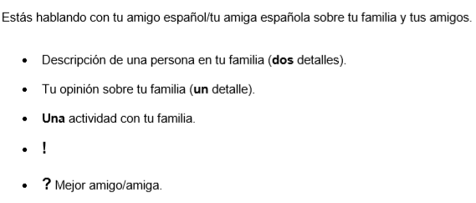
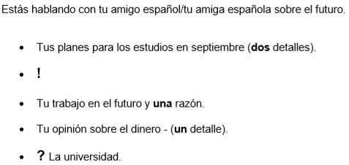
EXAMPLE ROLE PLAYS (DO WHAT IS ASKED-NO MORE, NO LESS)
FOUNDATION
Mi madre es alta y rubia. Me gusta mi familia Voy al cine con mi familia ! ¿Quién es tu mejor amigo? | Tu > mi, 1 verb, 2 adjectives (o>a ) Simple opinion, tu>mi, re-use familia Tu>mi, re-use con familia Respond to a question you hear (If you need it to be repeated, say “Repite por favor.”) Amigo/amiga = friend, use Who is? Re-use mejor amigo/amiga
HIGHER
Voy a estudiar historia y español ! Voy a ser profesora porque es interesante. El dinero es importante. ¿Vas a ir a la universidad? |  | tus planes = future = voy a Respond to a question you hear (If you need it to be repeated, say “Repite por favor.”) en el futuro = Voy a + infinitive; una razón = porque es + adjective/ or a simple opinion (Me gusta.) Are you going to go to university?
Mi madre es alta y rubia.
Me gusta mi familia
Voy al cine con mi familia
!
¿Quién es tu mejor amigo?
Voy a estudiar historia y español
!
Voy a ser profesora porque es interesante.
El dinero es importante.
¿Vas a ir a la universidad?

Slide 32
KEY TO SUCCESS IN THE PHOTO CARD (15 MARKS)
FOUNDATION (approximately 2 minutes) HIGHER (approximately 3 minutes) YOU WILL BE ASKED 5 QUESTIONS IN TOTAL You will have time to prepare answers to three of the questions which will be printed on the photo card. You will read these answers during the exam. You will also be asked two other unseen questions. The first question is always: ¿Qué hay en la foto? TO DO WELL Try to develop your answers-AIM FOR 3 DIFFERENT VERBS IN EACH OF YOUR 3 ANSWERS
CLUES TO TENSES FROM THE VERBS IN THE QUESTION
PAST TENSE
-aste -iste | ¿Qué reciclaste ? - What did you recycle? ¿Para qué usaste tu ordenador? - What did you use your laptop for? ¿Qué hiciste..? - What did you do…? ¿Qué asignatura te gustó más? -What subject did you like most? |  |  | Reciclé - I recycled Navegué - I surfed Subí - I uploaded Me gustó - I liked (it)
FUTURE TENSE
¿Te gustaría + infinitive-Would you like to… ¿Qué quieres + infinitive-What do you want to… ¿Qué vas a hacer…-What are you going to… ¿Cuáles serían…-What would be… ¿Cómo sería…-What would … be like? Si fueras a la universidad, ¿te gustaría más vivir con otros estudiantes o con tu familia? ¿Qué piensas de + infin |  |  | Me gustaría + inf Quiero + infin Voy a + infin Serían Seríá Me gustaría más Give your opinion
OPINION QUESTIONS
¿Cuál es tu opinión de/ ¿Qué opinas de ¿Prefieres pasar tus ratos libres en el ordenador o con tus amigos en el centro? ¿Por qué? ¿Es mejor visitar una ciudad o pasar tiempo en la playa ¿Que piensas de… ¿Te gusta + inf ¿Crees que es una buena idea + infinitive ¿Qué tipo de película prefieres? ¿Es bueno + infinitive… ¿Para ti es importante… ¿Cuáles son los aspectos positivos y negativos de + infin ¿Qué es lo positivo y lo negativo de… ¿Qué aspecto de … es más importante? |  | Give an opinion. Me gusta… o=or (A choice) Prefiero… porque… o=or (A choice) Es mejor… Give an opinion (No) me gusta… Prefiero Sí/No es bueno… Sí/No es importante… Give examples of positive & negative aspects of…
THE RULE OF 3

Slide 33

PHOTO CARD CHATTY MAT
Q1. ¿Qué hay en la foto? (PAWS)
To start off! |  |  |  | What’s there?
En la imagen En la foto Hay Veo Se puede ver La foto muestra | In the image In the photo There is/are I see You can see The photo shows |  |  | un hombre/una mujer unas personas un niño/a mucha gente unos edificios unos árboles una escena de |  |  | a man/woman some people a child lots of people some buildings some trees a scene of
Be specific! |  |  |  | How they FEEL & WHERE they are
En primer plano Al fondo A la izquierda A la derecha En el centro | In the foreground In the background To the left To the right In the centre |  |  | Está/Están dentro fuera en casa en el campo en el instituto alegre(s) contento/a(s) triste(s) cansado/a(s) enfadado/a(s) | He, She is/They are inside outside at home in the countryside in school happy happy sad tired angry
What they are doing
Está(n) hablando Está(n) sonriendo Está(n) riendo Está(n) trabajando Está(n) jugando Está(n) comiendo Está(n) usando su móvil Está(n) leyendo Está(n) estudiando | He/She is (They are) talking He/She is (They are) smiling He/She is (They are) laughing He/She is (They are) working He/She is (They are) playing He/She is (They are) eating He/She is (They are) using their mobile He/She is (They are) reading He/She is (They are) studying
 |  |  |  | Descriptions
 |  |  |  | Es/son alto/a(s) bajo/a(s) rubio/a(s) moreno/a(s) | He, She is/They are tall short blonde dark haired
Weather |  |  |  | Opinion phrases
Hace sol Hace calor Hace buen tiempo Hace mal tiempo Está lloviendo Está nublado |  | It’s sunny It’s hot It’s nice weather It’s bad weather It’s raining It’s cloudy |  | Creo que Pienso que Imagino que Supongo que Diría que Me parece que |  | I think that I think that I presume that I imagine that I would say that It seems to me that
Do you like it?
(No) Me gusta la foto porque ya que dado que puesto que |  | I (don’t ) like the photo because since given that given that | es bonita es interesante es hermosa está llena de color |  |  | it is pretty it is interesting it is beautiful it is full of colour

Slide 34

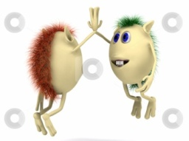
THE KEY TO SUCCESS IN THE CONVERSATION (30 MARKS)
MAKING THE CONVERSATION SEEM REAL! Repeat some of the words from the question: ¿Ves la tele todos los días? ¿Todos los días? Use hesitation: Pues, bueno, a ver, buena pregunta Ask questions: ¿Y tú? Use intonation & emotion to sound like you really mean what you’re saying REMEMBER IT IS A CONVERSATION, NOT AN INTERROGATION! INCLUDE MORE THAN ONE TIME FRAME IN SOME OF YOUR ANSWERS! Ejemplo: -Háblame de tu rutina escolar. (Tell me about your school routine.) -Pues, tengo cinco clases por día y cada clase dura una hora. Por ejemplo, ayer tuve inglés y matemáticas por la tarde. (Well, I have 5 lessons per day and each lesson lasts an hour. For example, yesterday I had English and maths in the afternoon.) Use what you know how to say rather than exactly what you want to say Back up your opinion using porque/ ya que/ puesto que/ dado que Use frequency & time phrases Use SPANISH STARS Use LOVE IT! REMEMBER TO ASK YOUR TEACHER A QUESTION! LISTEN TO YOUR TEACHER: BE PREPARED TO RESPOND TO QUESTIONS THAT ADD TO THE SPONTANEITY OF THE CONVERSATION IF POSSIBLE! BE PREPARED TO ANSWER QUESTIONS IN ANY ORDER IF POSSIBLE!
MARK SCHEME SUCCESS CRITERIA (H) Develops detailed answers (LONGER SENTENCES) Opinions are explained Reference to past, present & future events Accurate High quality language-wide variety of structures & vocabulary Consistently good pronunciation & intonation Responds promptly & with some fluency & has an air of spontaneity CONVERSATION LASTS 5-7 MINUTES (2 THEMES) | MARK SCHEME SUCCESS CRITERIA (F) Sometimes develops longer answers Sometimes explains opinions Some success in reference to past, present & future events Any errors do not interfere with understanding Attempts to use more complex structures and varied structures & vocabulary Generally good pronunciation Sometimes hesitates, relies on pre-learnt answers but some shows spontaneity CONVERSATION LASTS 3-5 MINUTES (2 THEMES)
???????????????????

Slide 35

Question 1 FOUNDATION (8 MARKS)
You have to write 4 sentences that describe a photo
GCSE SPANISH FOUNDATION & HIGHER WRITING
Same verb, different information will get you FULL Marks!
1 | Hay cuatro personas.
2 | Hay un restaurante.
3 | Hay dos mujeres.
4 | Hay dos hombres.
4 sentences using PAWS!
1 | Hay cuatro personas
2 | Están comiendo.
3 | Hace sol.
4 | Están en un restaurante.

Slide 36
Question 2 FOUNDATION (16 MARKS)
You have to write 40 words in total on 4 bullet points!
You might want to think of it as 4 sentences of about 10 words each.
Tu amiga española, Silvia, te ha preguntado sobre dónde vives.
Escríbele un email.
Menciona:
dormitorio
casa
pueblo
clima.
Escribe aproximadamente 40 palabras en español.
A SUCCESSFUL FORMULA
OPINION + LINK WORD + REASON
TRY TO VARY
YOUR OPINION | LINK WORDS | ADJECTIVES
Me gusta mi dormitorio | ya que | es bastante grande y muy bonito.
Me encanta mi casa | porque | es moderna y muy cómoda.
No me gusta mi pueblo | dado que | es aburrido y tan pequeño.
Odio el clima de mi región | puesto que | es horrible. Hace frío.

Slide 37

FOUNDATION & HIGHER (QUESTION 3) TRANSLATION INTO SPANISH
GENERAL ADVICE & VAN STRATEGY
STRATEGIES FOR TRANSLATION INTO SPANISH
Read all of the sentences through once.
Work then at sentence level. For each, try to produce a Spanish equivalent.
As you build each sentence, use a mental checklist for accuracy:
Verbs Subject – Verb agreement (Who is doing what?) Tense (When?) Position in the sentence
Adjectives Noun – Adjective agreement Position
Nouns Masculine / Feminine Singular / Plural Definite / Indefinite article
If you don’t know a word, try to think of a synonym or similar word.
If you can’t think of a suitable replacement word, use a short paraphrase to describe it.
If a whole sentence is too complex, try to express the meaning with a simpler expression.
Go through your work thoroughly. Imagine you have been given the job of marking it. Check for spelling, accents, & the items on your grammar checklist.
VAN CHECKLIST
VERBS ADJECTIVES NOUNS
VERBS
Subject – Verb agreement (Who is doing what?)
Tense (When?)
Position in the sentence
ADJECTIVES
Noun – Adjective agreement
Position
NOUNS
Masculine / Feminine
Singular / Plural
Definite / Indefinite article

Slide 38
Question 3 FOUNDATION (10 MARKS)
You have to translate 5 sentences. Translate what you can, even if you have to miss out some words!
1 | My teacher is nice. Mi profesor es bonito. |  | Es = is
2 | I listen to music in the car. Escucho música en el coche. |  | Escucho = I listen to
3 | I like to go to the cinema with friends. Me gusta ir al cine con amigos. |  | Me gusta + infinitive
4 | There are many poor people in the city. Hay mucha gente pobre en la ciudad. |  | Look at word order! Hay = There is /are
5 | I visited an interesting museum in Spain. Visité un museo interesante en España. |  | Learn past tense ending: É for AR verb (visitar = visité=I visited)
KEY VERBS |  |  | VERBS + INFINITIVE
PRESENT |  | PAST | -Me gusta escuchar música. I like to listen to music. -Me encanta leer. I love to read. -Quiero visitar España. I want to visit Spain. -Voy a ir al cine. I am going to go to the cinema. -Me gustaría ser actor. I would like to be an actor. -Prefiero vivir en Madrid. I prefer to live in Madrid. -Suelo jugar al fútbol en el parque. I usually play football in the park. -Antes/después de comer, voy a leer. Before/after eating, I am going to read.
Hay = There is/are Juego - I play Soy = I am Voy a = I go to (I am going to) Veo = I see Trabajo = I work Es = He/she/it is Está = is (location) Vamos = We are going Jugamos = We play Bailamos = We dance Visitamos = We visit Compramos = We buy Escribimos = We write Tenemos = We have Comemos = We eat |  | Fui = I went/ I was Jugué = I played Bailé = I danced Visité = I visited Compré = I bought Escribí = I wrote Fuimos = We went Jugamos = We played Bailamos = We danced Visitamos = We visited Compramos = We bought Escribimos = We wrote Tuvimos-We had Comimos-We ate

Slide 39
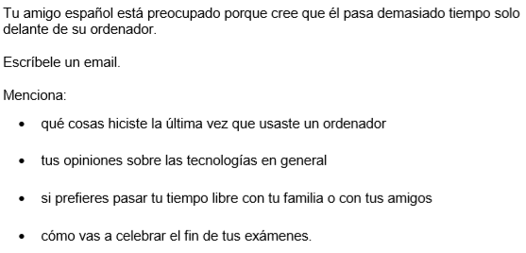
Question 4.1 or 4.2 FOUNDATION (Only answer ONE question.) 16 MARKS
Question 1.1 or 1.2 HIGHER (Only answer ONE question.) 16 MARKS
Write approximately 90 words
4 bullet points
Present, past, future time frames
Approximately 20-25 words per bullet point
Opinions & reasons in every bullet point
Sentence starter
THINK 5 Ws (Who, what, where, when, why) in every bullet point
Some complex structures (SPANISH STARS)
FAIL PROOF STRATEGY
CLUES FOR TENSES & OPINIONS
Present | Hay-there is/are; cómo es-what is … like; todos los días-every day; normalmente-usually
Past | iste or aste endings on verbs: Qué hiciste-what you did; adónde fuiste-where you went; qué compraste-what you bought; usaste-you used Reciente/ recientemente-recent/recently; pasado-past/last
Future | Tus planes-your plans; te gustaría-you would like; vas a-you are going to; lo que vas a hacer-what you are going to do; qué quieres hacer-what you want to do; que viene/próximo-next; en el futuro-in the future
Opinion | Lo que piensas de-what you think about; qué/si prefieres-what/if you prefer; por qué-why; tu opinión sobre-your opinion about

Slide 40



90 word task
25 word bullet point STRATEGY
Tus vacaciones del año pasado
Sentence starter | El año pasado (Last year)
Facts (3) | mi familia y yo pasamos dos semanas en el sur de España. (my family and I spent two weeks in the south of Spain.)
Opinions + reasons | Nos gustó mucho ya que no solo había mucho que hacer sino también hacía sol cada día. (We liked it a lot since not only was there a lot to do but also it was sunny every day.)
EXTRA: SPANISH STAR
10 SPANISH STARS THAT HIT ALL THE SUCCESS CRITERIA FOR A HIGH GRADE
español | inglés
Para + infinitive | In order to …
Me gusta + inf porque lo encuentro … | I like … because I find it …
Me interesa/me molesta + inf | … interests/annoys me
Lo mejor/lo peor | The best thing/the worst thing
Es más/ menos… que | It’s more/ less… than
Si fuera posible, me gustaría + inf | If it were posible, I would like to …
No solo … sino también | Not only … but also
Iba a + inf pero decidí + inf | I was going to … but I decided to…
Suelo + inf | I usually …
Espero + inf/ tengo la intención de + inf | I hope to/intend to …
Notes:
Reminder of the key elements

Slide 41
Question 2.1 or 2.2 HIGHER (Only answer ONE question.) 32 MARKS
2 Bullet points-150 words in total
(approx 75 words per bullet but NOT ESSENTIAL)
There can be an imbalance in the coverage of each bullet point as long as some coverage is evident.
A POSSIBLE STRATEGY INTRODUCTORY SENTENCE 3 IDEAS OPINION TO SUM UP THE BULLET POINT
cómo era tu pueblo en el pasado
Introductory sentence linked to the bullet point | Hoy en día mi pueblo es un lugar muy animado, moderno y atractivo. Sin embargo, en el pasado era muy diferente.
First idea: Primero ... | Primero, había mucho más industria con tantas fábricas y por consecuencia existía la contaminación atmosférica.
Second idea: Segundo | Segundo, no solo había pocos espacios verdes, sino también las calles estaban muy sucias con mucha basura por todas partes.
Third idea: Además ... | Además, la red de transporte público era poco fiable.
Your opinion to sum up the bullet point | En resumen, la verdad es que no me gustaba nada.
FOR HIGH MARKS IN QUESTION 2 YOUR ANSWER NEEDS TO BE:
fully relevant, detailed with lots of information
opinions expressed with reasons
complex structures used accurately
very good variety of vocabulary & structures
a fluent piece of writing
highly accurate

Slide 42

Question 3 HIGHER (12 MARKS)
Mi hermana va a casarse en julio | simple future tense (ir a + infinitve), reflexive verb
y mis padres quieren comprar | present tense (they)
una casa más pequeña. | word order
Mi padre trabaja en el centro de la ciudad | presenet tense (he)
y fuimos a ver un piso cerca de su despacho/oficina. | preterite tense (we) preposition (cerca de) possessive adjective (su)
Me gustaría vivir allí porque | infinitve after me gustaría
tendré mi propio dormitorio, | irregular stem in future tense of tener (tendr)
pero no tiene jardín | no “un” after “no tiene”
FOR HIGH MARKS IN QUESTION 3 YOU NEED TO BE ABLE TO:
describe the actions of others
know irregular as well as regular verb formations in past, present & future tenses
use infinitive constructions (mis padres quieren comprar)
have a wide range of vocabulary

Slide 43
PREPARING FOR THE LISTENING & READING EXAMS
Learn vocabulary
Learn time frames
Learn past, present & future tenses and verb endings
Learn synonyms. For example “conocido” (well known) is similar to “famoso” (famous); dar una vuelta = pasear = to go for a walk
Learn positive & negative opinions
Learn connectives. For example when you have to decide if an utterance is P, P&N or N connectives such as: pero (but), sin embargo (however), en cambio (on the other hand/ however), mientras que (whilst), aunque (although) give the suggestion of a change in opinion, so the answer would be P&N
Remember that at Higher Tier, 50% of the questions are aimed at grades 7-9 so these questions will be very challenging. So, listen & read to the end of each question before giving an answer-there will be distractors -you need to spot them!
For example you hear: “Un quince por ciento de los jóvenes declara sentirse ofendido cuando sus mensajes privados a sus amigos han sido colgados en un foro público.”
You have to choose from:
A: posted messages that upset their friends.
B: had personal messages shared without their permission.
C: found offensive comments on their page.
You may choose “C” because you heard “ofendido”. The answer is B (15% of young people feel offended when their private messages have been uploaded to a public forum.”
Go on line to AQA
LISTENING EXAM ADVICE
REMEMBER:
Section A: Answer the questions in English.
Section B: Answer the questions in Spanish. You will hear each utterance twice.
Maximise the 5 minutes' reading time by:
reading all the questions & question titles carefully, particularly those in Section B
looking at any examples given, as these point out the level of detail required
highlighting or underlining key words which have been highlighted in the rubrics/questions
identifying the questions which have two parts to answer from the same utterance (E.G. Question 12: 12.1, 12.2)
signposting Section B as it requires answers in Spanish
With questions where you have to give a written answer in English:
Make sure you read the question carefully so that you know exactly how to answer.
Always follow the example, if one is given.
Ensure that you give precise answers as vague answers will not be correct. For example, if you translate “deberes” as “work” instead of “homework” you will not get the mark.
With questions where you have to give a written answer in Spanish:
Read carefully the instructions and any examples given so that you know how to answer. For example, where the examples indicate that the answers should be an infinitive with another short detail, both of which should be written in Spanish. (E.G. Trabajar en España)

Slide 44
READING STRATEGIES
Prediction | What can you tell about the text from the title, exam rubric, any visuals, the layout, the punctuation?
Anticipation | Read the English questions to add to your overall sense of what the text is about, and anticipate possible answers based on real world logic and probability.
Skim reading | Read the whole text once through to add to your gist understanding. Don’t stop when there are unfamiliar words.
Scanning | Go back to the questions, one by one. Decide what information you need. Who? What? Where? When? Why? If the task is multiple choice, scan the text for those specific words. If not, scan for possible answers that fit, e.g. a person for ‘Who?’.
Evaluation | Keep the overall text and context in mind. Ensure that answers don’t contradict each other (use in-text logic) and are not impossible or unlikely (use real world logic).
Deduction & inference | In more challenging questions, the answers are not directly given but are built-up by piecing together hints from the text. Where the answer is not immediately clear, look at the sentence before and after the keyword to get more information.
READING EXAM ADVICE In Section A, answer the questions in English. In Section B, answer the questions in Spanish. In Section C, translate the passage into English. Remember: You will have to translate past, present and future activities. Read the introduction to the question. This will help you to give sensible answers. Answer every question, especially where you have to write a letter. If in doubt, have a guess! Read the whole of the sentence so that you can check that your first reaction is right. If you think the answer is ‘N’ (Now) for example, read on to make sure that this is not the distracter and that the correct answer is in fact ‘F’ (Future) or ‘P’ (Past). Do not copy whole chunks of Spanish because you might include the wrong answer as well as the right answer. Do not change the Spanish – copy it exactly from the Spanish passage. If you are asked to give one reason, only give one. In a questionnaire-type question, include information from the answer and the question in the questionnaire. Translate every word in the translation.
TRANSLATING FROM SPANISH INTO ENGLISH Read the whole text through and get a sense of the overall meaning or gist. Work then at sentence or phrase level. For each, try to produce an English equivalent that sounds right. You cannot often translate word for word. Mostly, you need to paraphrase: i.e. find a phrase that has the same meaning, but uses different words. Try to work out the meaning of any unfamiliar words in the sentence. Consider words surrounding the unfamiliar word and try out words that would fit, using an English sentence with gaps. E.g. Juan lee un libro = Juan *?* a book. Think about the context and use common sense. What makes sense in the context of the rest of the text? Once you have the meaning of the sentence in your head, play with the order of the words until you have English that sounds natural when you read it. The golden rule: read aloud what you have written. If it doesn’t sound right to you, it probably isn’t.

Slide 45
SYNONYMS |  | VOCABULARY LEARNING
fastidiar/ molestar dar un paseo/ dar una vuelta/ andar/ caminar/ pasearse soportar/ aguantar comprender/ entender empezar/ comenzar el cincuenta por ciento/ la mitad el veinticinco porciento / un cuarto grave/ serio necesario / esencial/ imprescindible hay que/ tiene que/ hace falta no hay / falta / no queda suspender/ fracasar fallecer/ morir el embotellamiento/ el atasco hacer ciclismo/ montar en bicicleta/ dar un paseo en bici el ocio/ los ratos libres la caridad/ la organización benéfica alumno/ estudiante la sierra/ la montaña cocinar/ cocer ventajas/ beneficios sueldo/ salario sano/ saludable quince días/ dos semanas cotidiano/ diario la vida nocturna/ la marcha hoy en día/ actualmente idioma/ lengua empleo/ trabajo lectura/ leer legumbres/ verduras perezoso/ vago hablar/ charlar los tebeos/ los cómics un descuento/ una reducción elegir/ escoger la alimentación/ la comida poco tranquilo/ no es tranquilo | to annoy to go for a walk to put up with to understand to start/ begin 50%/ half 25%/ a quarter serious necessary/ essential you have to there aren’t to fail to die traffic jam to cycle free time charity pupil/ student mountain to cook advantages wage/ salary healthy fortnight daily night life nowadays language job reading vegetables lazy to talk comics discount to choose food noisy | Have a word list in Spanish & English Tick the words that you already know Try to find an English cognate to help you with the meaning. For example, “tranquilo” is similar to “tranquil” in English. Divide your words into categories and learn the vocabulary in groups. Cover & say (Spanish-English & English -Spanish). Write the words down. Make word cards-Spanish on one side, English on the other Test with a partner. Record the vocabulary and listen to it. Use memrise.com vocabulary learning site. Pages 44-59 are divided into modules (see the top of each page for the module number). On the site the learning activities are divide into VIVA modules and then subsections matching the blocks of vocabulary on pages 44-59. Use vokabel.com vocabulary learning site to insert words and then test yourself (Spanish to English & then English to Spanish) Use Quizlet.com Give words a number using this Vocabulary Knowledge Scale: 1. I don’t remember having seen this word before. 2. I have seen this word before but I don’t know what it means. 3. I have seen this word before and I think it means … 4. I know this word: It means … 5. I can use this word in a sentence: E.G …

Slide 46
COMMON FEATURES OF THE TRANSLATION INTO ENGLISH QUESTION WITH EXAMPLES
STRATEGIES FOR TRANSLATION INTO ENGLISH Read the whole text through & get a sense of the overall meaning. Work then at sentence or phrase level. For each, try to produce an English equivalent that sounds right. You cannot often translate word for word. Mostly, you need to paraphrase: i.e. find a phrase that has the same meaning, but uses different words. Try to work out the meaning of any unfamiliar words in the sentence. Consider words surrounding the unfamiliar word & try out words that would fit, using an English sentence with gaps. E.g. Ellos leen un libro = They *?* a book. Think about the context & use common sense. What makes sense in the context of the rest of the text? Once you have the meaning of the sentence in your head, play with the order of the words until you have English that sounds natural when you read it. The golden rule: read aloud what you have written. If it doesn’t sound right to you, it probably isn’t.
OPINIONS (FOUNDATION & HIGHER) Me encanta-I love A mi amigo no le gusta-My friend doesn’t like (Other people’s opinions) En mi opinión-In my opinion OPINIONS (HIGHER) Espero que … sea/ sean-I hope that … is/ are | REASONS (FOUNDATION & HIGHER) porque-because REASONS (HIGHER) ya que-since; visto que-seeing that
 | PAST TIME FRAME (FOUNDATION & HIGHER) ayer-yesterday escuché-I listened to (é); comí-I ate (í) Habló-He/she spoke (ó); perdió-He/she lost (ió) Fui-I went; fue-He/she went PAST TIME FRAME (HIGHER) anoche-last night tuve deberes-I had homework estaba grabando-I was recording (Imperfect continuous tense) otros estudiantes me han ayudado-Other students have helped me (Perfect tense & object pronouns) ha colgado-he/she has uploaded (perfect tense)
PRESENT TIME FRAME (FOUNDATION & HIGHER) es-is son-are tengo-I have normalmente-usually puedes-you can trabaja-he/she works (other people’s actions) estudiamos-we study PRESENT TIME FRAME (HIGHER) ¿Qué estás haciendo?-What are you doing? (Present continuous tense) pasar tiempo chateando-to spend time chatting
 | ADJECTIVES & INTENSIFIERS (FOUNDATION & HIGHER) mucho- a lot muy-very relajante-relaxing útil-useful fácil-easy grave-serious
FUTURE TIME FRAME (FOUNDATION & HIGHER) la semana que viene-next week mañana-tomorrow el año próximo-next year Van a-They are going to Voy a-I am going to FUTURE TIME FRAME (HIGHER) haré-I will do (Future tense) quiero ver-I want to see será-It will be (Future tense) Sería-It would be (Conditional tense) dirían-they would say (Conditional tense)
 | COMPLEX STRUCTURES (HIGHER) es más … que-is more … than usarlo- use it no lo hice-I didn’t do it
 | SUBJUNCTIVE (HIGHER) espero que ...sea-I hope that ... is cuando empiece -when ... starts no seas -don’t be si supieran-if they knew

Slide 47
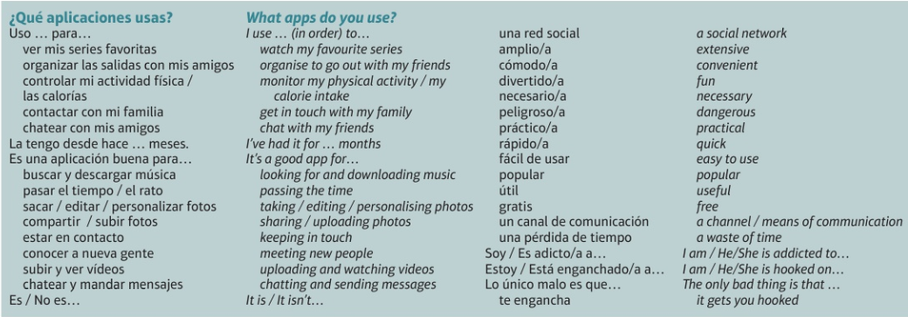
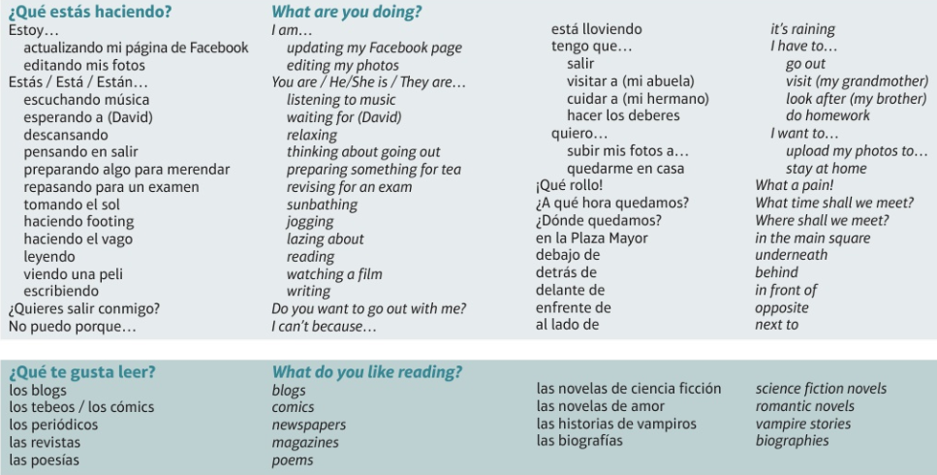
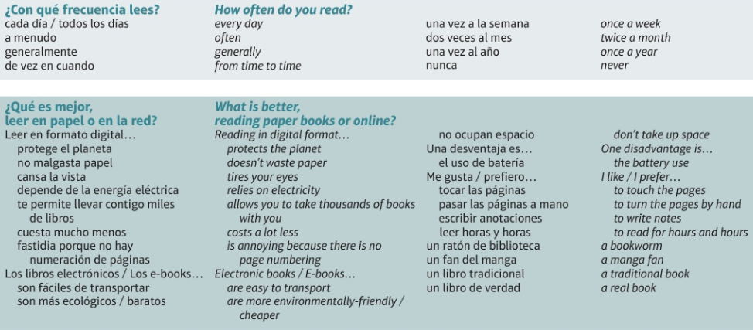
Theme 1 - Family, relationships, social media, reading habits
VIVA Module 3

Slide 48
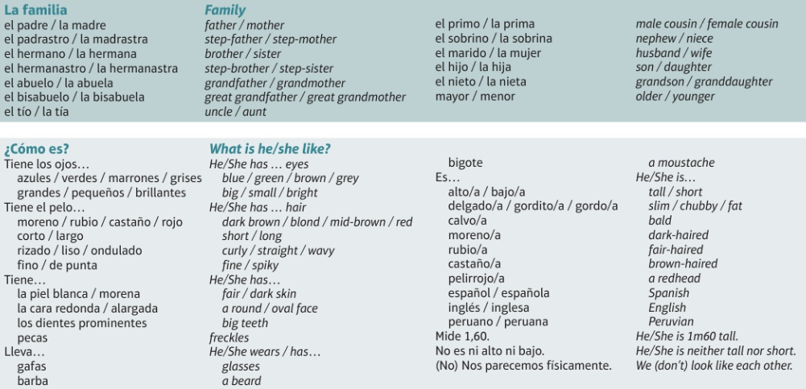
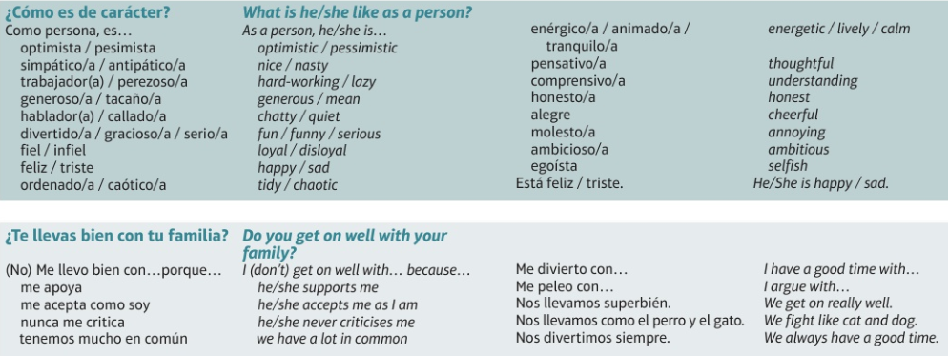
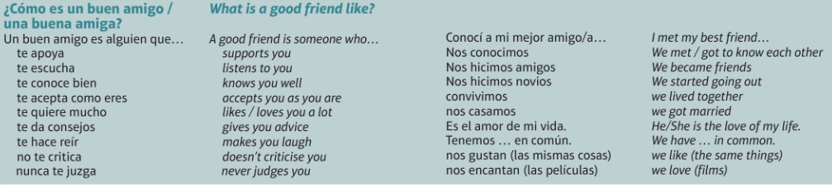
VIVA Module 3

Slide 49
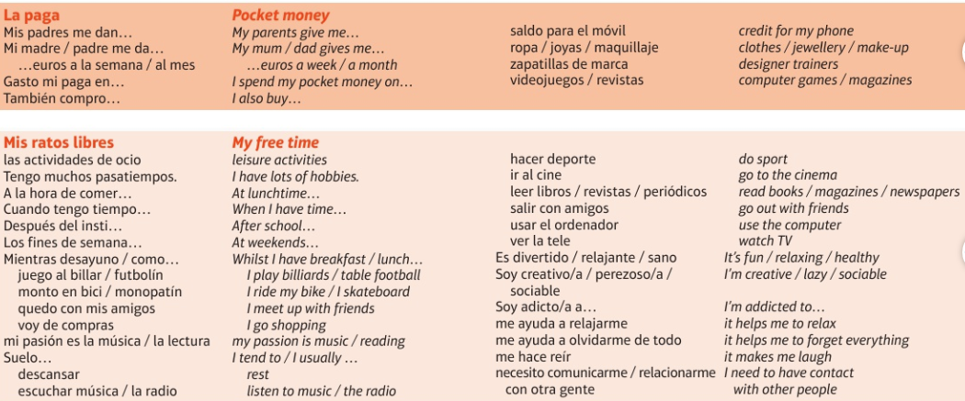
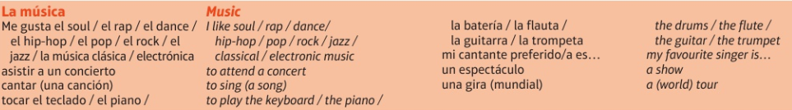
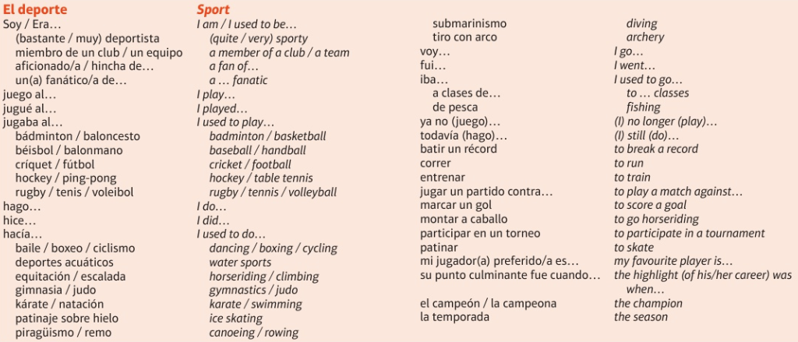
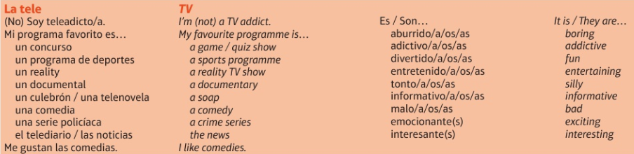
Theme 1 - Free time
VIVA Module 4

Slide 50
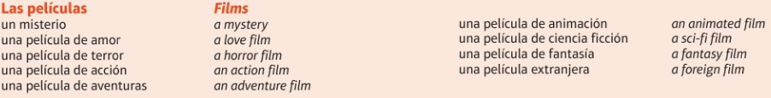
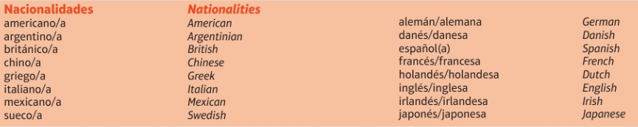
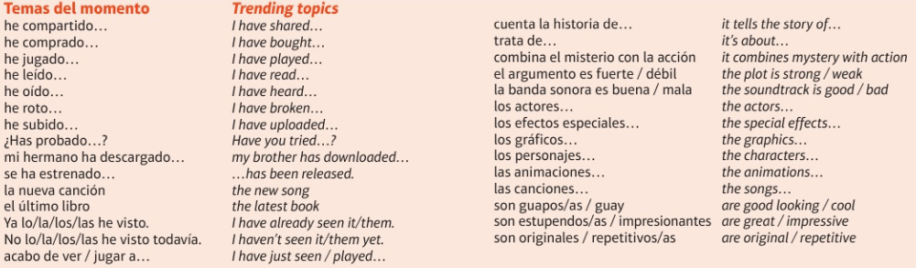
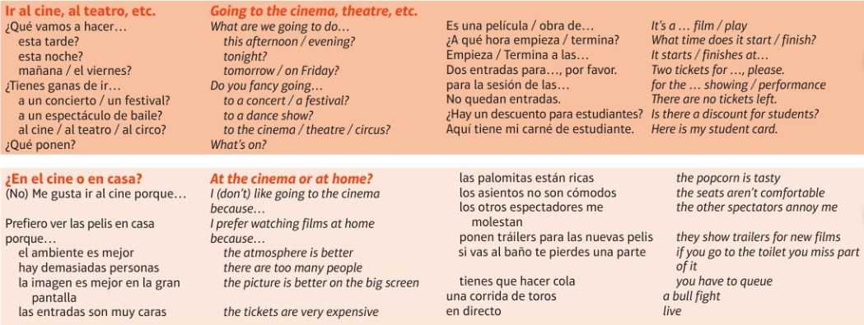
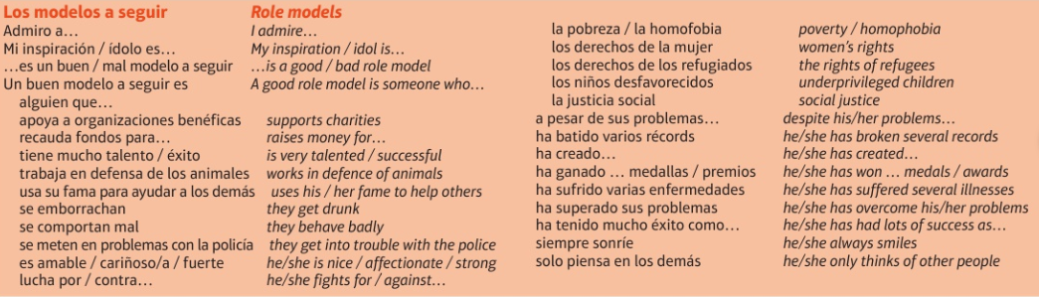
VIVA Module 4

Slide 51
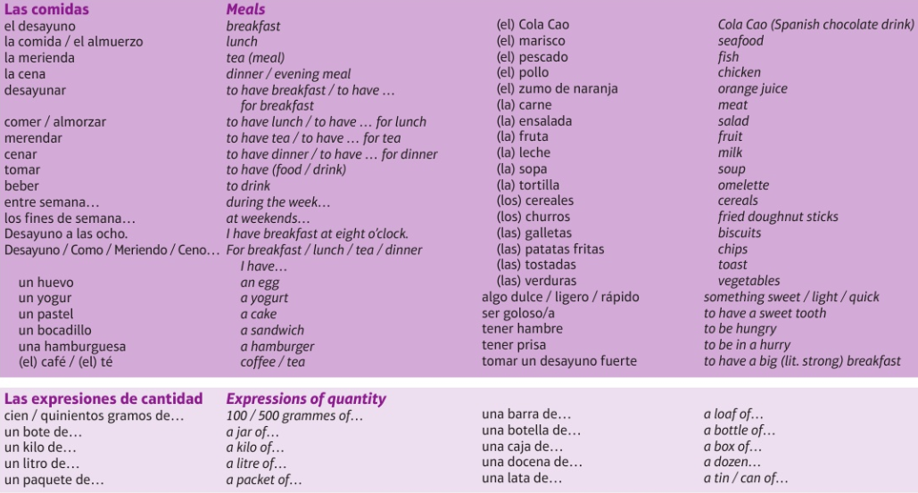
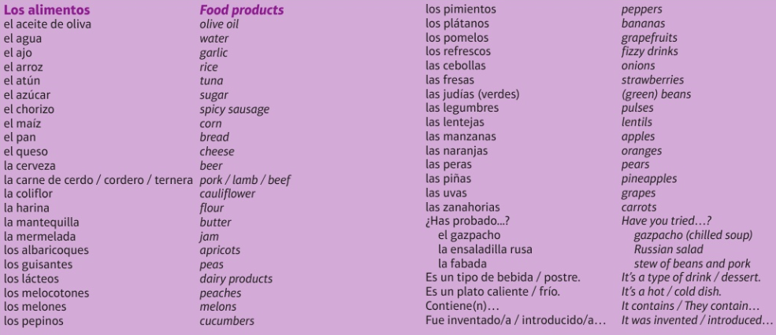
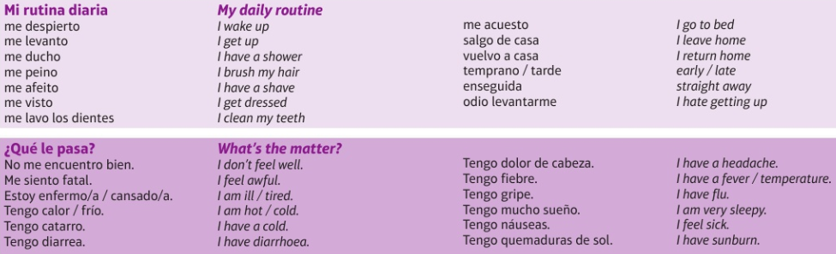
Theme 1 - Eating, Illness, Festivals
VIVA Module 6

Slide 52
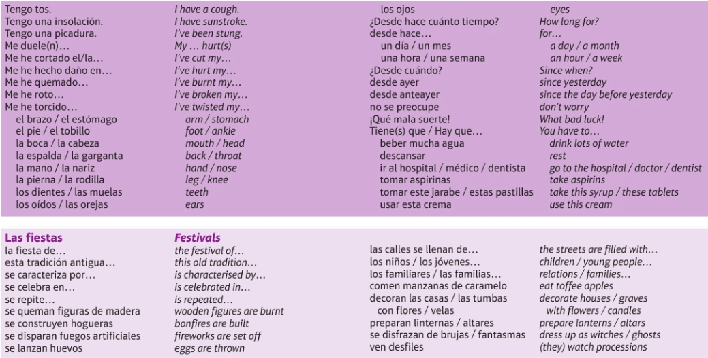
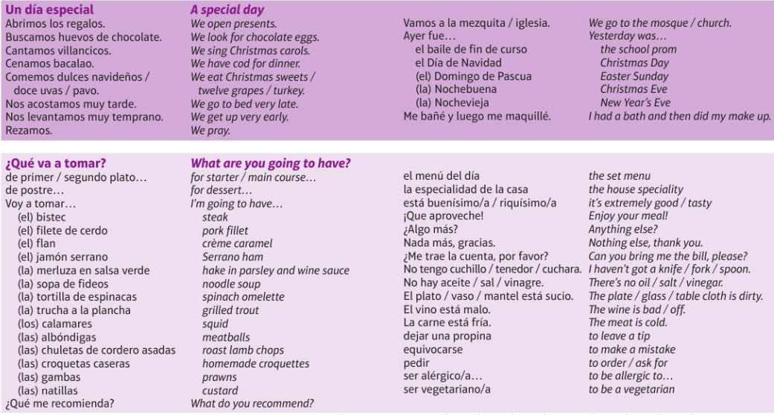
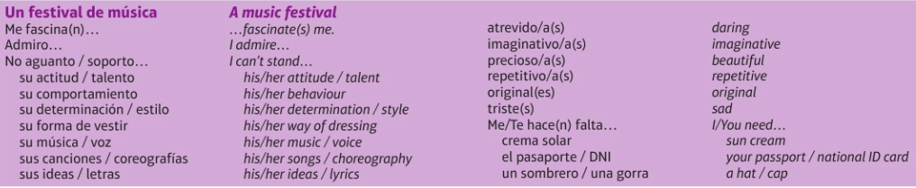
VIVA Module 6

Slide 53
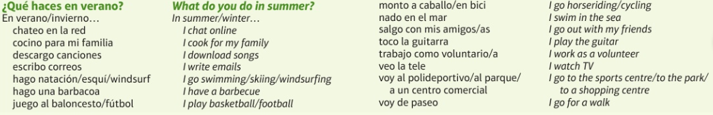


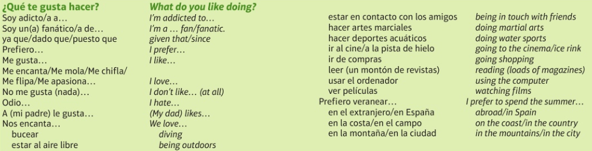
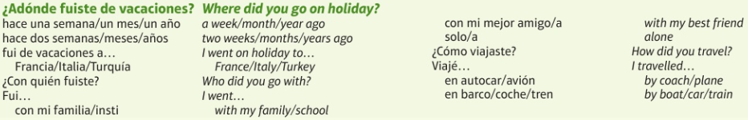
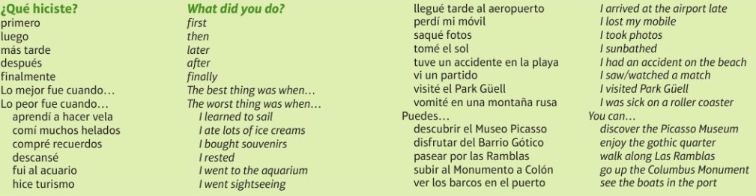
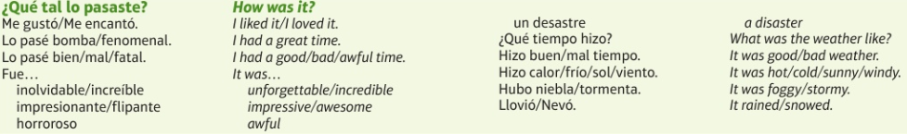
Theme 2 - Holidays
VIVA Module 1

Slide 54
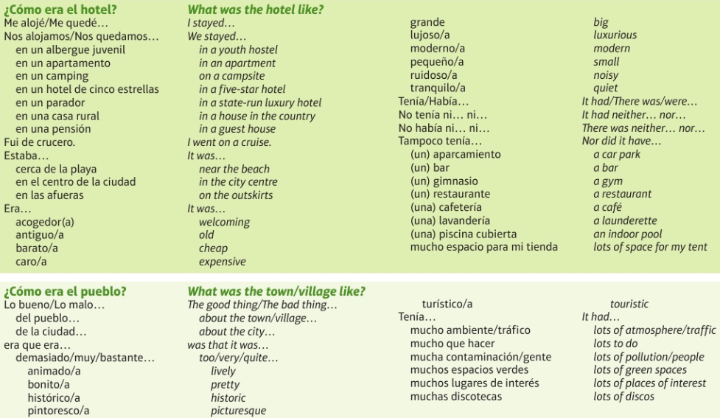
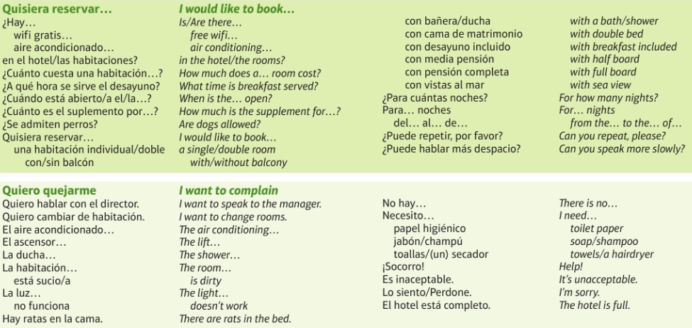
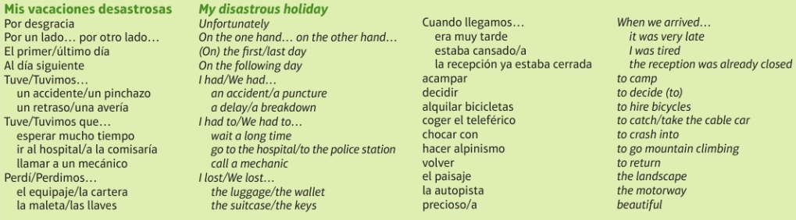
VIVA Module 1

Slide 55
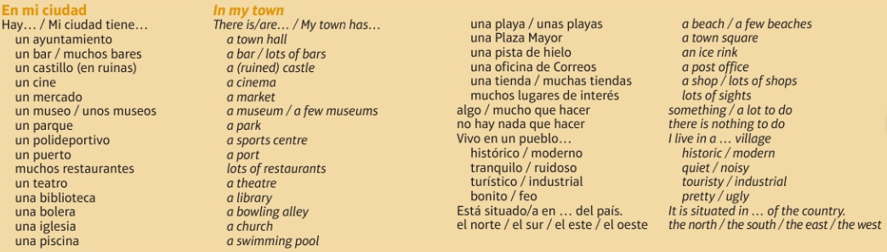
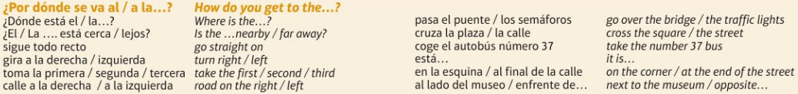
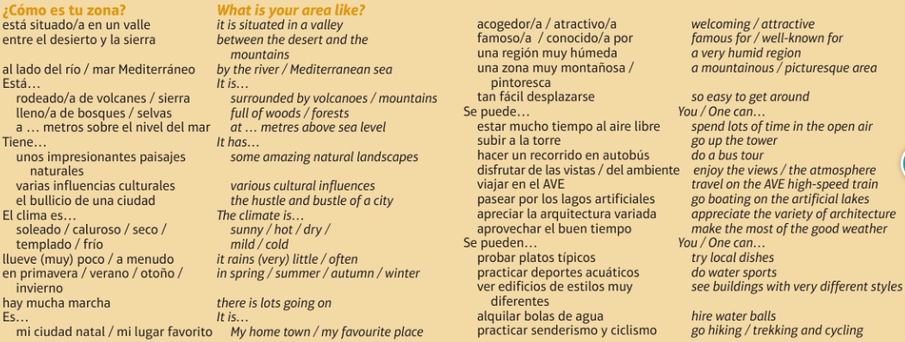
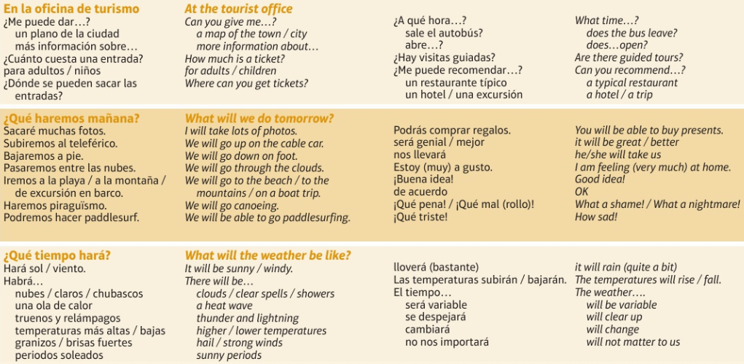
Theme 2 - Towns, places in a town & shopping
VIVA Module 5

Slide 56
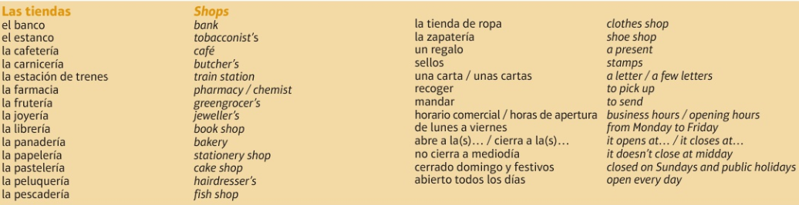
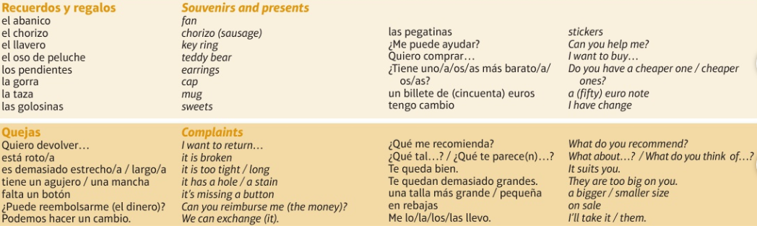
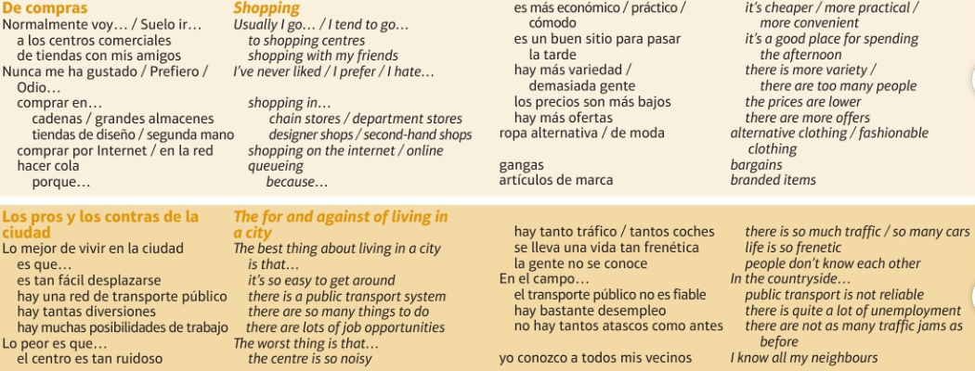
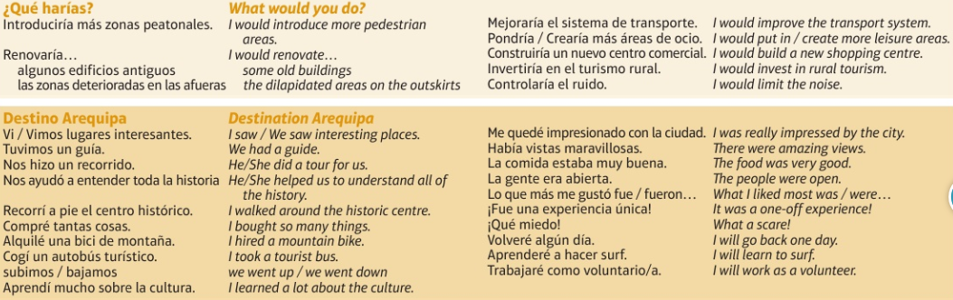
VIVA Module 5

Slide 57
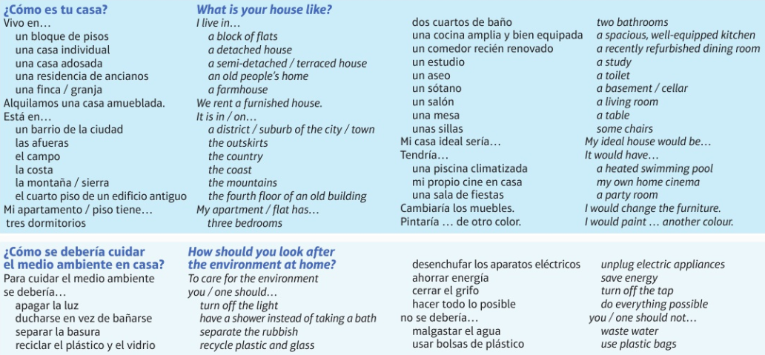
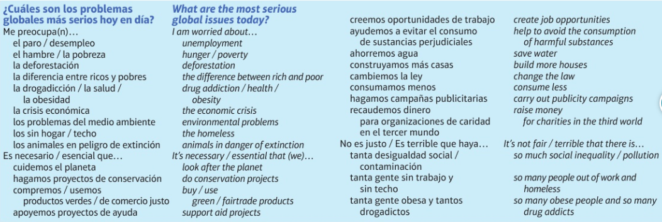
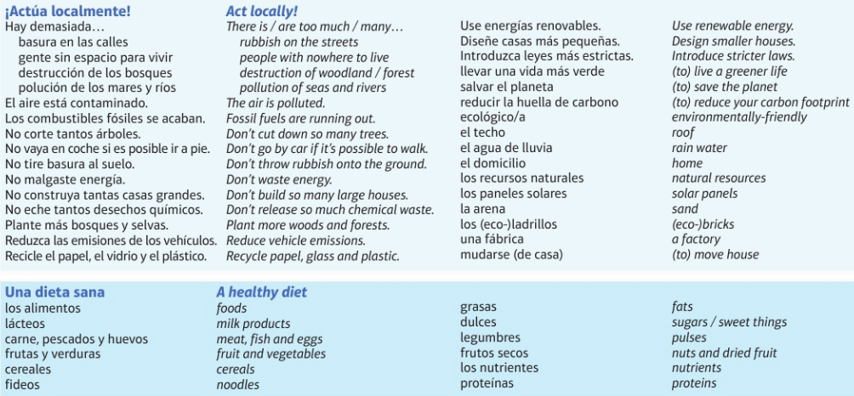
Theme 2 - Houses, global & social issues, health
VIVA Module 8

Slide 58
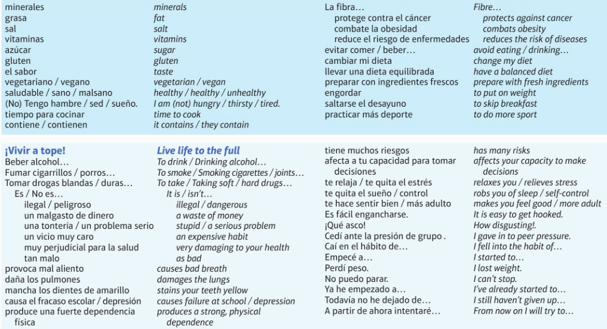
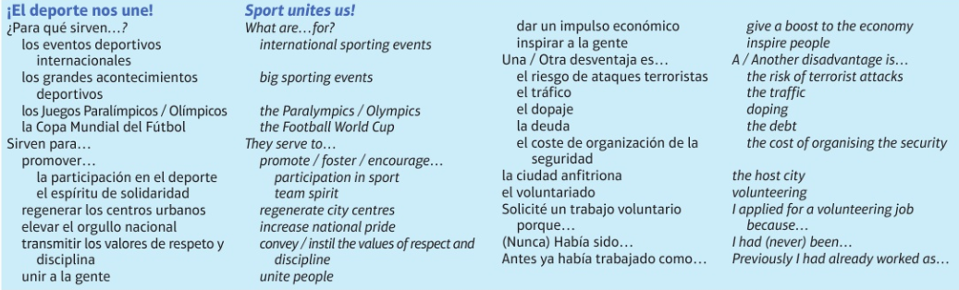
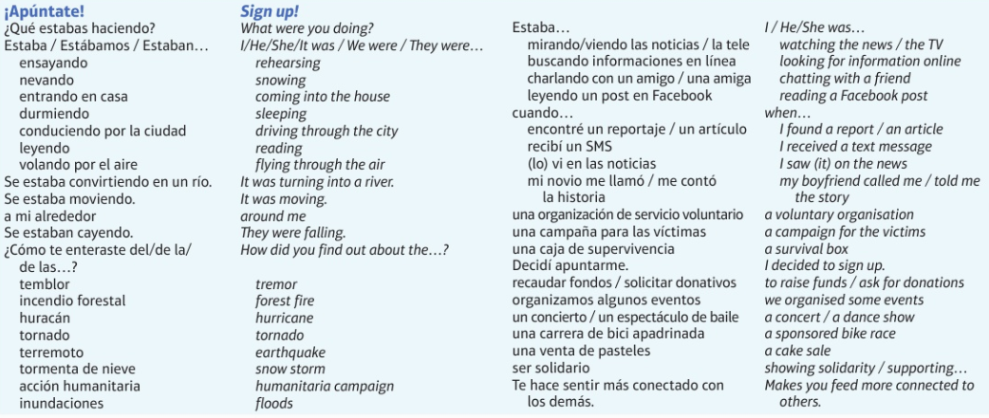
VIVA Module 8

Slide 59
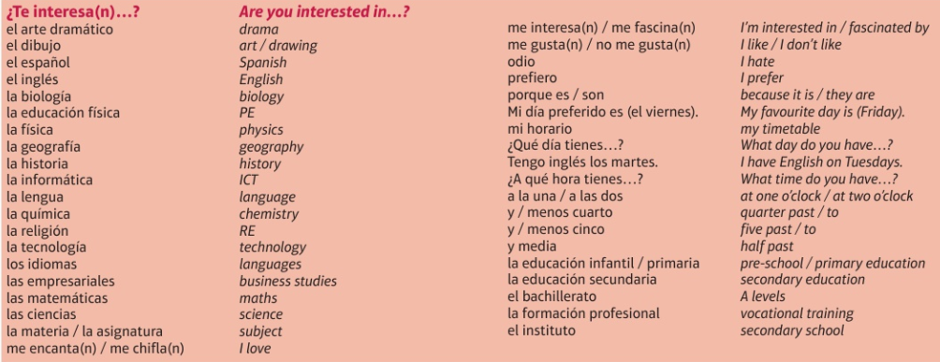
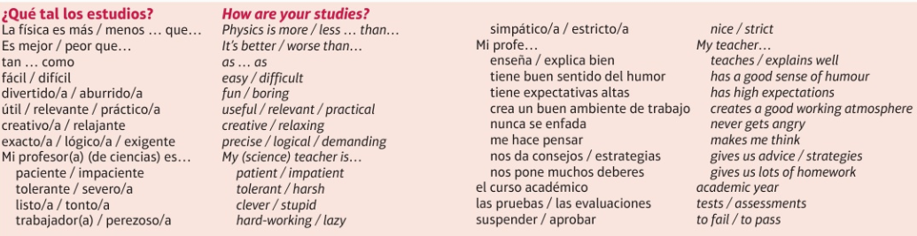


Theme 3 - School
VIVA Module 2

Slide 60



VIVA Module 2

Slide 61



Theme 3 - Jobs
VIVA Module7

Slide 62



VIVA Module 7

Slide 63
EXAM REVISION CHECKLIST BY SKILL
FOUNDATION & HIGHER |  | HIGHER
LISTENING & READING | Listening: Exam advice (pages 42-43) Reading Exam advice (pages 42-43) Synonyms (page 44) Listen to Spanish. Visualise the words you hear. Write down the words you recognise. Watch programmes/ films in Spanish (with subtitles) | 50% of questions at HIGHER TIER are aimed at grades 7-9 so they are very challenging Be exact in your answers, including all the relevant information. For example when you see or hear “al menos cincuenta” the answer is “at least 50”. So “50” on its own is not accurate.
SPEAKING & WRITING | You need to be able to describe actions in 3 time frames-past, present & future, give opinions & reasons! Use LOVE IT & SPANISH STARS Speaking & Writing: Pages 19-27 Never waste an opportunity to use an adjective with a noun or an intensifier with an adjective! Always use muy, bastante or poco with interesante Speaking: Role play preparation (pages 28-30) Photo card preparation (pages 31-32) Conversation preparation (pages 19-27 & 33) Copy out your conversation answers onto card-different colour for each theme to help you learn them. Writing: Pages 34-41 FQ1: Photo & 4 sentences (page 34) FQ2: 40 words (page 35) FQ3: translation into Spanish (pages 36-37) FQ4/ HQ1: 90 words (page 38) How to write a 25 word bullet point answer; 10 Spanish stars that ensure you meet the success criteria for grade 5+ (page 39) HQ2: 150 words (page 40) HQ3: translation into Spanish (pages 36 & 41) | Use the imperfect tense to describe repeated actions in the past with a time phrase such as: “Todos los días”. Use the perfect tense to say what you have done and the pluperfect tense to say what you had done. Use the “we” form of the verb to describe the actions of others with sentence openers such as: “Mis amigos y yo” or “Mi familia y yo”. Include lots of variety and Spanish Stars Make sure your include extended sentences in your Spanish Include the opinions of others in more than one time frame such as: “A mis amigos y a mi nos gusta pasar el fin de semana juntos.” Or: “Cada día nos gustaba tomar el sol, nadar en la psicina y jugar en la playa.”
FOR ALL 4 SKILLS | Know the basics (pages 2-6) “I” form of past, present, future verbs (pages 7-18) 10 essential verbs in 3 tenses (page 25) & 10 Spanish Stars that ensure grade 5+ (page 39) Question words (page 28) Vocabulary & structures (pages 46-61) Vocabulary learning strategies (page 44) Small but important words (page 5) Opinions & adjectives (page 22) Link words/ connectives (page 21) Use memrise.com to learn vocabulary from the VIVA course. Look at the VIVA module numbers on pages 46-61 as a guide to navigating the site Visit useful websites for learning & revising Spanish (list on page 63)

Slide 64
USEFUL WEBSITES FOR LEARNING & REVISING SPANISH
COURSE RESOURCES
On-line resources on KERBOODLE for HOMEWORK & independent study, covering all 4 skills (LISTENING, READING, SPEAKING & WRITING as well as GRAMMAR & VOCABULARY)
RESEARCH & REFERENCE
1. www.wordreference.com
Online dictionary – use this and not an online translator
2. http://www.conjugation.org/
Online verb conjugation tool – you type in the verb and it shows you all forms of all tenses
3. http://text-to-speech.imtranslator.net/
Paste in some (corrected!) text to the text box and choose Spanish from the drop-down language menu – listen to how to pronounce it and practise yourself!
4. http://www.spanishlanguage.co.uk/palabradia.htm
Sign up to the palabra del día and get your own Spanish word of the day emailed to you daily.
5. http://spanish.typeit.org/
Saves you having to know the Spanish character codes or use insert symbol.
GRAMMAR PRACTICE
1. http://www.colby.edu/~bknelson/SLC/index.php
All the grammar you could possibly wish for!
2. http://classtools.net/widgets/dustbin_6/k2uC7.htm
This link takes you to a tense sorting activity. Great for speed. You can also make your own grammar activities from the class tools site though.
3. http://www.studyspanish.com/tutorial.htm
Use menu on left to choose your area and explore!
VOCABULARY BUILDING & TOPIC KNOWLEDGE
1. http://www.espanol-extra.co.uk/
You need a password and login for this site
2. http://www.linguascope.com/default.htm
Also needs password and login
3. http://oye.languageskills.co.uk/intermediate/year10.html
4. http:// memrise.com & http:// vokabel.com & http:// quizlet.com
5. http://www.freerice.com/index.php?&t=18127850318&s=Spanish
For each answer you get right on this website 10 grains of rice are donated to help the world’s hungry.
GENERAL
1. http://www.bbc.co.uk/languages/spanish/
All sorts on here, including listening, grammar, cultural information
2. http://www.bbc.co.uk/education/revision/spanish/
BBC Bitesize revision
SPEAKING PRACTICE
1. www.voki.com
Make yourself an online persona and record yourself speaking Spanish. Save each one you make. OR paste in the text and choose a Spanish voice to say the text for you.

Slide 65
GCSE COURSE CONTENT (KERBOODLE ON LINE RESOURCE UNITS IN BRACKETS)
THEME 1 IDENTITY & CULTURE |  | THEME 2 LOCAL, NATIONAL, INTERNATIONAL & GLOBAL AREAS OF INTEREST | THEME 3 CURRENT & FUTURE STUDY & EMPLOYMENT
TOPIC 1: Me, my family & friends (UNIT 1) relationships with family & friends marriage/partnerships |  | TOPIC 1: Home, town, neighbourhood & region (UNIT 5) | TOPIC 1: My studies (UNIT 9)
TOPIC 2: Technology in everyday life (UNIT 2) social media mobile technology |  | TOPIC 2: Social issues (UNIT 6) charity/voluntary work healthy/unhealthy living | TOPIC 2: Life at school/college (UNIT 10)
TOPIC 3: Free time activities (UNIT 3) music cinema & TV food & eating out sport |  | TOPIC 3: Global issues (UNIT 7) the environment poverty/homelessness | TOPIC 3: Education post-16 (UNIT 11)
TOPIC 4: Customs & festivals in Spanish-speaking countries/ communities (UNIT 4) |  | TOPIC 4: Travel & tourism (UNIT 8) | TOPIC 4: Jobs, career choices & ambitions (UNIT 12)
SPANISH ACCENTS SHORT CUTS: PRESS …
Alt Gr + vowel = á é í ó ú (Caps Lock for capitals: Á É Í Ó Ú) Alt + 164 = ñ Alt + 168 = ¿ Alt + 173 = ¡
ACCURACY CHECKLIST (KEY STAGES 3 & 4)
MINOR ERROR: NO EFFECT ON COMMUNICATION
SP | Spelling
AC | Accent missing
ADJ | Adjectival agreement such as: rojo/ roja/ rojos/ rojas
GE | Gender of small but important words such as: A (un/ una), some unos/ unas), the (el/ la/los/ las), my (mi/ mis) etc
SERIOUS ERROR: EFFECT ON COMMUNICATION
VB | Wrong ending on verb or wrong tense
WO | Word order
INF | Infinitive needed
? | Unclear
NR | Not relevant
˄ | Missing word

