Slide 1
Year 10 Separate Chemistry

Slide 2
Skills and knowledge points
Identifying variables that make up an experiment (slide/page 3)
Drawing conclusions from graphs or data (slide/page 4)
Suggesting improvements to a practical (slide/page 5)
Using graphs to identify trends in data about Group 1 and Group 7 (slide/page 6)
Deducing the type of bonding in a compound/molecule using information about its properties (slide/page 7)
Comparing the different structure of carbon and their varying properties and uses (slide/page 8)
Identifying the state of a substance based on information about melting and boiling points (slide/page 9)
Using formula to work out the relative mass (slide/page 10)
Calculating the number of moles of a substance (HIGHER ONLY) (slide/page 11)
Identifying the limiting reactants in a problem (HIGHER ONLY) (slide/page 12)
Please see the corresponding slide/page for a resource. Answers are found at the end (slide/page 13 onwards)

Slide 3
Identifying variables that make up an experiment
Complete the variables table:
Use this link to help you: https://www.youtube.com/watch?v=nKbUbfadxRU
Variable | Definition | Examples:
Independent
Dependent
Control

Slide 4
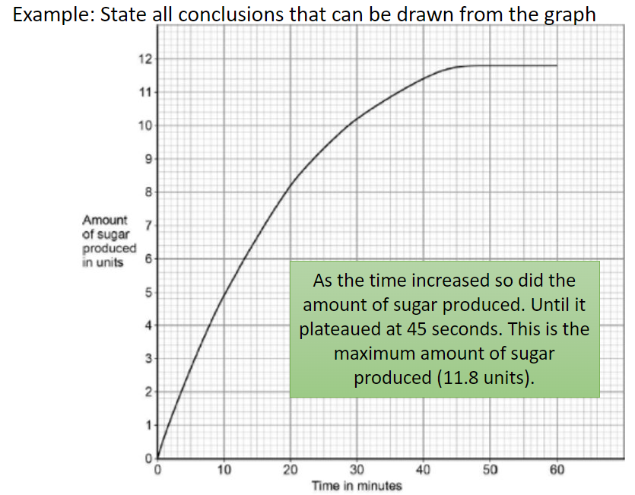
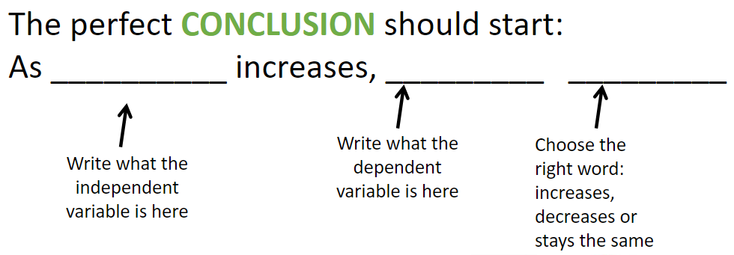
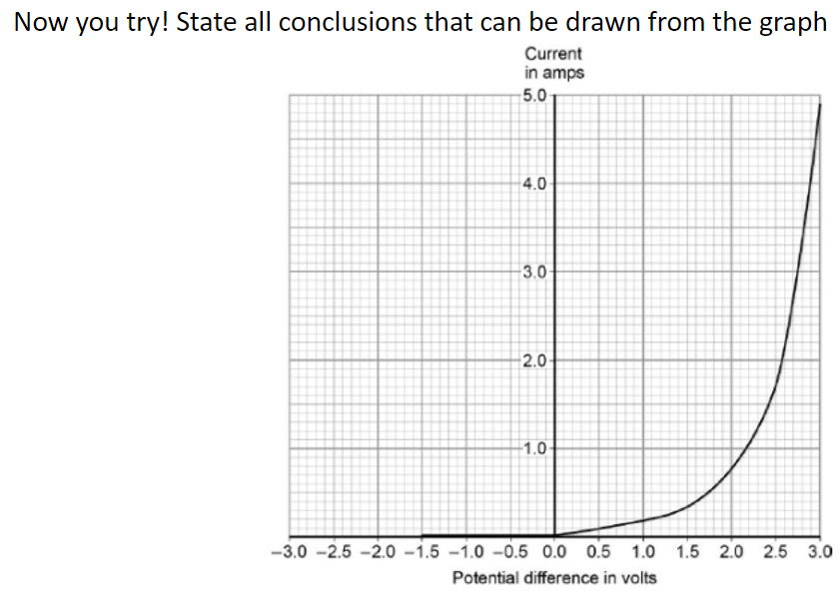
2. Drawing conclusions from graphs or data

Slide 5
3. Suggesting improvements to a practical
Improving practicals is all about getting more accurate results and reducing any sources of errors. There are a few answers that you can apply to most situations:
Repeat the experiment (identify anomalies and calculate a mean)
Improve the range of results, if you did 1-5g could you do 1-10g or go up in 0.5g instead of 1g
Use data loggers or digital equipment, you have a higher resolution, and it reduces random errors!
Have a look at the practical: https://www.savemyexams.com/gcse/physics/aqa/18/revision-notes/1-energy/1-1-energy-changes-in-a-system/1-1-8-required-practical-investigating-specific-heat-capacity/
Could you suggest any improvements?

Slide 6
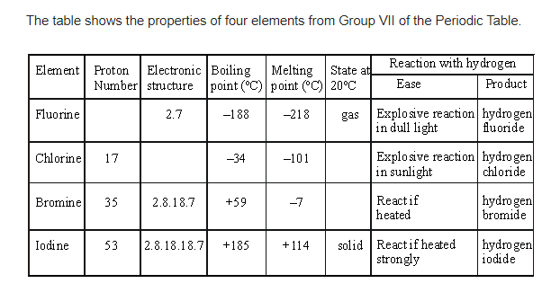
4. Using graphs to identify trends in data about Group 1 and Group 7
Step 1: identify what is the table is showing
Step 2: does the trend increase or decrease or do both
Step 3: look at the marks – if it is 2 marks you will need to identify the trend and use some data in your answer!
Try the questions for the table above!
Q1: Which is the most reactive in Group 7?
Q2: What happens as you go down the group to reactivity?
Q3: Which element has the highest melting point?
Q4: What happens as you go down the group to the melting and boiling point?

Slide 7
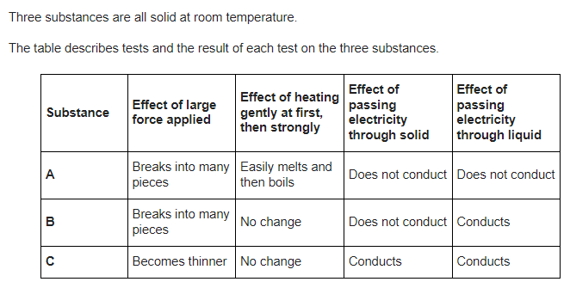
5. Deducing the type of bonding in a compound/molecule using information about its properties
use the links to work out which substance in the table is an ionic compound, which is a covalent compound, and which has metallic bonding: https://www.bbc.co.uk/bitesize/guides/zj38scw/revision/3

Slide 8
6. Comparing the different structure of carbon and their varying properties and uses
Make a flash card for each of the examples of bonding in carbon, follow the link: https://www.bbc.co.uk/bitesize/guides/zgq8b82/revision/1
Make sure you do it for diamond, graphite, graphene and fullerenes!
Here is an example below:
Side 1:
Diamond
Side 2:
Bonding: giant covalent
Properties: high melting and boiling point, hard
Structure: carbon forms 4 bonds with other carbon atoms in a giant structure

Slide 9
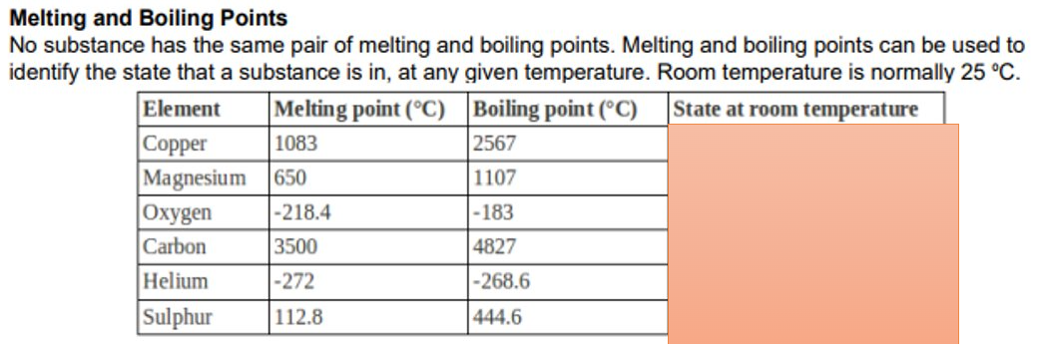
7. Identifying the state of a substance based on information about melting and boiling points
The boiling point is the temperature at which a substance changes state from a liquid to a gas
The melting point is the temperature at which a substance changes state from a solid to a liquid
If the temperature is in between these two points a substance is a liquid!
Use this information to identify what state the substances are in the table:

Slide 10
8. Using formula to work out the relative mass
Use the periodic table in your planner to find the atomic mass of the elements in the molecules below and work out their relative atomic mass, two examples have been done for you:
NaCl = Na mass = 23, Cl mass = 35.5, 23 + 35.5 = 58.5
F₂ = F mass = 19, there are 2 fluorine atoms so: 19 x 2 = 38
CaO =
Cl₂ =
CO₂ =
MgO =
KI =
Al₂O₃ =
CaCO₃ =
CuSO₄ =

Slide 11
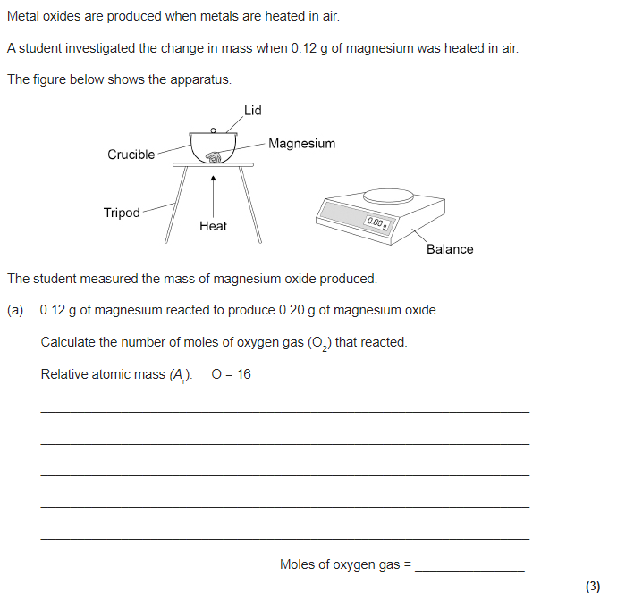
9. Calculating the number of moles of a substance
Moles = mass/relative mass
Try the question below:

Slide 12
10. Identifying the limiting reactants in a problem
Watch this video: https://www.youtube.com/watch?v=MuzOmFhiE8o
Then summarise how to work out the limiting reactant in a mini how to guide!

Slide 13
Answers:

Slide 14
Identifying variables that make up an experiment
Complete the variables table:
Use this link to help you: https://www.youtube.com/watch?v=nKbUbfadxRU
Variable | Definition | Examples:
Independent | the variable for which values are changed or selected by the investigator. | Light for photosynthesis Volume of acid
Dependent | the variable of which the value is measured for each and every change in the independent variable | Time taken to change colour Temperature change
Control | one which may, in addition to the independent variable, affect the outcome of the investigation and therefore has to be kept constant or at least monitored | Mass of object Total volume of solution Type of plant used

Slide 15
2. Drawing conclusions from graphs or data
As the voltage/potential difference increased so did the current.
This was a slow increase until 1.5V to 3A then a faster increase from 1.5V to 3V where it finished at 4.8A.

Slide 16
3. Suggesting improvements to a practical
Have a look at the practical: https://www.savemyexams.com/gcse/physics/aqa/18/revision-notes/1-energy/1-1-energy-changes-in-a-system/1-1-8-required-practical-investigating-specific-heat-capacity/
Could you suggest any improvements?
Repeat the practical more than once
Use a digital thermometer
Use insulation around the block to get a more accurate temperature change

Slide 17
4. Using graphs to identify trends in data about Group 1 and Group 7
Try the questions for the table above!
Q1: Which is the most reactive in Group 7? FLUORINE
Q2: What happens as you go down the group to reactivity? IT DECREASES AS YOU GO DOWN, IODINE IS THE LEAST REACTIVE
Q3: Which element has the highest melting point? IODINE
Q4: What happens as you go down the group to the melting and boiling point? THEY BOTH INCREASE, IODINE HAS THE HIGHEST BOILING AND MELTING POINT.

Slide 18
5. Deducing the type of bonding in a compound/molecule using information about its properties
Covalent
Ionic
Metallic

Slide 19
6. Comparing the different structure of carbon and their varying properties and uses
How your flash cards to your chemistry teacher:
Make sure you have done one for:
Diamond
Graphite
Graphene
Fullerenes
Side 1:
Diamond
Side 2:
Bonding: giant covalent
Properties: high melting and boiling point, hard
Structure: carbon forms 4 bonds with other carbon atoms in a giant structure

Slide 20
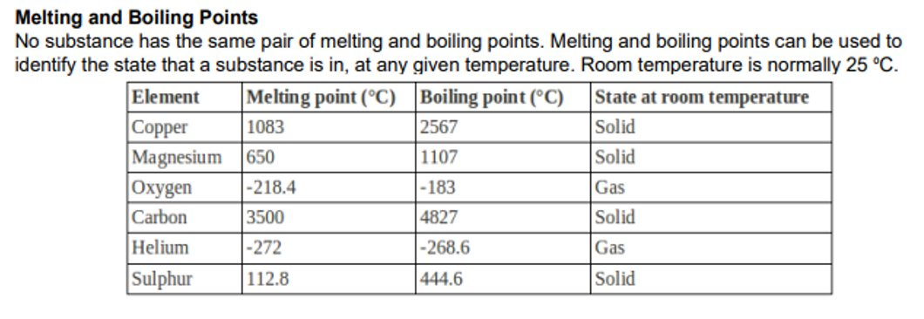
7. Identifying the state of a substance based on information about melting and boiling points
The boiling point is the temperature at which a substance changes state from a liquid to a gas
The melting point is the temperature at which a substance changes state from a solid to a liquid
If the temperature is in between these two points a substance is a liquid!
Use this information to identify what state the substances are in the table:

Slide 21
8. Using formula to work out the relative mass
Use the periodic table in your planner to find the atomic mass of the elements in the molecules below and work out their relative atomic mass, two examples have been done for you:
NaCl = Na mass = 23, Cl mass = 35.5, 23 + 35.5 = 58.5
F₂ = F mass = 19, there are 2 fluorine atoms so: 19 x 2 = 38
CaO = Ca=40, O = 16 = 56
Cl₂ = 35.5 x 2 = 70
CO₂ = C = 6, O = 16, 6 + (16 x 2) = 6 + 32 = 38
MgO = Mg = 24, O = 16, 24 + 16 = 40
KI = K = 39, I = 127, 39 + 127 = 166
Al₂O₃ = Al = 27, O = 16, (27 x 2) + (16 x 3) = 54 + 48 = 102
CaCO₃ = Ca = 40, C = 6, O = 16, 40 + 12 + (16 x3) = 52 + 48 = 100
CuSO₄ = Cu = 64, S = 32, O = 16, 64 + 32 + (16 x 4) = 96 + 64 = 160

Slide 22
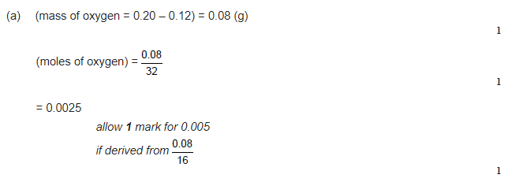
9. Calculating the number of moles of a substance
You must show your working out!

Slide 23
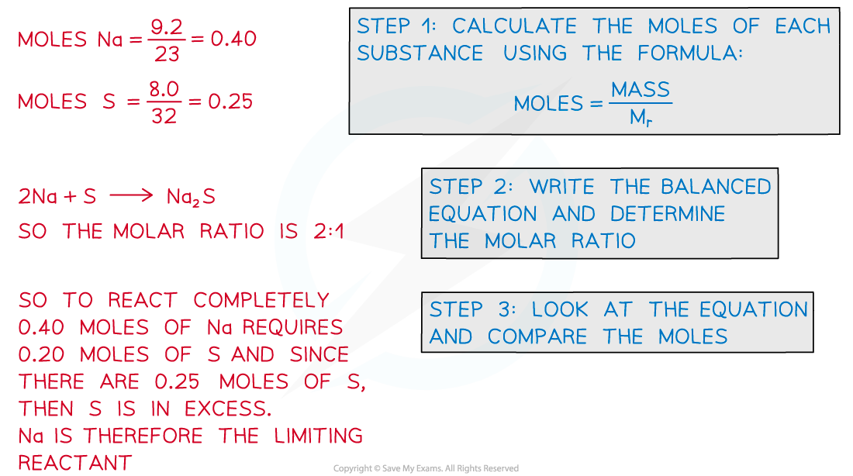
10. Identifying the limiting reactants in a problem
The steps are:
  Convert the mass of each reactant into moles by dividing by the molar masses
  Write the balanced equation and determine the molar ratio
  Look at the equation and compare the moles

