Slide 1
Year 10 Combined Biology

Slide 2
Skills and knowledge points
Identifying variables that make up an experiment (slide/page 3)
Drawing conclusions from graphs or data (slide/page 4)
Suggesting improvements to a practical (slide/page 5)
Identifying trends from data in health (slide/page 6)
Describing the effect of CHD on a person (slide/page 7)
Applying the science to explaining the impact of a non-communicable disease (slide/page 8)
Evaluating disease treatments using information given and recommending the best treatment (slide/page 9)
Recalling the symptoms and treatments for the 7 diseases (slide/page 10)
Identifying the pros and cons of vaccines (slide/page 11)
Evaluating drug treatments using information given and recommending the best drug option (slide/page 12)
Please see the corresponding slide/page for a resource. Answers are found at the end (slide/page 13 onwards)

Slide 3
Identifying variables that make up an experiment
Complete the variables table:
Use this link to help you: https://www.youtube.com/watch?v=nKbUbfadxRU
Variable | Definition | Examples:
Independent
Dependent
Control

Slide 4
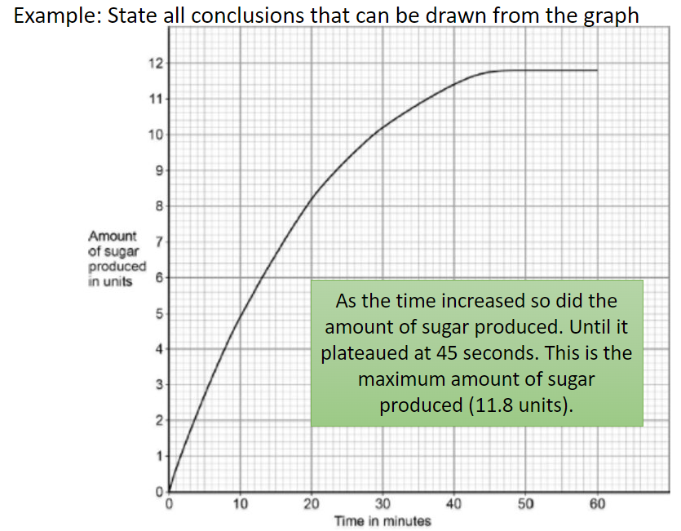
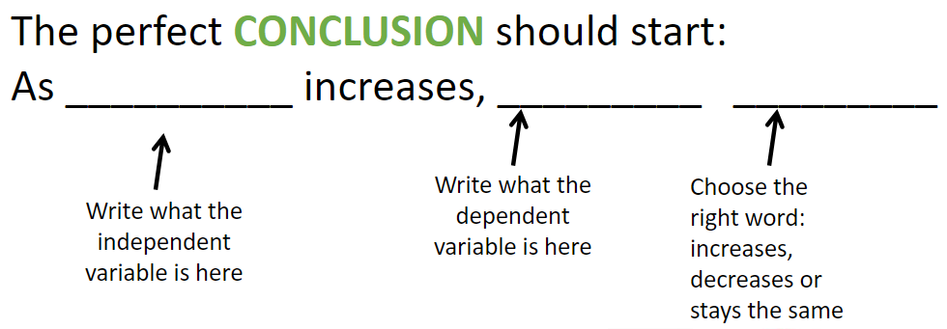
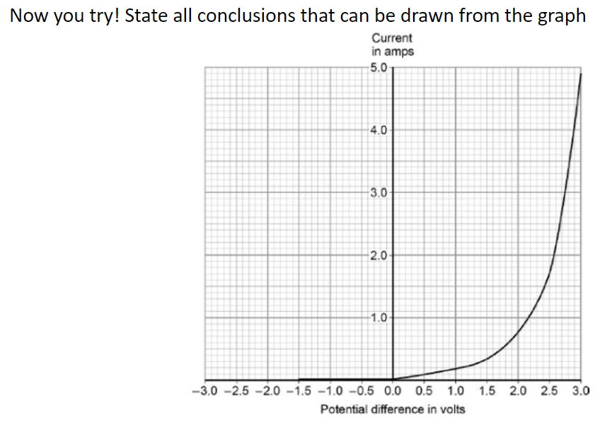
2. Drawing conclusions from graphs or data

Slide 5
3. Suggesting improvements to a practical
Improving practicals is all about getting more accurate results and reducing any sources of errors. There are a few answers that you can apply to most situations:
Repeat the experiment (identify anomalies and calculate a mean)
Improve the range of results, if you did 1-5g could you do 1-10g or go up in 0.5g instead of 1g
Use data loggers or digital equipment, you have a higher resolution, and it reduces random errors!
Have a look at the practical: https://www.savemyexams.com/gcse/physics/aqa/18/revision-notes/1-energy/1-1-energy-changes-in-a-system/1-1-8-required-practical-investigating-specific-heat-capacity/
Could you suggest any improvements?

Slide 6
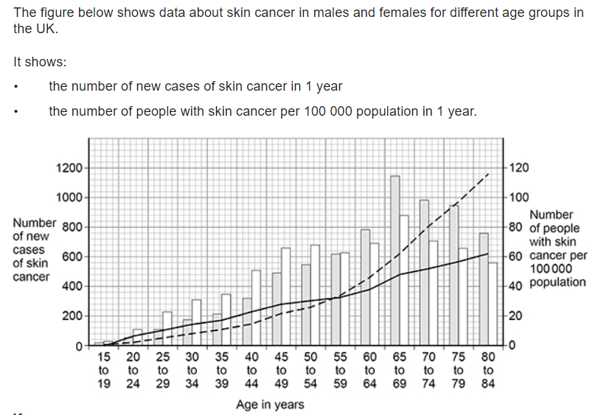
4. Identifying trends from data in health
Step 1: identify what is the graph showing
Step 2: does the trend increase or decrease or do both
Step 3: look at the marks – if it is 2 marks you will need to identify the trend and use some data in your answer!
Try the questions for the graph above!
Q1: There are no new cases of skin cancer diagnosed in people younger than 15 years of age. Explain why.
Q2: Give two conclusions about the number of new cases of skin cancer. Use the figure above.

Slide 7
5. Describing the effect of CHD on a person
Use this website to produce a spider diagram about how CHD can affect someone: https://www.savemyexams.com/gcse/biology/aqa/18/revision-notes/2-organisation/2-3-health--disease/2-3-1-chd-a-non-communicable-disease/

Slide 8
6. Applying the science to explaining the impact of a non-communicable disease
Follow the link: https://www.bbc.co.uk/bitesize/guides/zxr7ng8/revision/10
Create a 10-fact summary of the information

Slide 9
7. Evaluating disease treatments using information given and recommending the best treatment
In an evaluate question you need to describe the pros and cons for each option and then suggest which you would recommend! Try this 6 mark question:
A drug is only licensed for the medical conditions it was tested to treat in the clinical trials.
Drug regulations:
• control what drugs a doctor can prescribe
• ensure doctors can prescribe a drug with confidence
• protect patients.
AMD is an eye condition that can result in very poor vision. Doctors treat approximately 40 000 new cases of AMD each year. Two drugs licensed to treat AMD in the UK are drug A and drug B.
In many other countries drug C is used to treat AMD. Drug C is only licensed in the UK to treat cancer.
The cost per injection for each drug is:
• drug A £561
• drug B £800
• drug C £28
The number of injections required to treat AMD is the same for each drug. In 2018 the High Court in the UK gave permission for drug C to be used to treat AMD.
Evaluate the decision to allow the use of drug C to treat AMD in the UK.

Slide 10
8. Recalling the symptoms and treatments for the 7 diseases
Make a flash card for each of the symptoms and treatments for each disease, follow the link: https://www.savemyexams.com/gcse/biology/aqa/18/revision-notes/3-infection--response/3-1-communicable-diseases/3-1-2-viral-diseases/
Make sure you do it for bacterial, viral, fungal and protist diseases!
Here is an example below:
Side 1:
Measles
Side 2:
Symptoms: fever, red skin rash
Treatments: isolation and fluids
Prevention: vaccines

Slide 11
9. Identifying the pros and cons of vaccines
Read the passage and identify the pros and cons of immunisation (vaccinating people).
Advantages and disadvantages of immunisation
The advantages of immunisation are obvious - they stop individuals becoming ill. If enough people are immunised, immunisations can also stop pathogens infecting whole populations. This is called herd immunity.
There are also risks to having immunisations. For instance, some people suffer from a mild reaction to the vaccine.
In recent years there has been much controversy surrounding the MMR vaccine. Some people used to think the vaccine - which is a combined treatment against measles, mumps and rubella - could cause autism in children. They decided not to risk letting their child have the vaccine and hoped they would not catch measles, mumps or rubella.
But this meant that, as fewer and fewer children were immunised, the three diseases began to spread more easily and the number of cases began to increase. More recent studies by the World Health Organisation have shown that there is no link between the MMR vaccine and autism.
Immunisations can never be completely safe and there is always a risk of some side-effect. So, when making a decision, these are some of the factors that need to be considered:
when fewer people are immunised, the number of cases of the disease increases
the chance of falling seriously ill or dying from the disease may be far greater than the chance of experiencing a serious side-effect
using a vaccine may be much cheaper than treating a very ill person

Slide 12
10. Evaluating drug treatments using information given and recommending the best drug option
See number 7

Slide 13
Answers:

Slide 14
Identifying variables that make up an experiment
Complete the variables table:
Use this link to help you: https://www.youtube.com/watch?v=nKbUbfadxRU
Variable | Definition | Examples:
Independent | the variable for which values are changed or selected by the investigator. | Light for photosynthesis Volume of acid
Dependent | the variable of which the value is measured for each and every change in the independent variable | Time taken to change colour Temperature change
Control | one which may, in addition to the independent variable, affect the outcome of the investigation and therefore has to be kept constant or at least monitored | Mass of object Total volume of solution Type of plant used

Slide 15
2. Drawing conclusions from graphs or data
As the voltage/potential difference increased so did the current.
This was a slow increase until 1.5V to 3A then a faster increase from 1.5V to 3V where it finished at 4.8A.

Slide 16
3. Suggesting improvements to a practical
Have a look at the practical: https://www.savemyexams.com/gcse/physics/aqa/18/revision-notes/1-energy/1-1-energy-changes-in-a-system/1-1-8-required-practical-investigating-specific-heat-capacity/
Could you suggest any improvements?
Repeat the practical more than once
Use a digital thermometer
Use insulation around the block to get a more accurate temperature change

Slide 17
4. Identifying trends from data in health
Try the questions for the graph above!
Q1: There are no new cases of skin cancer diagnosed in people younger than 15 years of age. Explain why.
- little exposure to ionising radiation/UV light/sunlight/don't use sunbeds
Q2: Give two conclusions about the number of new cases of skin cancer. Use the figure above.
Any two from:
• more females than males diagnosed each year up to age 59 (years)
• more new cases in males than in females from 60 (years)
• greatest number of people / males / females diagnosed in age group 65-69 (years)
• number of new cases increases in males up to age group 65−69 (years) after which they decrease / fall
ignore the number of cases of skin cancer increases with age

Slide 18
5. Describing the effect of CHD on a person
They can have a heart attack
They can develop a plaque in their coronary arteries
How CHD can affect someone
Part of the heart can die and not contract
This can stop the blood flow to parts of the heart
If there is no blood then that part of the hear will not get oxygen

Slide 19
6. Applying the science to explaining the impact of a non-communicable disease
A non-communicable disease cannot be caught from another source, they naturally develop in the body
Lots of cancers are non-communicable diseases
Malignant - these tumours are cancerous and can break apart, move around the body and start new instances of the same cancers in a process called metastasis
Benign - these tumours are less serious because they are not cancerous, and do not spread
Cancers can also be caused by viruses
Cancers are best treated when caught early and can be treated using chemotherapy or radiotherapy
Risk factors increase your chances of developing a disease
Lifestyle choices can affect whether or not you get a non-communicable disease
Obesity and lack of physical activity can increase your chances of developing type 2 diabetes
Smoking and drinking alcohol can also cause non-communicable disease likes liver disease and lung cancer

Slide 20
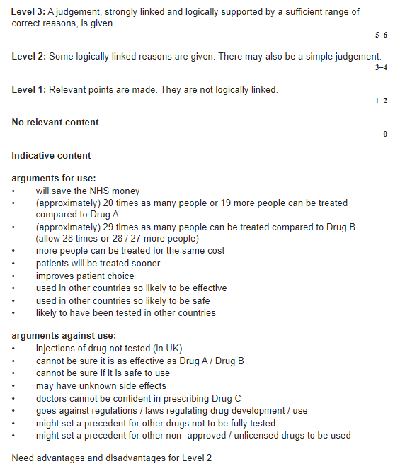
7. Evaluating disease treatments using information given and recommending the best treatment

Slide 21
8. Recalling the symptoms and treatments for the 7 diseases
Show your cards to your biology teacher!
Measles (V)
HIV (V)
Tobacco mosaic virus (V)
Salmonella (B)
Gonorrhoea (B)
Malaria (P)
Rose black spot disease (F)
Side 1:
Measles
Side 2:
Symptoms: fever, red skin rash
Treatments: isolation and fluids
Prevention: vaccines

Slide 22
9. Identifying the pros and cons of vaccines
Pros | Cons
They stop individuals becoming ill If enough people are immunised, immunisations can also stop pathogens infecting whole populations. This is called herd immunity. Using a vaccine may be much cheaper than treating a very ill person | Some people suffer from a mild reaction to the vaccine False/fake news can affect people getting the vaccine due to incorrect information being circulated There is always a risk of some side-effect

Slide 23
10. Evaluating drug treatments using information given and recommending the best drug option
See number 7

