Slide 1
Year 10 Combined Physics

Slide 2
Skills and knowledge points
Identifying variables that make up an experiment (slide/page 3)
Drawing conclusions from graphs or data (slide/page 4)
Suggesting improvements to a practical (slide/page 5)
Comparing the different models of the atom (slide/page 6)
Identifying isotopes using diagrams (slide/page 7)
Recalling the properties of alpha, beta and gamma radiation (slide/page 8)
Planning a practical to work out the type of nuclear radiation an object is emitting (slide/page 9)
Solving problems for half-life using graphs (slide/page 10)
Identifying a use of radiation based on the half-life (slide/page 11)
Describing the uses of radiation in medical treatments (slide/page 12)
Please see the corresponding slide/page for a resource. Answers are found at the end (slide/page 13 onwards)

Slide 3
Identifying variables that make up an experiment
Complete the variables table:
Use this link to help you: https://www.youtube.com/watch?v=nKbUbfadxRU
Variable | Definition | Examples:
Independent
Dependent
Control

Slide 4
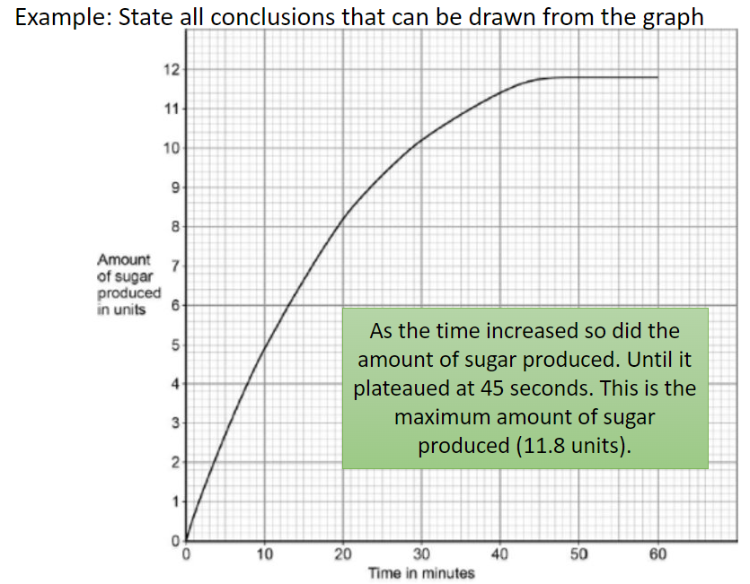
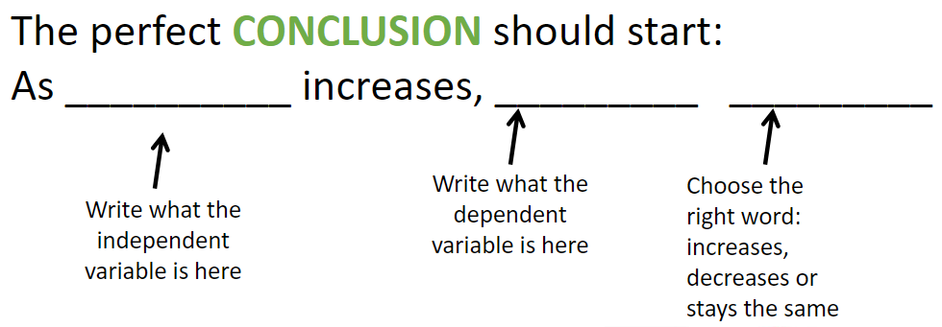
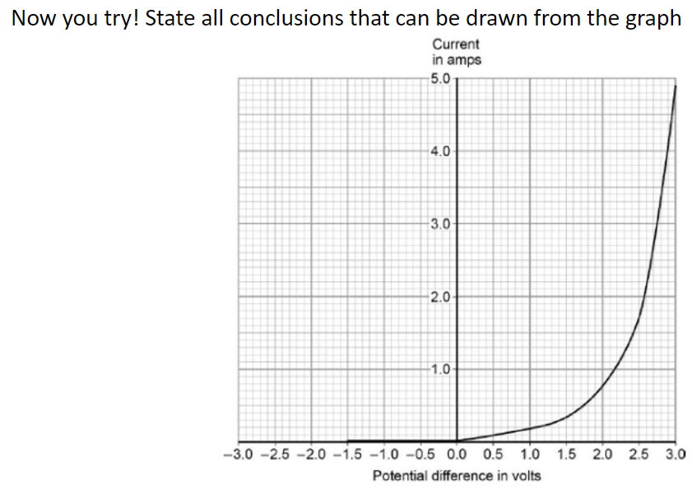
2. Drawing conclusions from graphs or data

Slide 5
3. Suggesting improvements to a practical
Improving practicals is all about getting more accurate results and reducing any sources of errors. There are a few answers that you can apply to most situations:
Repeat the experiment (identify anomalies and calculate a mean)
Improve the range of results, if you did 1-5g could you do 1-10g or go up in 0.5g instead of 1g
Use data loggers or digital equipment, you have a higher resolution, and it reduces random errors!
Have a look at the practical: https://www.savemyexams.com/gcse/physics/aqa/18/revision-notes/1-energy/1-1-energy-changes-in-a-system/1-1-8-required-practical-investigating-specific-heat-capacity/
Could you suggest any improvements?

Slide 6
4. Comparing different models of the atom
Watch the video and complete the same different table below
Video: https://www.youtube.com/watch?v=sG6QoLxwIw4
Same (what is the same between the plum pudding and the nuclear model?) | Different (what is different between the plum pudding and the nuclear model?)

Slide 7
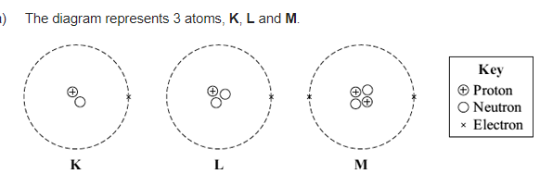
5. Identifying isotopes using diagrams
An isotope is a version of an element that has the same number of protons and electrons but a different number of neutrons. The atomic number is the same but the mass number is different.
Look at the picture below, identify the number of protons, electrons and neutrons for each element and then suggest which are the same element and which is the odd one out!

Slide 8
6. Recalling the properties of alpha, beta and gamma radiation
Make a flash card for each of the examples of nuclear radiation, follow the link: https://www.bbc.co.uk/bitesize/guides/zxbnh39/revision/2
Make sure you do it for alpha, beta and gamma!
Here is an example below:
Side 1:
Alpha
Side 2:
Composition: 2p and 2n
Properties: most ionising, least penetrating
Charge: 2+
Stopped by: paper/skin

Slide 9
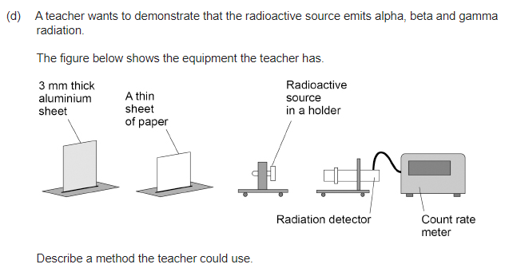
7.Planning a practical to work out the type of nuclear radiation an object is emitting
Use the equipment below and complete the 6-marker plan!

Slide 10
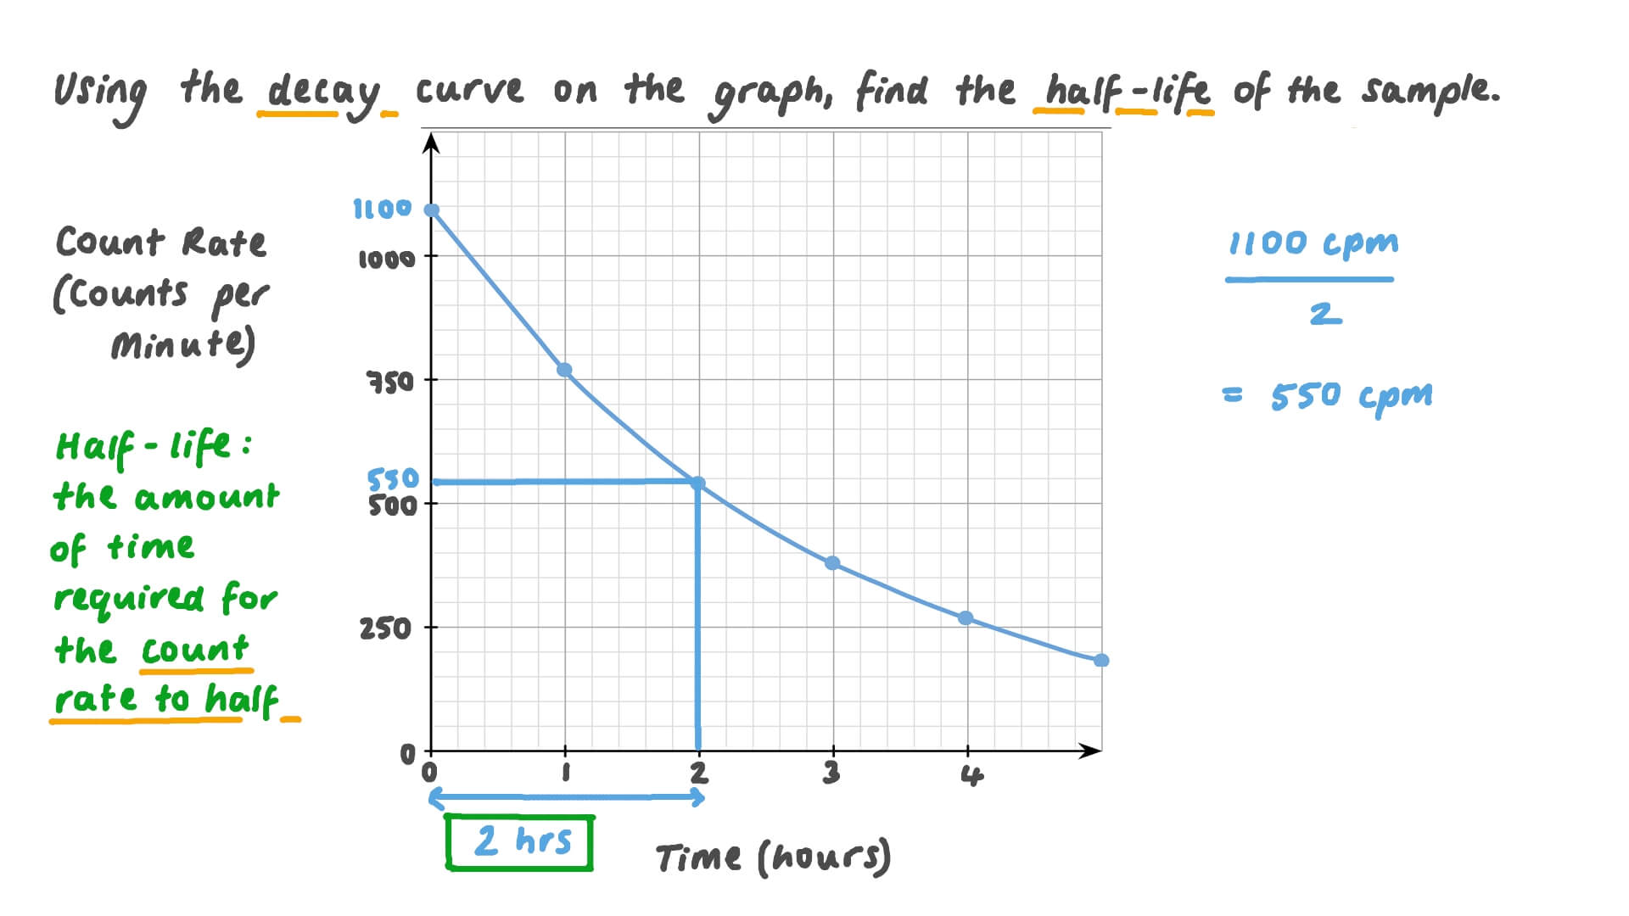
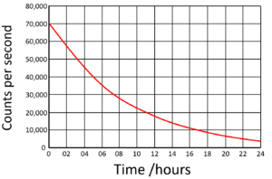
8. Solving problems for half-life using graphs
Half-life is the time taken for half the nuclei in a sample to decay. It can be calculated using graphs.
Firstly, you need to work out the full sample size/count rate, then half that number. Then use the graph to draw a line from half to the LOBF. Then draw down from there to the time on the x-axis and that is your half-life! Look at the example below and then you can try!
You try on this graph:

Slide 11
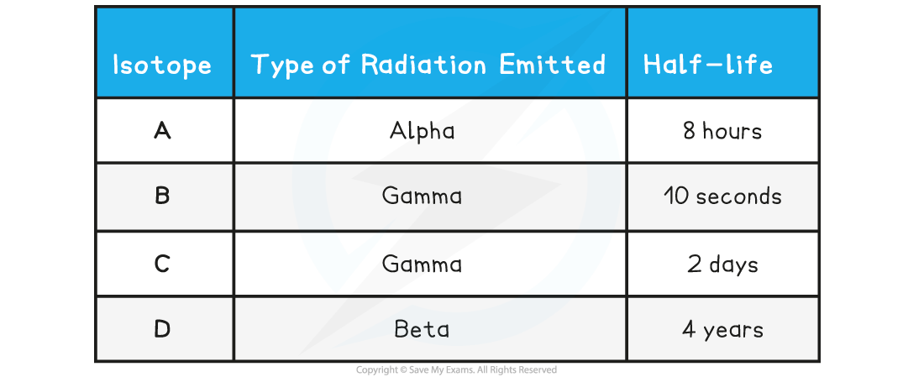
9. Identifying a use of radiation based on the half-life
Radiation can be useful for lots of things. Watch the video and make a list. https://www.youtube.com/watch?v=gDrR_dVmqZk&pp=ygUSdXNlcyBvZiByYWRpYXRpb24g
Now try the question below:
A new medical tracer is required for investigating the absorption of a particular substance found in blood around the body. Which of the different isotopes in the table would be most suitable?

Slide 12
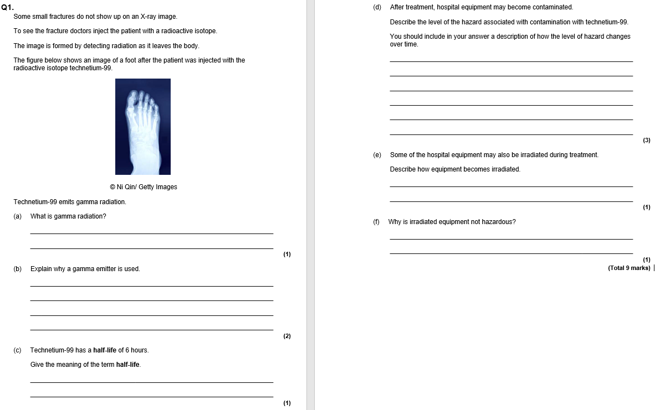
10. Describing the uses of radiation in medical treatments
Radiation can be used for lots of medical uses like: X rays, radiotherapy, medical tracers and sterilisation. Watch the video and then try the question: https://www.youtube.com/watch?v=gDrR_dVmqZk

Slide 13
Answers:

Slide 14
Identifying variables that make up an experiment
Complete the variables table:
Use this link to help you: https://www.youtube.com/watch?v=nKbUbfadxRU
Variable | Definition | Examples:
Independent | the variable for which values are changed or selected by the investigator. | Light for photosynthesis Volume of acid
Dependent | the variable of which the value is measured for each and every change in the independent variable | Time taken to change colour Temperature change
Control | one which may, in addition to the independent variable, affect the outcome of the investigation and therefore has to be kept constant or at least monitored | Mass of object Total volume of solution Type of plant used

Slide 15
2. Drawing conclusions from graphs or data
As the voltage/potential difference increased so did the current.
This was a slow increase until 1.5V to 3A then a faster increase from 1.5V to 3V where it finished at 4.8A.

Slide 16
3. Suggesting improvements to a practical
Have a look at the practical: https://www.savemyexams.com/gcse/physics/aqa/18/revision-notes/1-energy/1-1-energy-changes-in-a-system/1-1-8-required-practical-investigating-specific-heat-capacity/
Could you suggest any improvements?
Repeat the practical more than once
Use a digital thermometer
Use insulation around the block to get a more accurate temperature change

Slide 17
4. Comparing different models of the atom
Watch the video and complete the same different table below
Video: https://www.youtube.com/watch?v=sG6QoLxwIw4
Same (what is the same between the plum pudding and the nuclear model?) | Different (what is different between the plum pudding and the nuclear model?)
Both have positively charged parts Both have negatively charged parts Both have a circular shape Both have no neutrons Both have no overall charge (have the same amount of positive and negative charges) | The positive part of the plum pudding is spread out throughout the 'pudding', whereas in the nuclear model it is in the small highly charged nucleus The negative part of the plum pudding are dotted throughout the pudding, whereas in the nuclear model the electrons are in shells orbiting the nucleus

Slide 18
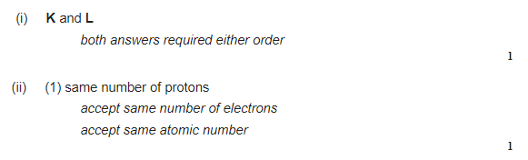
5. Identifying isotopes using diagrams
An isotope is a version of an element that has the same number of protons and electrons but a different number of neutrons. The atomic number is the same but the mass number is different.
Look at the picture below, identify the number of protons, electrons and neutrons for each element and then suggest which are the same element and which is the odd one out!

Slide 19
6. Recalling the properties of alpha, beta and gamma radiation
How your flash cards to your chemistry teacher:
Make sure you have done one for:
Alpha
Beta
Gamma
Side 1:
Alpha
Side 2:
Composition: 2p and 2n
Properties: most ionising, least penetrating
Charge: 2+
Stopped by: paper/skin

Slide 20
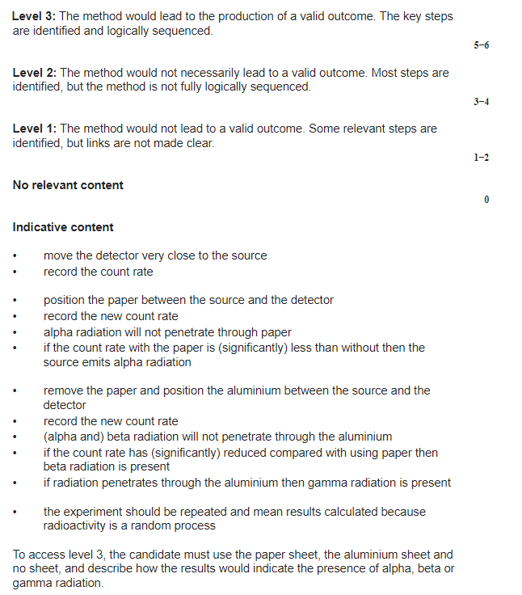
7.Planning a practical to work out the type of nuclear radiation an object is emitting

Slide 21
8. Solving problems for half-life using graphs
Half-life is the time taken for half the nuclei in a sample to decay. It can be calculated using graphs.
Firstly, you need to work out the full sample size/count rate, then half that number. Then use the graph to draw a line from half to the LOBF. Then draw down from there to the time on the x-axis and that is your half-life! Look at the example below and then you can try!
The sample size is 70,000.
Half of 70,000 = 35,000.
The line on the graph goes down to 6 hours.
So, 1 half-life is 6 hours!

Slide 22
9. Identifying a use of radiation based on the half-life
List of uses medical tracers, pipework tracers, sterilization, radiotherapy for cancer, thickness detector
ANSWER: C
A suitable medical tracer must:
  Be able to penetrate out of the body
  Have a long enough half-life to move around the body before it decays away
  Have a short enough half-life that it won’t remain in the body at dangerous levels for too long
The answer is not A because alpha radiation cannot penetrate out of the body
The answer is not B because the half-life is too short
The answer is not D because the half-life is too long

Slide 23
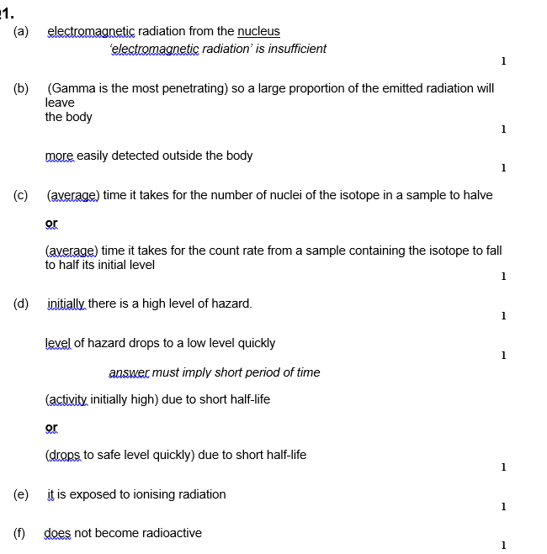
10. Describing the uses of radiation in medical treatments
Radiation can be used for lots of medical uses like: X rays, radiotherapy, medical tracers and sterilisation. Watch the video and then try the question: https://www.youtube.com/watch?v=gDrR_dVmqZk

