Slide 1


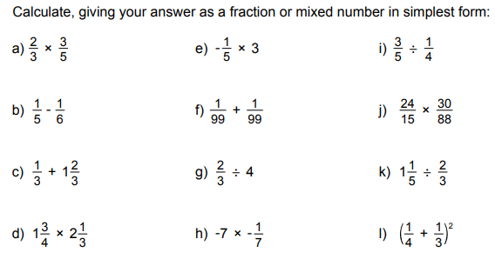
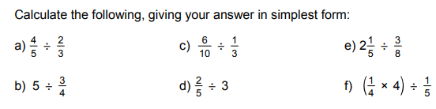
Using the four operations confidently with fractions to solve problems
Enter codes U793, U224 and U538 in the Sparx independent learning section and/or
Follow these links to watch videos on “the four operations”
https://corbettmaths.com/2012/08/21/fractions-addition-and-subtraction/
https://corbettmaths.com/2012/08/21/division-with-fractions/
https://corbettmaths.com/2012/08/21/multiplying-fractions-2/
Work through the questions below to check your understanding (solutions on next page):

Slide 2
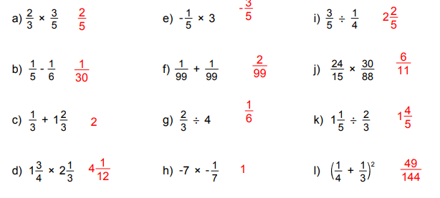
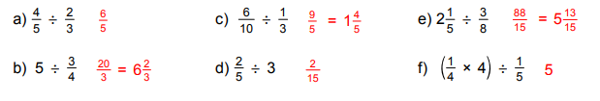
Solutions

