Slide 1


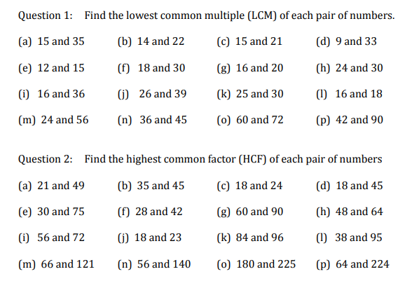
Using prime factor decomposition to find highest common factors and lowest common multiples of two (or more) numbers.
Enter code U250 in the Sparx independent learning section and/or
Follow this link to watch a video on “Product of primes”
https://corbettmaths.com/2012/08/20/lcm-and-hcf-using-product-of-primes/
Work through the questions below to check your understanding (solutions on next page):

Slide 2
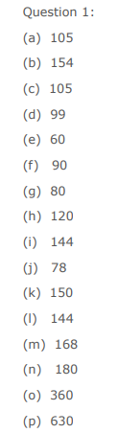
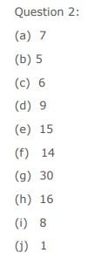

Solutions

