Slide 1


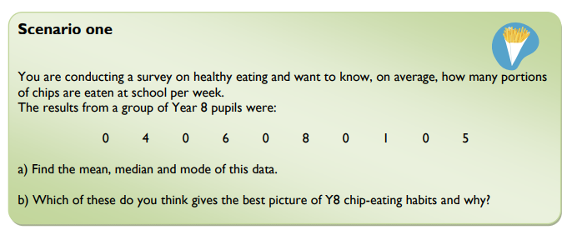
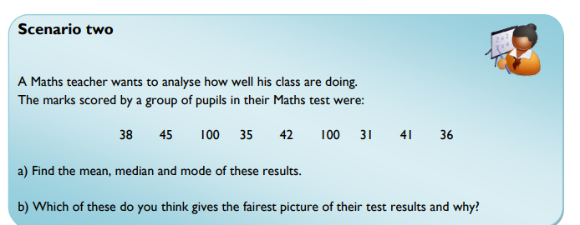
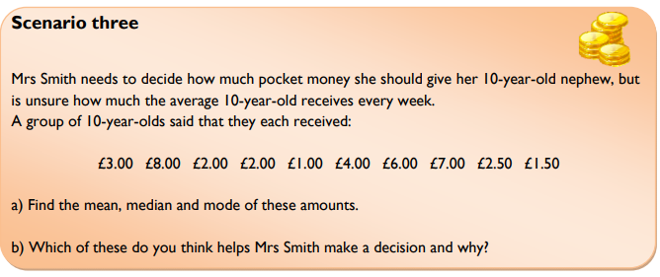
Choosing the most suitable type of average (and range) to make effective comparisons between data sets.
Enter code U717 in the Sparx independent learning section and/or
Follow these links to watch videos on “Averages”
https://corbettmaths.com/2012/08/02/the-median/
https://corbettmaths.com/2012/08/02/the-mean/
https://corbettmaths.com/2013/12/21/the-mode-video56/
https://corbettmaths.com/2012/08/02/the-range-video/
Work through the questions below to check your understanding (solutions on next page):

Slide 2
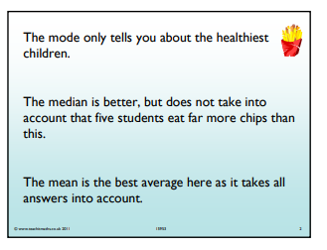
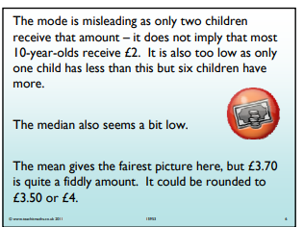
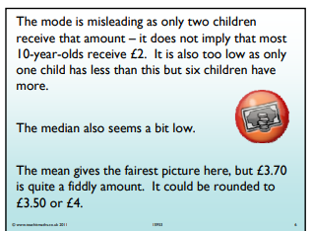
Solutions

