Slide 1


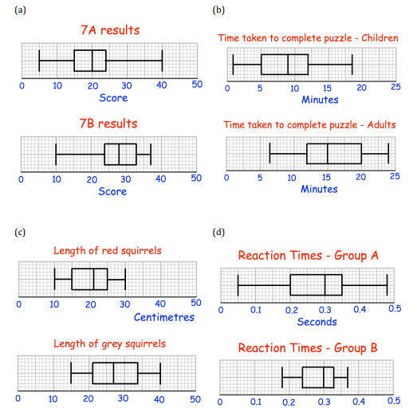
Using box plots to comment on distributions and make comparisons between data sets.
Enter codes U879, U837 and U507 in the Sparx independent learning section and/or
Follow this link to watch a video on “Comparing box plots”
https://corbettmaths.com/2013/05/15/comparing-box-plots/
Work through the questions below to check your understanding (solutions on next page):
Compare the distributions of each pair of box plots below

Slide 2
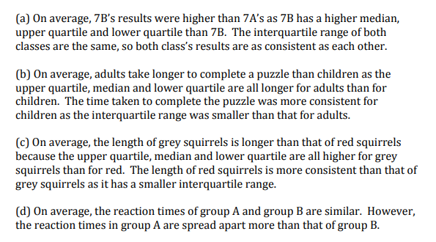
Solutions

