Slide 1


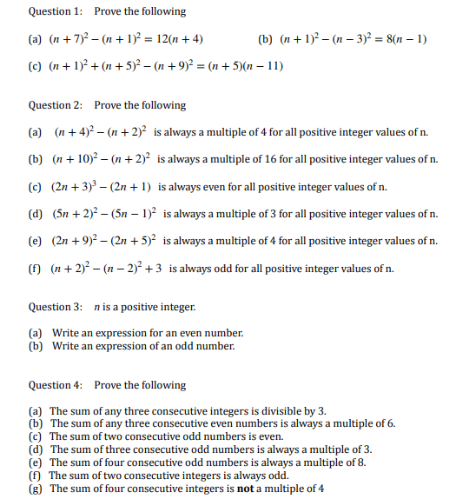
Using algebra efficiently to construct proofs and arguments.
Enter code U582 in the Sparx independent learning section and/or
Follow this link to watch a video on “Algebraic proof”
https://corbettmaths.com/2016/04/24/algebraic-proof/
Work through the questions below to check your understanding (solutions on next page):

Slide 2
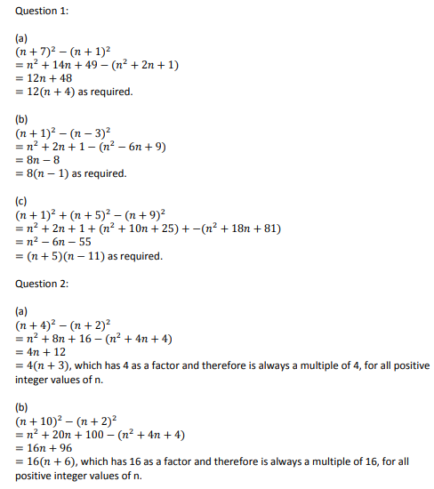
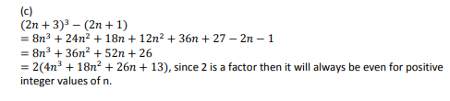
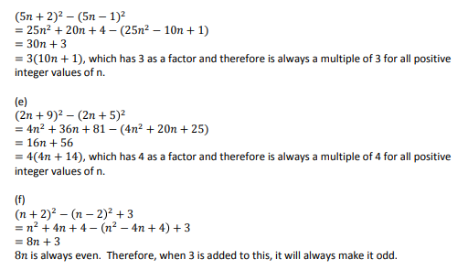
Solutions

Slide 3
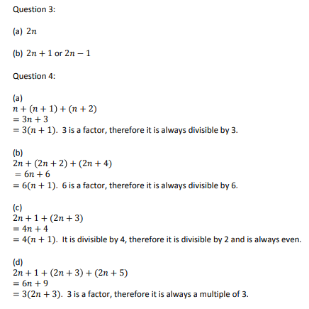
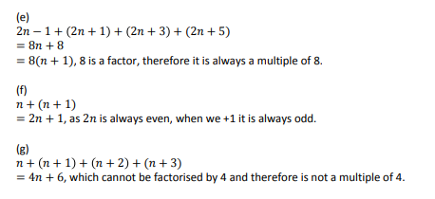
Solutions continued:

