Slide 1


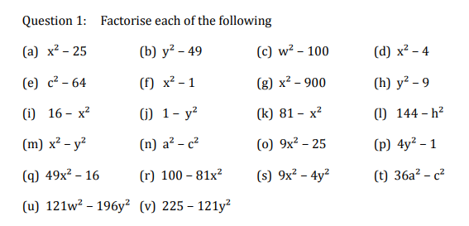
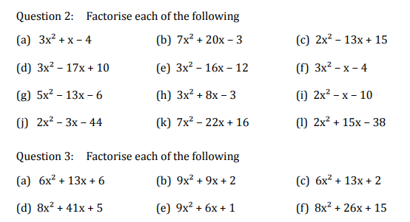
Factorising a range of quadratics, including the difference of two squares.
Enter codes U178, U858 and U963 in the Sparx independent learning section and/or
Follow these links to watch videos on “Quadratic factorisation”
https://corbettmaths.com/2013/02/06/factorising-quadratics-1/
https://corbettmaths.com/2013/02/07/factorising-quadratics-2/
https://corbettmaths.com/2013/02/08/difference-between-two-squares/
Work through the questions below to check your understanding (solutions on next page):

Slide 2
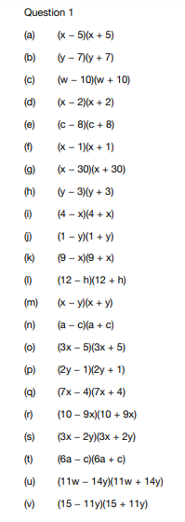
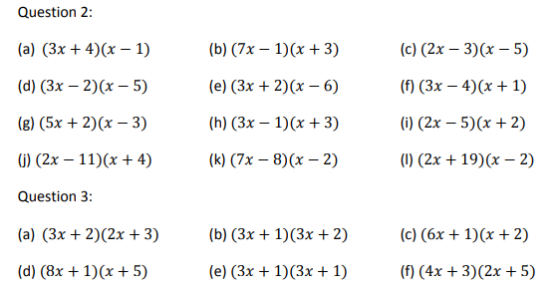
Solutions

