Slide 1


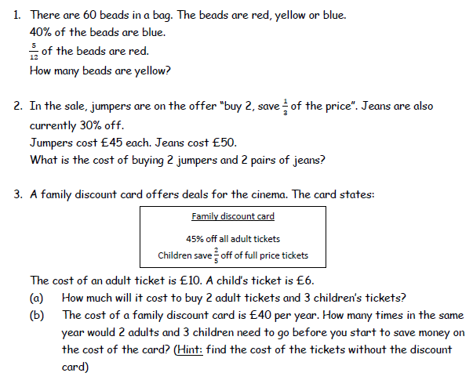
Identifying with confidence the appropriate method to solve practical problems involving fraction and percentage calculations.
Enter code U874 in the Sparx independent learning section and/or
Work through the questions below to check your understanding (solutions on next page):

Slide 2
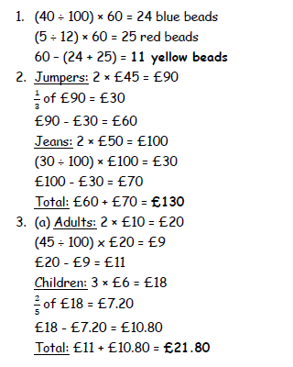
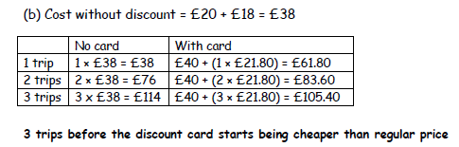
Solutions

