Slide 1


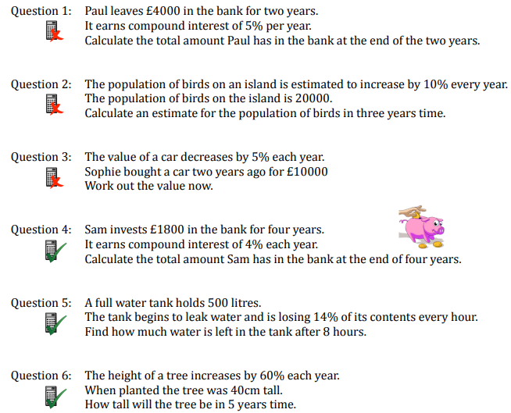
Solving repeated percentage change problems in a range of contexts.
Enter codes U332 and U998 in the Sparx independent learning section and/or
Follow this link to watch video on “Compound Interest”
https://corbettmaths.com/2012/08/21/compound-interest/
Work through the questions below to check your understanding (solutions on next page):

Slide 2
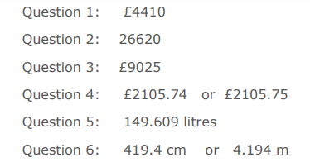
Solutions

