Slide 1
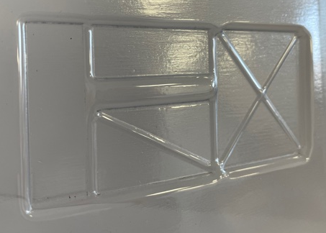
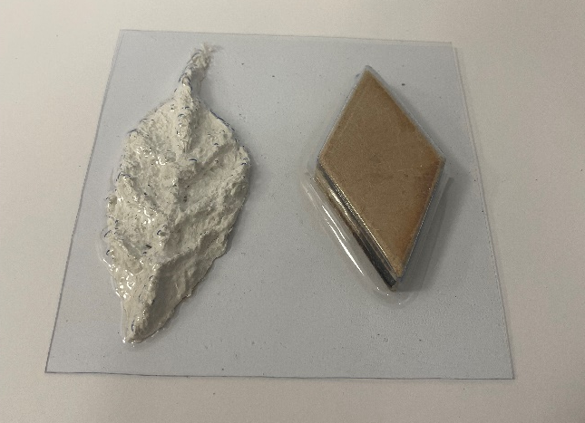
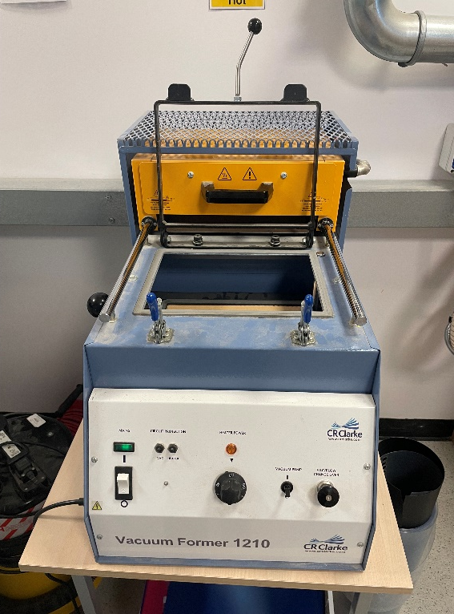
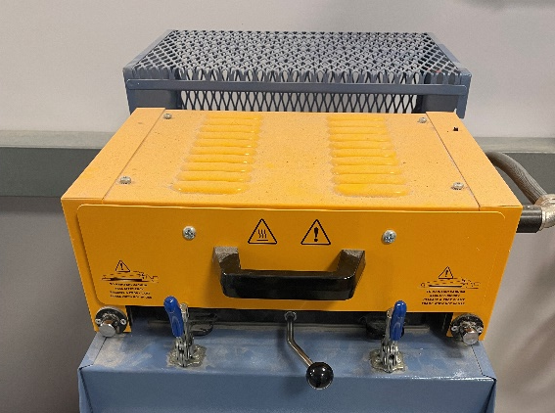
Vacuum Forming
Heater
Vacuum forming
Once completed, place your plywood and mod roc formers on the bed of the vacuum former.
Lower the bed
Secure the mylar in place using the clamp and toggle clamps.
Pull the heater over the mylar and allow to heat for approximately 1 minute. If the mylar is looks ready (as shown in demonstration) move on to the next step. If not place back in the oven and check every 10 seconds.
Raise bed into mylar and turn on vacuum pump.
Leave for 30 seconds and then remove both former and mylar.
Use scissors to cut the formed shapes free of excess mylar
Clamp
Bed
Toggle clamp
Equipment:
Vacuum forming machine
Mod roc former
Plywood former (made on scroll saw process)
Sheet of mylar
Scissors
Vacuum pump
Heater pulled forward to cover the mylar

Slide 2
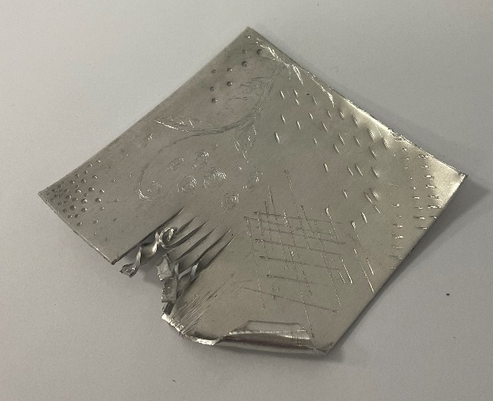
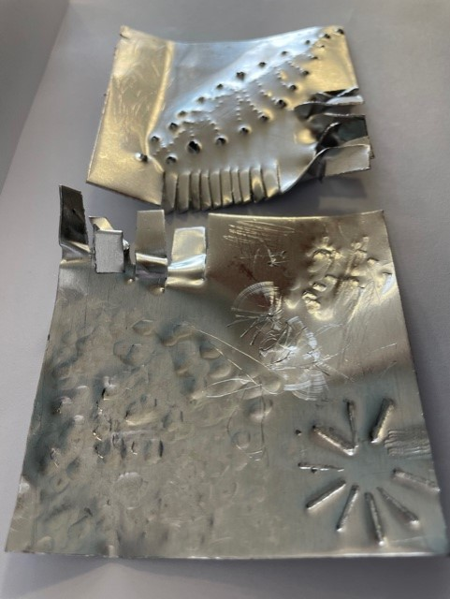
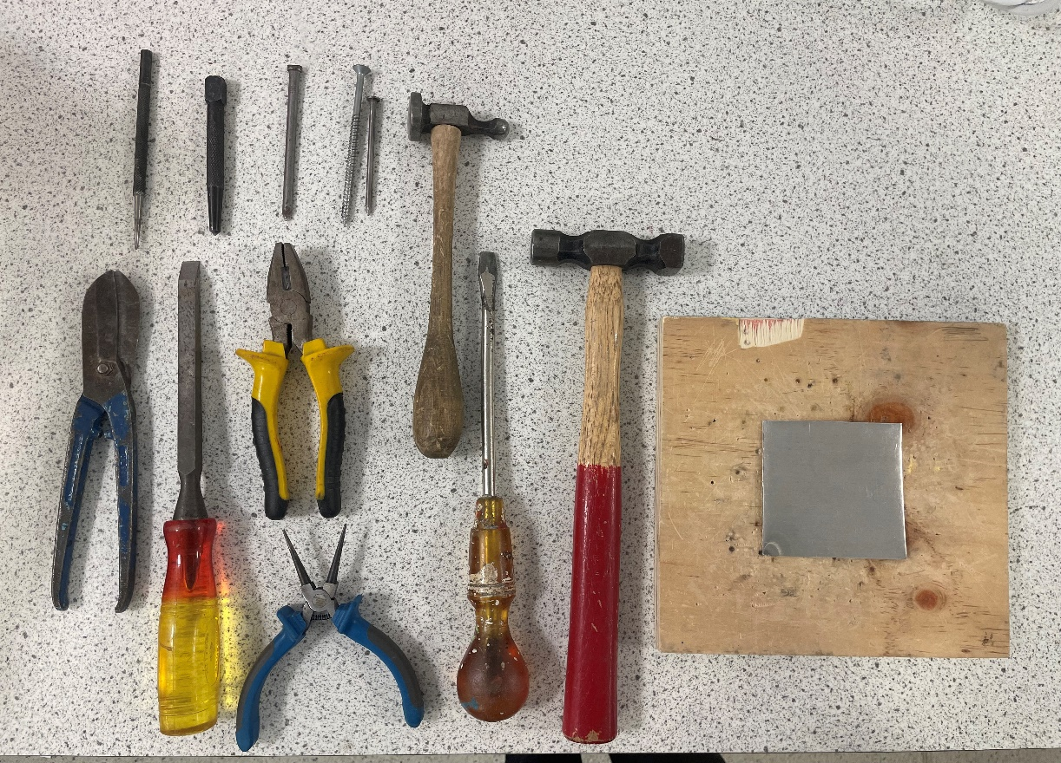
Aluminium Beating
Place your square of aluminium on to a board and use the range of tools provided to create marks and patterns across the surface.
Equipment:
Aluminium sheet
Sacrificial board
Tin snips - try cutting some thin strips in the aluminium
Chisel/Screw driver - try hitting this with the hammer to create indents on the surface.
Pliers and needle nose pliers - try twisting the edge of the material or the strips you cut with the tin snips.
Hammer - try using the chasing hammer to beat the surface of the aluminium. The ball peen hammer can be used to hit a chisel/screw driver etc.
Scriber - do not hit this or you might snap the tip. Try scratching the surface of the metal.
Centre punch - designed to create indents to help drill more accurately on metal this will create noticeable circular indents.
Screws/nails - try hitting different parts of these with a hammer to create indents on the surface.
Centre punch
Screws/nails
Chasing hammer
Scriber
Screwdriver
Tin Snips
Pliers
Ball peen hammers
Board
Aluminium
Square
Chisel
Needle nose
Pliers

Slide 3
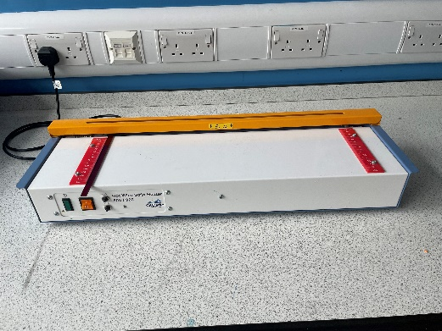
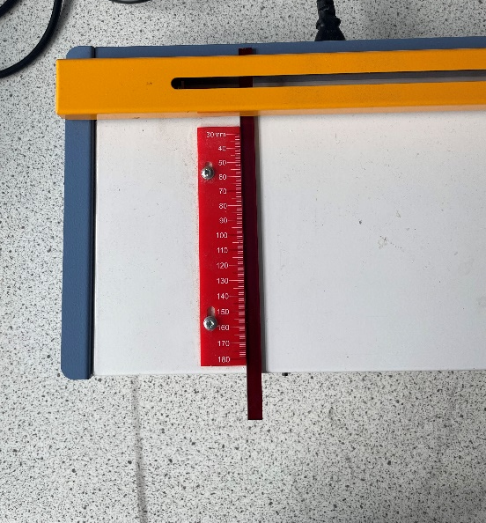
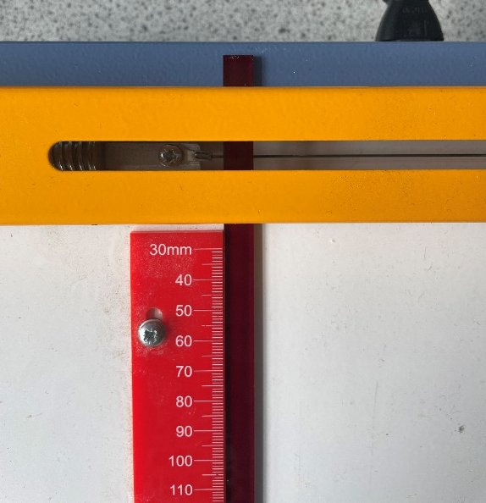
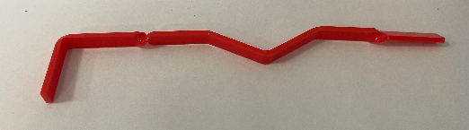
Line Bending
Equipment:
Line bender
10x200mm acrylic strip
90 degree former
45 degree former
Select your strip of acrylic. You are going to create a series of twists and bends along the length of the acrylic.
Line the piece you will fold/bend with the hot wire of the strip heater. You should heat both sides for thirty seconds at a time. You can check if the acrylic is ready to fold by trying to fold it. If it folds easily, it is ready. If it requires force, you need to heat it for longer.
Once ready, bend the acrylic over the 90 or 45 degree former or twist the acrylic to the desired shape and hold in place for 30 seconds to 1 minute.
Repeat this process, moving along the length of the acrylic strip.

Slide 4
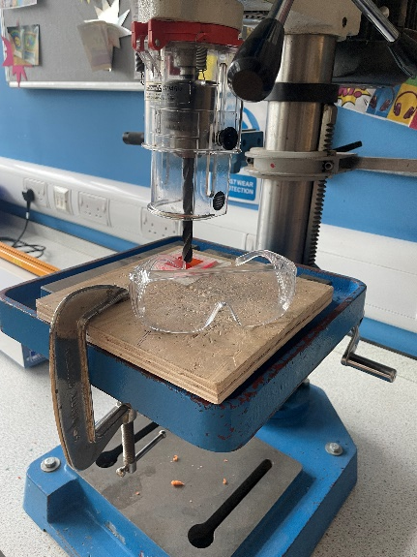
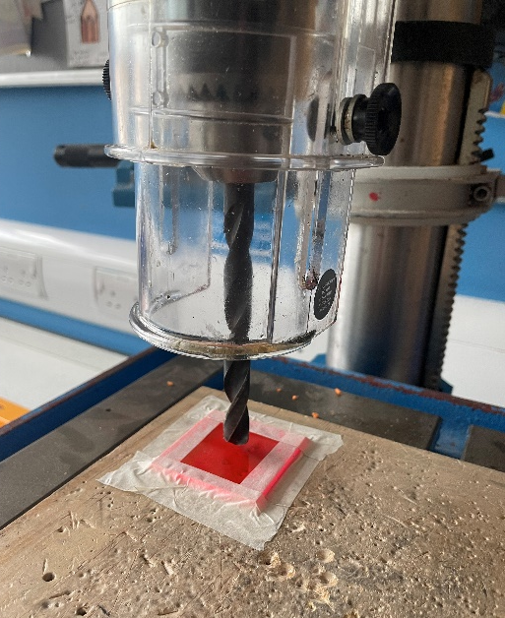
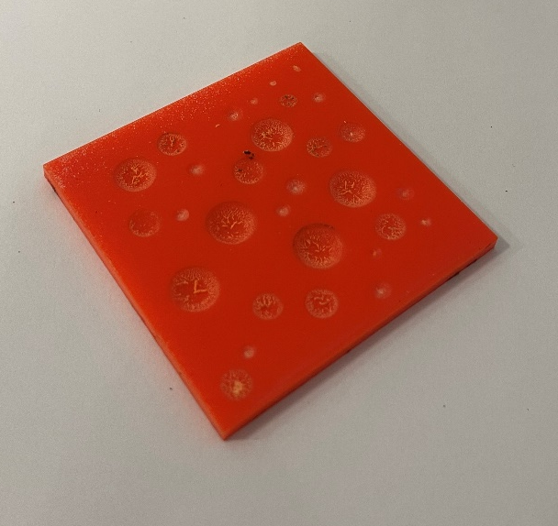
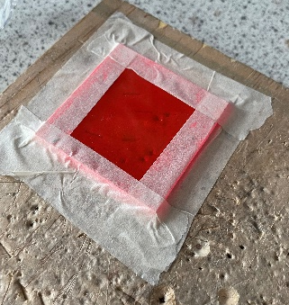
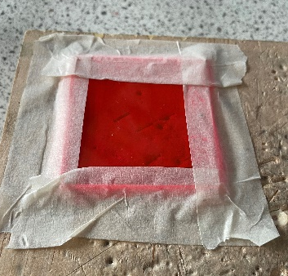
Pillar Drilling
Secure the 80mm x 80mm acrylic square on to the piece of board provided using masking tape (this must be secured as shown in the demonstration and in figure 1 below. Your tape should not be applied loosely as in figure 2).
Put your safety goggles on
Line the acrylic up with the drill bit and hold the board at the edge.
Lower the guard. Turn on the drill. If it won’t turn on try releasing the emergency stop by twisting it.
Lower the drill on to the surface of the acrylic until it creates an indent.
Repeat this process, pulling the drill bit to different depths to create a surface pattern on the acrylic.
Equipment:
80mm x 80mm acrylic square
G clamp
Sacrificial board
Safety goggles
Pillar drill
Masking tape
Figure 1
Figure 2

Slide 5
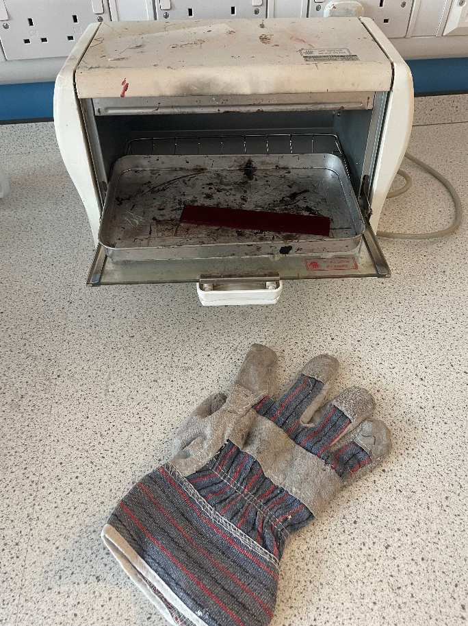
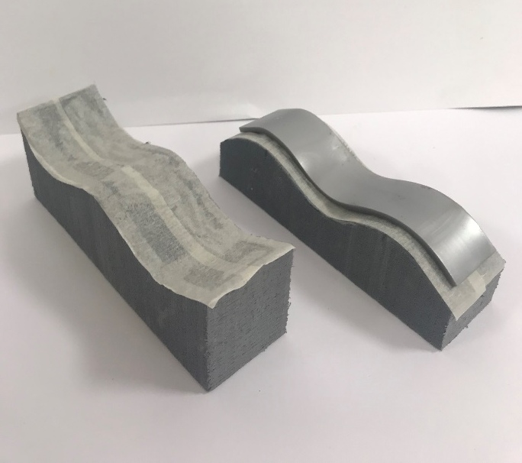
Convection Oven
Equipment:
30mm x 120mm acrylic strip
Heatproof gloves / gauntlets
Convection oven
Styrofoam former
Vice
Put the acrylic shelf in to the convection oven using heat proof gloves.
Leave in the oven for one minute and remove the acrylic. If the acrylic is flexible move on to the next step. If not place the acrylic back in to the oven and check every 30 seconds.
Place in to the former you created and secure in the vice. Do not over tighten.
Leave in the vice for 5-10 minutes and remove.

Slide 6
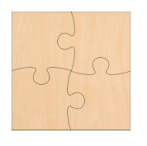
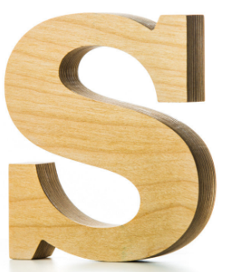
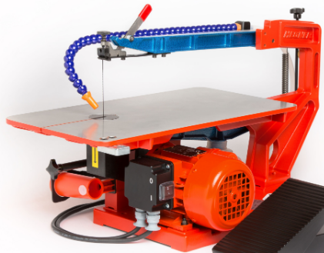
Scroll Saw
Equipment:
Scroll saw
Pencil
Ruler
Safety goggles
80mm x 80mm plywood
Collect 80mm x 80mm plywood square
Use a sharp pencil to mark out a 4 piece jigsaw or your initial on your plywood
Adjust the hold down / guard so it is just higher than the plywood.
Push the blade into the plywood, following the lines. Turn slowly. It is also possible to remove the blade to achieve a sharp angle.
Remember to push the plywood firmly down to the scroll saw table.
Push the red stop button to turn the saw off.

Slide 7
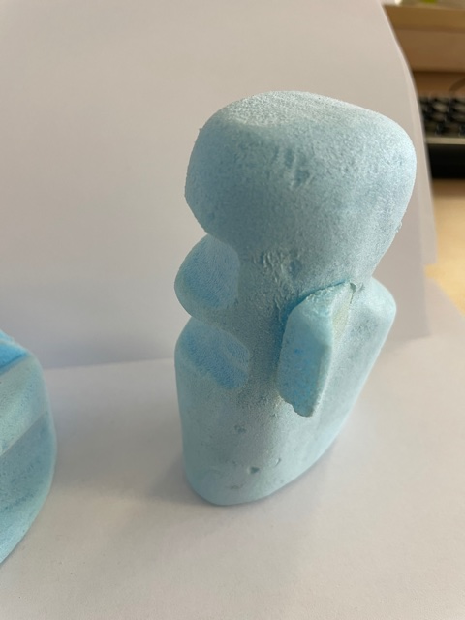
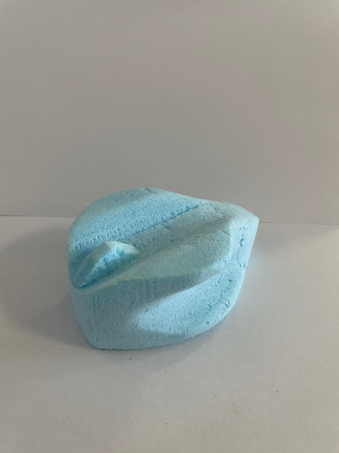
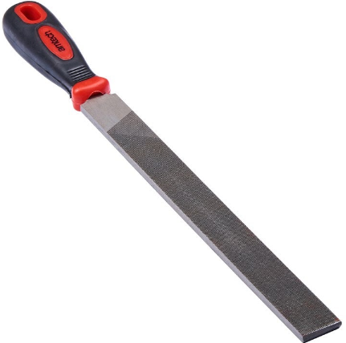
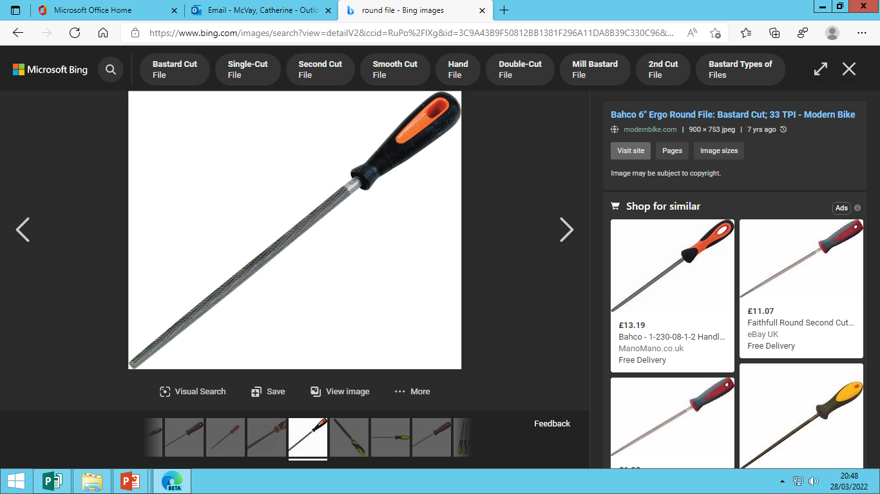
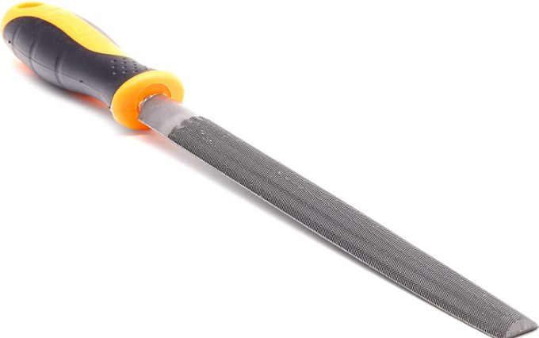
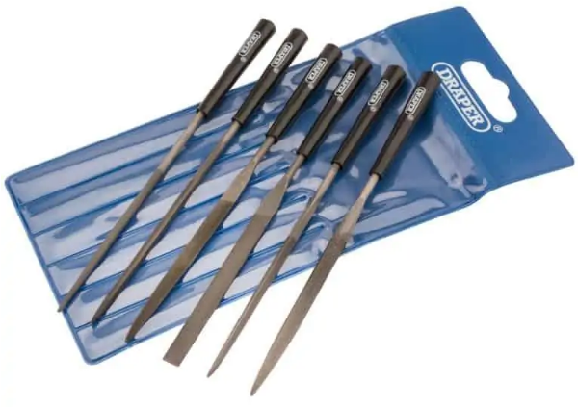
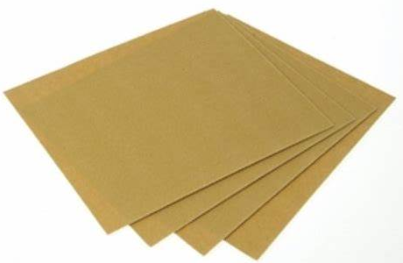
File Forming
Equipment:
80mm x 80mm x 80mm Styrofoam
Flat file
Round file
Half round file
Triangular file
Needle files
Glass paper
Select your 80 x 80 x 80mm styrofoam block.
Secure your styrofoam block into the vice. Use a coping saw to cut the corners away around the edge of the block to begin to form your hand held remote.
Use a range of files to file the shape of your ergonomic handle
Finish with glass paper.

Slide 8
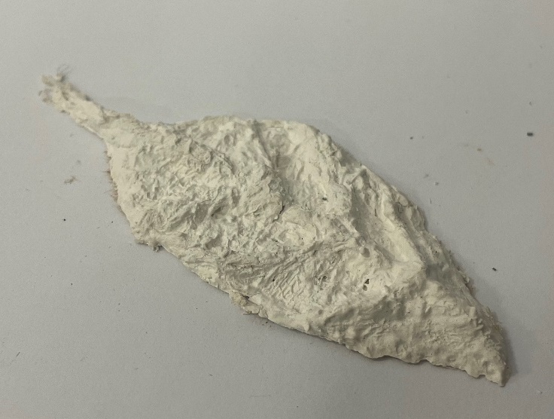
Modroc Former
Take a piece of scrap card and mark out a rectangle 70 x 40mm (this is the maximum size your modroc former can be).
Cut small strips of Modroc and dip them into the water pot.
Once wet, shape them as desired on to the piece of card.
Continue building up layers until your former is at least 3mm in height.
Once completed, write your name on the cardboard and leave to dry in a safe place. You cannot vacuum form with this until at least next lesson.
Equipment:
Mod roc
Scrap card
Water pot half full with water
Scissors

