Slide 1
Bell Task: What is market research?
Option A: Market research is finding out about the stocks and shares market. Knowing how profitable a business is in order to develop new products. Knowing how profitable a business is will allow you to see where successful products have been made or where errors have meant that a product failed.
Option B: Market research is an effort to gather information about the market you wish to place your product into, target markets and customers. You will research your competition and investigate your customers, starting with who they are and including things such as preferences, opinions, sales figures, anthropometric data etc. It is an important component of successful product design and a major factor in creating saleable products.
Option C: Market research is knowing how a design business functions. Researching the day to day tasks a Product Designer, Architect, Graphic Designer etc. will undertake at work. By knowing this you will understand the market which you wish to work within and make the correct career choice.

Slide 2
Bell Task: What is market research?
Market research is an effort to gather information about the market you wish to place your product into, target markets and customers. You will research your competition and their products as well as investigate your customers; starting with who they are and including things such as preferences, opinions, sales figures, anthropometric data etc. It is an important component of successful product design and a major factor in creating saleable products.

Slide 3
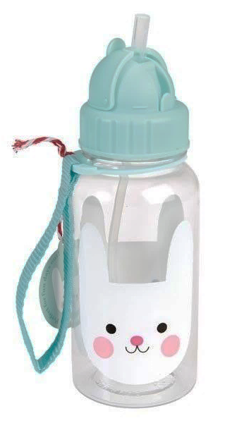
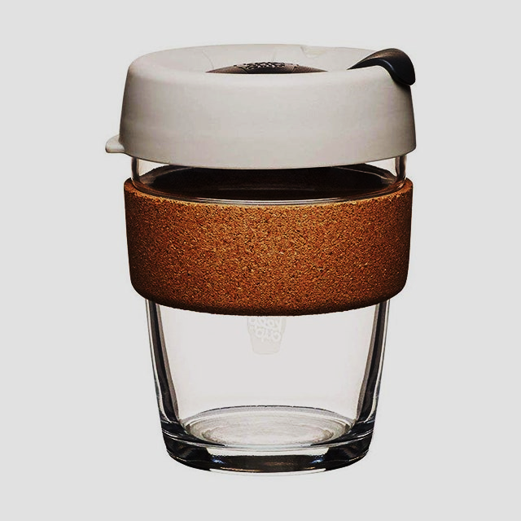
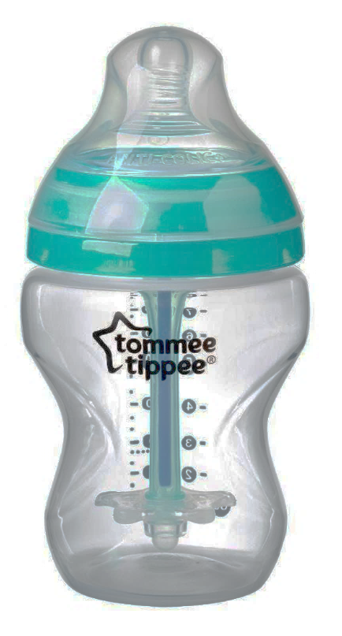

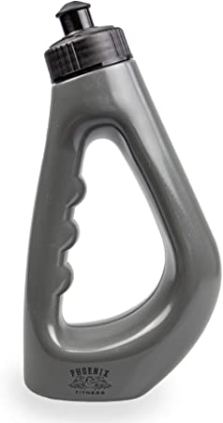

Starter:
Who is the intended customer for each of these drinks bottles / cups?
Why do they all look different?
What forms of research might you carry out to make a new drinks cup / bottle?
Why is it important that designers and manufacturers understand the specific needs of our client / user group?

Slide 4
What is Primary Research?
What is Secondary Research?
Self created / conducted
Trustworthy
Specific your focus / tailored to your project
Usually small scale
Time consuming
Costly
Already complied or created by others
Usually published
Cost effective or free to access
Usually broad scale
Quicker than carrying out primary research
Might not focus on specific area you need
Could be biased or untrustworthy

Slide 5

Primary Research??? Or Secondary Research???
Internet
Books
Observations of users
Interviews
Magazines
Articles
Case studies
Product analysis
Government statistics
Company information
Taking measurements
Official data
Focus groups
Physical material testing
Questionnaires
Newspapers
Radio
The work of others
TV

Slide 6
Investigation Techniques
Primary Research Secondary Research
Observations of users
Internet
Interviews
Official data
Case studies
Magazines
Product analysis
Articles
Books
Taking measurements
Company information
Focus groups
Government statistics
Physical material testing
Newspapers
Questionnaires
The work of others
TV
Radio

Slide 7
Task 1: Collect your file from the box at the back of the room.
Task 2: Collect a post it note from your table.
Task 3: Complete the retrieval task on your post it note without looking in your file for the answers.
Retrieval:
1. Define Market Research…
2. What is Primary Research? Give 3 examples…
3. What is Secondary Research? Give 3 examples…

Slide 8
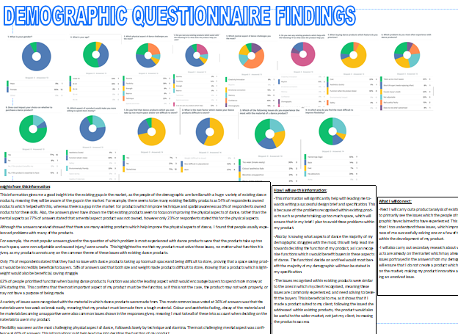
Market research
Questionnaire – Mostly closed questions with a selection of possible answers. This allows for simple data to be collected for a larger number of consumers. Wide variety of topics can be asked which are relevant to information required, graphs and tables can easily be produced from this information.
Advantages
Can be given to a specific target market / demographic
Larger data collection to see an over view of a demographic
Questions can be planned to gain relevant data
Easy / quicker to analyse information than with open questioning
Disadvantages
Only simple to collate data if closed questions used
Do not allow public to give further explanation
Does not allow for ‘meaningful conversation
Uses
To get overview of larger target market / demographic

Slide 9
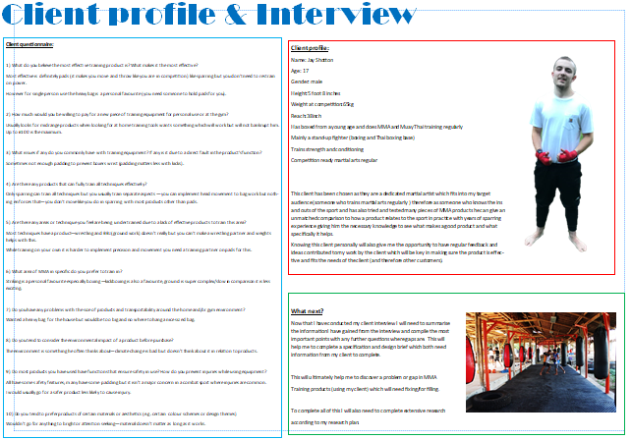
Market research
Interviews – Mostly use open questions to allow the interviewee to expand and explain their comments. These interviews usually take longer than a questionnaire and given a smaller field of responses, but they are useful when creating a bespoke or a batch product for a small target market.
Advantages
Can be conducted with specific client(s) / user(s)
Questions can be planned or adapted at the moment to gain relevant information.
In depth understanding of individual or small group
User centred approach
Allows the interviewee to expand on their responses
Could collect anthropometric data or ergonomic feedback
Disadvantages
Only a small amount of info gained about the wider audience
Time cost
Uses
To understand a specific client or user groups needs

Slide 10

Market research
Focus groups – Open and closed questioning dependant of size of group and type of information required. Audio and recordings of these can help for later reference and checking. There can be interaction with products, components and prototypes to carry out observations as well as questioning. In a focus group conversations and comments can be collected too.

Slide 11
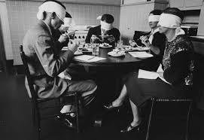
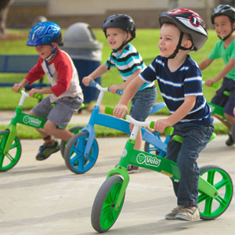
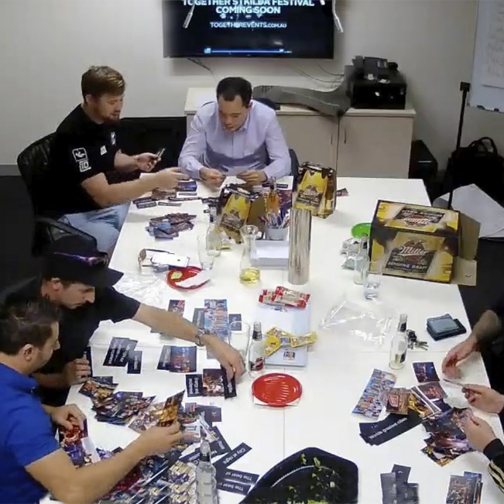
Market research
Focus groups – Open and closed questioning dependant of size of group and type of information required. Audio and recordings of these can help for later reference and checking. There can be interaction with products, components and prototypes to carry out observations as well as questioning. In a focus group conversations and comments can be collected too.
Advantages
Can be conducted with specific client(s) / user(s)
Questions can be planned or adapted at the moment to gain relevant information.
In depth understanding of individual or small group
User centred approach
Allows the interviewee to discuss and expand on their responses
Could collect anthropometric data or ergonomic feedback
Disadvantages
Only a small amount of info gained about the wider audience
Time cost
People can behave differently in focus group situation
Uses:
To understand a specific client or user groups needs

Slide 12
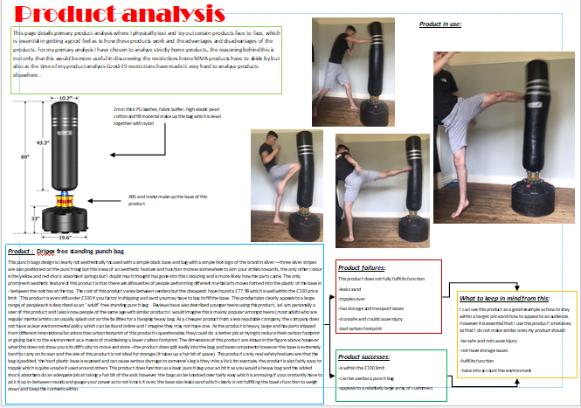
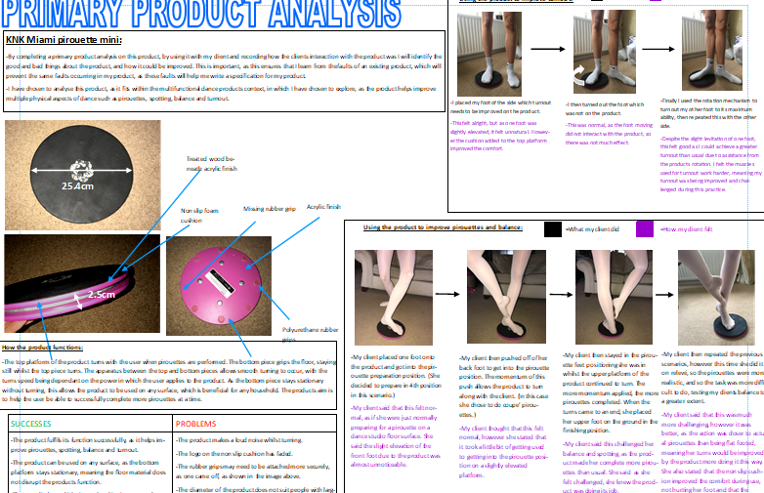
Market research
Product Analysis – product interaction and well as product disassembly can highlight strengths and weaknesses of existing products or competitors products. Can help us understand how a product is made, material qualities, uses, aesthetics etc.
Advantages
Can be conducted with specific products relating to your context
Can understand the current market
Can gain an understanding of what works and what does not work
Gives inspiration
Can be used in a focus group / interview situation
Product can be disassembled
Disadvantages
Cost of buying products
Product analysis over internet is not reliable
Can cause fixation
Uses:
To understand rivals, material and product testing

Slide 13
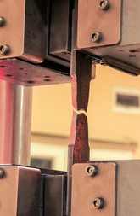
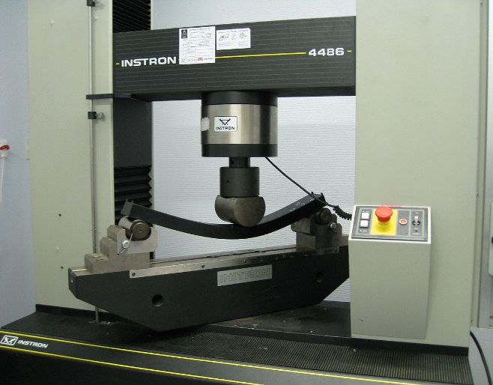
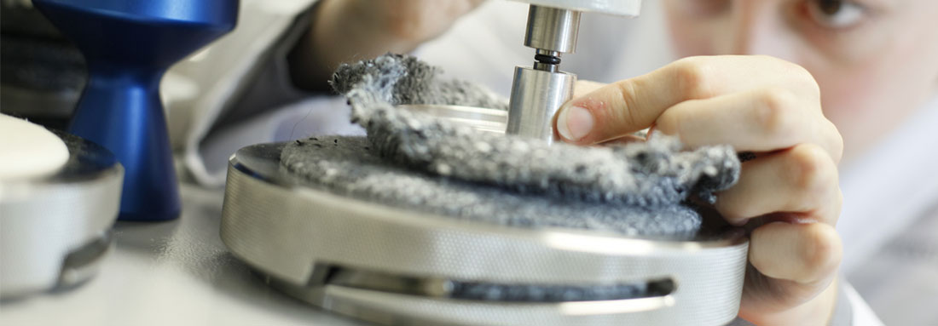
Market research
Material Testing– Using workshop and industrial techniques to test to suitability of a material for the intended product. These tests can look at aesthetic appeal, finishes, weathering, strength, roughness, coloration etc.
Advantages
Can test suitable materials against stresses and environmental factors
Can see which materials will be suitable and make decisions
Can test simple material form, existing products or prototypes
Can be conducted via CAD
Disadvantages
Cost of materials and machinery / software
Uses:
To understand which materials are suitable for your product

Slide 14
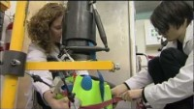
Market research
Material Testing– Using workshop and industrial techniques to test to suitability of a material for the intended product. These tests can look at aesthetic appeal, finishes, weathering, strength, roughness, coloration etc.

Slide 15

Market research
Material Testing– Using workshop and industrial techniques to test to suitability of a material for the intended product. These tests can look at aesthetic appeal, finishes, weathering, strength, roughness, coloration etc.

Slide 16

Starter: Review Quiz
What is market research?
What might happen if we do not carry out thorough market research?
What is primary research?
What is secondary research?
Give 5 examples of possible market research you could carry out / use when developing a product…

Slide 17
Market research – Planning Your Research
Context – Teenage Lifestyles
You are going to design a product to fit with the context of teenage lifestyles. This is a very broad context and at the moment you have no ideas what ‘type’ of product you will make. All you need know is that you will have a client who is a teenager and your product must improve or benefit their lifestyle somehow…
Task : For each form of market research, identify how you will use it to work explore and develop a product for this context. Create an expanded mind map to explore the possible uses of each.
Survey 1 form in each year group
Questionnaire
Closed questions
Planning Market Research
Main challenges?

Slide 18
Market research – Planning Your Research
Context – Teenage Lifestyles
Questionnaire: Who would you survey (age, gender, hobbies, education? What type of questions might you ask? How many people would you survey? How would you show the data?
Interview: Who would you interview? What questions might you ask? Would you give them products to interact with, what products would you give? Would you record your interview?
Focus group: How many people would you include? What type of people would you include? What questions might you ask? Will you be in the room? What tasks will you give them? Will you record your focus group?
Product analysis: Which products would you analyse? Which products might you disassemble? What questions will you ask about each product?
Material testing: Which materials will you test? How will you test them?

Slide 19
Market research – Extension Task
Context – Teenage Lifestyles
You are going to design a product to fit with the context of teenage lifestyles. This is a very broad context and at the moment you have no ideas what ‘type’ of product you will make. All you need know is that you will have a client who is a teenager and your product must improve or benefit their lifestyle somehow…
What information would be useful?
Hobbies?
Age?
School life?
Sport?
Injuries?
Favourite colour?

Slide 20
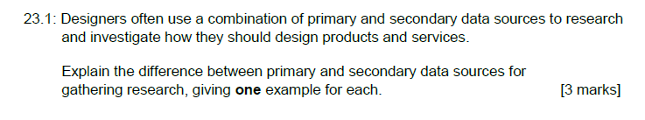
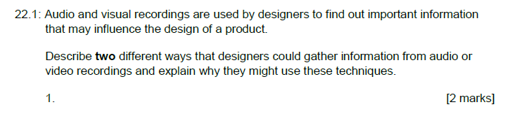
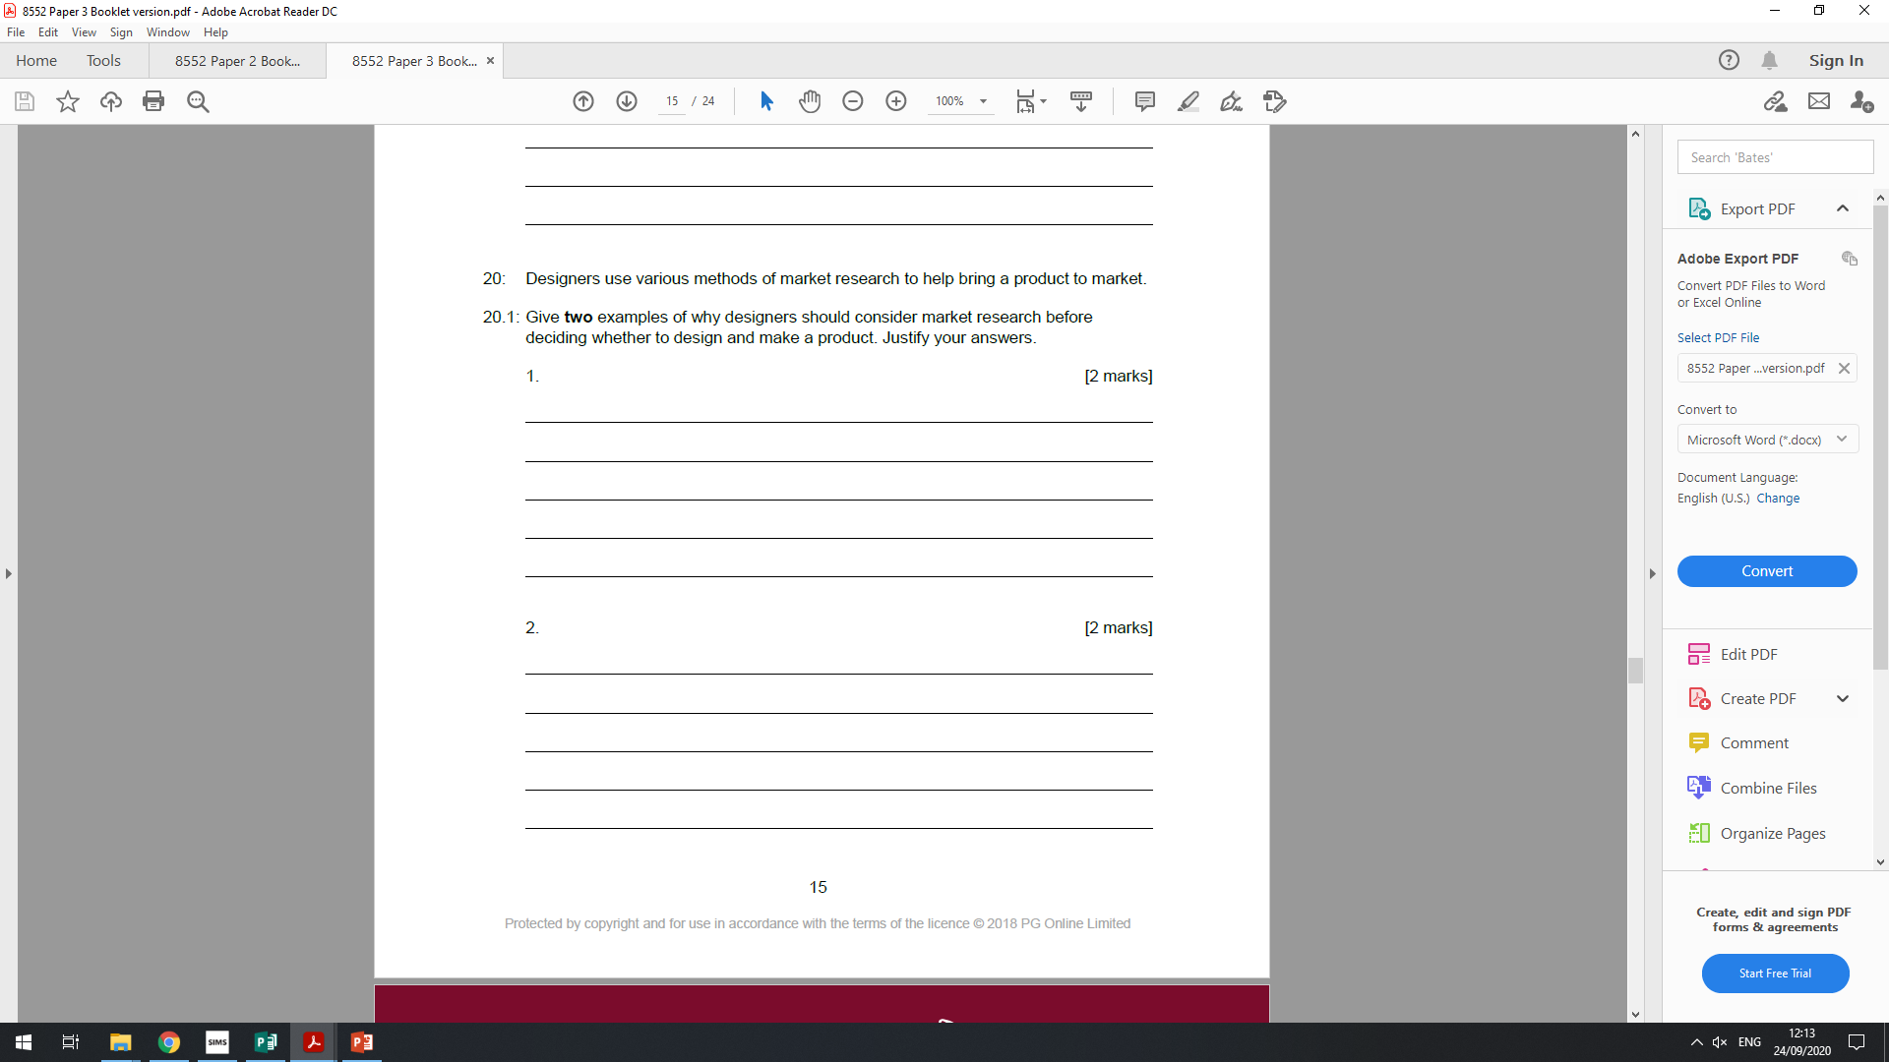
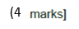
Exam Style Questions
(4

Slide 21
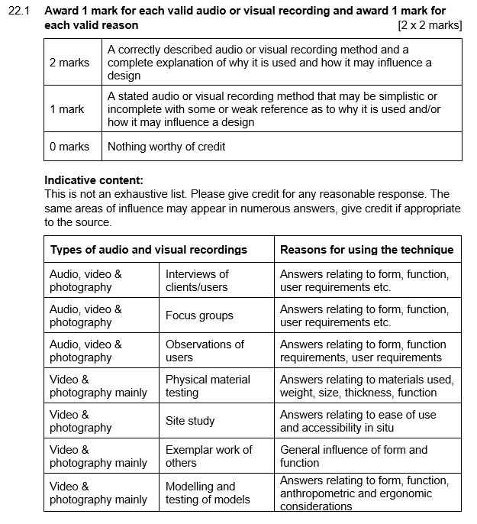
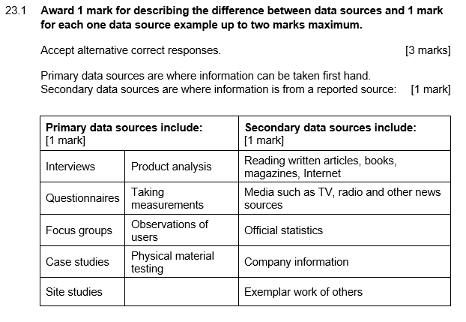

Slide 22
