Slide 1
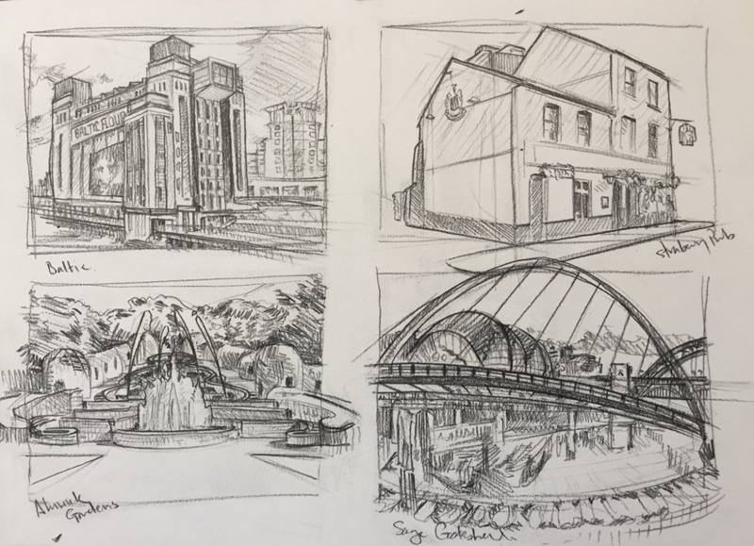
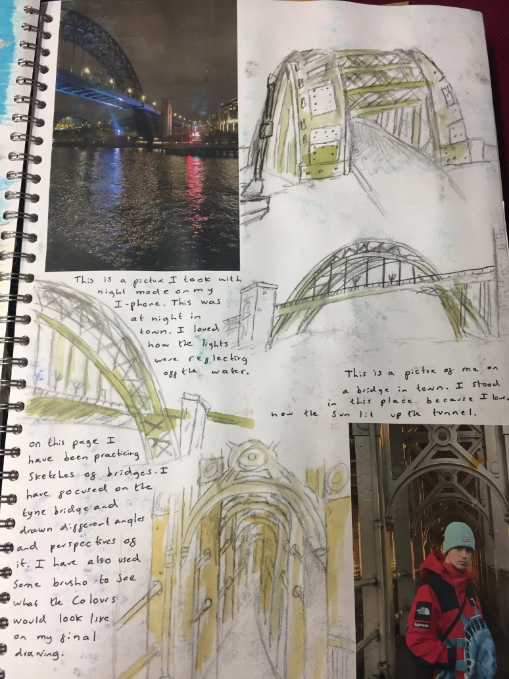
DEVELOPING IDEAS
Lesson 1 Objective: To gather and record new ideas for the theme Northern Lands through sketching interesting compositions
Task
Split up your page into maximum of 4 sections. It’s up to you how you decide to split the page.
Use pencil/graphite stick to sketch out 2-4 different scenes using your research. (Places, people, objects of the North)
COMPOSE YOUR OWN IDEAS BY COMBINING IMAGES TOGETHER

Slide 2
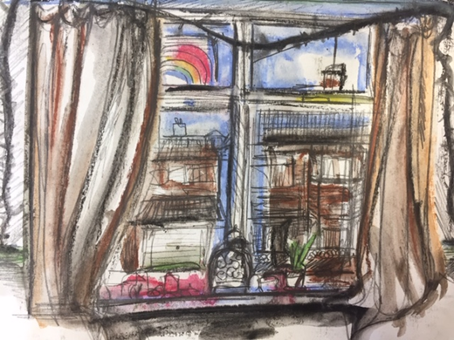
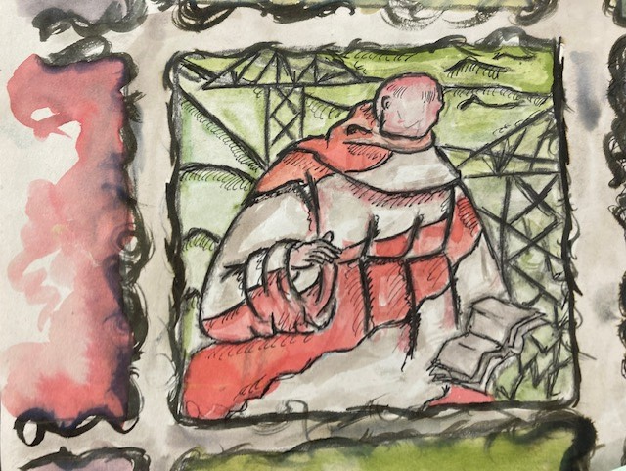
Task 2: Choose & apply appropriate materials for your experimental sketches.
Suggested:
Paint (acrylic & watercolour)
Alcohol markers
Fine liner
Pastels
Coloured pen
Pencil work
Layers of paper collage
Year 10 examples

Slide 3
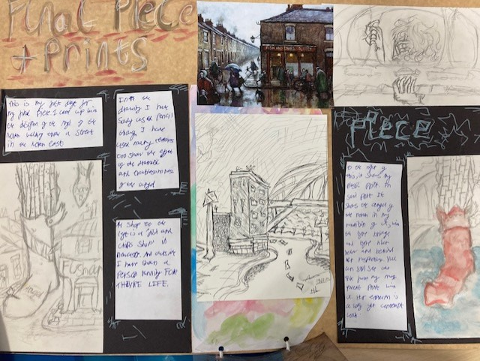
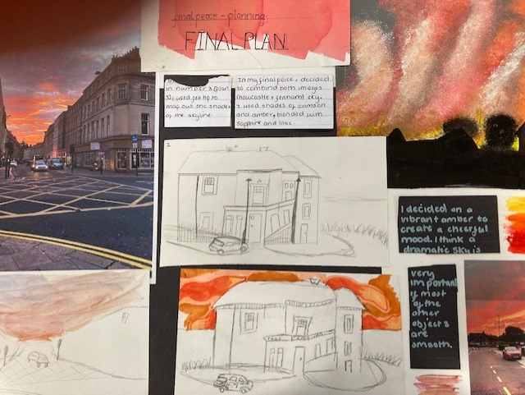
Year 10 FINAL PIECE PLANNING examples
Annotations to explain your ideas
Reference pictures/photos
COMPOSITION SKETCHES IN PENCIL AND PEN
Background painted ideas

Slide 4
Review: Have your experiments today helped you make any decisions about your larger piece? Annotate it!
Can you visually explain and explore your idea through creative experimental development pages?
What have you created today?
Why have you chosen that particular medium or technique?
Has this experiment helped you make decisions about your final piece?
Next I need to explore/experiment with……………………..

Slide 5
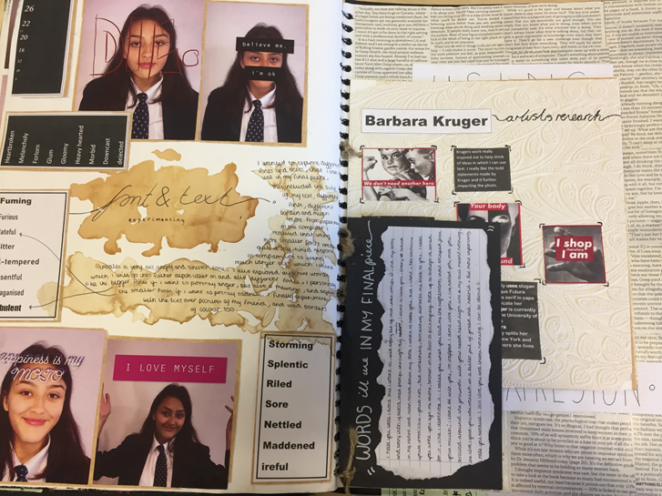
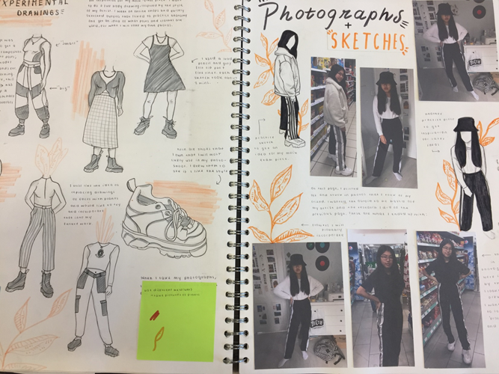
THOROUGH DEVELOPMENT. Have you thought of everything?
Annotations to explain your idea.
Quality photographs to personalise your project.
Exploring your chosen images in your most successful materials.
Different colour palette choices
Different ways of applying the materials
Exploring layouts/composition ideas using drawings/collage of photos.
Background choice.
A mixture of fine drawings and quicker sketches.
AIM: Could I pick up your book and make your piece without you there ?
Can I see your decision making on the page?

