Slide 1
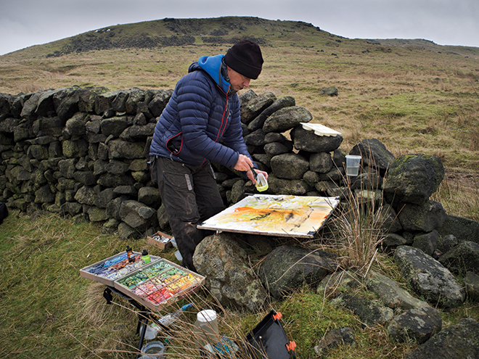
Applying extra layers of materials to drawings and paintings to create greater depth in observational pieces

Slide 2
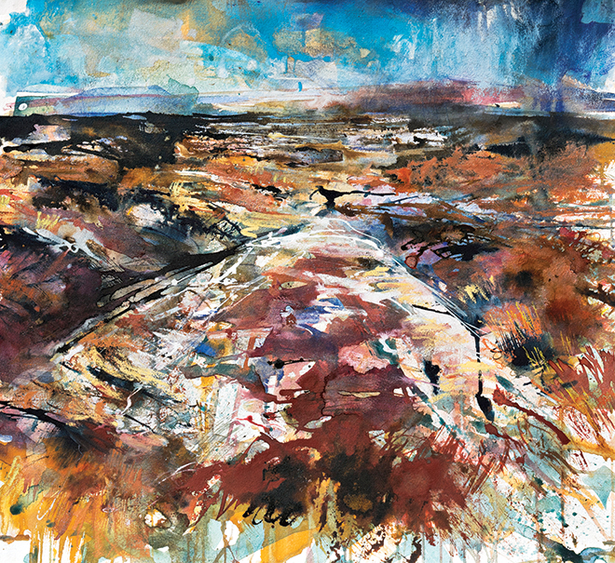
Read about Robert Dutton’s mixed media landscapes
https://www.jacksonsart.com/blog/2016/10/12/expressive-landscapes-robert-dutton/
‘Moorland Solitude’ Acrylic inks, watercolour, gouache and pastel on Canson Moulin du Roy Watercolour Paper, 56x61cm

Slide 3
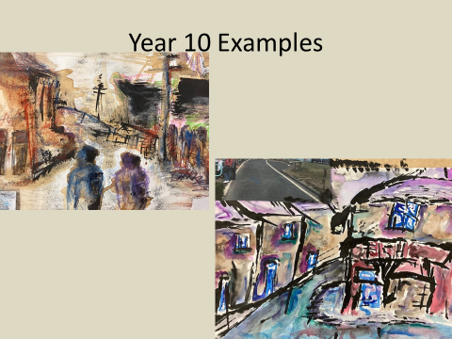
Task:
Plot out the basic shapes of your chosen landscape. (Horizon line is a good place to start)
Start with light washes over your landscape
Dry
Use coloured pens/marker pen to pick out the details
You can use pastel/ paint brush marks to work on top of the first 2 layers

