Slide 1
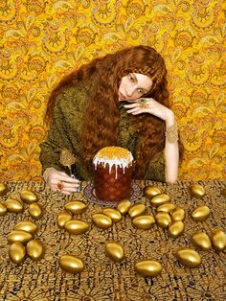
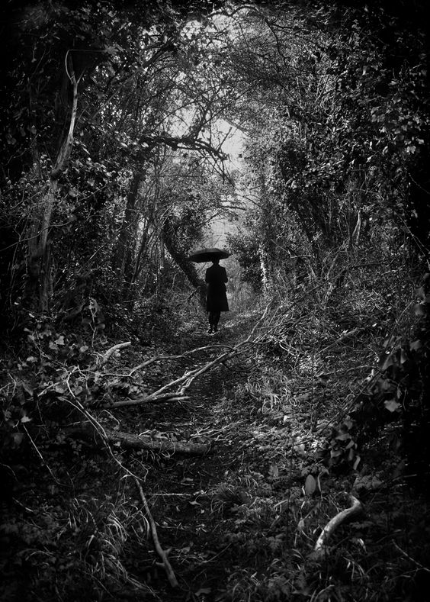
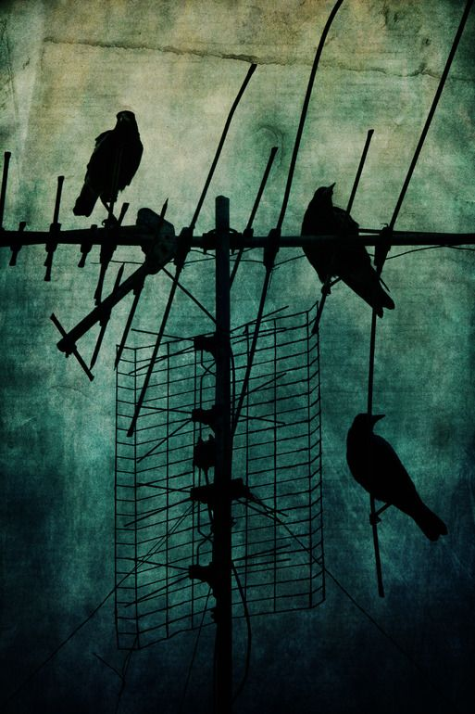
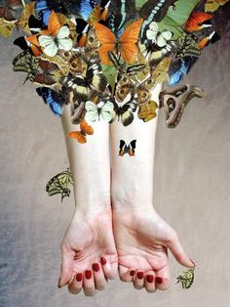
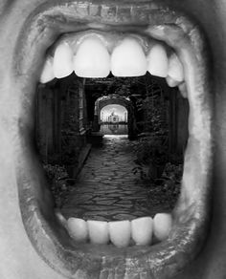
Using Photography to enrich your coursework
Collect and create exciting new Strange & Fantastic images and photographs to give your work some fresh ideas.
A full Photoshoot could look amazing in your books.
Consider:
Subject Matter
What are you going to photograph?
Props/costumes you might need
Location (interior & exterior)
Background (plain or busy)
Camera angle (view from above, below, zoomed in)
Lighting (natural, lamps, candles, torches)
Close ups

Slide 2
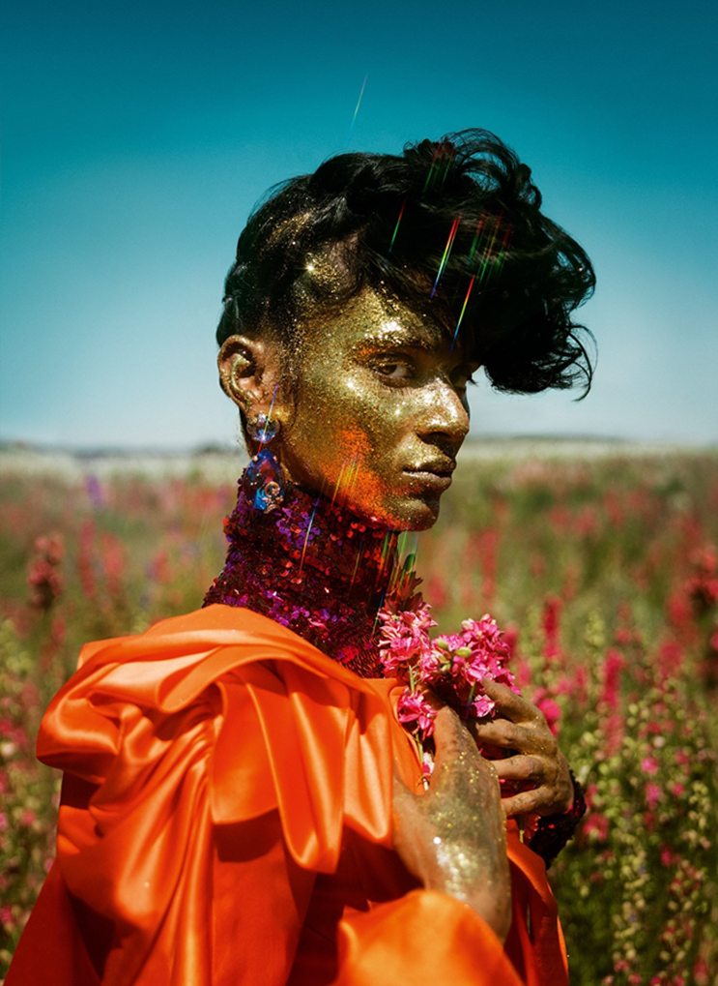
Photoshoots
The best GCSE projects we’ve seen have exciting photographs in them. In fact, some of the photographs are so ambitious and exciting they become part of the final piece and really help students record their ideas.
Explore your coursework theme with some some photography techniques and collect some strong images to include in your project.

Slide 3
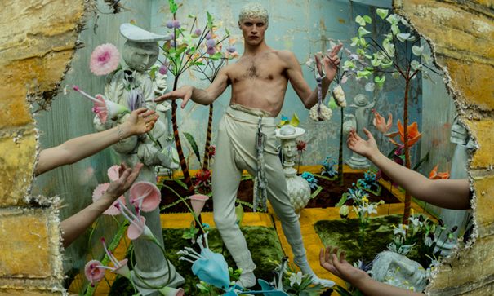

KEY FEATURES
Prop & Set Heavy
Dramatic
Lighting
Pose
Viewpoint/Awkward poses and angles

Slide 4
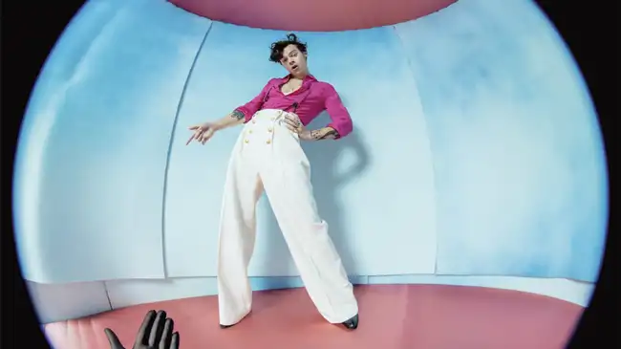
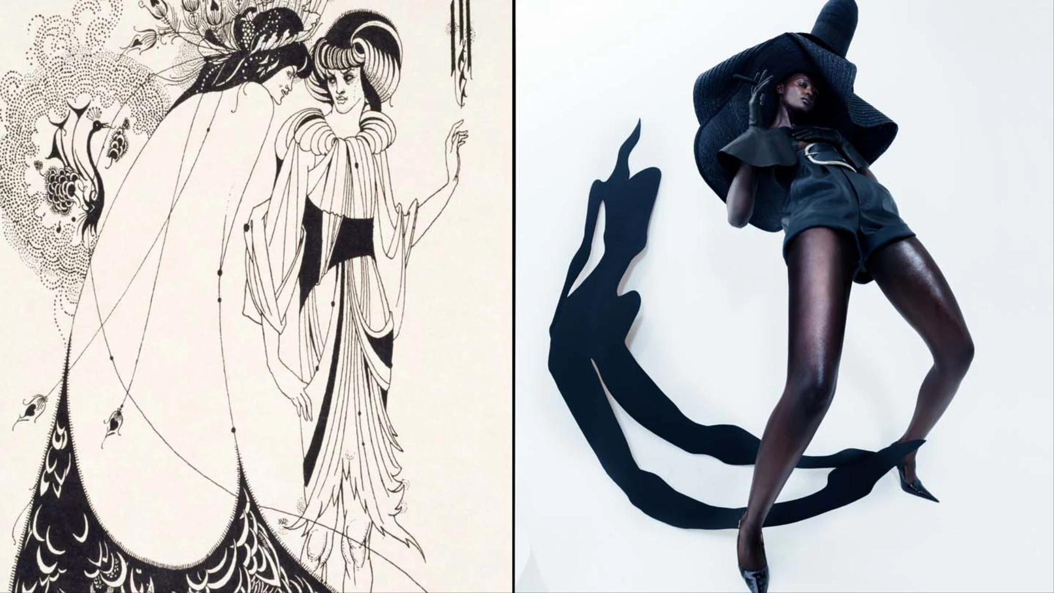
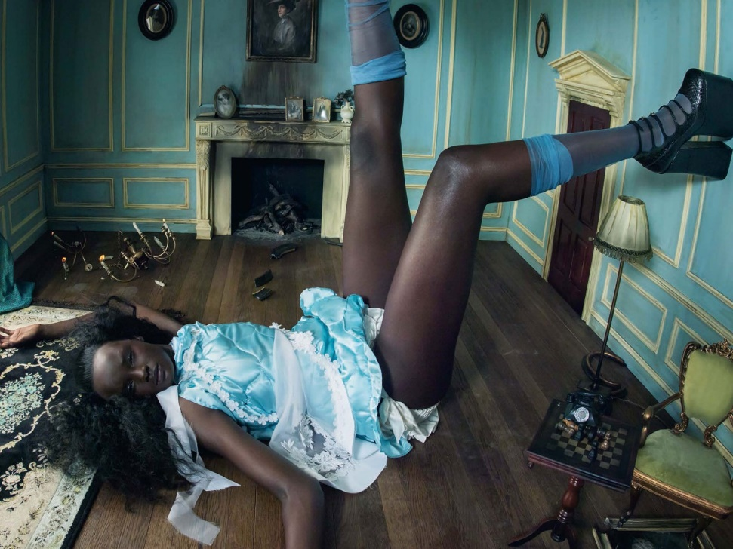
Story telling
Fun
Power poses
Figures given height over the viewer

Slide 5
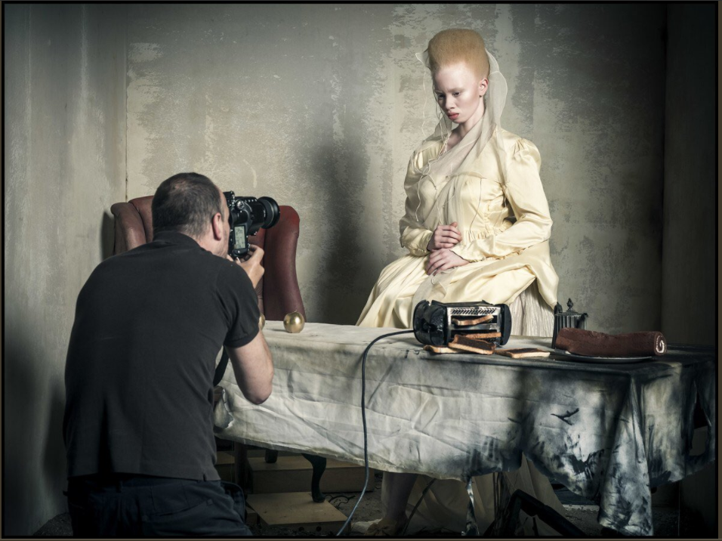
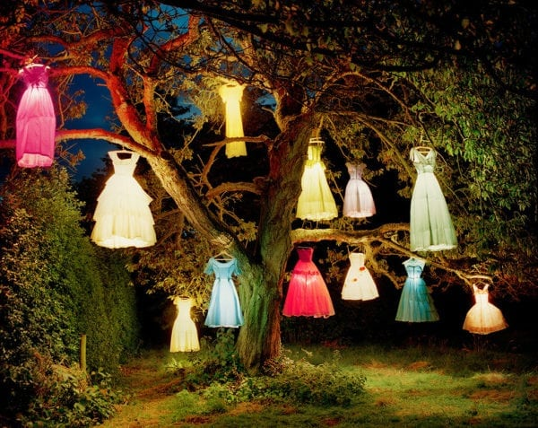
Tim Walker, The Dress-Lamp Tree, England, 2002
At what point does fashion photography become art? A new show at the Getty Center in Los Angeles explores the art of fashion photography at its most creative. Tim Walker, a photographer whose set-heavy images often dip into realms beyond our traditional understanding of fashion—to theatre, installation and more—does away completely with the notion of models in the above image, hanging various inner-lit dresses from a large tree.

Slide 6
Could you borrow ideas from Tim Walker about striking poses, awkward angles, maybe you could include over the top props and costumes! Perhaps, you don’t even need a model, what about creating something like his dress tree?

Slide 7
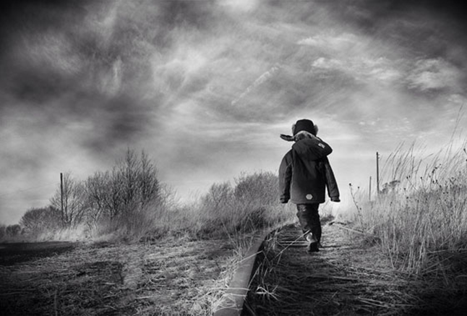
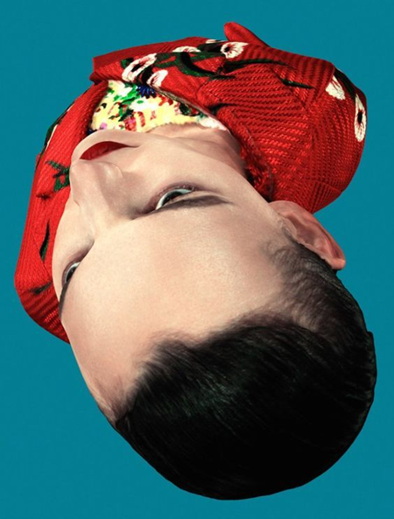
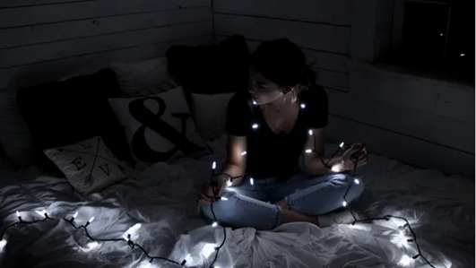
OTHER THINGS TO CONSIDER FOR YOUR PHOTOSHOOT
Look at the next few slides before you take your photoshoot or photoshoots.

Slide 8
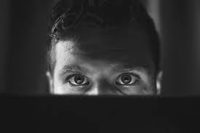
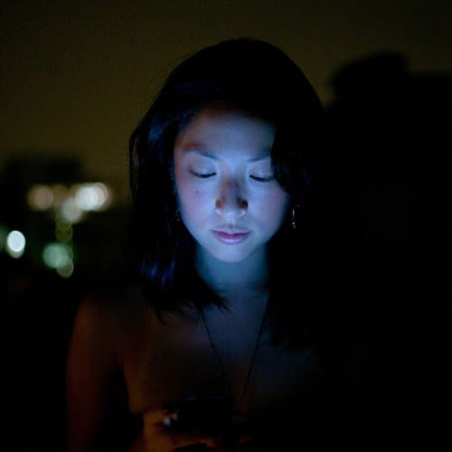
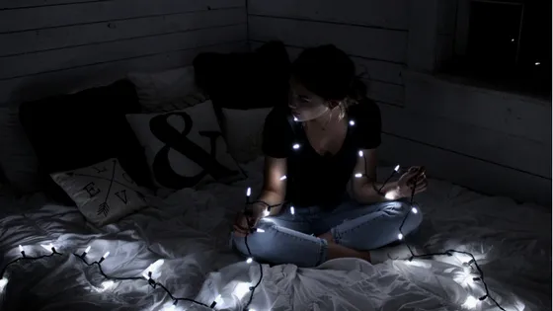
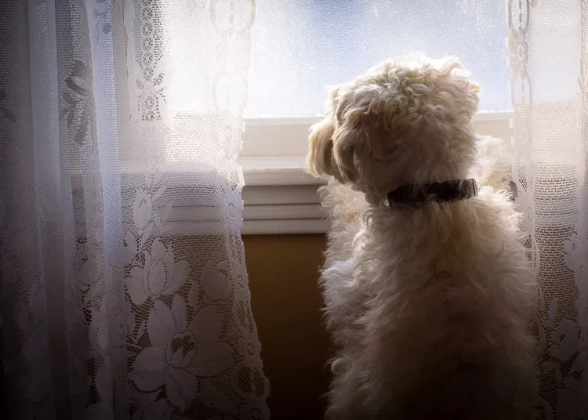
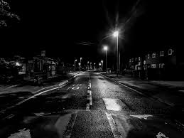
LIGHTING CREATES MOOD
Experiment with lighting.
Could you use natural light, torches, candles, fairy lights, lamps, street light, light from a phone or laptop screen, window light? What time of day will you take your photographs?

Slide 9
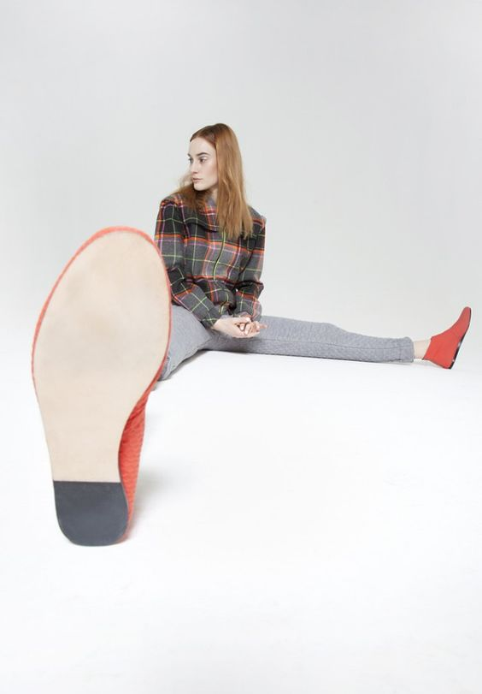
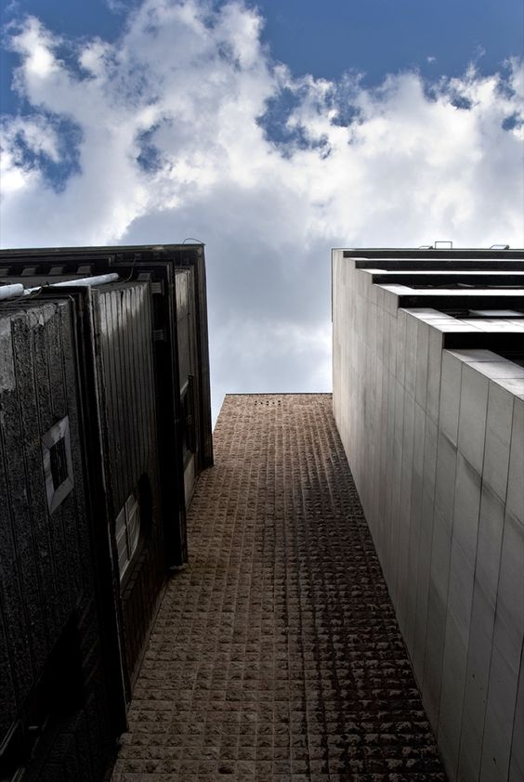


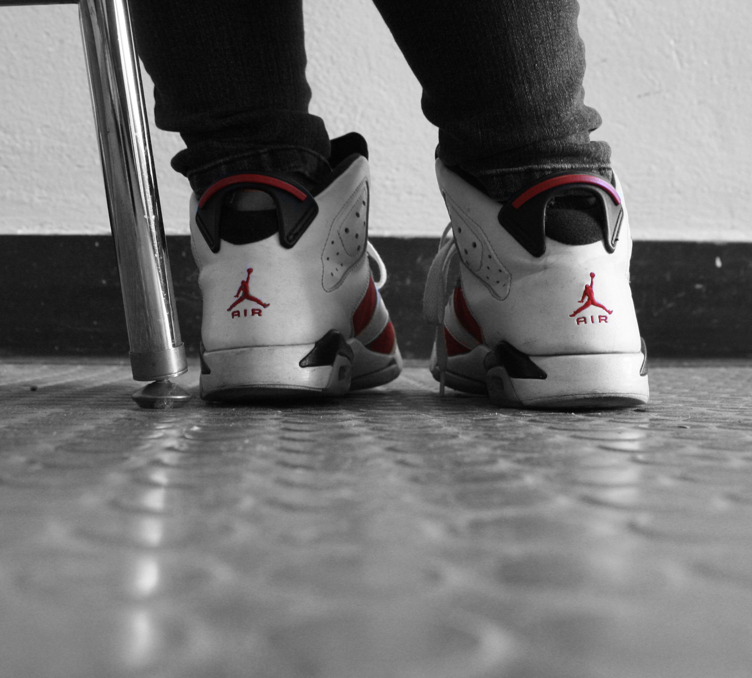
CHANGING THE VIEWPOINT & ANGLE CAN MAKE NORMAL THINGS LOOK STRANGE & FANTASTIC.
THINKING ABOUT YOUR THEME AND THE OBJECTS AND PEOPLE YOU ARE SURROUNDED BY. PHOTOGRAPH THEM FROM A RANGE OF ANGLES.
LISTEN TO ADVICE ON PHOTOGRAPHY
Change the angle that you shoot from
Lie down on the floor
Shoot under or below things
Birds eye view
Zoom right in on something
Take a photograph from a reflection
Take a photograph from above your subject.

Slide 10
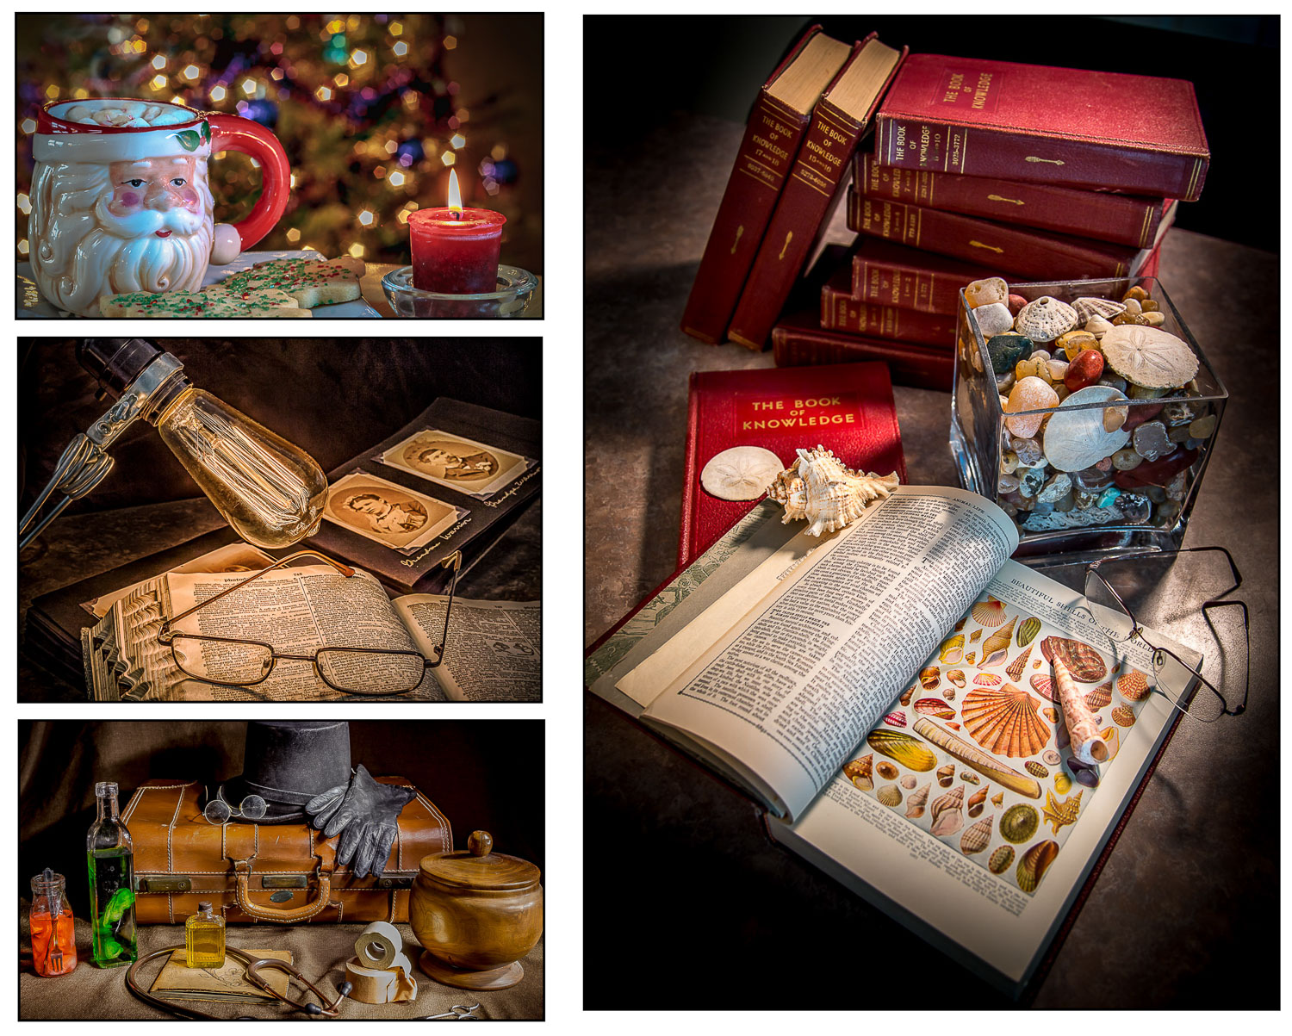
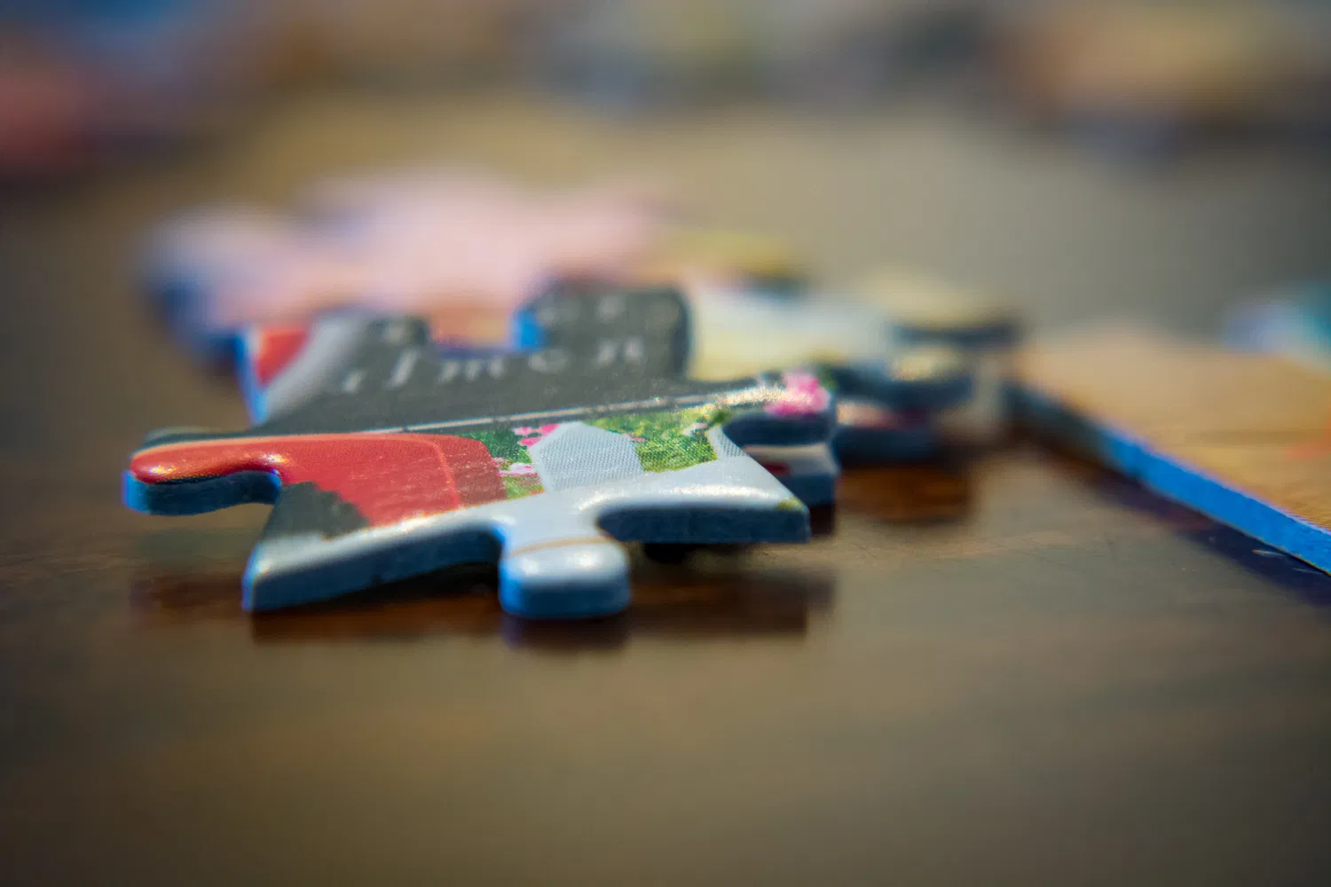
Use your photographs to tell a story!
Use your objects, background, lighting, camera angle, and whatever other photographic tricks you can summon. Your objective is to make the viewer see the story in your photo. A picture can be worth a thousand words, if you choose those “words” carefully.

Slide 11
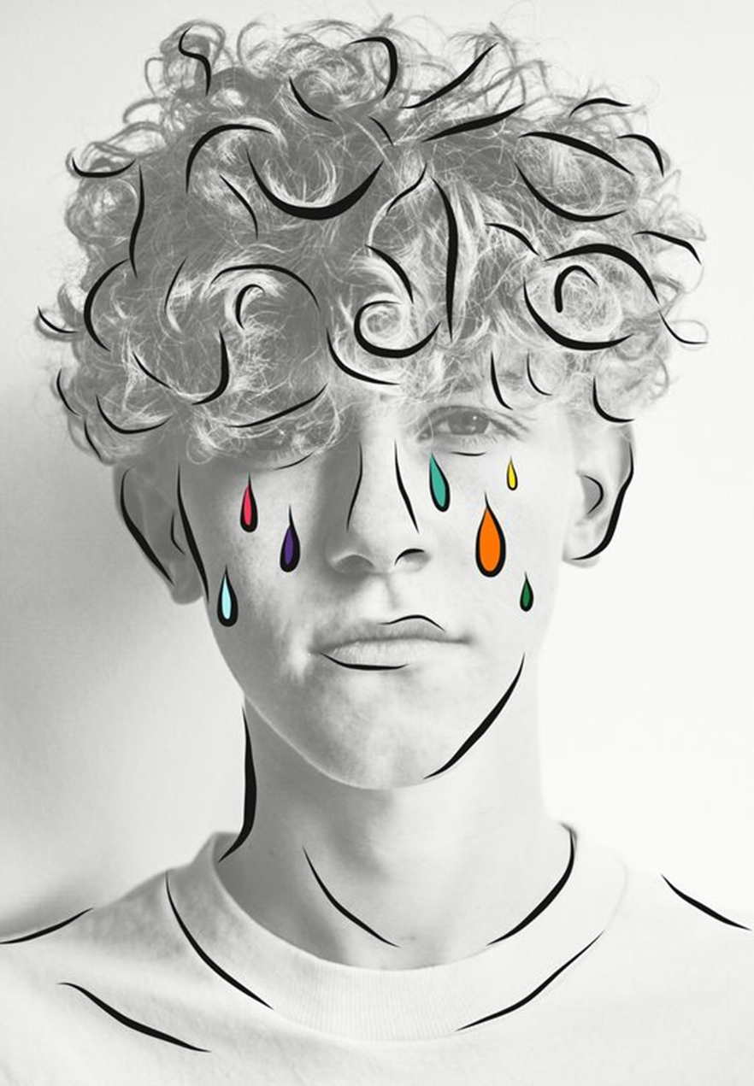
Take a photo and edit it using free apps, filters and drawing tools.
When confident try doing your own digital artwork without using an image underneath.
You could do this using your own photographs or FOUND images from the internet.
EDITING APPS FOR FREE
Digital drawing/editing apps:
Tayasui sketches
Glitchlab
Mirrorlab
Hypocam
Instasquare
Photoshop express
Hipstamatic
Pixlr
Snapseed
Fragment
Kaleidacam
Prisma
Instagram Layout
PhotoPea - www.photopea.com
Pixlr
VSCOcam
Tiny Worlds (99P)
Autodesk sketchbook
Snap seed
FXStencil
Vinci
Prisma
1

Slide 12
