Slide 1
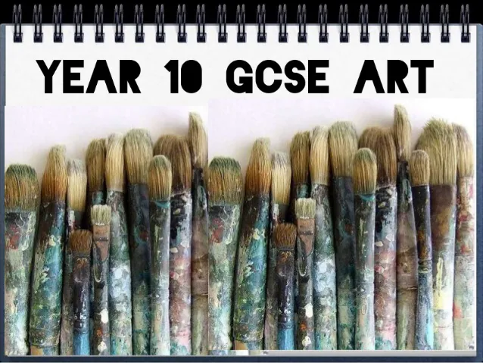
Presenting visual work in an imaginative, clear and coherent manner
1. A02 Reviewing and refining (improving) your work through written annotations.
2. A03 Learning to presenting and recording your ideas in a clear and creative manner.

Slide 2
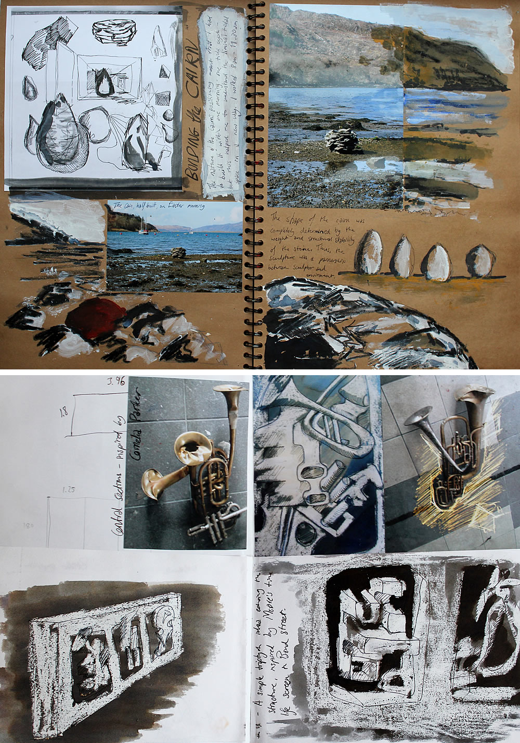
IDEAS AND EXAMPLES
Place photographs/images alongside
your own drawings and paintings.
Give everything enough room on the page/board.
Include fine work and looser sketches.
Small areas of annotation to show you
Are reviewing your work as you go!

Slide 3
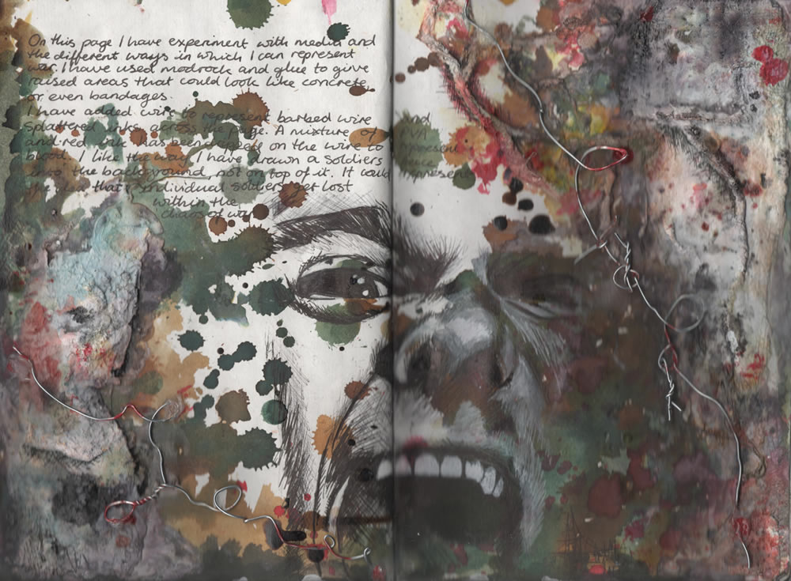
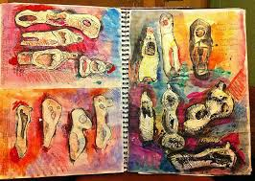
Backgrounds can be added if it helps the artwork stand out.
Washes of colour, paper backgrounds are worth considering

Slide 4
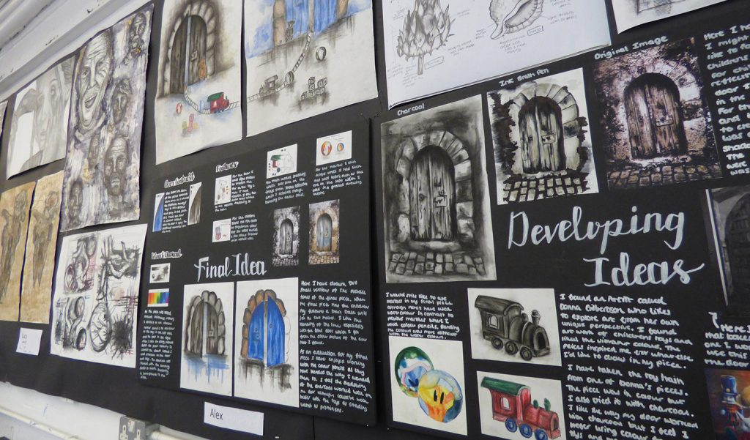
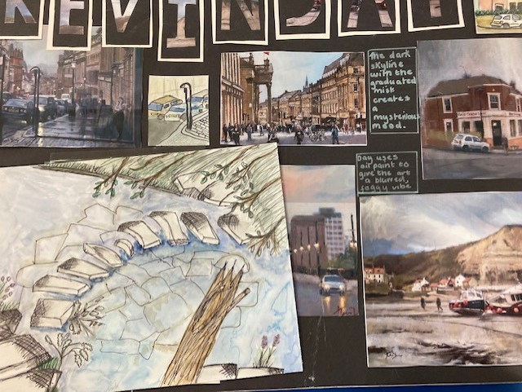
Keeping it simple with plain backgrounds can make your work look wonderful

Slide 5
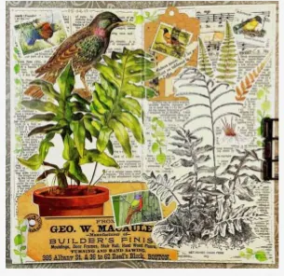
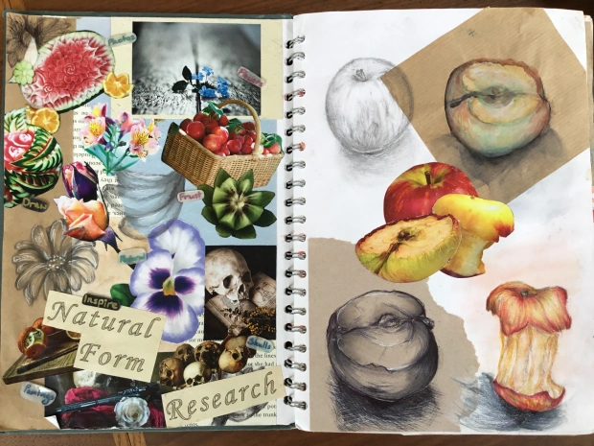
Over lap drawings if you wish and consider different coloured backgrounds/papers.

Slide 6
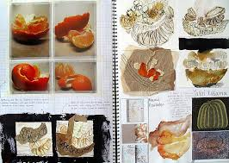
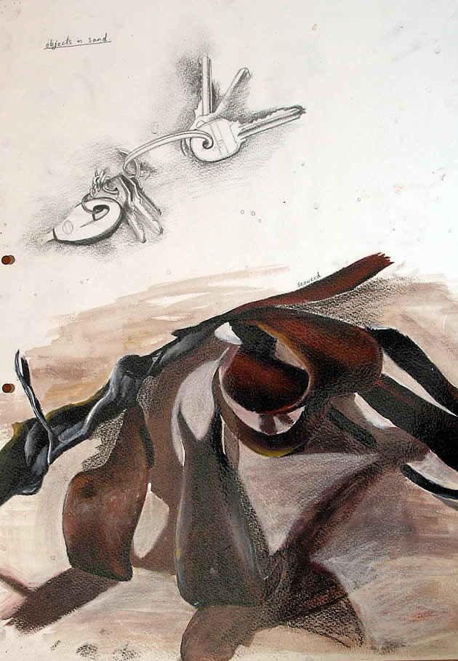
Fill gaps on pages with extra sketches and studies linking to the theme.
Suggested:
Zoomed in studies
Loose sketch from a slightly different angle
Cutting up an image and drawing in the missing parts
Adding extra images/photos
Add appropriate backgrounds where neded

Slide 7
Review: Annotate it!
Can you visually explain and explore your idea through creative experimental development pages?
What have you created today?
Why have you chosen that particular medium or technique?
Has this experiment helped you make decisions about your final piece?
Next I need to explore/experiment with……………………..

