Slide 1

Observing details and textures more closely from first and second hand images and objects to improve accuracy in drawings and paintings.

Slide 2
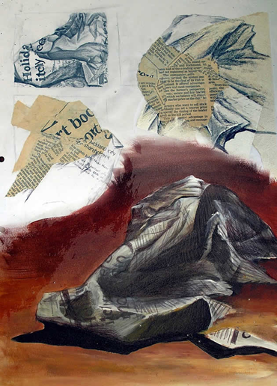
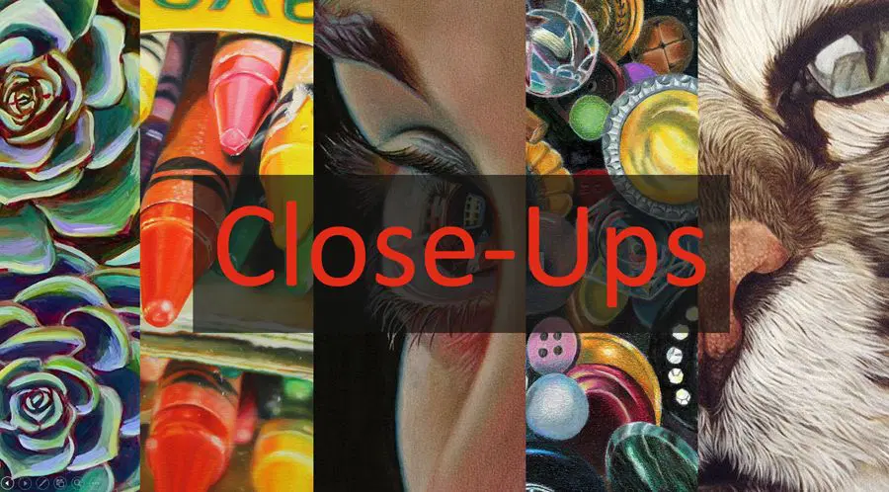
Read the article
https://theartyteacher.com/artists-who-create-close-ups/

Slide 3
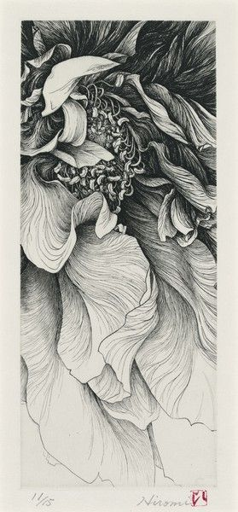

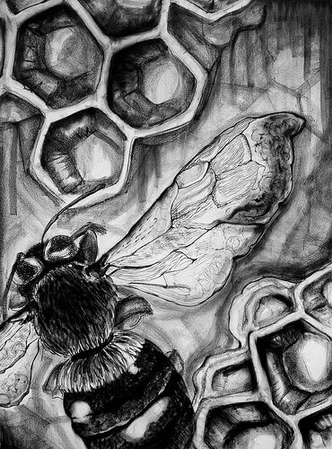
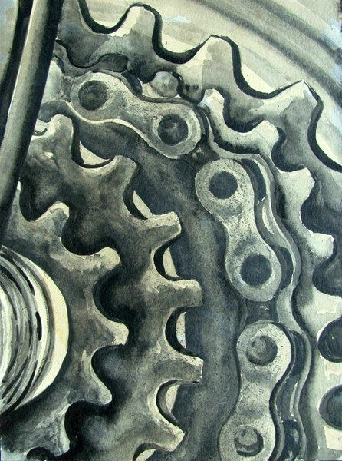
Close ups examples

Slide 4
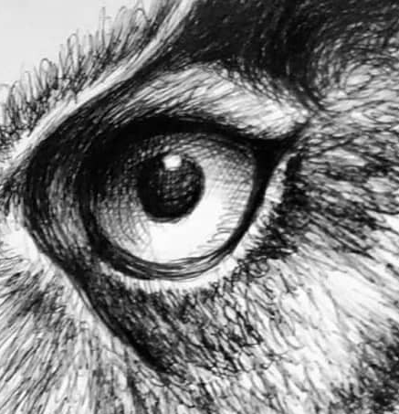
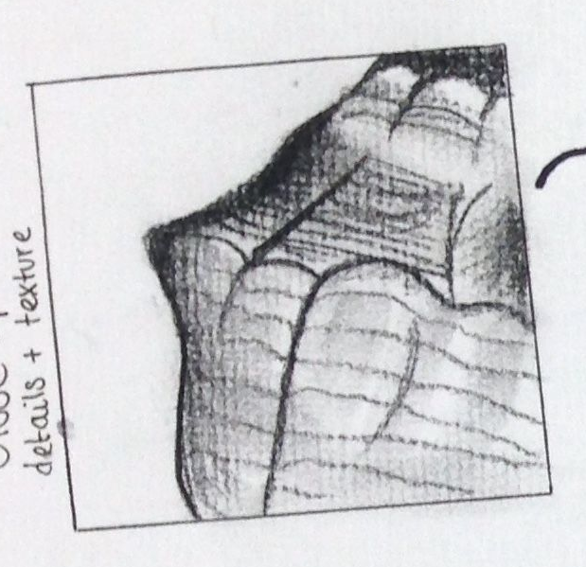
Creating your own close up
1/ Take a photograph of an interesting texture.
2/ Draw a box
3/ Use your phone to zoom in on the object so it may look like this
4/ Next use lines to focus only on the surface of the object

