Slide 1
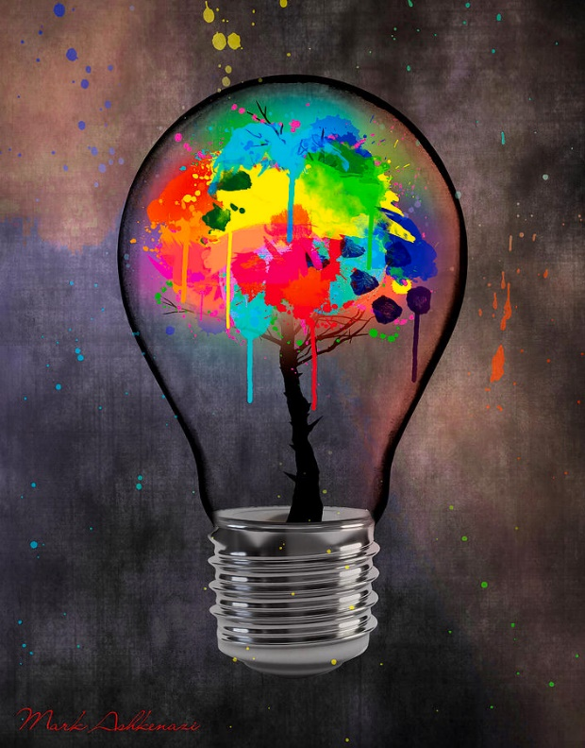
DEVELOPING IDEAS
Idea 1
(Connect to previous ideas and research)
Draw out the ideas clearly
The most successful art works and experiments of my project so far are
1)
2)
3)
Review each idea through a short annotation.
Idea 2
(Connect to previous ideas and research)
For my final piece I would like to
Explore ____________________
Combine____________________
Use ________________________
Create ______________________
Idea 3
(Connect to previous ideas and research)
Ensure you have experimented with different compositional layouts materials, techniques, colour palettes and backgrounds.
Things to consider –
Art material
Composition layout ideas
Surface
Foreground
Background
Layers
Technique and application
Colour palette
Scale
2D/3D/Canvas/Board/Found object
The artist/research/photography that will inspire this work is _____________
This will be communicated within the artwork via ______________________
________________________________
Final Idea
Even when you have found your best idea you can make it even better for your final piece.
HAVE YOU GIVEN ENOUGH DETAIL ON THE FINAL COMPOSITION?

