Slide 1
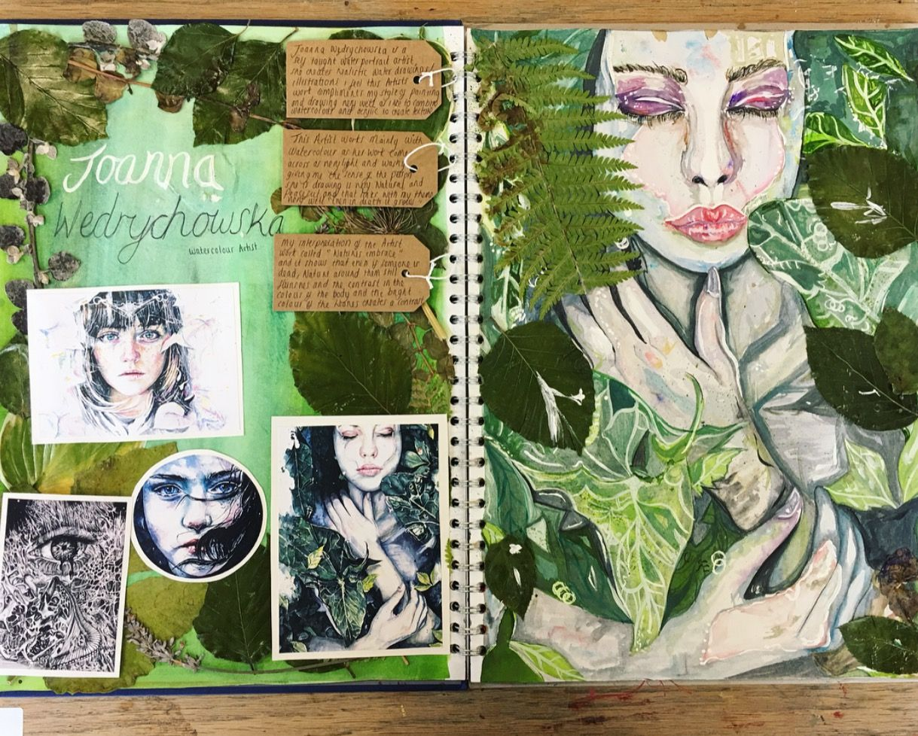
This week Assessment Objective Focus: AO1
Develop ideas through investigations informed by contextual and other source demonstrating analytical and cultural understanding (Artist research & development of ideas using research)
Student has used similar materials to the artist and added their own embellishment
Images and written responses are well presented
Suitable background

Slide 2
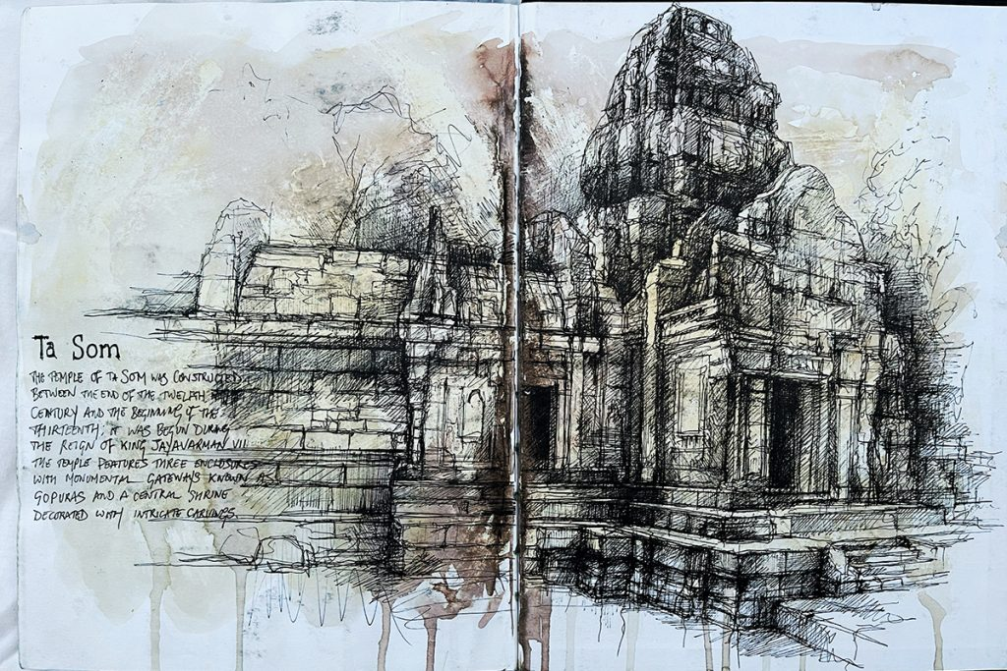
Artist Part 1
Look at Ian Murphy’s work.
Read out about his technique and answer the questions on the next slides.
https://www.ianmurphyartist.com/about/
VISUAL ANALYSIS CREATED BY THE STUDENT IN THE STYLE OF THE ARTIST!

Slide 3
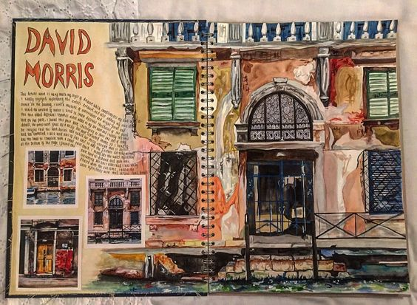
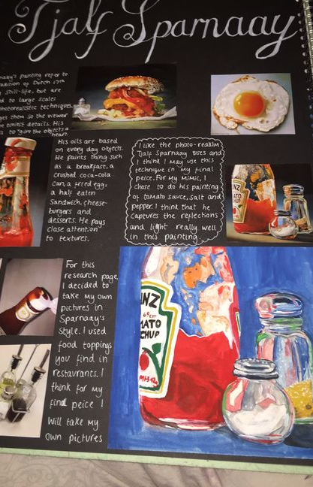
Examples
High quality work in the style of the artist
Looks like the most important part of the page
Student has taken their own photos using the artist

Slide 4
Jealous Curator
Tate
Saatchi Gallery
This is colossal
The Art Story
Pinterest
Artsy
Art2day
TheCoolHunter
Artnet
LensCulture
Museum of Modern Art
HOW DO I FIND AN ARTIST TO RESEARCH?
TRY THESE SITES

Slide 5
Looking for an artist to inspire your project?
https://www.artistaday.com/?page_id=17683 This website is great for seeing thousands of artists and you can even look at top ten results for specific themes. E.g. work featuring butterflies.
You don’t need to select artist now, but it might be useful to jot some names down of any artists you like the look of.

Slide 6
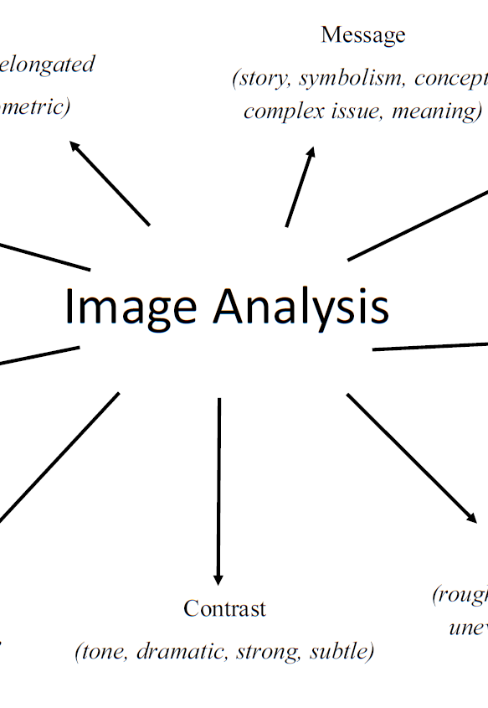

Slide 7
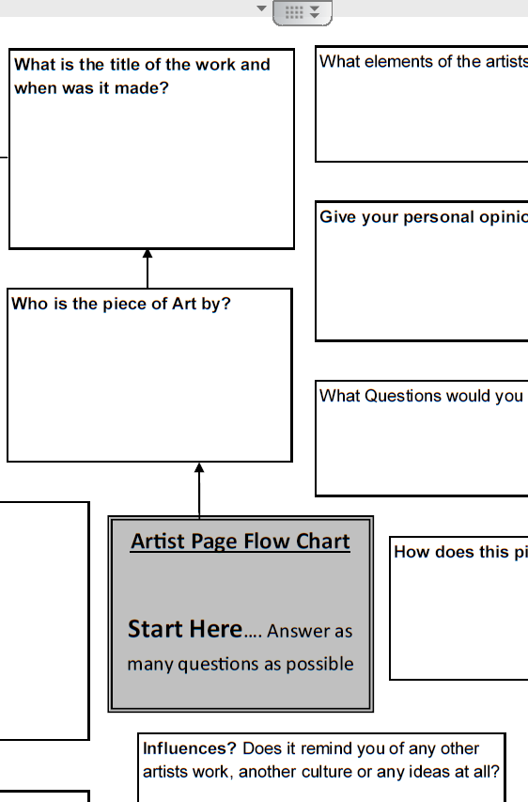
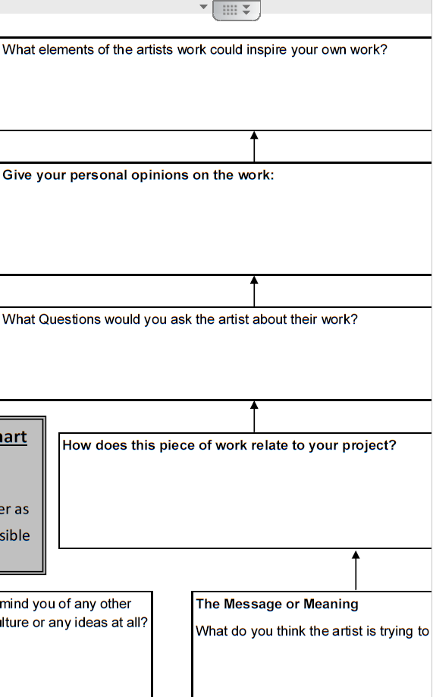
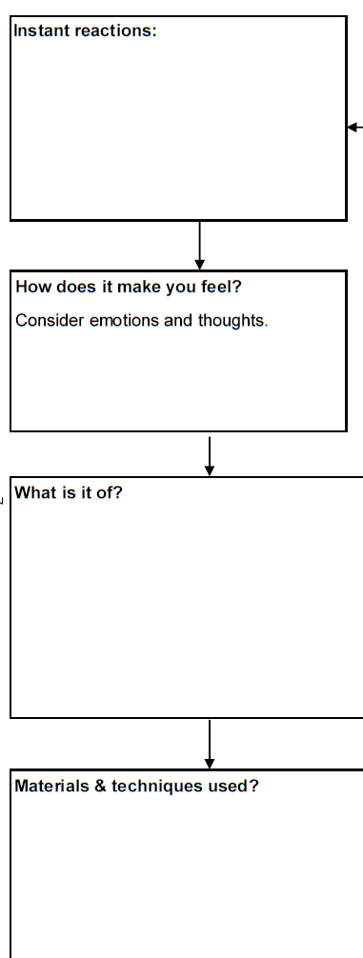
Can you use the keyword and prompts to add any more detail to your written analysis?

Slide 8


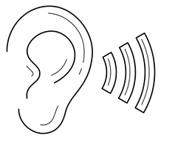

ARTIST QUESTIONS
What do you see?
Start by using your senses to note down what you feel. Use your imagination! ☺
1.Describe what do you see in the piece of art? Is there a clear style? Use the keywords to help.
2.What do you feel when looking at the artworks? (mood/atmosphere) e the keywords to help.
3. Does the artist give any clues about the subject? (e.g. the character of the model; type of place )
4. How does the artist apply the materials? (e.g. colours, brush strokes, detail, line, loose, composition)
5. Why did you select this particular artist for your project? And how could you use their style or techniques in your own work?
Can you tell what it feels like? Use your imagination
Does this piece of art make a sound? What can you hear?
Does it remind you of something you’ve experienced before? (use your memory)

Slide 9
LINE
Short; flowing; scribble; loose; sweeping; tight; broken; faint; heavy, confident; angular; continuous; cross hatched; diagonal; horizontal, vertical; spiral; energetic.
COMPOSITION
Background; Space; Mid-ground; foreground; extreme foreground; Near; blurred; complex; overlap; confused; eye-line; focus; frame;
Perspective; proportion; layout; scale; Symmetry; lines
TYPE
Realistic
Photorealism
Abstract
Distort
Emotional
Exaggerated
Cartoon/ Caricature
Fantasy
Figurative
Landscape
Seascape
Portrait
Interior
Architectural
Still Life
Impressionist
Surreal
Illusions
Pop Art
Fauvism
Stylised
Expressionists
Drawing
Painting
Printing making
Collage
Sculpting (3D)
Carving
Ceramic
Digital
Street Art
Textiles
Photography
Installation
Architecture
Fashion
Mixed Media
Land Art (Using the landscape)
Assemblages
Shape Angular; body figure; form; frame; model; Organic/natural ; precise; accurate; rough; Sculpted; sharp; uniform ; distorted
Tone & Light
Shading; tonal blending; Shadow; light; highlight; tint; dark; bleach; bright; contrast; crisp; faded; graduated; harsh intense; smooth; gentle; haze; softened natural & artificial light; dramatic; soft.
FORM & SPACE
Scale & size, Proportion; Perspective; Vanishing points; Angles; Viewpoint;
Carved; cast; decorate; human form; woven; motif; natural; pointed/sharp; rounded; scattered; stacked; ordered; chaotic.
Colour
Blend; harmonious; Contrasting; intense mixed; opaque; matt; gloss; bright; surreal; pale; pastel; primary; pure; saturated; secondary; exaggerated; clash; soft; tint; translucent; transparent; vibrant; cold; warm; deep; dull; glowing; luminous; neon; earthy
PATTERN
Embellish; flowing; fluid; geometric; repeat; ornamental; overlap; simple;
Symmetric; irregular; natural; stamp;
Uniform & ordered; stencil; structured
Texture
Coarse; cross hatched; dots/ pointillism; fine; flat; smooth; glaze; impasto; jagged matt; glossy; rough; crumple; shiny; splatter; thick; thin; wash; bubbled; worn; aged

Slide 11
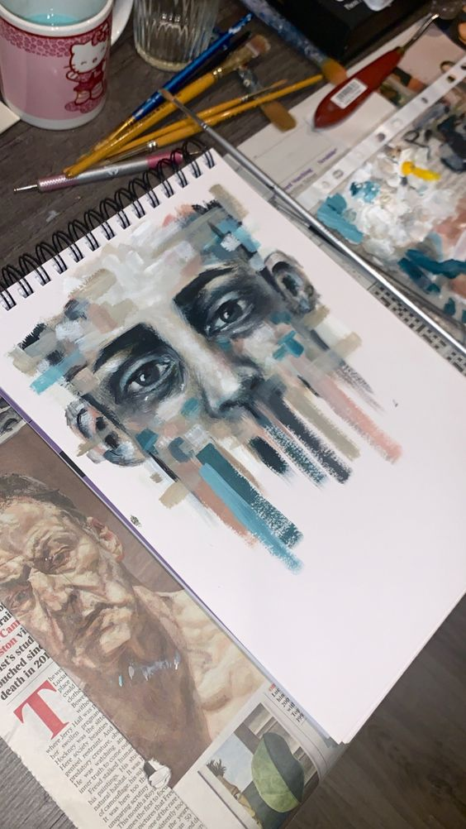
Artist Page Checklist
Priority 1: A strong visual response to the artist work (This does not have to be a copy of the artist work, but should show a flavour of the artist’s style and materials)
Written annotations to explain your artist choice and style
Clear title ( artist name or movement)

Slide 12
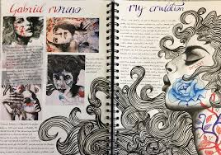
Artist Part 2
Plotting out a drawing link to your artist research next to your written research homework.
We can add the materials in the next lessons
Make sure it is big enough on the page.
*You can copy the artist piece OR you could apply their style to your own image
VISUAL ANALYSIS CREATED BY THE STUDENT IN THE STYLE OF THE ARTIST!
WRITTEN ANALYSIS

