Slide 1
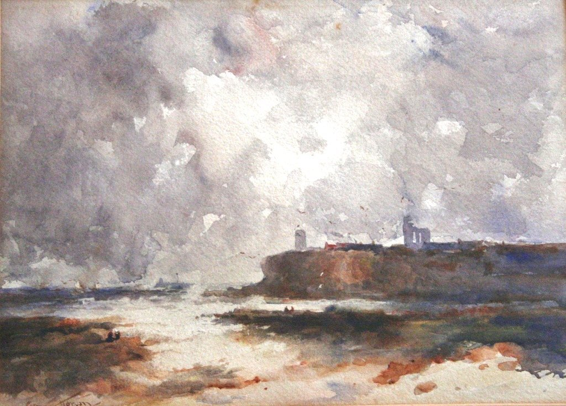
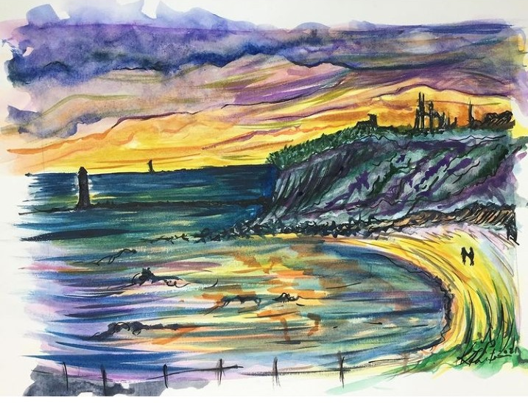
Watercolour: How can it change the mood?
King Edward’s Bay, Tynemouth.

Slide 2

What mood will you try to create?
What colours will help you achieve it?

Slide 3
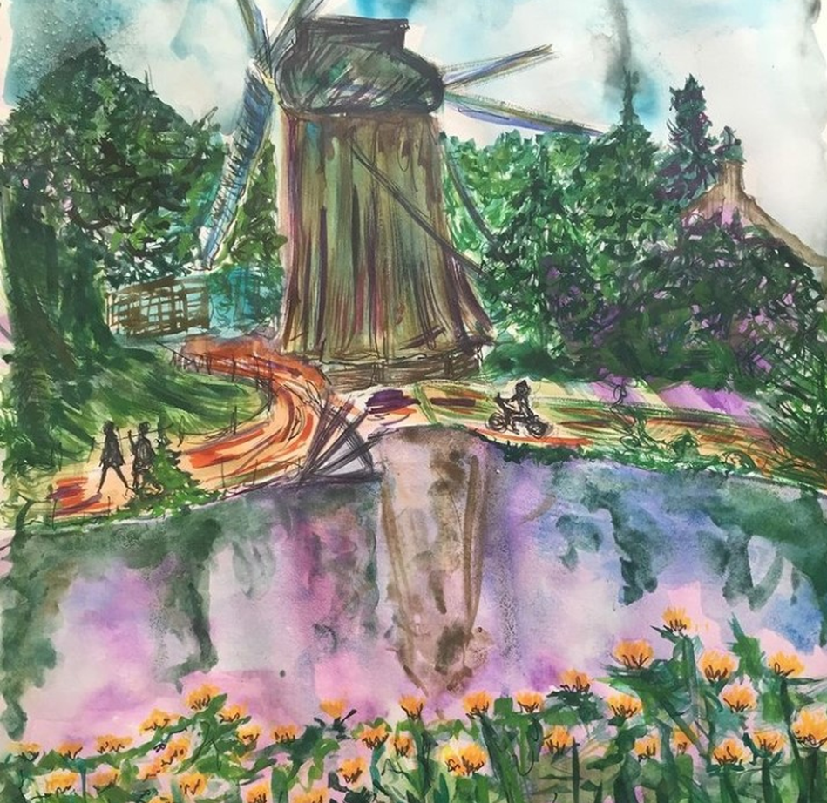

Lesson Objective: 1/Learning to experiment with colour palette choices to change the mood.
2. Develop brush control.
Sketch out brief line shapes
Mix your colour palette
Apply light washes of paint
Dry
Build up darker tones to layer on top.
Dry
Pen work if needed or extra layers of paint.
Wash and drop watercolour
Loose pen marks can help pick out details
Layers of watercolour
Loose lines

Slide 4
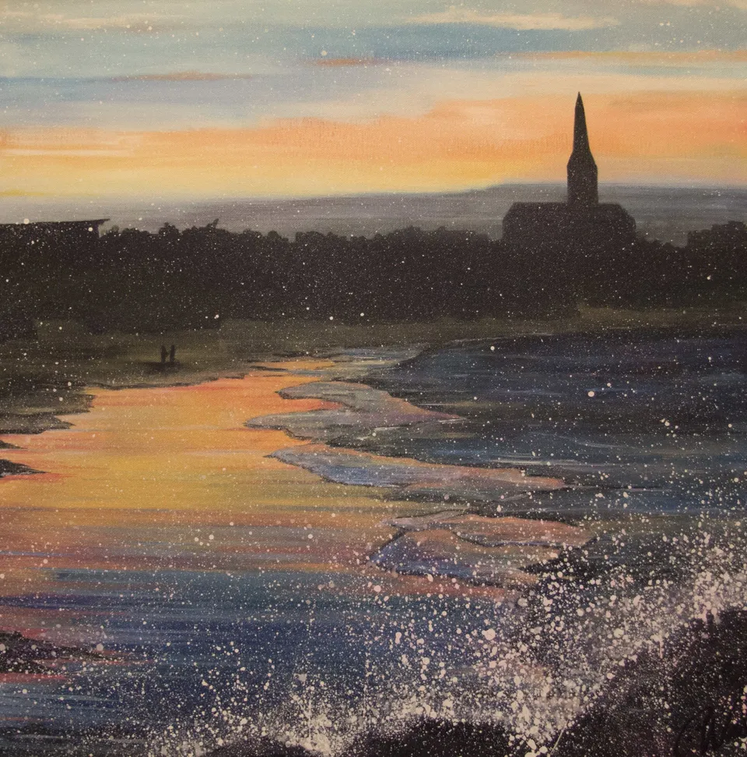
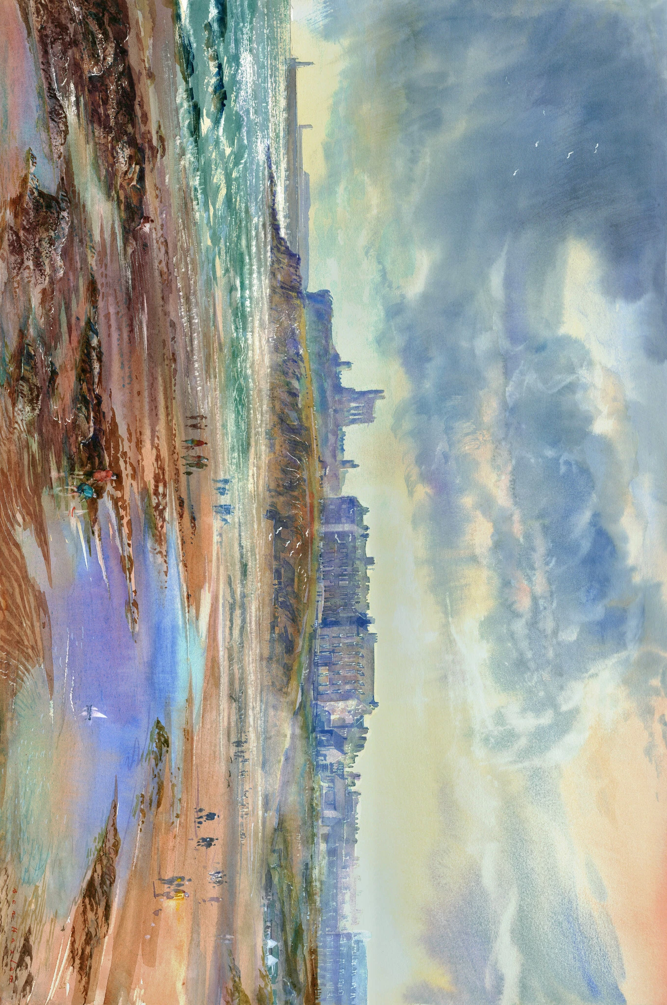
Find your own image or select on of the attached images

Slide 5
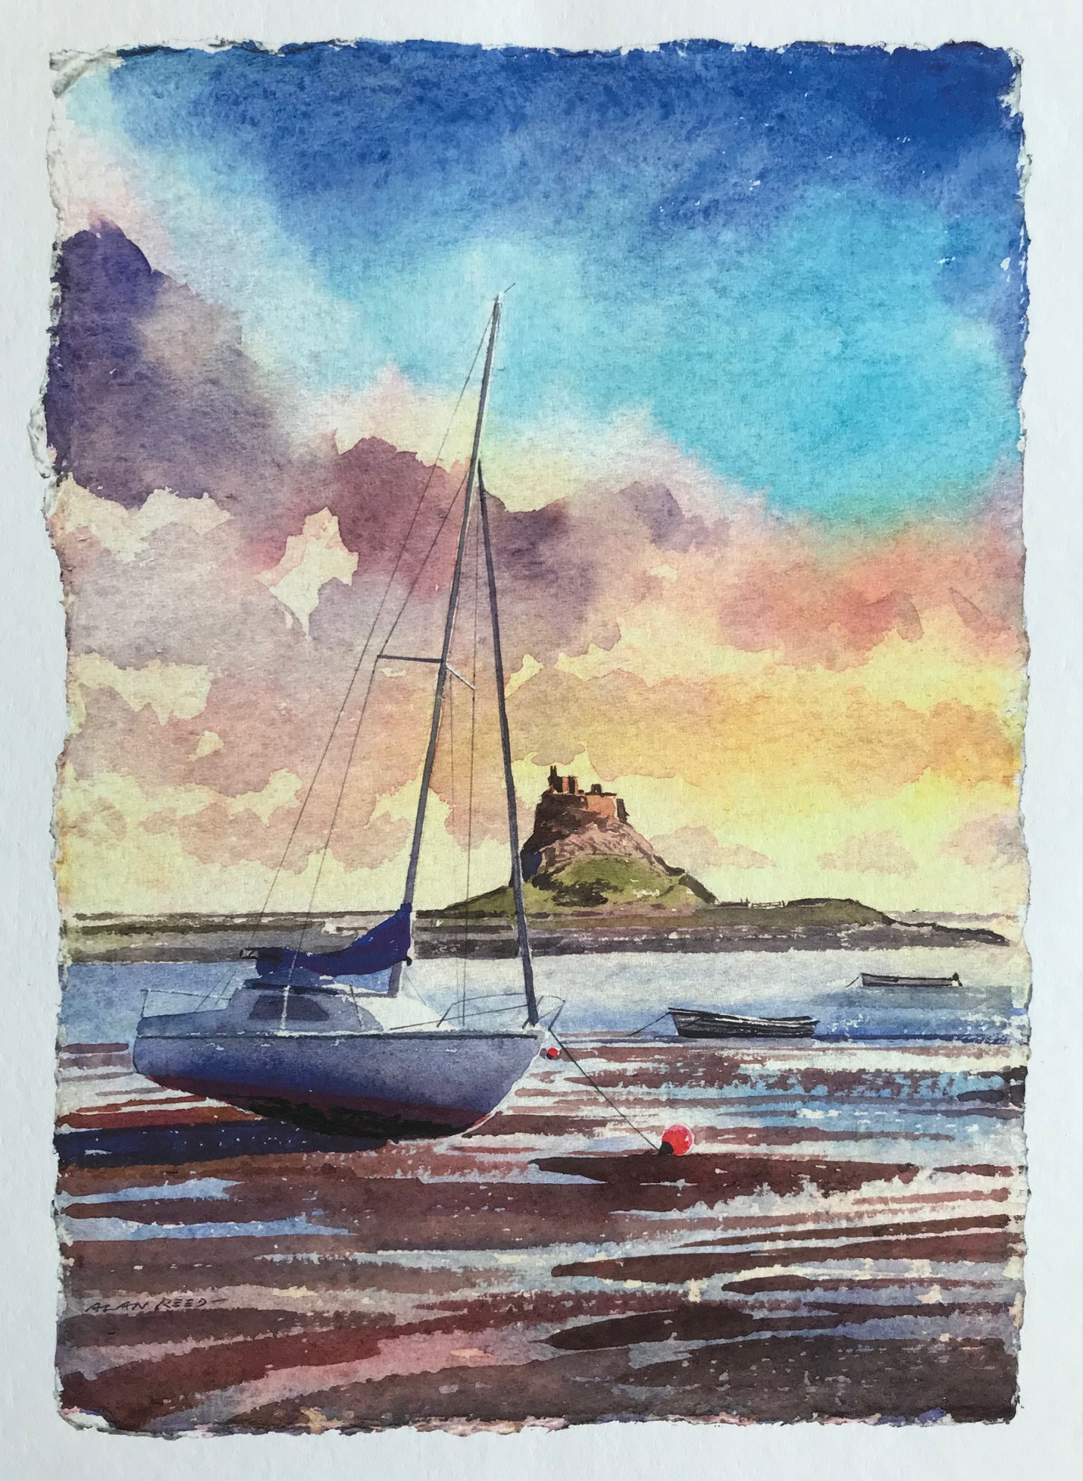
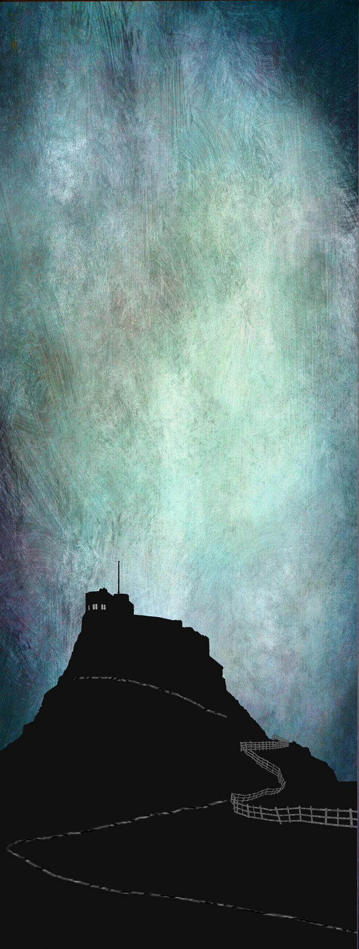
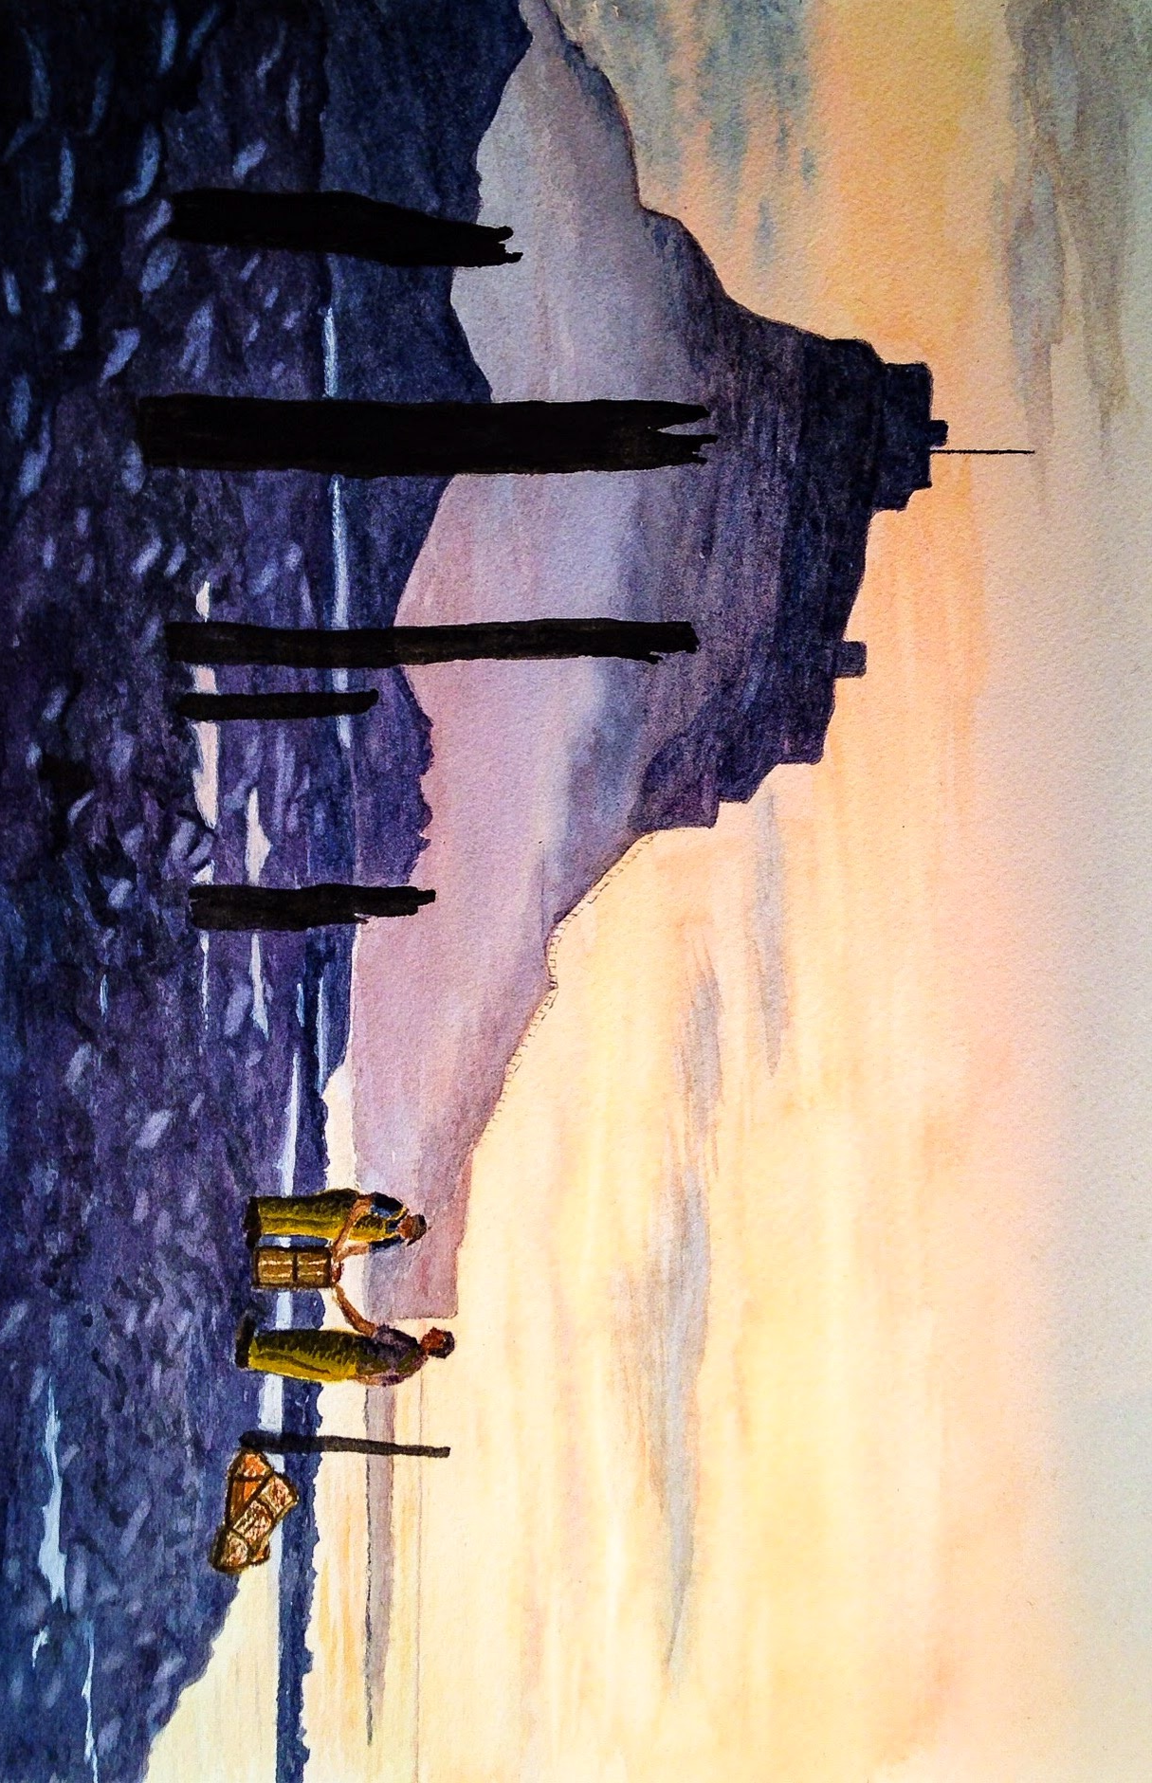

Slide 6
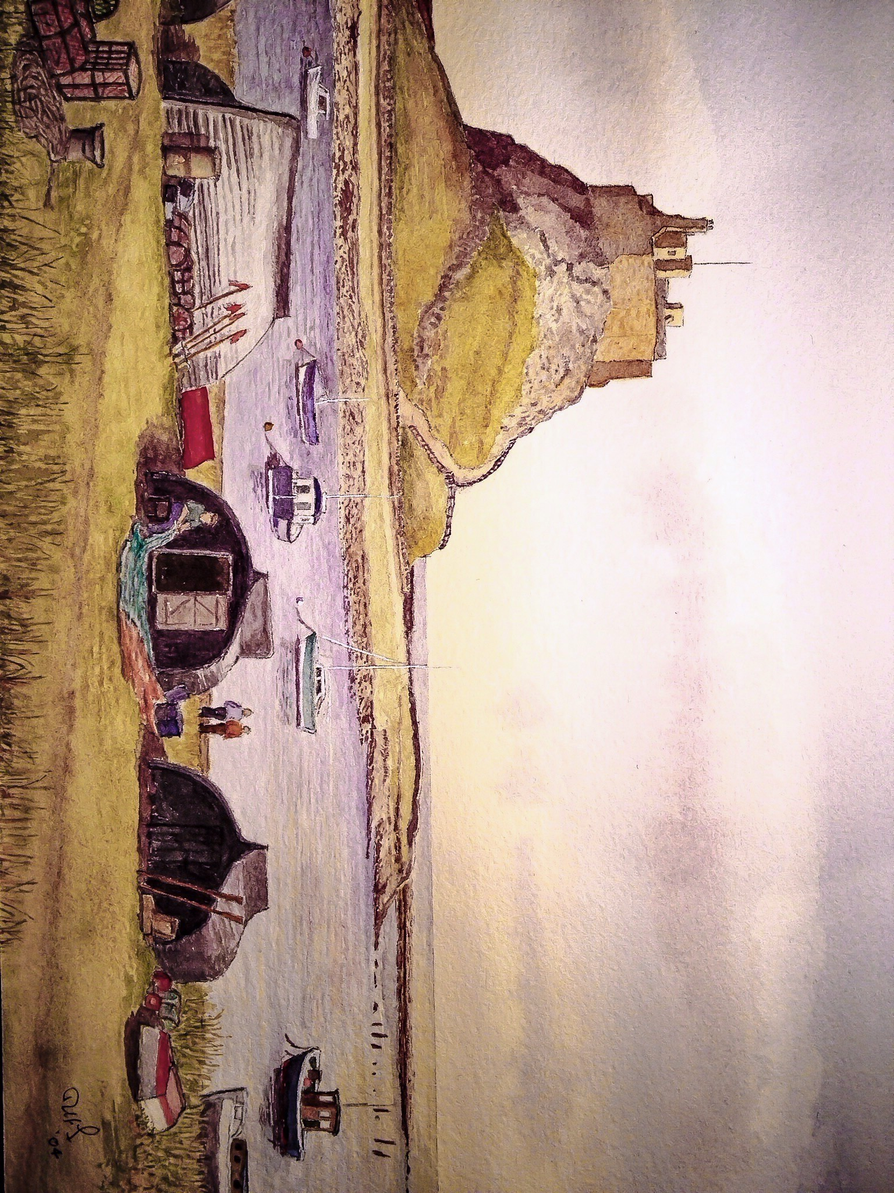
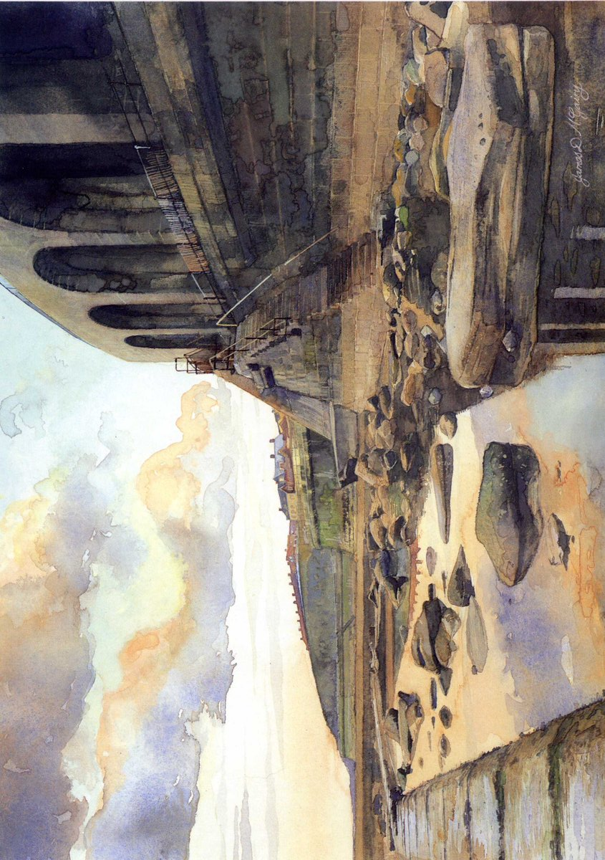

Slide 7


Slide 8
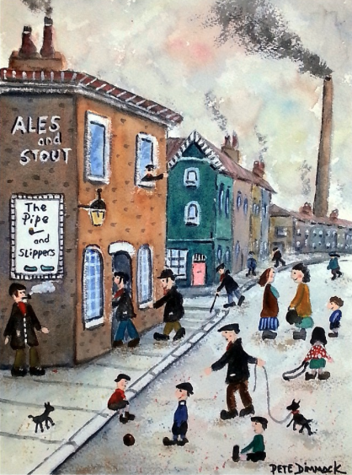
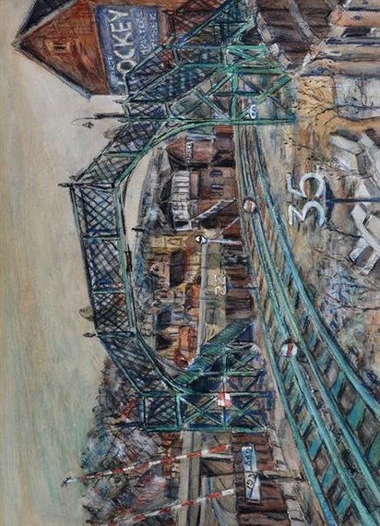

Slide 9

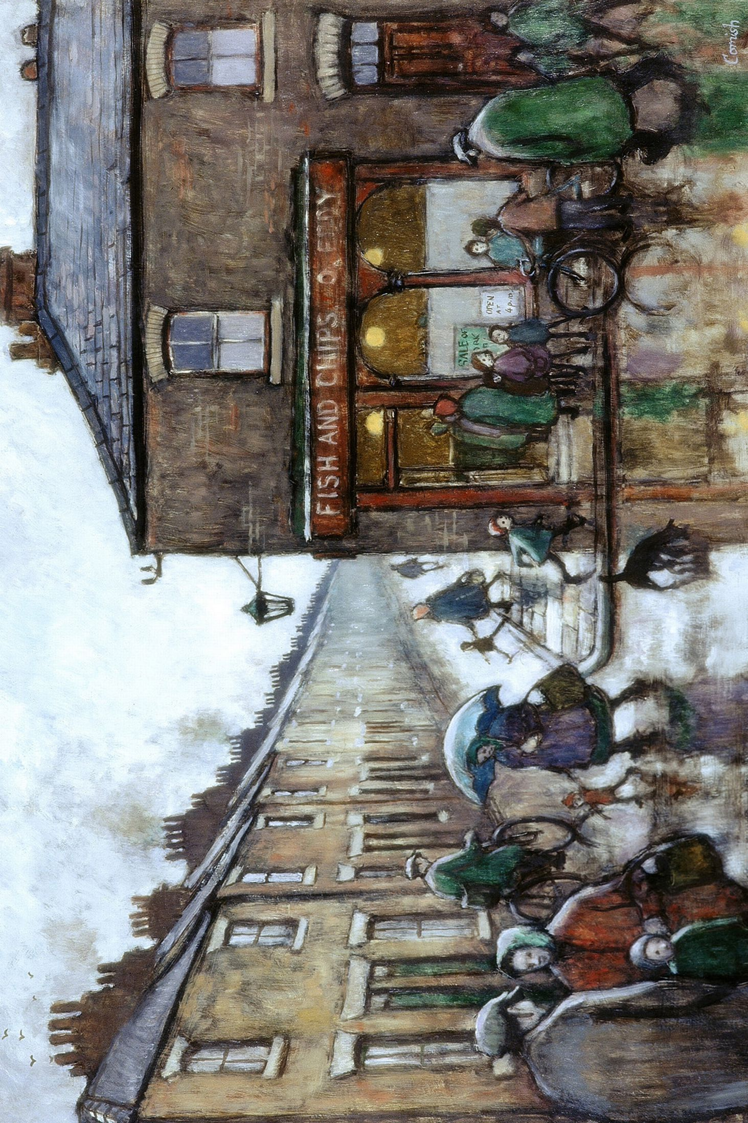

Slide 10
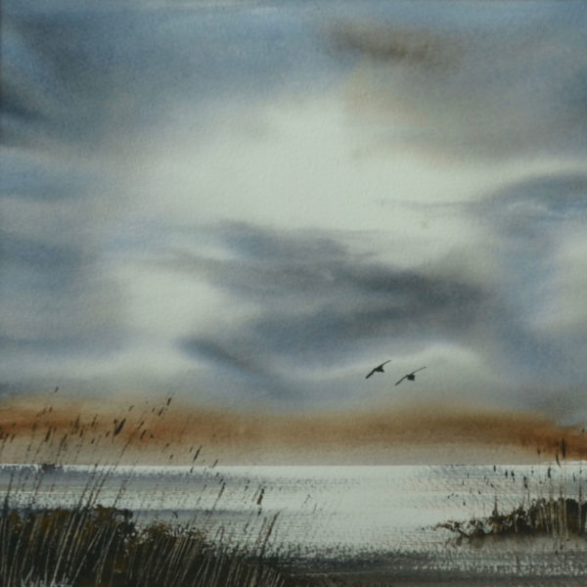


Slide 11
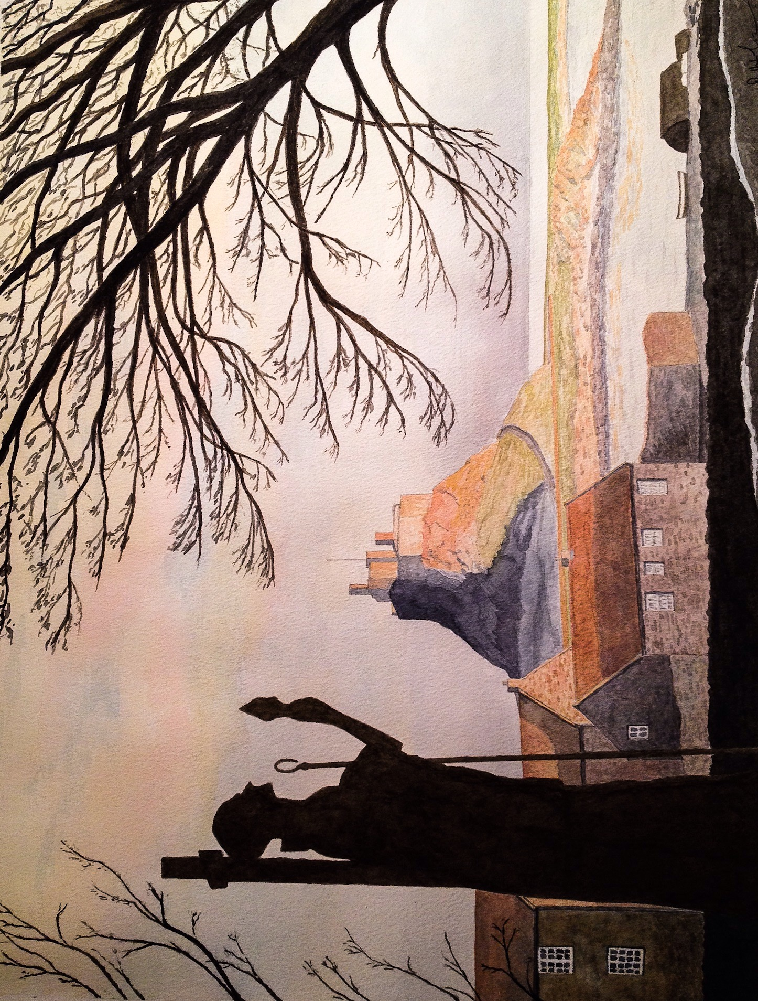
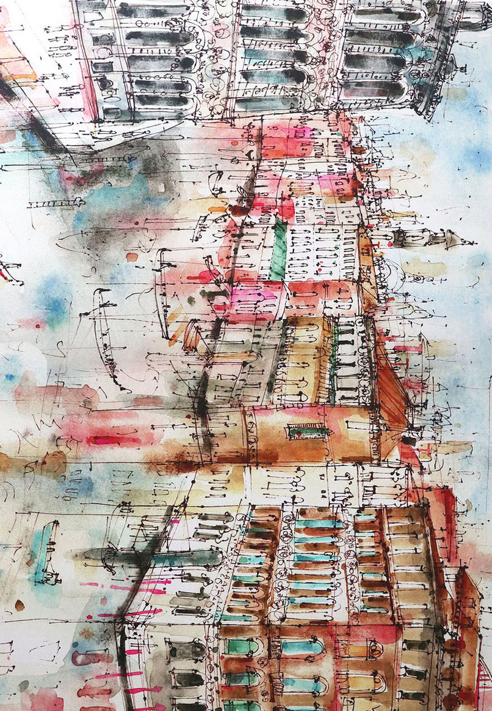

Slide 12

