Slide 1
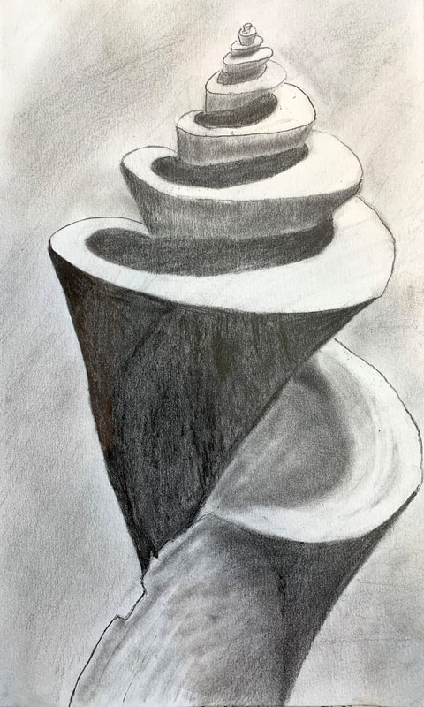
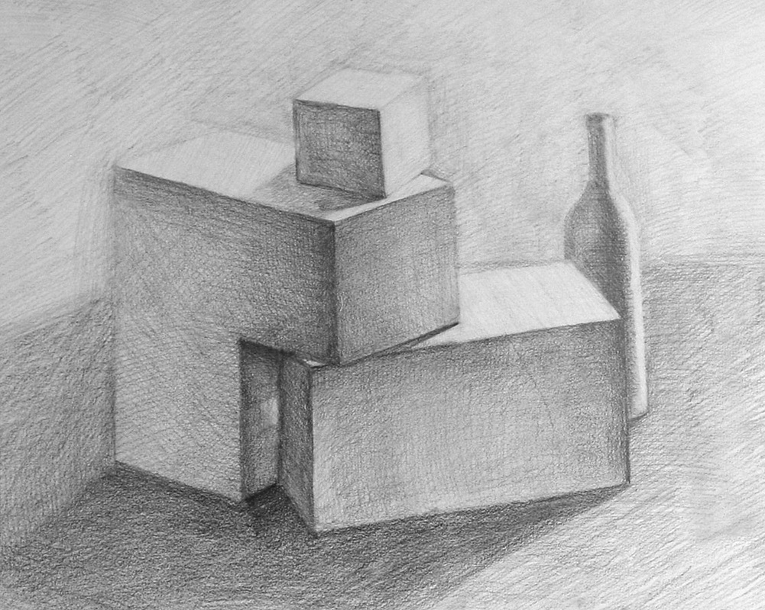
Using a wider variety of tonal shades to increase depth in observational studies

Slide 2
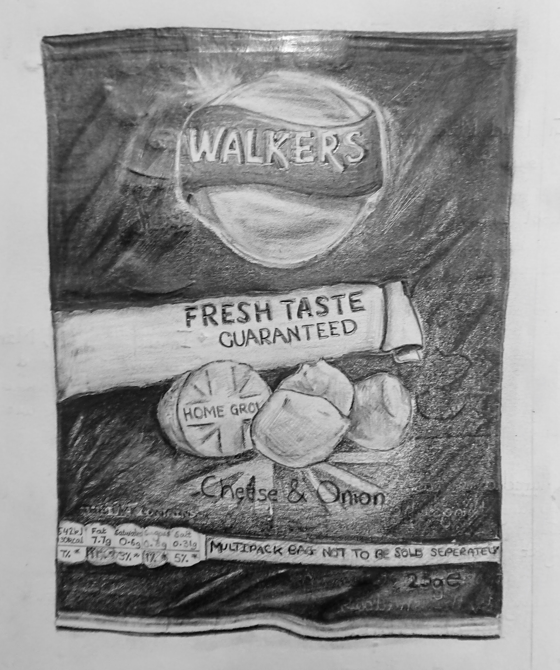
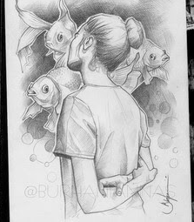
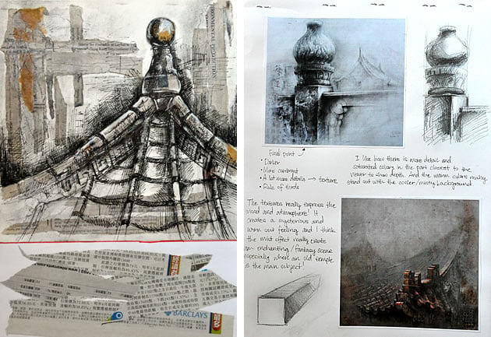
What makes a quality drawing?
LOOK AT THESE EXAMPLES.

Slide 3
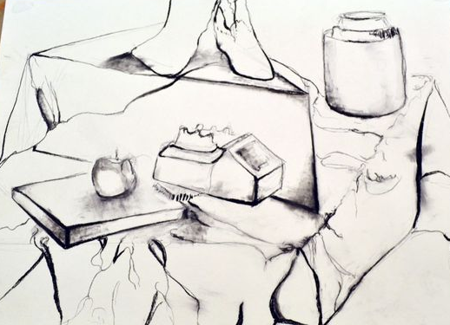
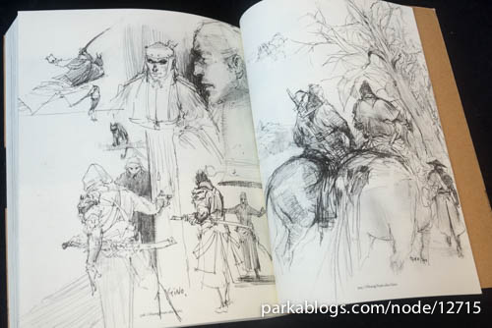
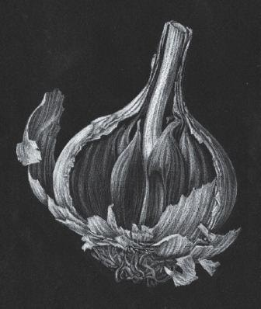
FOCUS ON QUALITY IN PENCIL
Weight of line
Darker lines
Lighter, delicate line
Avoid using a heavy outline
Parts of sketches
Delicate areas
Shadow behind the subject
Don’t reply on a heavy outline .
Line and dot sketches
Intricate details
Applying different pressures
Creating a variety of tonal shades

Slide 4
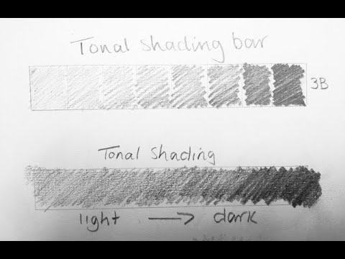
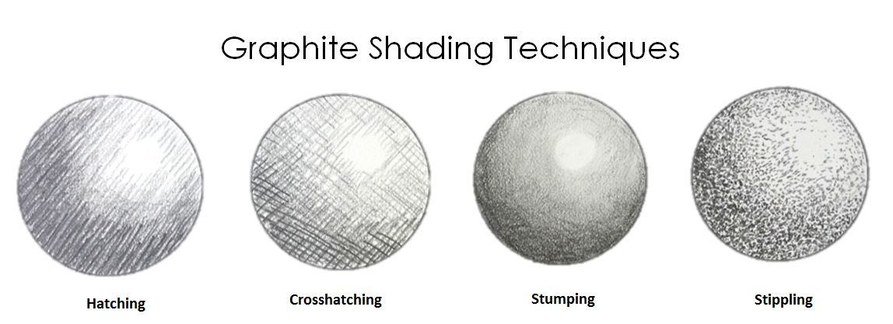
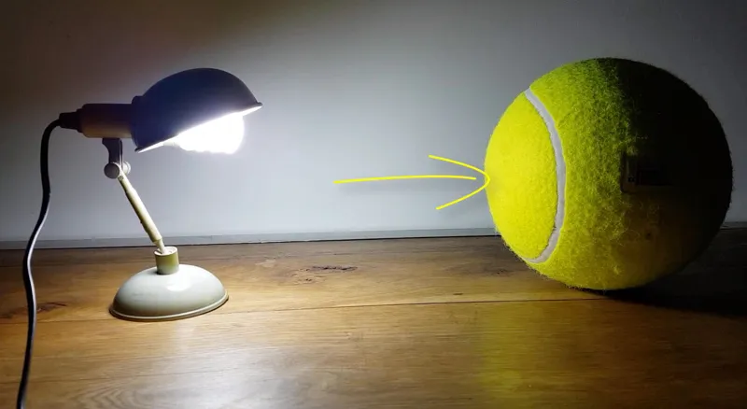
Task
Check out this website to see why tone is important https://www.tate.org.uk/art/tone-coursework-guide#:~:text=You%20can%20make%20a%20tonal,the%20brightest%20and%20darkest%20shades
Select 1 of your images for your project to create a quality pencil piece.
Plot out the shapes lightly and measure each shape in relation to the next.
Build up line details from the image
Look at where the shadows and highlight appear on the objects.
Use different pressures to create the dark and light tones.

