Slide 1


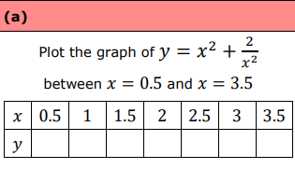
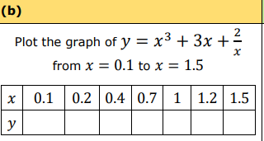
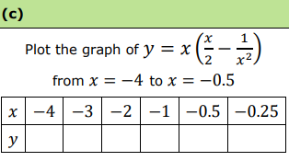
Using a table of values to plot a range of non-linear graphs.
Enter codes U989, U980, U593 and U229 in the Sparx independent learning section and/or
Follow this link to watch a video on “Sketching graphs”
https://www.youtube.com/watch?v=1WgZFoDhpt4
Work through the questions below to check your understanding (solutions on next page):

Slide 2
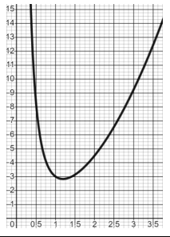
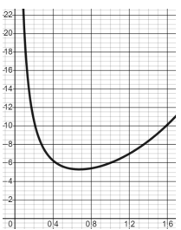
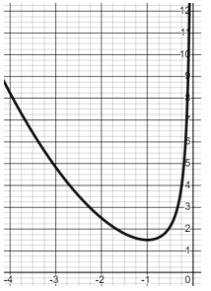
Solutions

