Slide 1


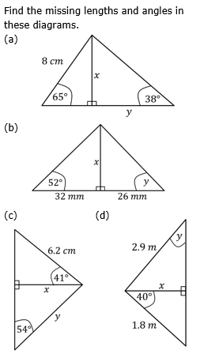
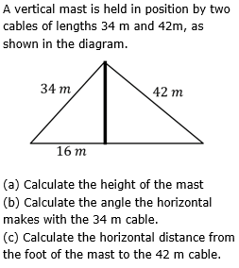
Choosing the appropriate trigonometric ratio to find missing sides or angles in right-angled triangles in a range of situations.
Enter codes U283 and U545 in the Sparx independent learning section and/or
Follow this link to watch a video on “Trigonometry”
https://corbettmaths.com/2013/03/30/trigonometry-missing-sides/
https://corbettmaths.com/2013/03/30/trigonometry-missing-angles/
Work through the questions below to check your understanding (solutions on next page):

Slide 2
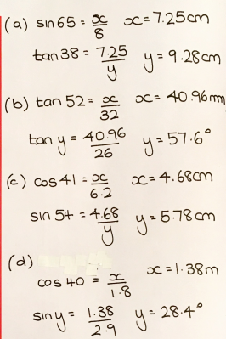
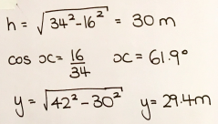
Solutions

