Slide 1


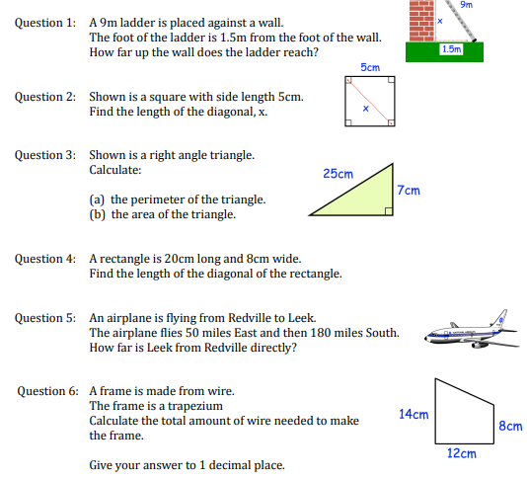
Solving worded problems using Pythagoras’ Theorem.
Enter code U385 in the Sparx independent learning section and/or
Follow this link to watch a video on “Pythagoras”
https://corbettmaths.com/2012/08/19/pythagoras-video/
Work through the questions below to check your understanding (solutions on next page):

Slide 2
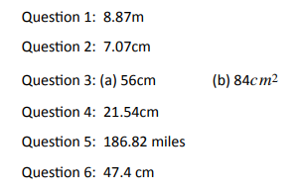
Solutions

