Slide 1


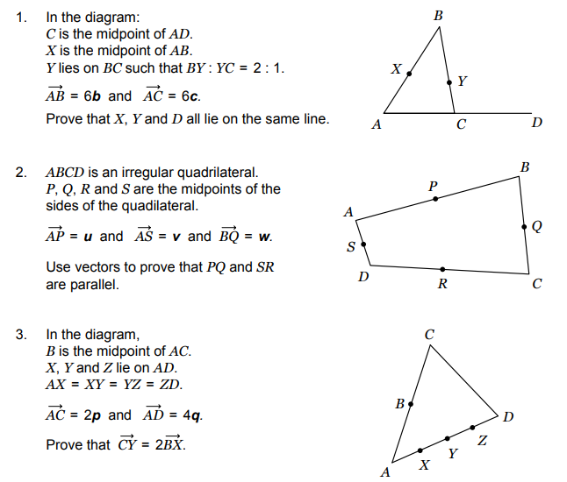
Using vectors in a range of geometric arguments and proofs.
Enter code U781 in the Sparx independent learning section and/or
Follow this link to watch a video on “Vectors”
https://corbettmaths.com/2016/04/25/vectors/
Work through the questions below to check your understanding (solutions on next page):

Slide 2
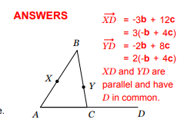
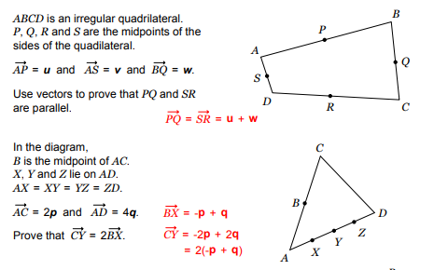
Solutions

