Slide 1


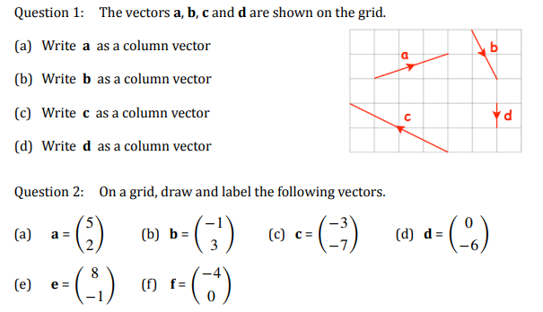
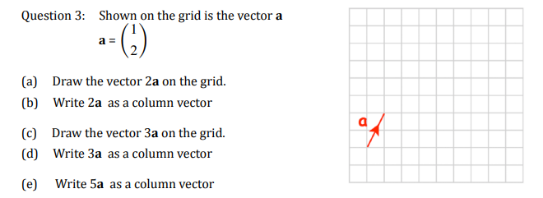
Representing a two-dimensional vector as a column vector and drawing on a square or coordinate grid.
Enter codes U632 and U903 in the Sparx independent learning section and/or
Follow this link to watch a video on “Vectors”
https://corbettmaths.com/2017/09/25/column-vectors/
Work through the questions below to check your understanding (solutions on next page):

Slide 2
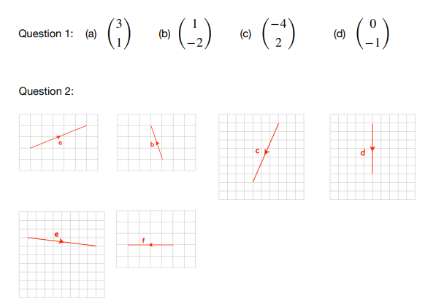
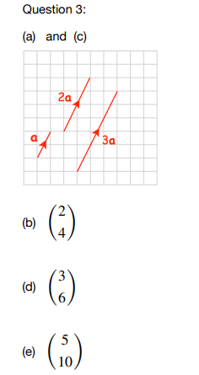
Solutions

