Slide 1


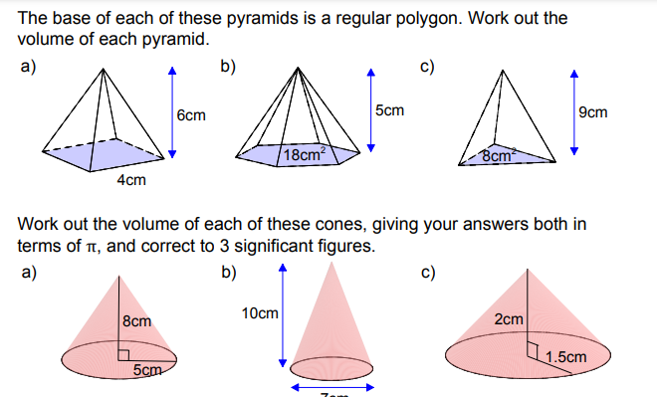
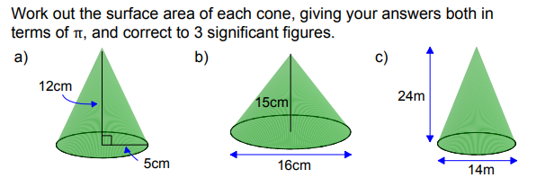
Using given formulae to solve problems involving volume or surface area of spheres, cones and pyramids.
Enter codes U771 and U426 in the Sparx independent learning section and/or
Follow these links to watch videos on “Volume and Surface Area”
https://www.youtube.com/watch?v=myp-LSzVErE
https://www.youtube.com/watch?v=J8o6E81pZvg
Work through the questions below to check your understanding (solutions on next page):

Slide 2
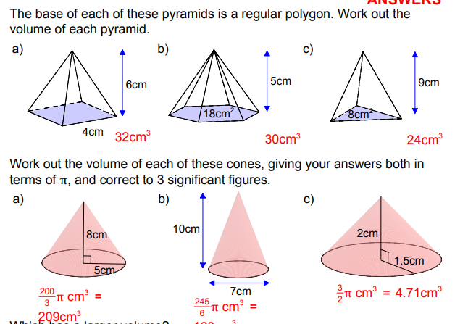
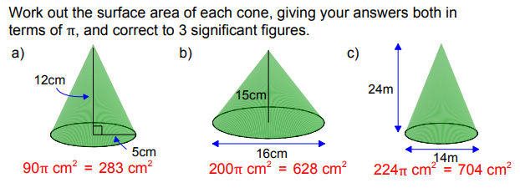
Solutions

