Slide 1


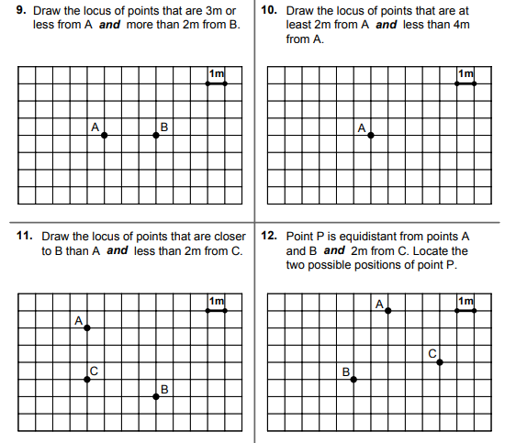
Using ruler and compass constructions to solve “loci” problems in real life situations.
Enter code U820 in the Sparx independent learning section and/or
Follow these links to watch videos on “Loci”
https://corbettmaths.com/2013/03/31/loci-part-1/
https://corbettmaths.com/2013/03/31/loci-part-2/
https://corbettmaths.com/2013/03/06/loci-part-3-2/
Work through the questions below to check your understanding (solutions on next page):

Slide 2
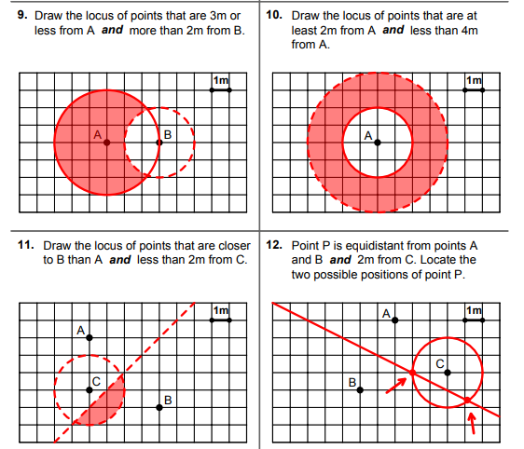
Solutions

