Slide 1


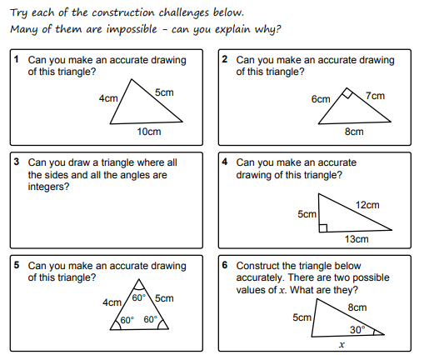
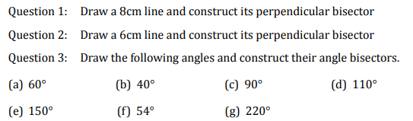
Using a ruler and compass to construct perpendicular bisectors, angle bisectors and triangles.
Enter code U979 in the Sparx independent learning section and/or
Follow this link to watch videos on “Constructions”
https://corbettmaths.com/2013/03/26/angle-bisector/
https://corbettmaths.com/2012/08/24/perpendicular-bisector/
Work through the questions below to check your understanding (solutions on next page):

Slide 2
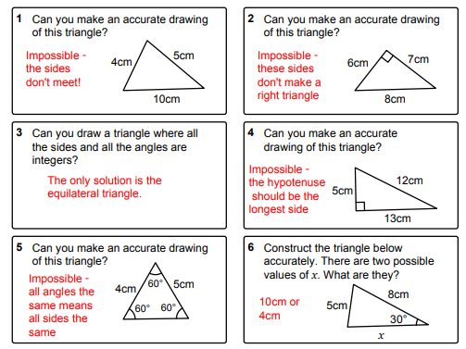
Solutions

