Slide 1


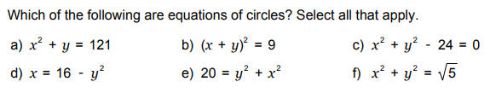
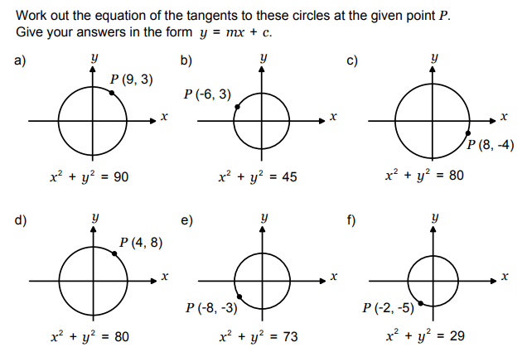
Recognising and using the equation of a circle.
Enter code U567 in the Sparx independent learning section and/or
Follow this link to watch a video on “Circles and tangents”
https://www.youtube.com/watch?v=N4JpUUkudrY
Work through the questions below to check your understanding (solutions on next page):

Slide 2
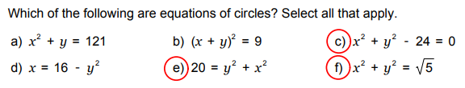
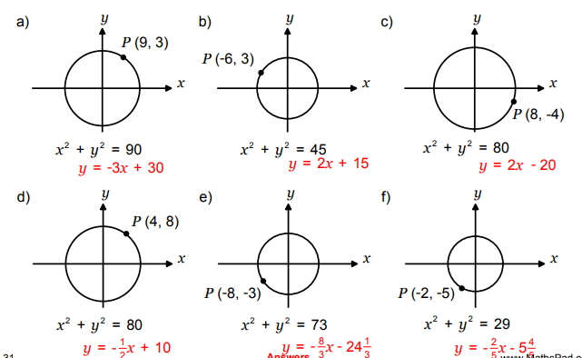
Solutions

