Slide 1
What is a barrier?
What types of barrier might there be in HSC?

Slide 2

What are Barriers?
Barriers are factors (issues) which prevent you from using a service at all or using it properly. These barriers mean that people cannot take control over their own life and may need to rely on others to allow them to take control.
Why are barriers so bad?
Prevent people from getting any treatment or support
Some people can’t control the barriers
Why are barriers hard to control or prevent?
No money
Scared
Too young or old

Slide 3
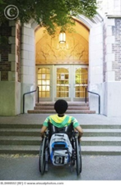

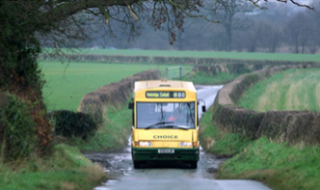
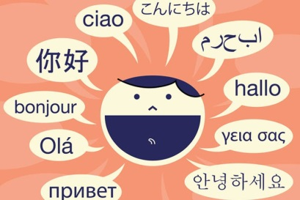

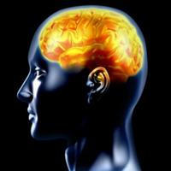
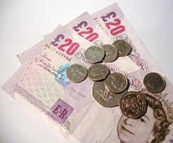
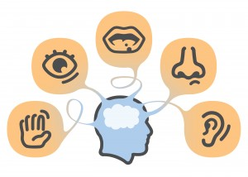
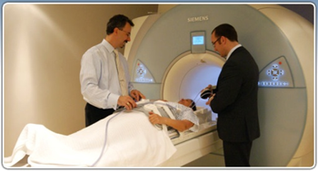
The 8 types of barriers
Physical Barriers
Social, cultural and psychological
Geographical Barriers
Language Barriers
Intellectual
Barriers
Financial Barriers
Resource Barriers
Sensory Barriers
Notes:
A sheet is provided to glue in.

Slide 4
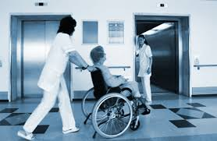
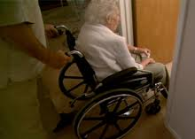
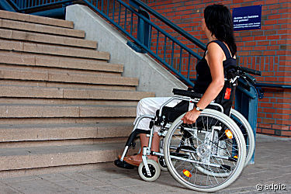
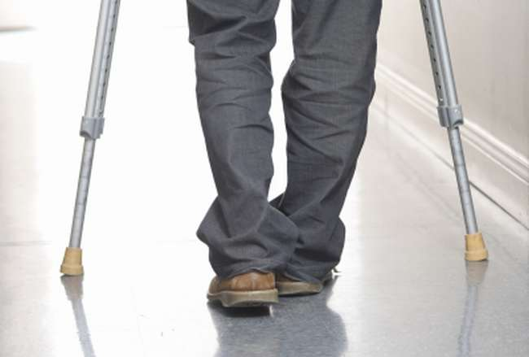
Physical Barriers
Physical barriers are linked to the physical access to services of the person or the building itself. These barriers prevent someone from using the service properly or at all.
Examples of physical barriers of a person:
Being in a wheelchair
Using crutches
Having a buggy
Poor mobility or low strength
Examples of physical barriers of a building:
Lack of lifts or ramps
Cluttered hallways
Narrow corridors
No disabled toilet facilities

Slide 5
Examples of Physical Barriers
Physical
Barriers
Ramps and stairs
Lack of lifts and lift controls being out of reach
Lack of adapted toilet facilities
Lack of space to move around
Places to leave equipment safely
No clear signs for the deaf or intellectually imparied
Lack of parking

Slide 6
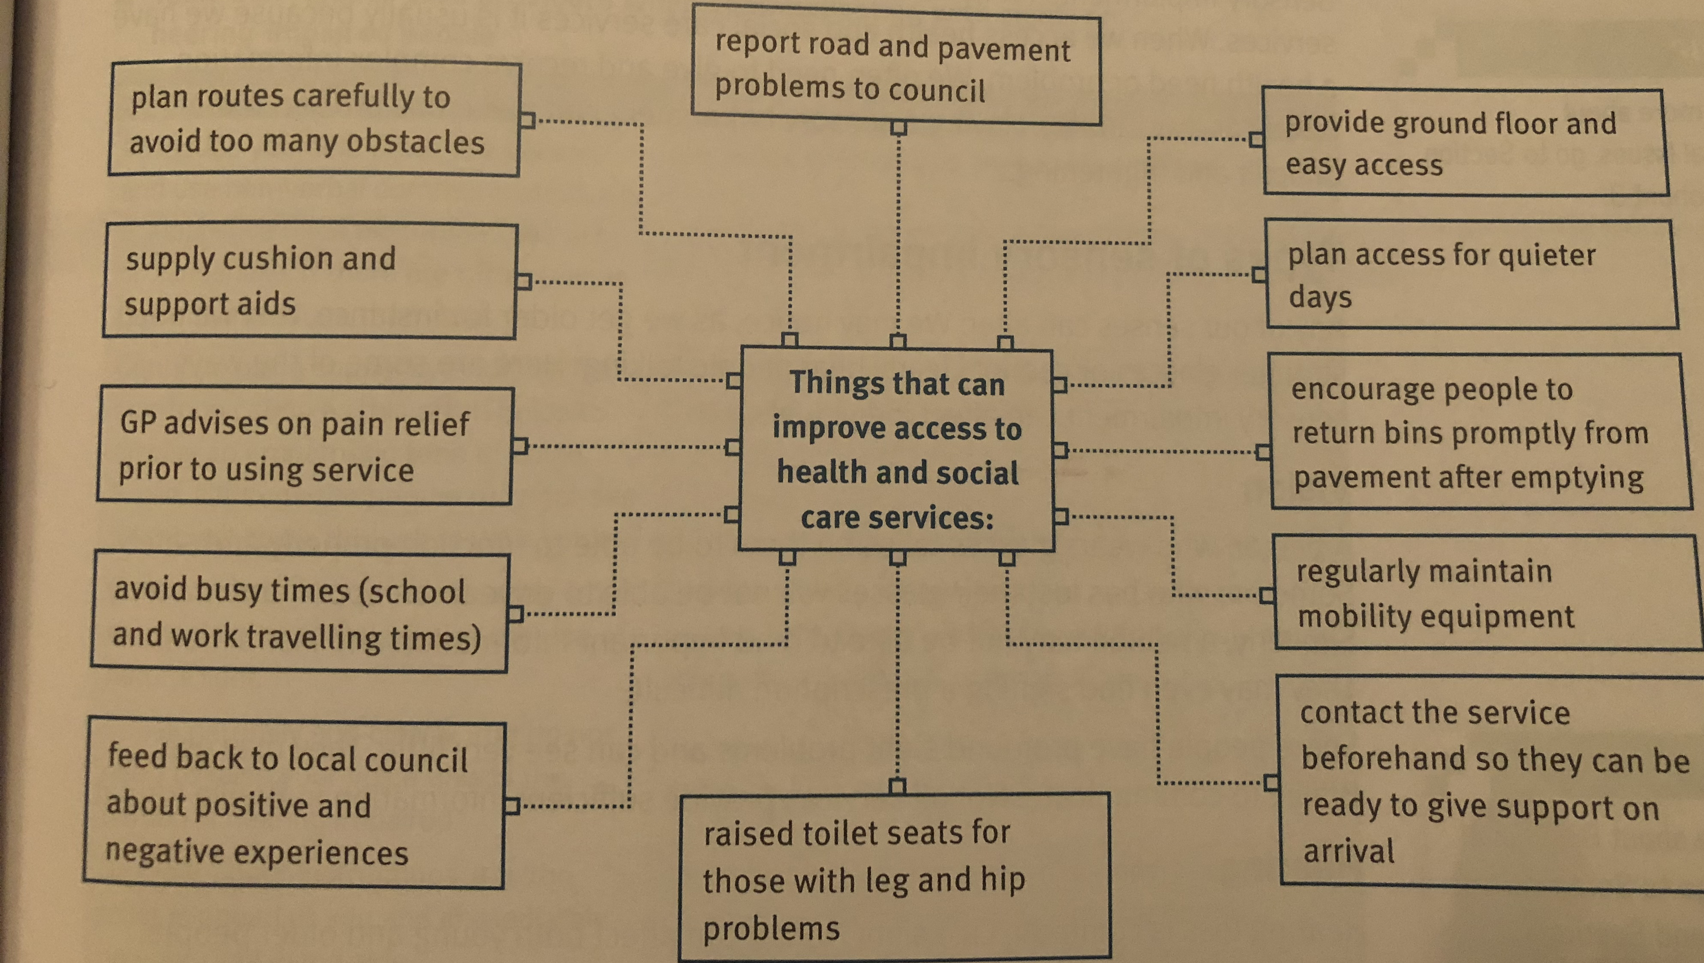
Overcoming Physical Barriers

Slide 7
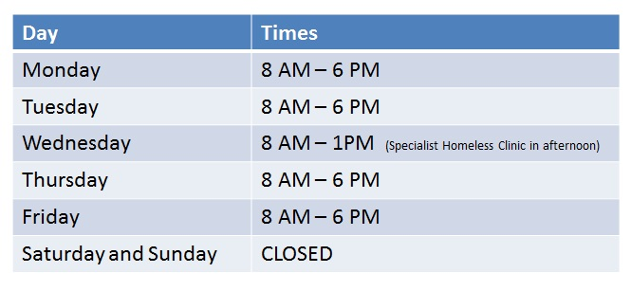


Resource Barriers
Resource barriers can arise when there are shortages in staff, beds, medication, facilities or long waiting lists.
What are the other barriers linked to
resources?
Lack of information
Opening times
Specialist staff
Costs of medication
Not a lot of specialist equipment

Slide 8
Examples of Resource Barriers
Resource
Barrier
Staff shortages
Not enough vaccinations or medication
Lack of information
Not enough money to fund the service
High demand for the service
Waiting lists to be treated
Not enough specialist equipment

Slide 9
Overcoming Resource Barriers
Miss Cooper is staying in a nursing home while her bungalow is fitted with handrails and ramps. She recently broke her hip and is recovering in the nursing home.
She used the phone in her room to make an optician’s appointment at 10:00am tomorrow. She asked for a carer to go with her because she needs physical assistance.
The nurse in charge informed her that no one can take her then – all care staff will be helping other residents to wash, dress and have breakfast. The home is also short staffed.
Why are the care team particularly busy in the morning in nursing homes?
How might Miss Cooper feel about not being able to attend her opticians appointment?
How can the care team help her attend an appointment that will be acceptable to her and put less strain on staffing resources?

Slide 10
Overcoming Resource Barriers
Miss Cooper is staying in a nursing home while her bungalow is fitted with handrails and ramps. She recently broke her hip and is recovering in the nursing home.
She used the phone in her room to make an optician’s appointment at 10:00am tomorrow. She asked for a carer to go with her because she needs physical assistance.
The nurse in charge informed her that no one can take her then – all care staff will be helping other residents to wash, dress and have breakfast. The home is also short staffed.
Answers:
They have to get all clients up, medicate them and feed them ready to start the day
Neglected, disempowered, unimportant
Have volunteers or family members support, rearrange her appointment when more staff are available.

Slide 11

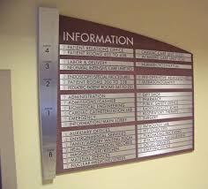
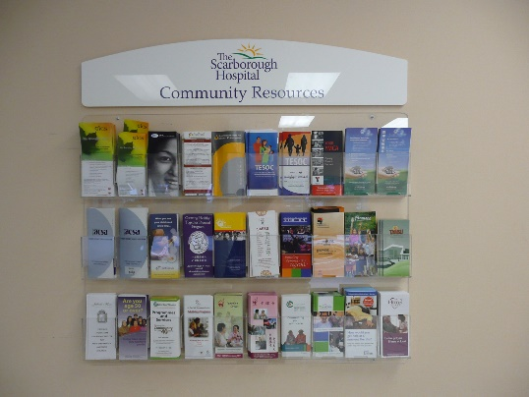
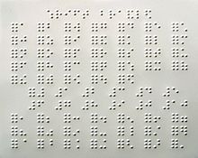
Sensory Barriers
Senses are important because they allow us to see, hear, taste, touch and smell. However sometimes we can have difficulties with one or more of our senses.
Discuss: What reasons are there for senses declining?
Old age where they naturally start to deteriorate, being born with an impairment or an illness/accident.
How do these images show sensory barriers when accessing a service:

Slide 12
Examples of Sensory Barriers
Sensory
Barriers
Signs which are too small
Relying on glasses to function properly
Lack of braille for the blind
Tannoy’s which cannot be heard by the deaf
Loss of hearing and lack of understanding of important conversations
Colour coded directions for those who are colour blind
Relying on other to direct them to a service

Slide 13
Overcoming Sensory Barriers
Hearing loops (a special type of sound system for use by people with hearing aids)
British Sign Language (BSL)
Interpreters
Communication cards (a set of icons that patients can use if they are having difficulty communicating their immediate needs, wants or concerns)
Large print leaflets
Braille leaflets
Staff collecting vulnerable service users from waiting areas

Slide 14




Psychological Barriers
Psychological barriers are not physical, but are caused when people are too scared or worried to use a service.
Why might people not want to use services?
Too proud to ask for help
Scared of getting more ill (superbug)
People might judge them
Not having someone to go with them
Feel like a burden

Slide 15
Psychological Barriers
Psychological
Barriers
Fear and stigma of service
Lack of understadning about the service
Trying to cope without help
Being scared to go on thier own
Not wanting to ask for help
Scared of being judged
Doesn’t want people to know

Slide 16
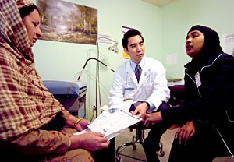
Cultural Barriers
People from different cultural backgrounds might find accessing services difficult. They could be worried that their cultural needs wont be met within services of other may judge them.
What cultural barriers are you aware that prevent access to services?
Not having professionals who are of the same sex, for example, women doctors/consultants for women
Some treatments being considered unacceptable to certain cultures.
Preferences about food or dress may not be understood properly.

Slide 17
Overcoming social, cultural and psychological barriers
Awareness campaigns
Posters and leaflets
Well women and well men clinics
Choice of service provider (e.g. if male or female is preferred)
Collaboration with community and faith groups

Slide 18
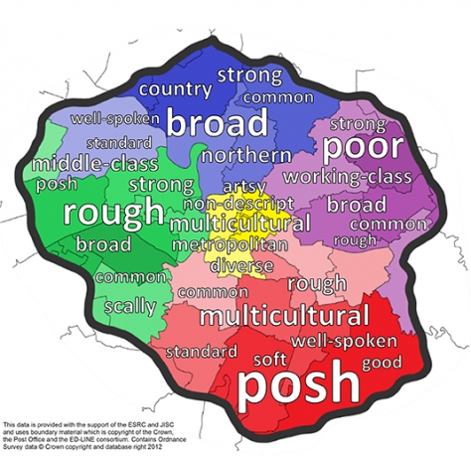
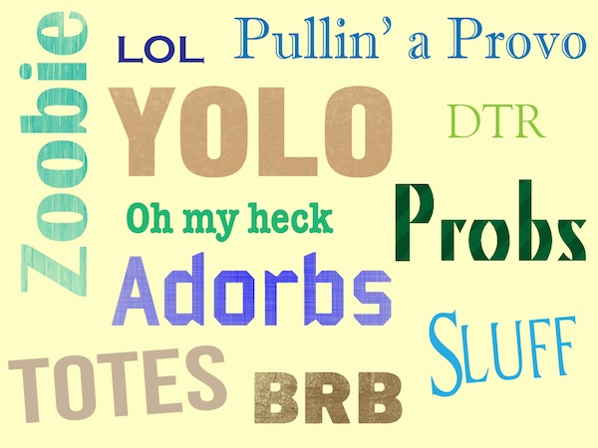

Language Barriers
Several thousand languages, phrases and terms in language are spoken across the world. But this can become a barrier to accessing health services when you cannot communicate effectively.
How can language be a barrier?
Jargon – technical words or phrases used by a professional
Slang – informal words which are not the standard part of language
Dialect – a variety of language or speech pattern specific to the area you live

Slide 19
Examples of Language Barriers
Language
Barriers
A person who has dementia reverting back to their first language
Stuttering and speech difficulties which could cause confusion
Not speaking the same language when trying to explain your issues
Using jargon when trying to explain a patients condition
Slang may be used and cause confusion
Lack of interpreters to explain situations
All letters and written information in one language

Slide 20
Overcoming Language Barriers
Face-to-face and telephone interpretation services
Health and wellbeing group meetings for speakers of other languages
Longer appointments
Use of advocates
Staff training and awareness of common speech and language difficulties.

Slide 21
Overcoming Language Barriers
For each of case studies below make a note of their language barrier and how they can be overcome.
French patient waiting in A&E with a broken leg
Barrier - Overcome by -
Bulgarian patient waiting in a doctors surgery and given leaflets to read about infections
Barrier - Overcome by -
Dementia patient who has reverted back to their first language
Barrier - Overcome by -
Surgeon with an Irish accent explaining a procedure to an elderly person
Barrier - Overcome by -

Slide 22

Intellectual Barriers
Some people find learning and problem solving difficult. This intellectual disability could lead to physical and mental difficulties to access health and social care services.
What are intellectual difficulties?
An intellectual disability is caused by an interference with the brain development, before, during or after birth.

Slide 23
Examples of Intellectual Barriers
Intellectual
Barriers
Poor education about where to go for health care
Lack of knowledge about health impacts
They may feel too embarrassed to ask for help
They cannot read or write
They may not be able to make their own decisions
They rely on parents who are unaware of their health issues
They have a fear of hospital and medical support

Slide 24
Overcoming Intellectual Barriers
Use of Health Passports and All About Me documents
Use of advocates
Use of Learning Disability Nurses (LDN’s) and support workers
Quiet Clinics’
Quiet waiting areas
Longer appointment times
Use of communication cards
Adhering to The Accessible Information Standard
Providing low text ‘easy read’ leaflets

Slide 25
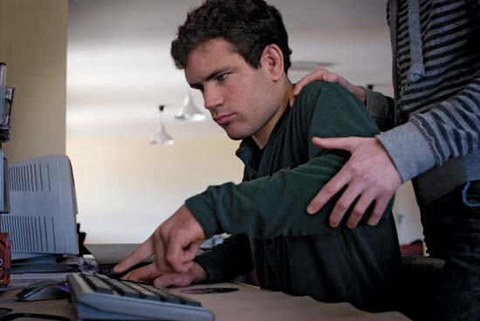
Overcoming Intellectual Barriers
This is James, he has autism and has stopped eating. James’ carer Mary knows there is something wrong and he has started to lose a lot of weight.
What intellectual barriers does James face?
2. How can we overcome these intellectual challenges?

Slide 26
Overcoming Intellectual Barriers
This is James, he has autism and has stopped eating. James’ carer Mary knows there is something wrong and he has started to lose a lot of weight.
What intellectual barriers does James face?
He cannot explain his emotions, he does not like to talk to strangers about his health problems , he does not like going to new places as they scare him.
2. How can we overcome these intellectual challenges?
Prepare James for his hospital visit, avoid noisy areas, speak clearly and do not shout, involve his family with him, be prepared to explain all of the processes about to be taken, read leaflets to him if needed.

Slide 27

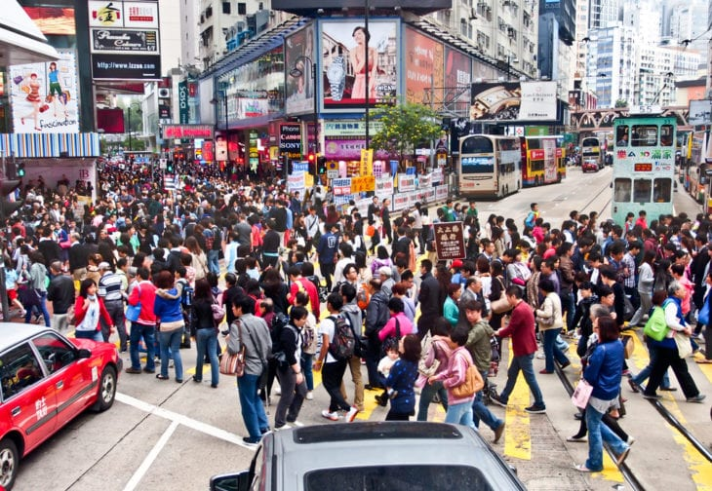
Geographical and Financial Barriers
What different barriers to services might people face based on living in these locations?

Slide 28
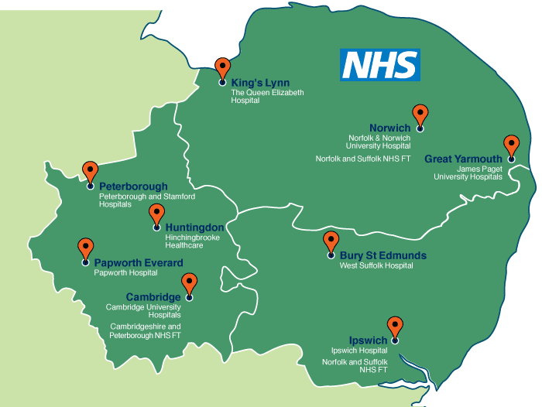
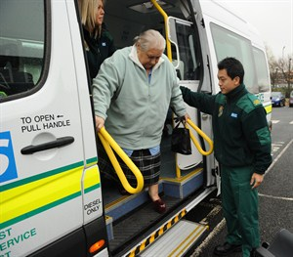
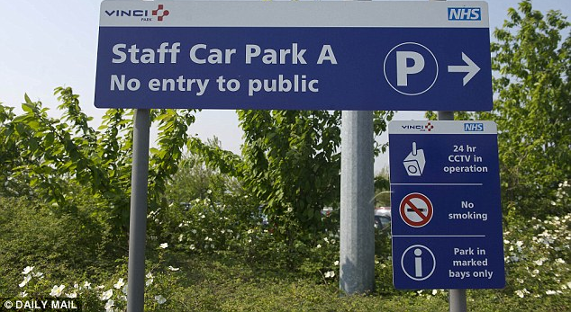
Geographical Barriers
Geographical barriers are problems caused by where people and resources physically are.
What issues could you face here?
Living too far away
Living close but its very busy
Transport issues

Slide 29
Examples of Geographical Barriers
Geographical
Barrier
Too far away for clients
Have to rely on public transport
No where to park
Transport not very often
Relying on other people to take you
Living in a rural area
Not easy to get to without help

Slide 30
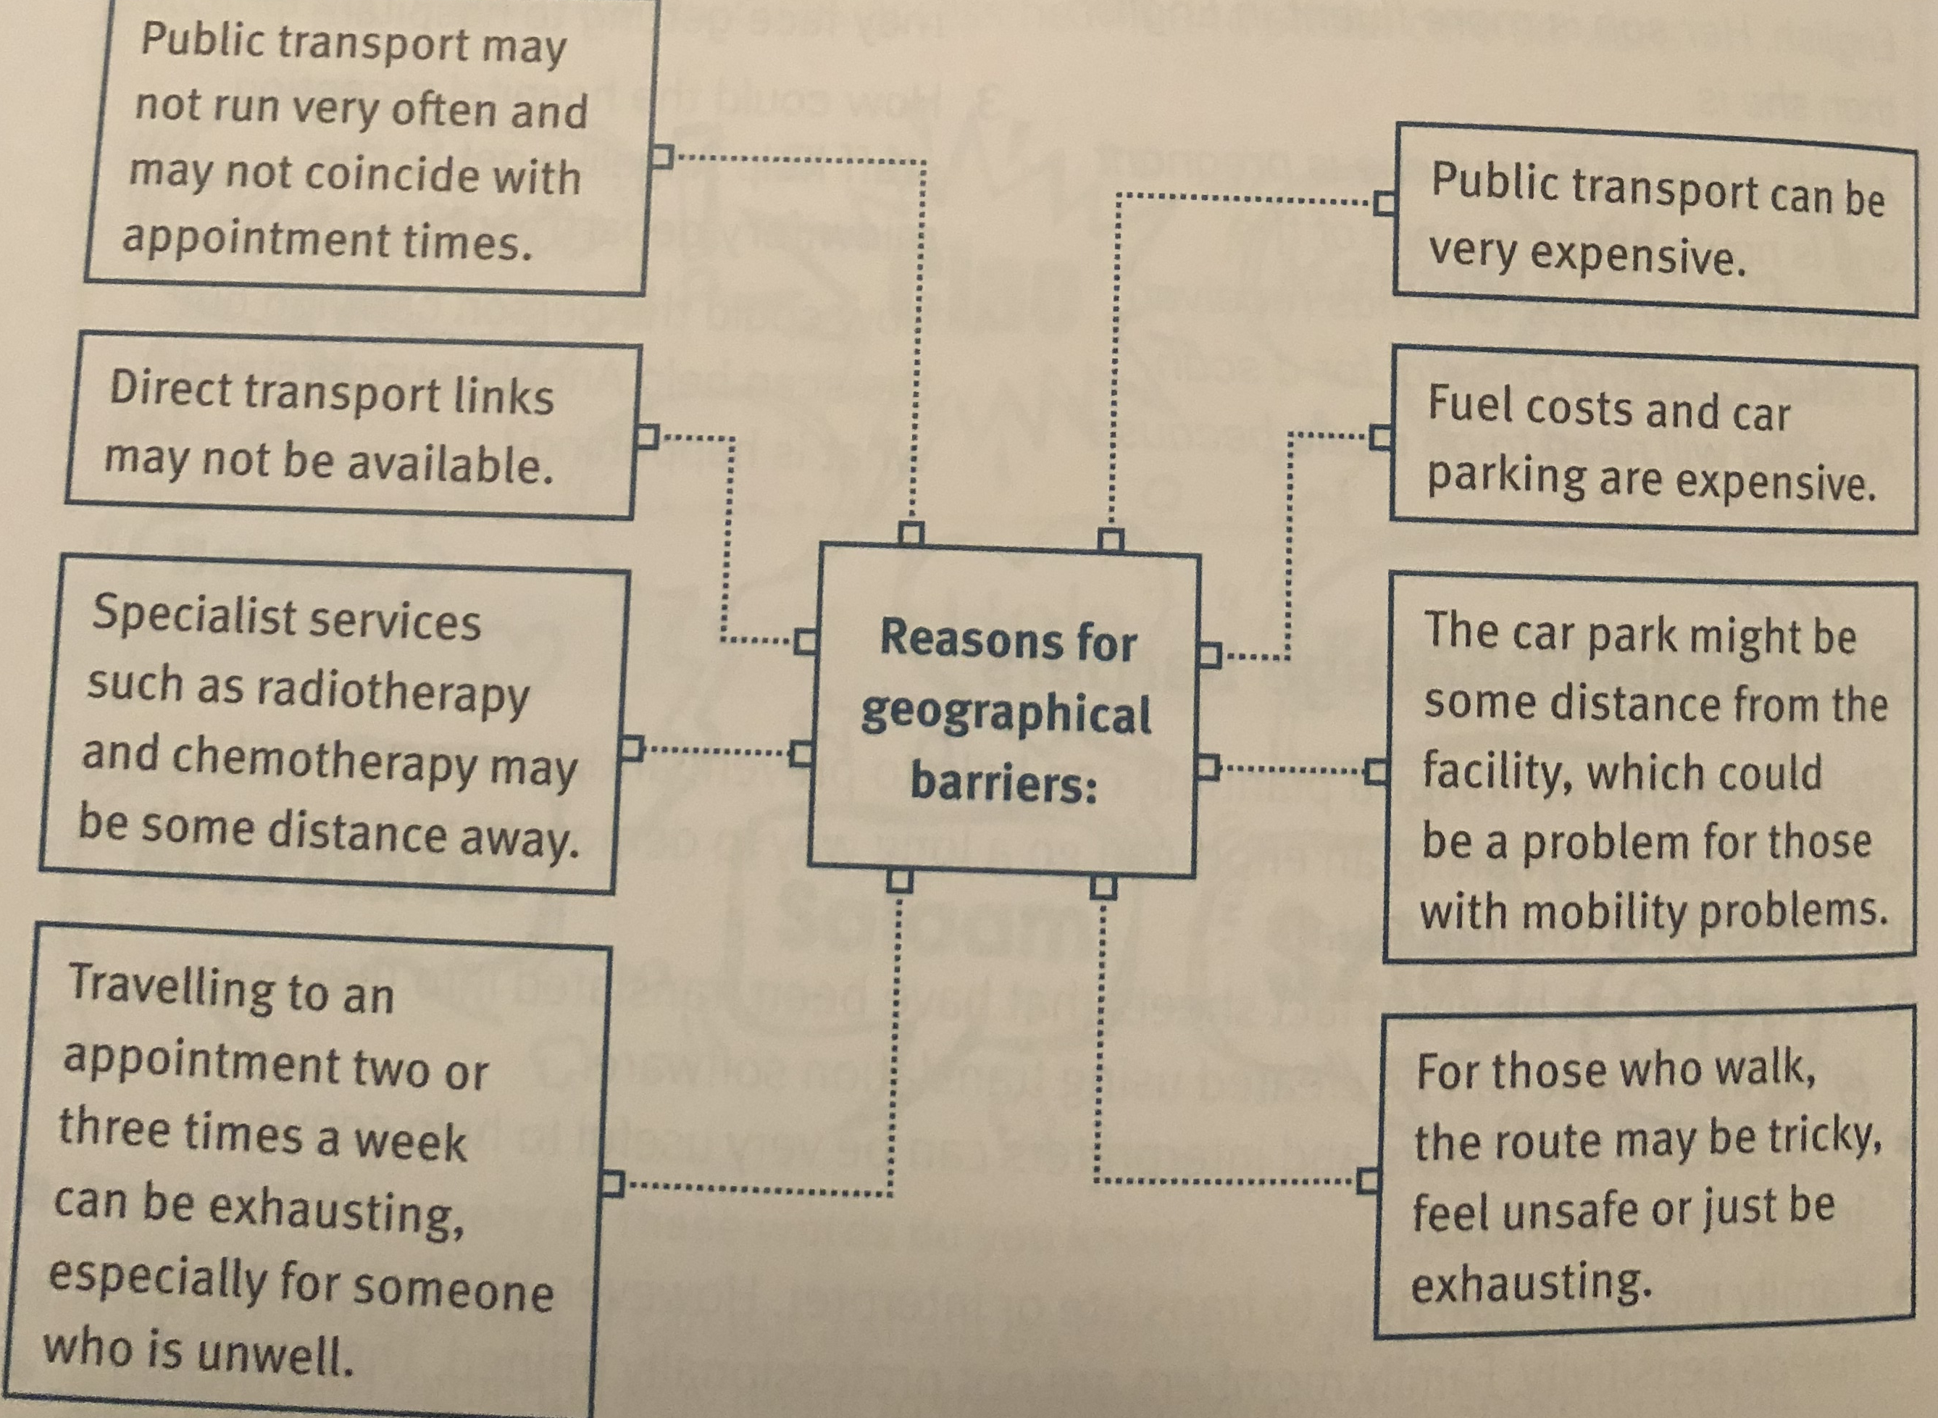
Reasons for Geographical Barriers

Slide 31
Overcoming Geographical Barriers
Local community transport schemes for disabled or elderly service users
Home/community visits
Community clinics
Telehealth schemes

Slide 32
Overcoming Geographical Barriers
Robert Case Study
Robert has been diagnosed with prostate cancer. He needs to have radiotherapy treatment in a specialist hospital 35 miles from his home. There are no direct transport links. Each treatment takes -15 minutes. He needs to attend 5 days a week for 6 weeks – that is 30 sessions in total.
To begin with, Robert was fine driving. But the treatments started to make him tired and feel unwell. So family and friends took turns to drive him there. Hospital transport was available, but the journey took much longer. Robert could have stayed in discounted accommodation close to the hospital to avoid all of the travel. But he preferred to be at home with family after his treatments. Thankfully, radiographers offered appointment times that avoided rush hours.
Make a note of all of the ways in which his geographical barrier have or could be overcome.
Challenge: What are the possible strengths and weaknesses of each of these strategies.

Slide 33
Overcoming Geographical Barriers
Answers:
Voluntary transport to and from the appointments
Nearby mobile health surveillance units
Family and friends providing transport
Local discounted accommodation
Changing appointment times
Refund car parking charges

Slide 34
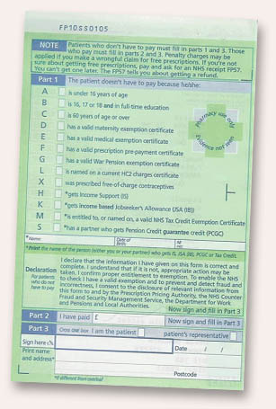
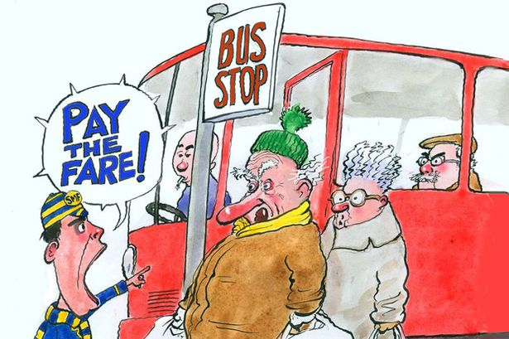

Financial Barriers
A financial barrier includes the charges or fees for using services. Some people may not be able to afford services the NHS does not provide.
What sort of services do people need to pay for?
Transport to getting to places
Childcare to be able to go to services
Medication
Dentists

Slide 35
Examples of Financial Barriers
Financial
Barrier
Cannot afford bus or train
Cannot afford precriptions
Paying for parking
Expensive to use service
Charges for certain services
Having to borrow money from friends and family

Slide 36
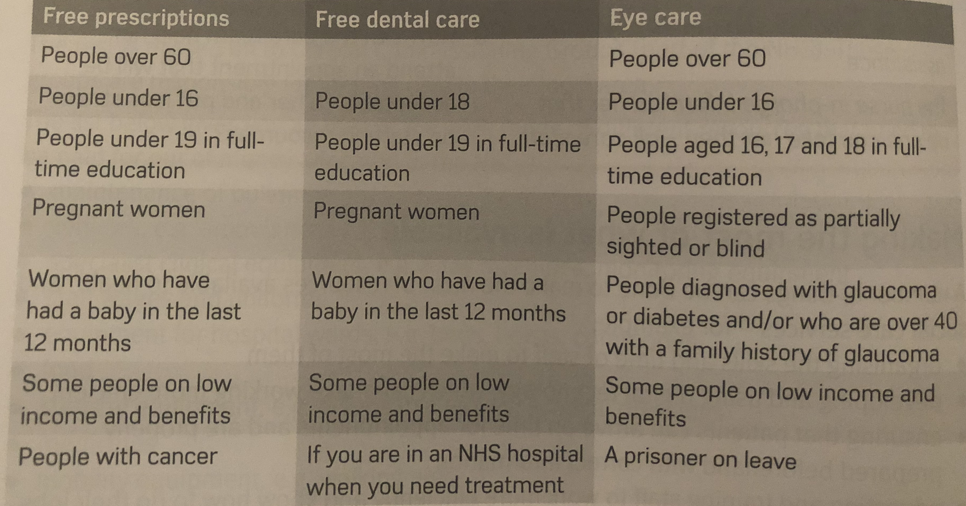
Overcoming some Financial Barriers

Slide 37
Overcoming Financial Barriers
NHS exemption certificates
NHS Low Income Schemes
NHS vouchers for eye tests, glasses and lenses
NHS Healthcare Travel Costs Scheme (HTCS)
Charitable schemes such as community transport

Slide 38
Overcoming Financial Barriers
Josephine is 30 years old and she needs to pay for NHS dental and sight tests. She made an appointment for both. Her first appointment is at the dentist and she needs to have 1 filling. The next day Josephine has her sight test and she needs to wear glasses.
a) Make a guess of how much will she pay
b) Make a guess of how much her glasses will cost
c) What will the cost be for the sight test and glasses?
d) Combine the costs of the eye test and dental cost

Slide 39
Overcoming Financial Barriers
a) Make a guess of how much will she pay
b) Make a guess of how much her glasses will cost
c) What will the cost be for the sight test and glasses?
d) Combine the costs of the eye test and dental cost
A - Answer: Band 1: £21.60 covers an examination, diagnosis and advice. If necessary, it also includes X-rays, a scale and polish, and planning for further treatment. Band 2: £59.10 covers all treatment included in Band 1, plus additional treatment, such as fillings, root canal treatment and removing teeth (extractions).
B - Answer: On average frames cost from £65 and lenses around £45 depending on the prospection needed.
C - Answer: Eye tests cost around £25 and the glasses in total are £110 so £135 in total.
D - Answer: £194.10

