Slide 1
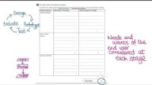
Design Strategies

Slide 2

Designers

Slide 3
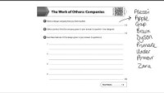
Brands

Slide 4
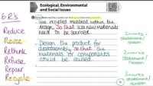
Sustainable Design

Slide 5
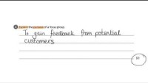
Market Research

Slide 6

Design Communication

Slide 7
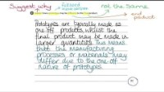
Design Communication

