Slide 1
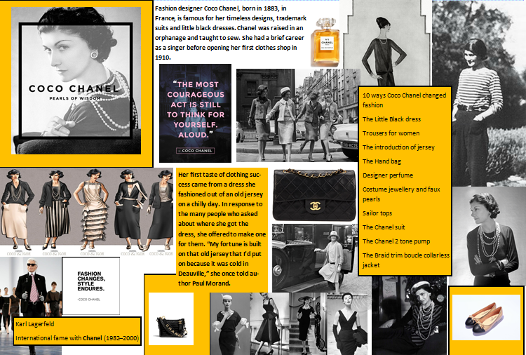

Slide 2
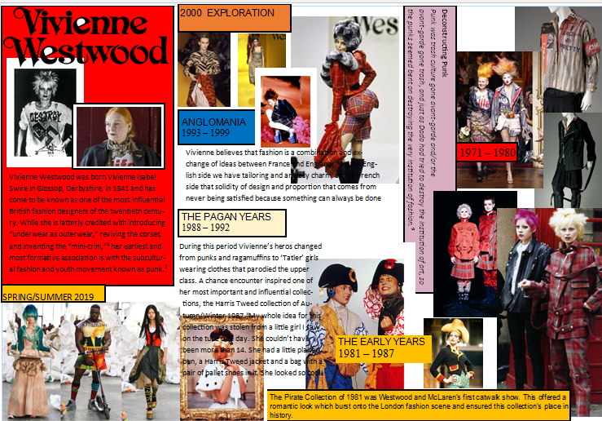

Slide 3
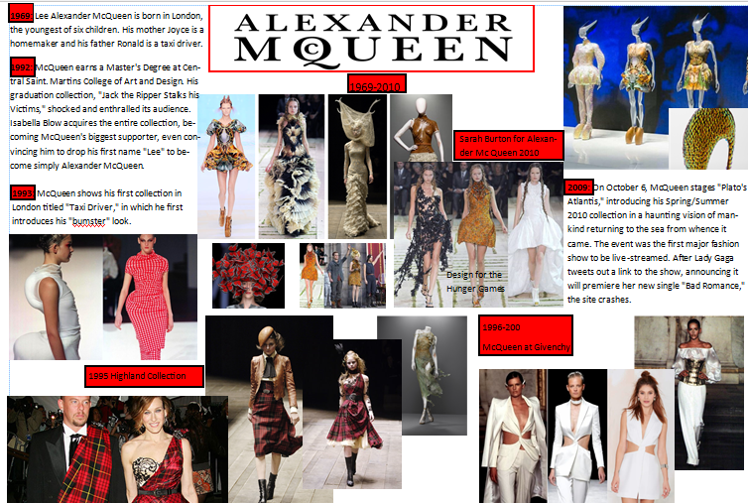

Slide 4
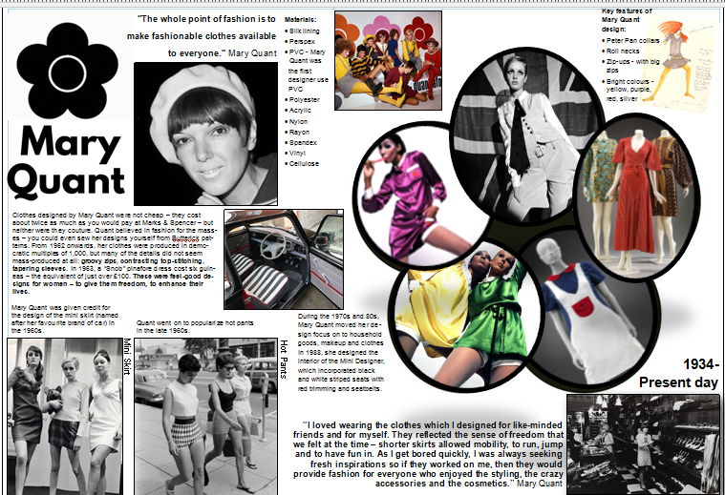

Slide 5
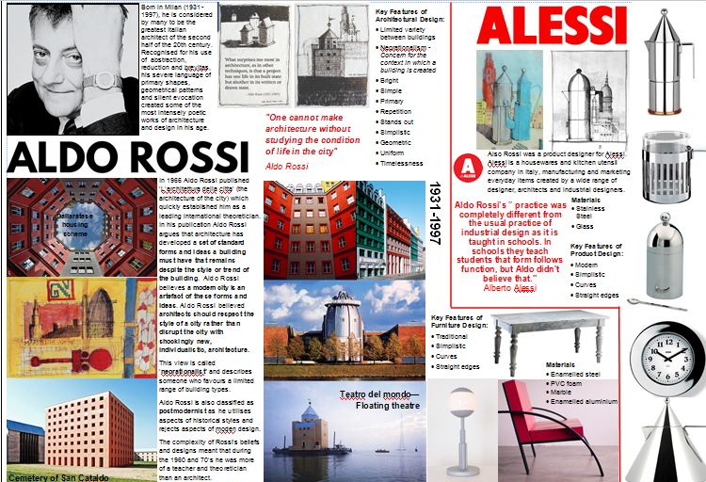

Slide 6
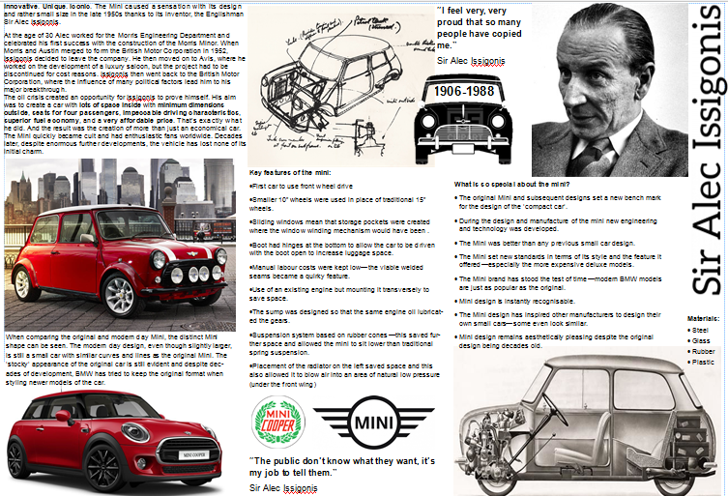

Slide 7
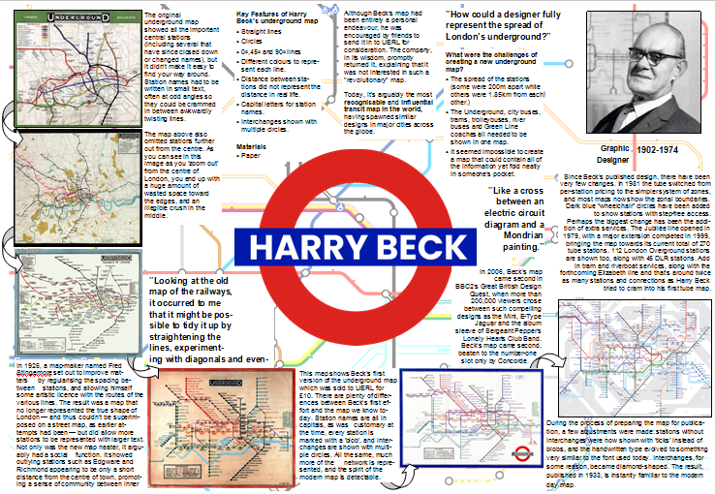

Slide 8
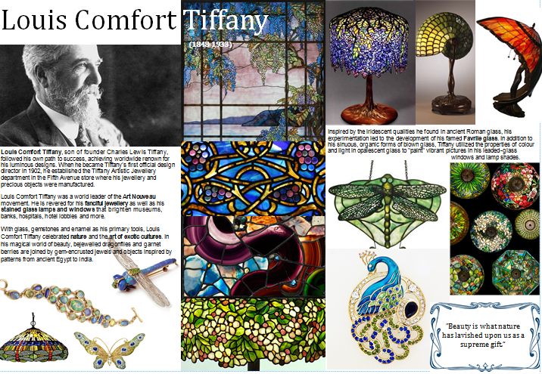

Slide 9
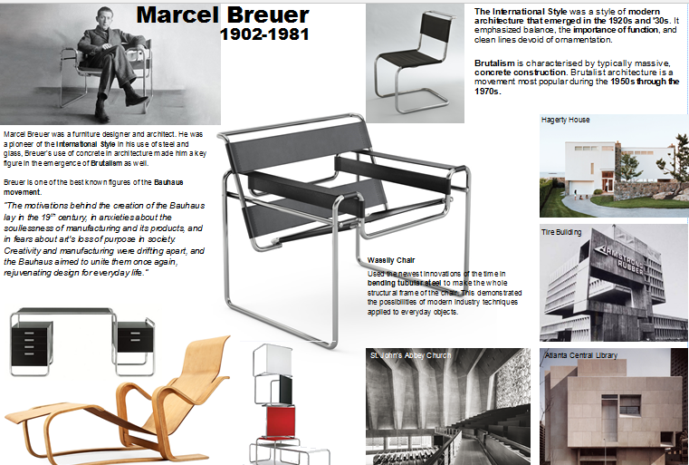

Slide 10
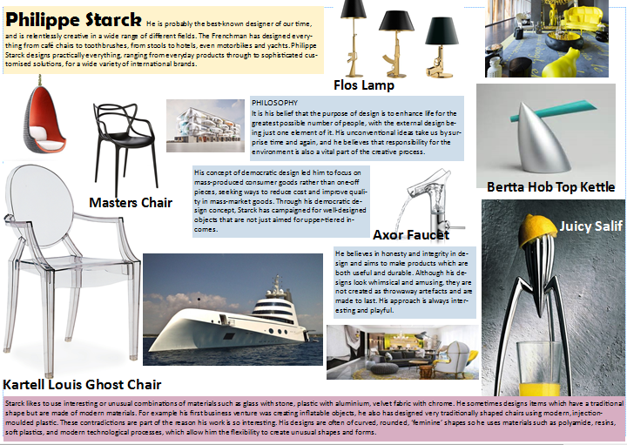

Slide 11
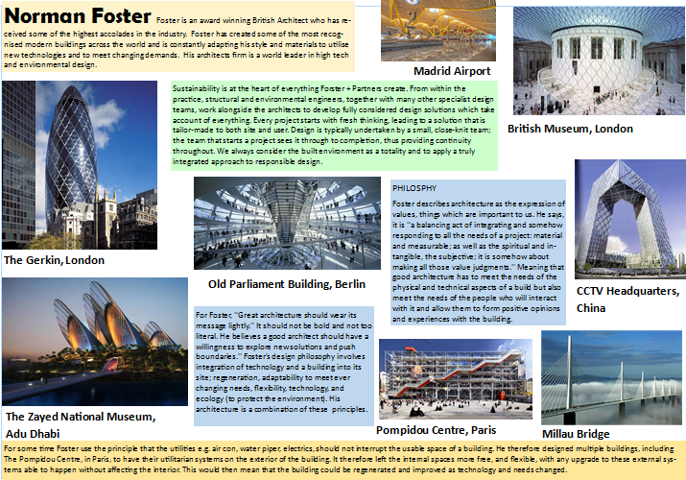

Slide 12
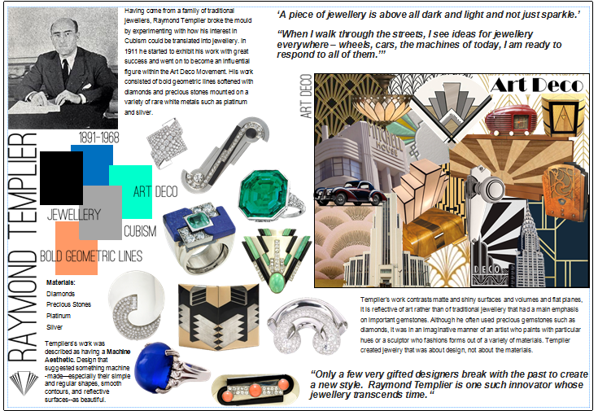

Slide 13
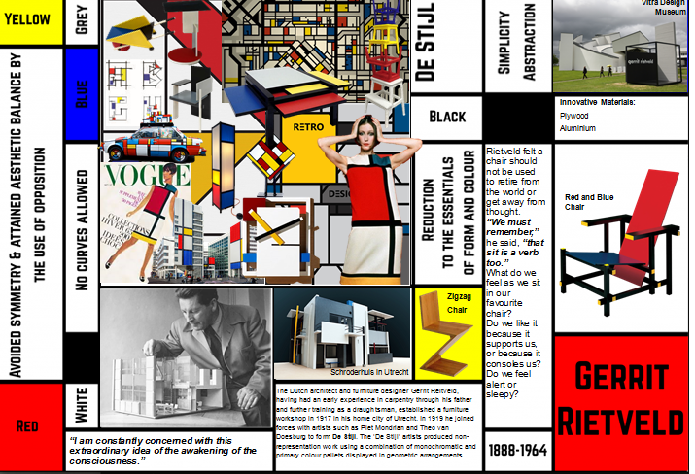

Slide 14
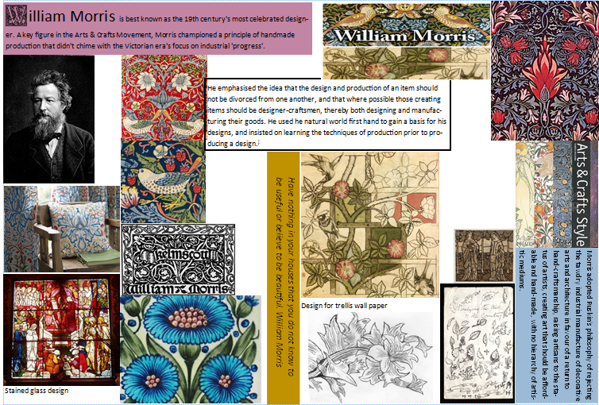

Slide 15
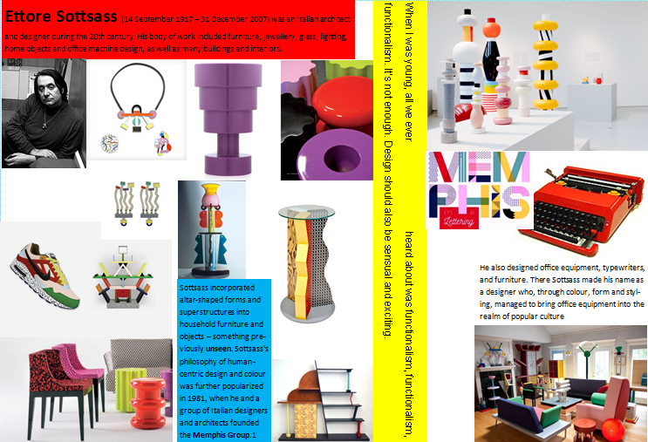

Slide 16
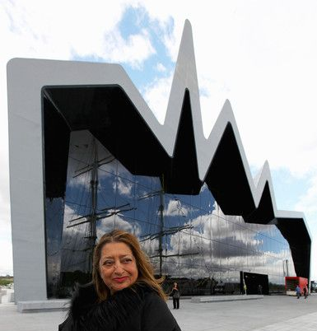
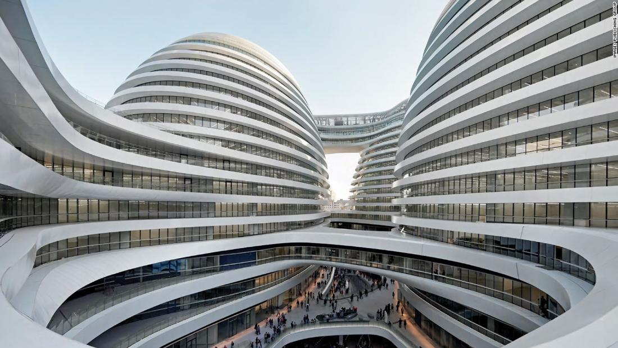
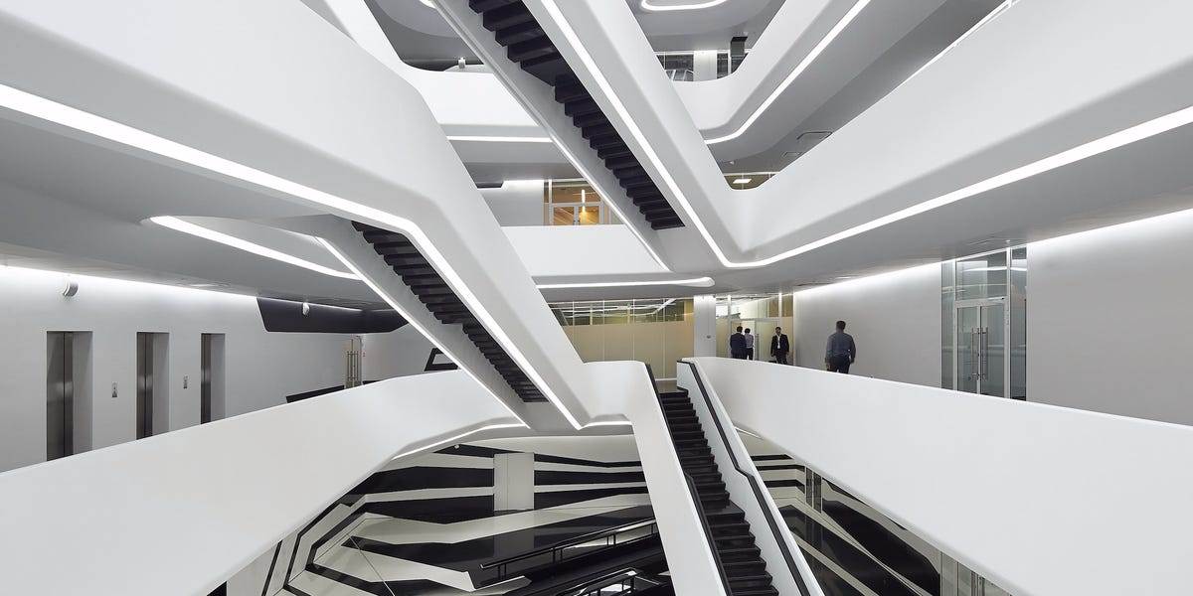
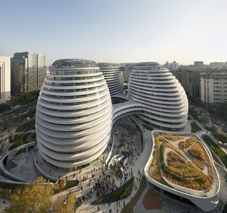
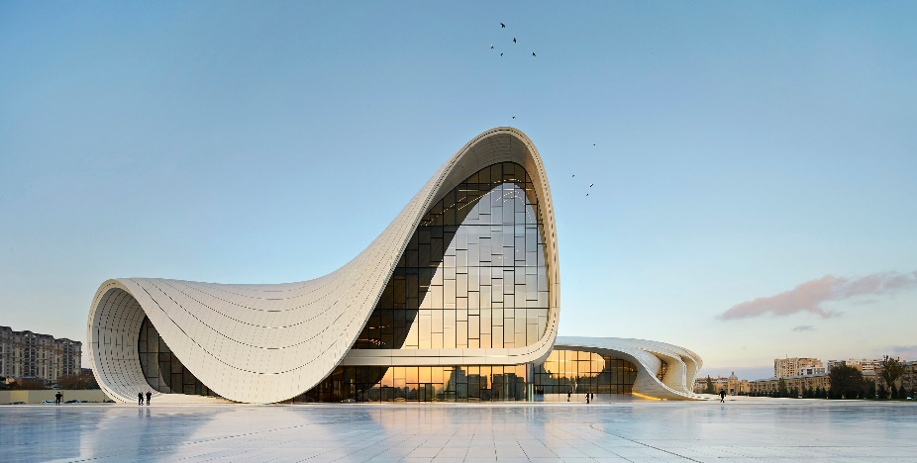
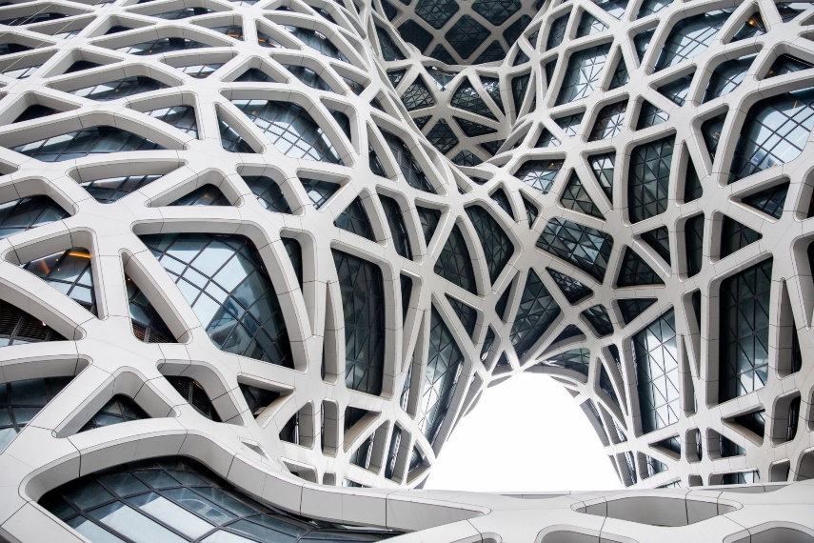
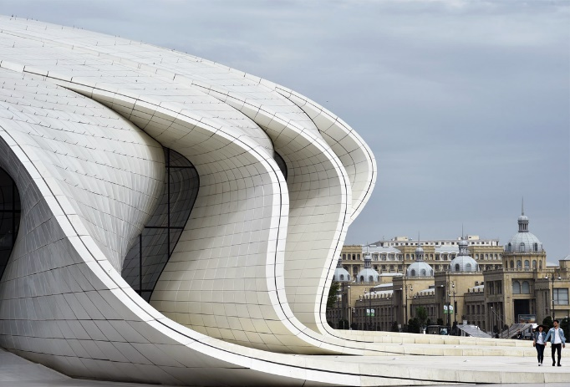
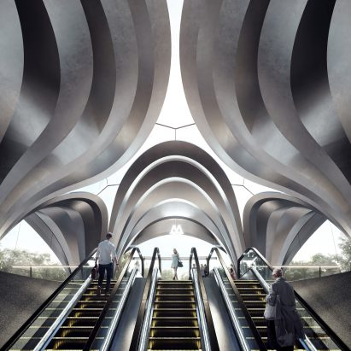
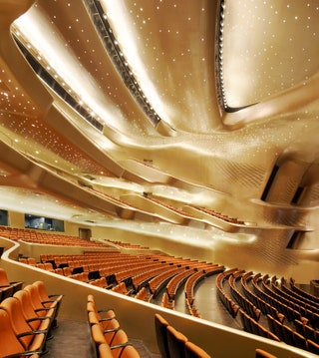
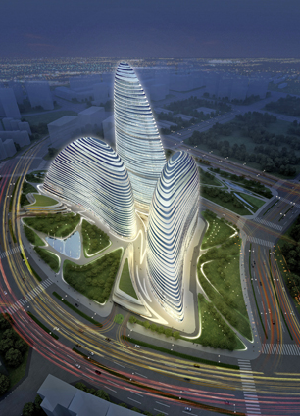
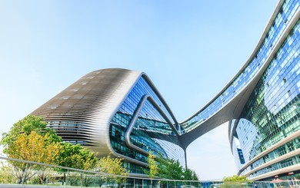
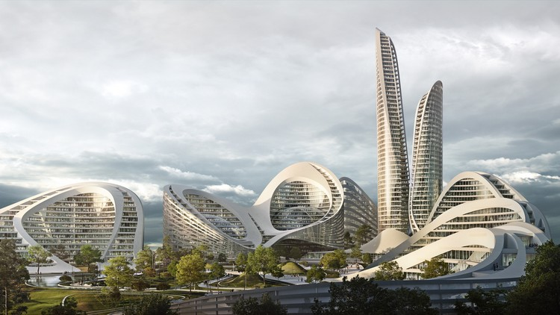
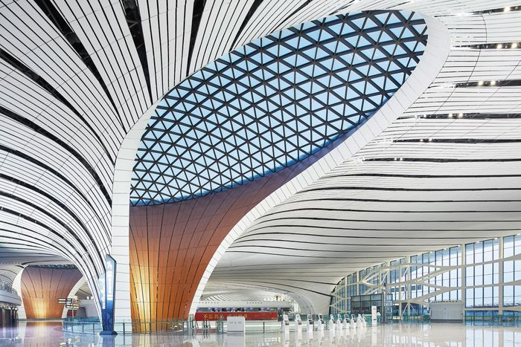
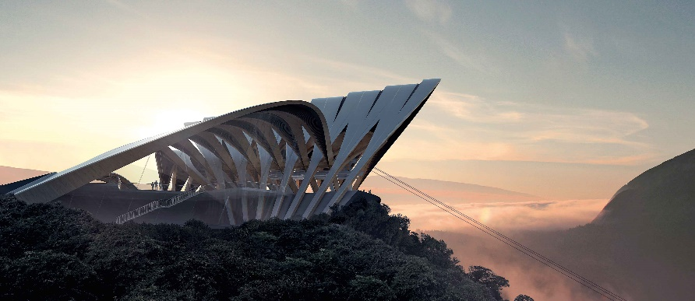
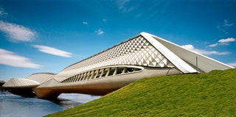
Zaha Hadid
The Iraqi-British Zaha Hadid became famous for her intensely futuristic architecture characterised by curving façades, sharp angles, and severe materials such as concrete and steel. The structures she designed successfully accomplished what mystifies so many when they observe great architecture: She took the strongest materials in the world and manipulated them to form objects that appear soft and sturdy at the same time. She claimed, architecture "must contribute to society's progress and ultimately to our individual and collective wellbeing." The buildings born of her vision and the collective genius of her firm Zaha Hadid Architects,sometimes seem fantastical, triumphant and even a bit loud, but they all stem from architecture’s base function – to support and even perform everyday life.
Hadid’s creative process for architecture began with paintings and drawings. She was inspired by Russian artists of the suprematism movement, particularly Kazimir Malevich, Vladimir Tatlin, and Aleksandr Mikhailovich Rodchenko. Suprematist painters’ work focused on geometrical abstraction. Hadid’s meticulous, beautiful paintings showed abstract versions of what she intended to realize in fully constructed buildings. She said that approaching design in this way allowed her to think differently about how to organise space.
As digital technology became a part of the everyday world, Hadid saw that her design vision could expand even further. Three-dimensional modelling and other digital tools allowed the architect and her team to recreate landscapes in the virtual world and envision new concepts for spaces.
TheZaragoza Bridge Pavilion, built in 2008, doubles as a pedestrian bridge across the Ebro River in Zaragoza, Spain. The building’s exterior, comprising 29,000 triangles, is composed of fiberglass-reinforced concrete. The Riverside Museum, an addition to theGlasgow Museum of TransportScotland, cuts a striking figure with its zigzagging zinc-clad roof. Galaxy Soho, a retail, office, and entertainment complex in Beijing, comprises four spherical structures clad in aluminium and stone that are bound together by pedestrian bridges. Hadid’s 2005 addition to theOrdrupgaard Museum, just north of Copenhagen, is constructed from black lava concrete and glass, which reflects its lush surroundings. TheGuangzhou Opera HouseChina’s Guangdong province is shaped to resemble two pebbles on the bank of the Pearl River. The interior of the shimmering main auditorium is lined with panels of gypsum moulded in flowing, organic shapes and lit with thousands of tiny lights that resemble stars in the night sky. Clad in reinforced concrete and polyester, the 619,000-square-footHeydar Aliyev CentreBaku, Azerbaijan, is known for its swooping façade.

