Slide 1
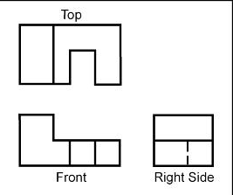
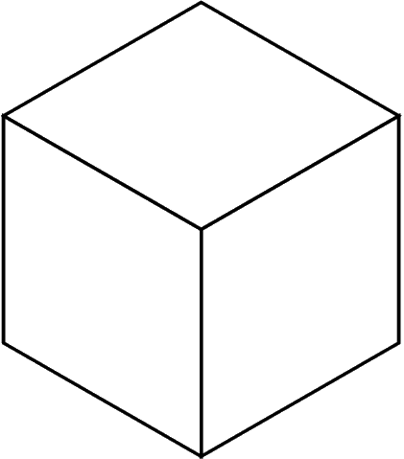
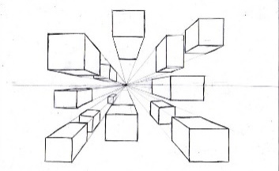
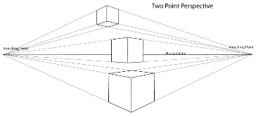
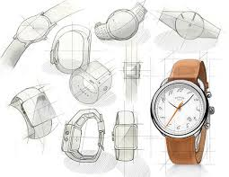
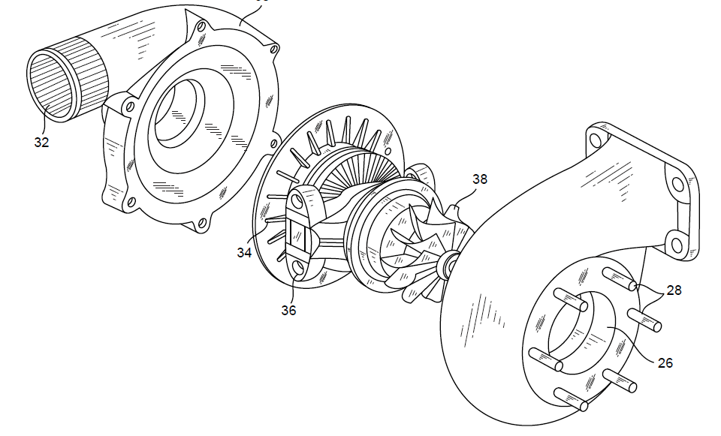
Briefs, Specifications, ideas and development
Technique | Description/ notes | Diagram
Orthographic Projection/ Working Drawings | Includes “Front”, “Plan” and “End” 2D Views, and often an Isometric 3D View Standardised method for scale, dimensions and line types Great for manufacturing
Isometric | Common 3D sketching method Can be drawn free-hand or using isometric paper and ruler Angles are at 30 degrees Great for seeing most of the products
1-Point Perspective | A 3D drawing method Often used by interior designers and architects Gives drawings depth Only uses 1 vanishing point
2-Point Perspective | Used for 3D designs Exaggerates the 3D effect Objects can be drawn above of below the horizon line but must go to the 2 vanishing points
Annotated Drawings/ Free and Sketches | Quick and easy way of getting ideas down Range of ideas can be seen Annotation helps explain designs further
Exploded View | Helps see a final design of a product and all it’s parts Can see where all the parts fit Great for manufacturers
Design Briefs
A Design Brief is the statement of how you will solve the Design Problem
It will often include:
Constraints/ limitations
What the product is
Materials/processes
Any key information you know
Design Specifications
A Design Specification is a list of requirements your product has to meet in order to be successful
It is also useful for evaluation. If your product hasn’t met the Spec then it gives you a starting point for improvements.
Aesthetics | What the product looks like? Style? Colour Scheme? Design Movement?
Customer | Who would buy it? (Age, gender, socio-economic, personality) How does the design appeal to them?
Cost | How much will it cost? (min-max) Why?
Environment | Where will it be used? Why? How will you make it suitable?
Safety | How is it safe? How will it be checked? Why must it be safe?
Size | What is the maximum or minimum size? Why?
Function | What does the product do? What features make it do that function well? How is it unique from similar products?
Materials | What is it made from? Why?
Manufacture | How might it be made? Why? What scale of production? Why?
Modelling and Development
Modelling and development are key to testing and improving products
This can be done physically using materials like; card, foam, clay, man-made boards or virtually in CAD
Modelling helps the designer get feedback from the customer, check aesthetics, function, sizes and even materials and production methods and change them if needed

Slide 2
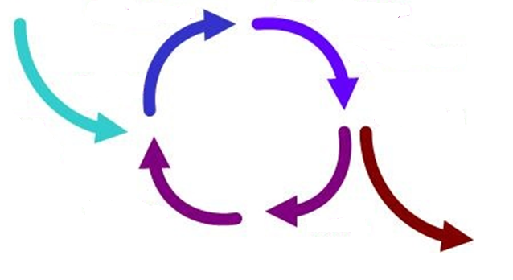
Design Strategies
Design Strategies are used to solve Design Fixation, and help develop creative design ideas.
Iterative Design
A Proposal is made
It is then planned and developed to meet the brief
It is analysed and refined
It is then tested and modelled
Systems Approach
Usually used for electronic products
Often uses diagrams to show systems in a visual way
Planning the layout for the correct sequences e.g. inputs, outputs, timings, etc
Electronics and mechanical systems need an ordered and logical approach
Then evaluated against the brief – many versions fail but that then informs development to make the idea better
The cycle then repeats and if the product is successful it is then made and sold on the market
Systems Approach
Advantages | Disadvantages
Does not need specialist knowledge Easy to communicate stages Easy to find errors | Sometimes over-simplifies stages Can lead to unnecessary stages
Iterative Design
Advantages | Disadvantages
Consistent testing helps solve problems earlier Constant feedback Easy evidence of progress | Designers can loose sight of “the big picture” Time consuming
Collaborative Approach
Working with others to share data and solving problems and coming up with design proposals can help with creativity
User-Centred Design
This is when designs are based on fulfilling the needs and wants of the Users/ Clients at every stage of the design process
Numerous companies work in teams, and has been shown to improve the range and quality of ideas produced
Questioning and testing is ongoing and is often found through interviews, questionnaires, surveys, etc
Collaborative Approach
Advantages | Disadvantages
Gets multiple opinions and a range of views Working in groups can produce more ideas | Can be difficult to design ideas with opposing views Can be difficult to find time to communicate with multiple people
User-Centred
Advantages | Disadvantages
User feels listened to Makes sure the product meets their needs | Requires extra time to get customer feedback If focused on just one person it can limit appeal to others

Slide 3
Scales of Production
Name/ Type | How many it makes | Key Info | Examples of Products
One-off Production | 1 | Also known as Bespoke or Prototype manufacture Custom-made products Specialist workers/ skills Specialist machines and materials High Quality but expensive | Towers / Bridges One-off Houses Custom made clothes
Batch | 10s-1000s | Uses a mix of workers and machinery Uses jigs, moulds and templates to help make identical products Stations of workers e.g. cutting station, painting station, etc Can have some variation e.g. colour, finish, flavour | Baked foods Limited edition car Socks Chairs
Mass | 10,000s - 100,000s | Big assembly lines (and sub-assembly lines) Heavily automated Standard and identical products Little worker input | Cars Bottles Microchips Plain shirts
Continuous | 100,00s + | 24/7 production Heavily automated Standard and identical products Little worker input | Energy Water Paper Plastic
One-off Production
Advantages | Disadvantages
Custom made High Quality Materials High Quality Craftsmanship | Time consuming Specialist training for workers Expensive to buy
Batch Production
Advantages | Disadvantages
Lower cost than one-off Jigs, moulds and templates help products look identical Can have some variety | High storage costs Jugs, moulds and templates have to be checked Workers can become bored on their station
Mass Production
Advantages | Disadvantages
Large amounts made at once All products are identical and to same standard Using automation reduced human error | Initial starting costs are high If production line stops, the product can’t be made Workers become bored monitoring machines and repetitive tasks
Continuous Production
Advantages | Disadvantages
Large amounts made at once All products are identical and to same standard Using automation reduced human error | Initial starting costs are high If production line stops, the product can’t be made Workers become bored monitoring machines and repetitive tasks

Slide 4
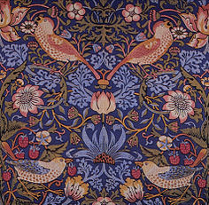
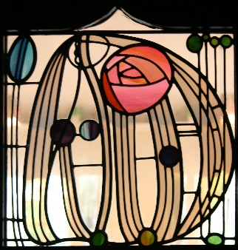
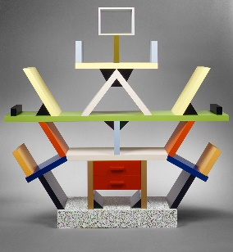
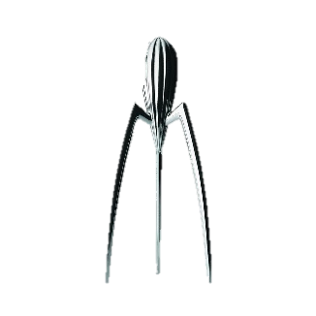
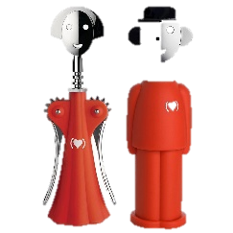

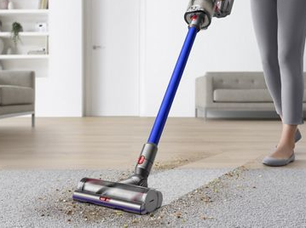
Work of others and Customer Research
Work or Others
Image/ Example | Designer | Design Movement | Key info
 | William Morris | Arts and Crafts | British designer in 1880s Simple natural crafts Useful and beautiful products (wallpapers, cushions, etc)
 | Charles Rennie Mackintosh | Art Nouveau | Scottish designer in 1860s – 1920s Known for light and shadow Created stained glass and furniture Inspired by nature and geometric lines
 | Ettore Stottas | Memphis | Italian designer in the 1950s/60s Enjoyed making everyday objects wacky and bold Used lots of bold colours and black lines
Research
Product Analysis
Case studies
Interviews
What methods of research can be used to find information?
Questionnaires and surveys
Materials testing
Social media and email
Research can be divided into 2 categories; Primary Research and Secondary Research.
Primary is research you complete yourself.
Secondary is research from resources others can gathered e.g. books, magazines and internet
Primary research is generally more reliable as it is done by the person using it and can double-check the data
Image/ Example | Brand | Key info
 | Alessi | Italian Design Company Homeware and kitchen utensils “Post-modern” style Phillipe Starke is a major designer
 | Apple | USA-based tech company Famous for iconic designs of iPod and iPhone Steve Jobs and Johnathon Ive are major designers Known for innovative and modern design
 | Dyson | British engineering company Famous for vacuum cleaners and innovative technology James Dyson is a major designer
Another key piece of research, is Anthropometrics and Ergonomics. This helps develop the sizes of products, etc to make sure it fits the User
Anthropometrics | The study of measurements of the human body. E.g. Knowing the grip width of a palm, if designing a new travel coffee cup
Ergonomics | The application of anthropometrics to ensure products are safe and comfortable to use. This can also include; size, material, appearance, brightness, sound and texture. E.g. making sure the travel cup is the correct size, and an insulating smooth material to make it comfortable to hold for long periods

