Slide 1
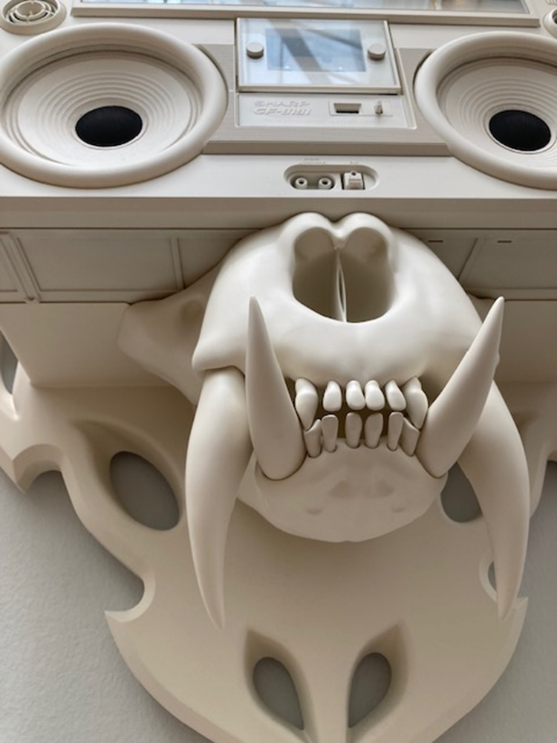
Year 11
Assessment objectives
You are given a mark out of 24 for each of the assessment objectives
AO1: Develop ideas through investigations, demonstrating critical understanding of sources.
AO2: Refine work by exploring ideas, selecting and experimenting with appropriate media, materials, techniques and processes.
AO3: Record ideas, observations and insights relevant to intentions as work progresses.
AO4: Present a personal and meaningful response that realises intentions and demonstrates understanding of visual language.
How we mark an Art project.
Your project is marked using 4 different assessment objectives. This will give you a good idea about what you need to do to improve.
1/Coursework projects Environment & Strange and Fantastic marked /96 marks
2/Exam Projects /96 marks

Slide 2
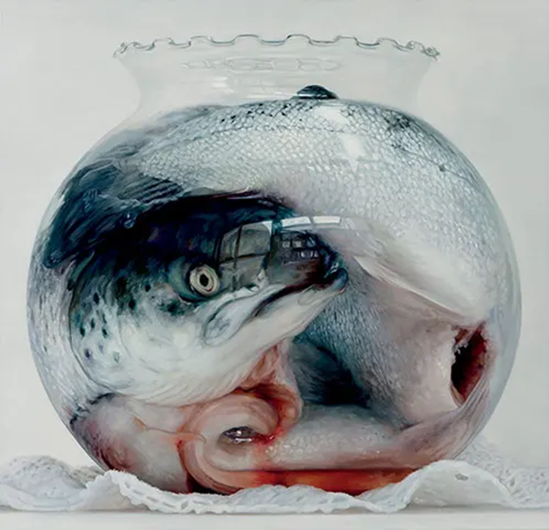
Assessment objectives
You are given a mark out of 24 for each of the assessment objectives
AO1: Develop ideas through investigations, demonstrating critical understanding of sources.
This includes the following:
ability to effectively develop ideas through creative and purposeful investigations. Making it clear that your ideas are moving on.
Using your artists and research to help you develop ideas and techniques
Trying out ideas in different ways which help you move towards your final pieces.

Slide 3
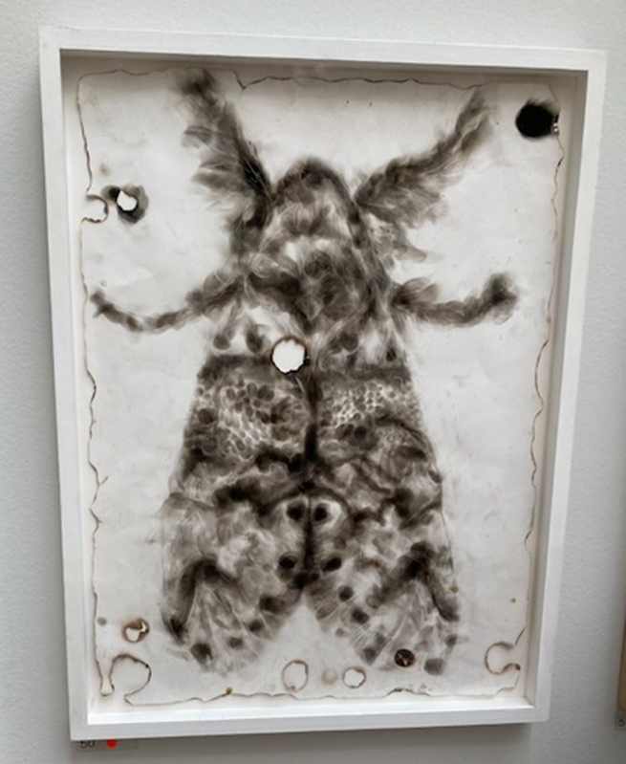
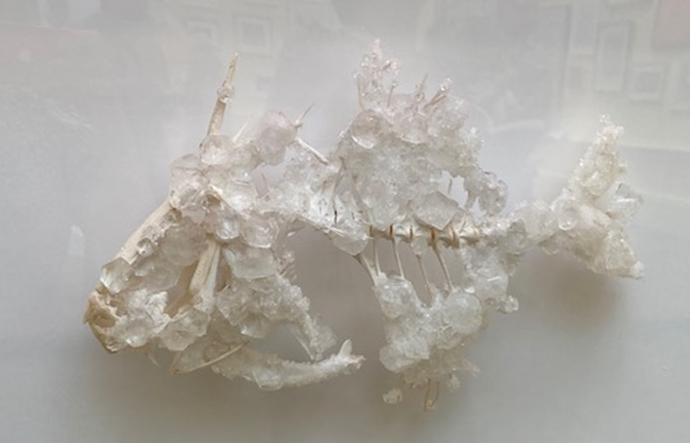
Assessment objectives
AO2: Refine work by exploring ideas, selecting and experimenting with appropriate media, materials, techniques and processes.
This includes:
ability to thoughtfully refine and improve ideas
Testing out materials and different techniques to work out which ones will work best for you.
Being experimental with materials, tools, layouts.
Selecting the right materials for your idea.
This is not about repeating the same image in lots of different materials. You should be learning something new from each experiment.

Slide 4
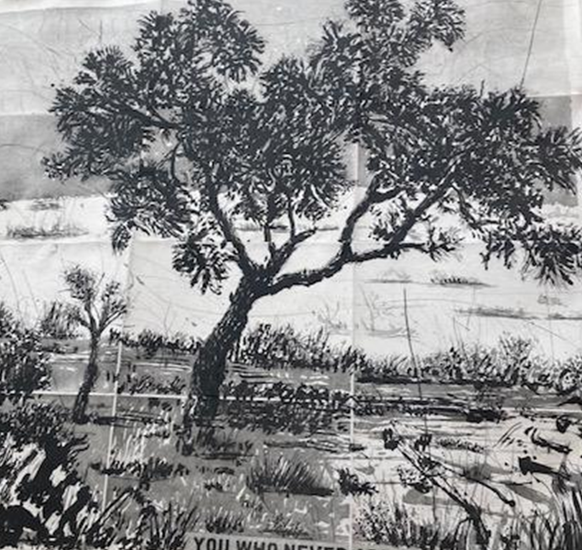
Assessment objectives
AO3: Record ideas, observations and insights relevant to intentions as work progresses.
This includes:
The quality of your drawing, painting, printing, photography etc.
How clear your ideas are in the book and how well you review your idea and try to improve it.
Using annotations to explain your ideas

Slide 5
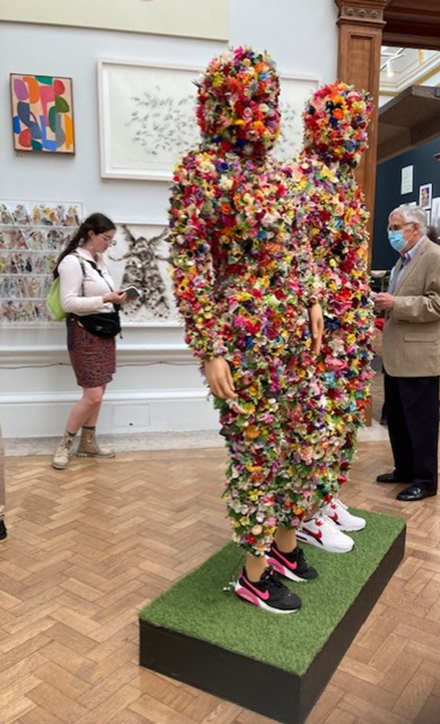
Assessment objectives
AO4: Present a personal and meaningful response that realises intentions and demonstrates understanding of visual language.
This includes:
The final piece/visual conclusion to your project
How well you have made links between the research, development and the final piece.
Making sure the final pieces has been explored in the final development pages of the book.
Making sure the idea is personal and isn’t just a good copy of someone else’s wok ☺
Be ambitious with your final pieces and ensure they are top quality ☺

Slide 6
3 drawings | Experimental Drawings exploring different types of drawings and mark making (pencil, bio, pen studies, colour pen can work too­) Try 3 different techniques. Pointillism Short strokes line Scribbles Cross hatching knitted lines Circular

Slide 7
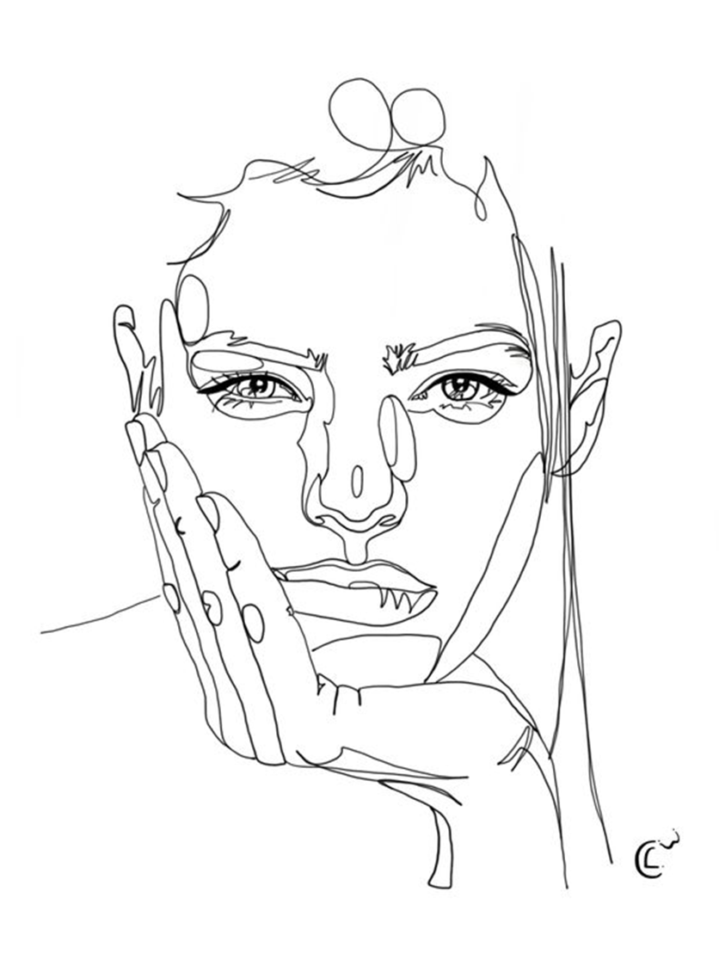
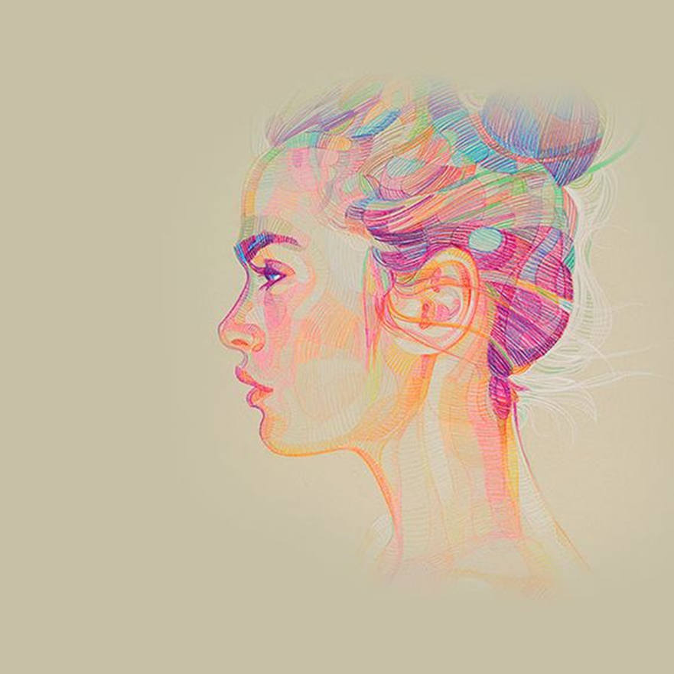
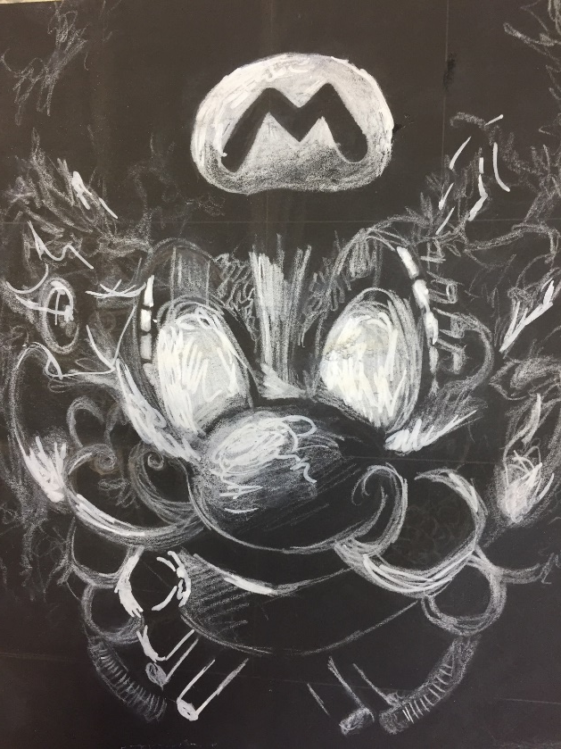
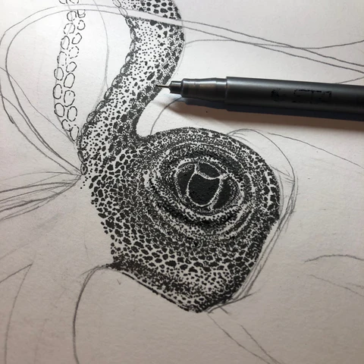
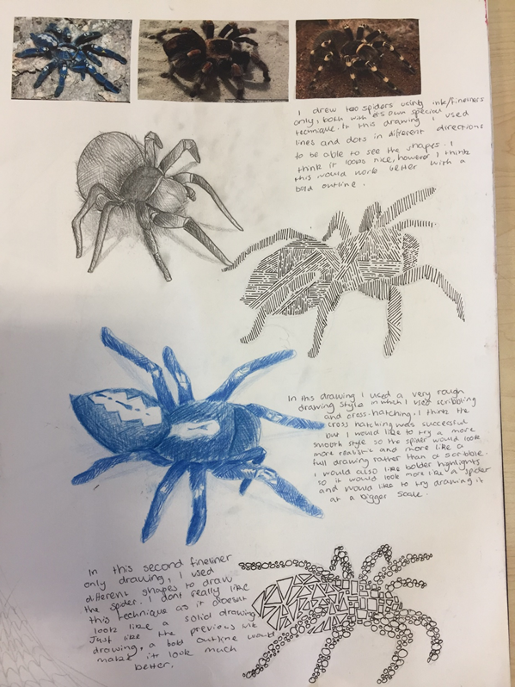
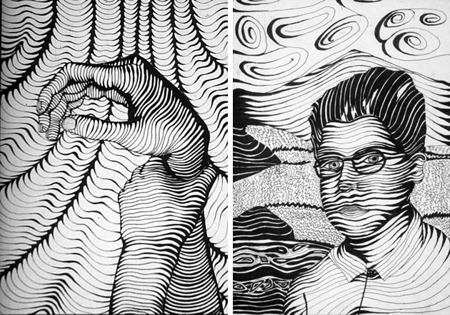

Continuous lines
SCRIBBLES/CIRCULAR
THE OPTIONS…….
Cross hatching
Line
Pointillism (drawing with dots)
Strange and Fantastic is a broad title, do not feel restricted to portraits unless you want to.
SHORT LINES
Directional line
& knitting lines together

Slide 8

Annotate
Which mark making techniques have been the most effective on your piece of work?
How could you push your favourite technique forward? (slightly different technique, material, difference surface, size and background)
Pointillism
Short strokes line
Scribbles
Cross hatching
knitted lines
Circular

