Slide 1
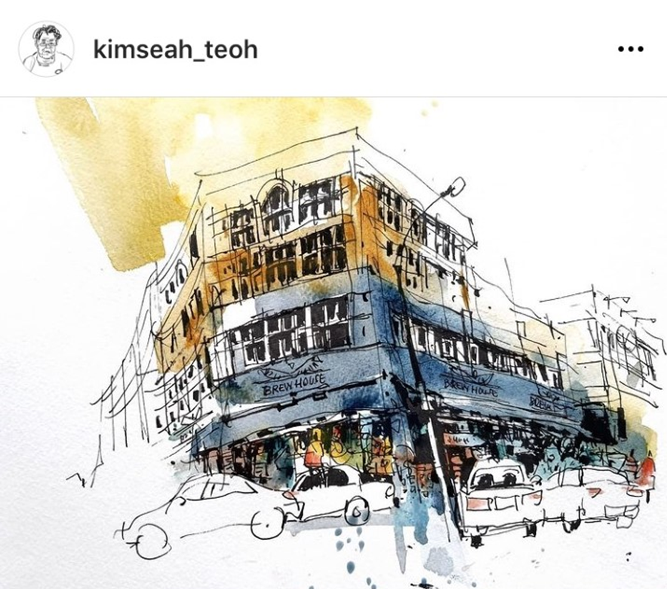
https://www.youtube.com/watch?v=cDzcoyeaRKI
Watch the video which focuses on different painting techniques

Slide 2
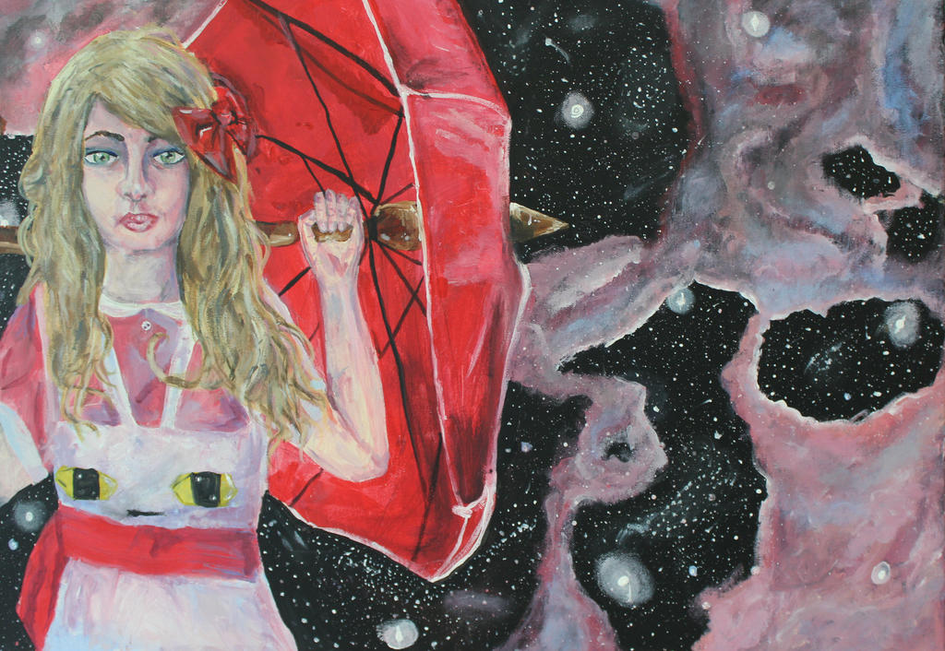
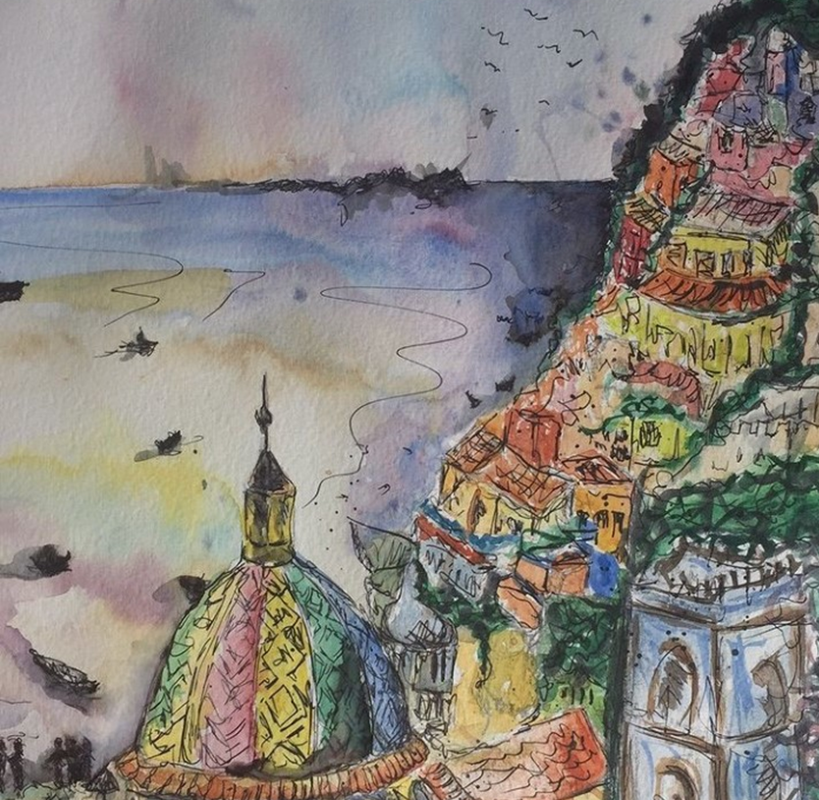
Lesson Objective: 1/Learning to experiment with colour palette choices to change the mood.
2. Develop brush control.
Loose pen marks can help pick out details
Select a strange and fantastic related image.
Sketch out brief line shapes
Mix your colour palette
Apply light washes of paint
Dry
Build up darker tones to layer on top.
Dry
Pen work if needed or extra layers of paint
Shadows
Washes to start can help break up the page or canvas
Layers of watercolour/acrylic
Mix different shades of the colour on your palette
Loose lines
Adding water to your paint can give the image more energy and movement

