Slide 2
Jealous Curator
Tate
Saatchi Gallery
This is colossal
The Art Story
Pinterest
Artsy
Art2day
TheCoolHunter
Artnet
LensCulture
Museum of Modern Art
HOW DO I FIND AN ARTIST TO RESEARCH?
TRY THESE SITES

Slide 3
Question for your artist page
Complete the following questions for artist Kate MacDowell . You may want to carry out extra research into his artwork to find out extra information about the meaning of the art work. Record the answers neatly next to your work in the style of the artist.
Who created the art work?
Describe the artwork using the relevant keywords as though you were explaining it to someone who cannot see it.
Are there any recurring themes in their work?
Keywords
Shape
Pattern
Line
Form
Colour
Tone
Texture
Repeat
Intricate
Expressive
Photorealism
Foreground, mid ground & background
Mood
Space
Street art/graffiti
Monochromatic
Fragile
Environment
3D sculptures
Surreal
Composition
What do you know about the materials the artist has selected?
Why have they chosen these materials? Why are they suitable for this piece of art?
e.g. The artist has used washes of paint & ink to create movement and feelings of confusion.
What is the artist trying to convey with the artwork? Is there a message/meaning/story behind the work?

Slide 4
Looking for an artist to inspire your Strange & Fantastic project?
https://www.artistaday.com/?page_id=17683 This website is great for seeing thousands of artists and you can even look at top ten results for specific themes. E.g. work featuring butterflies.
You don’t need to select artist now, but it might be useful to jot some names down of any artists you like the look of.

Slide 5
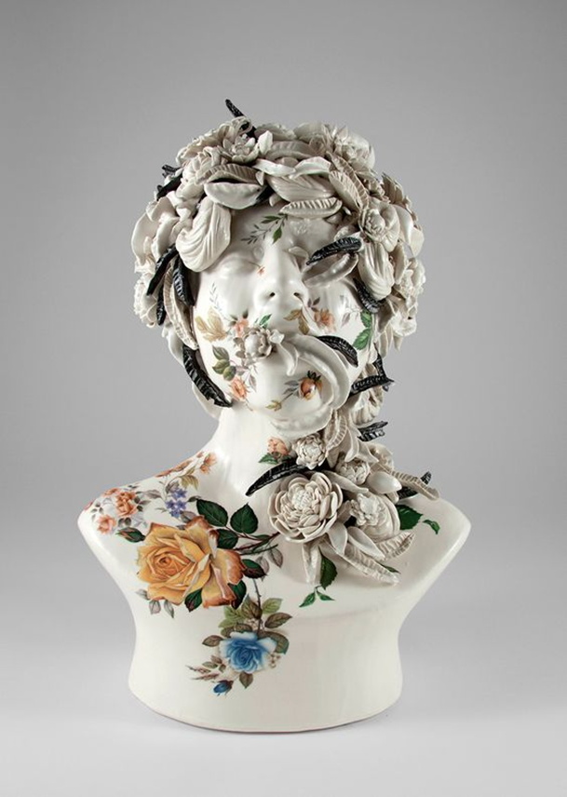
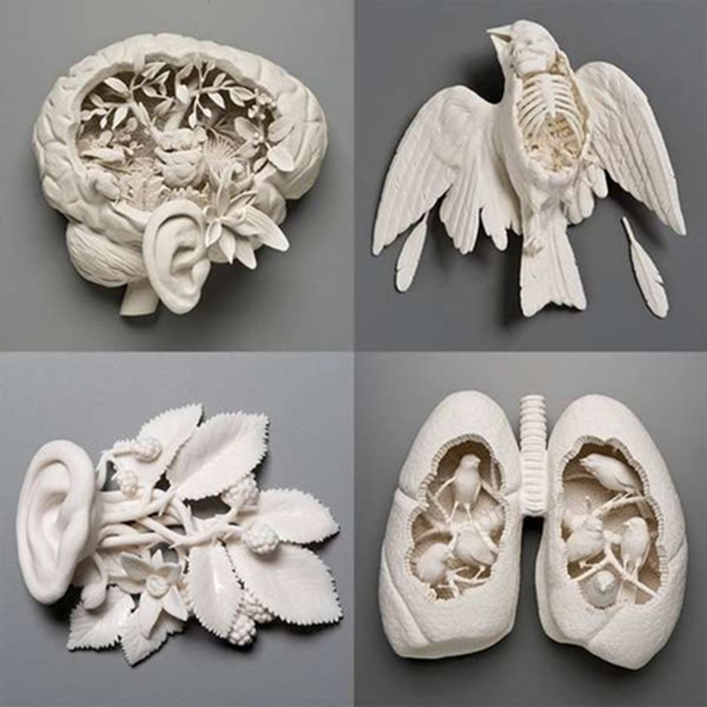
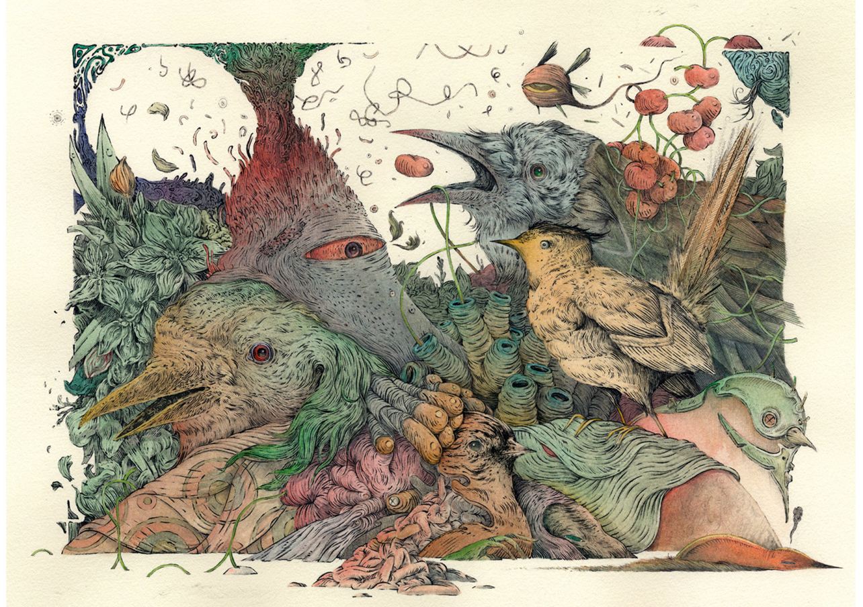
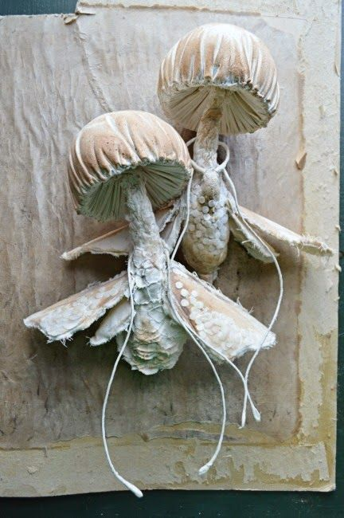
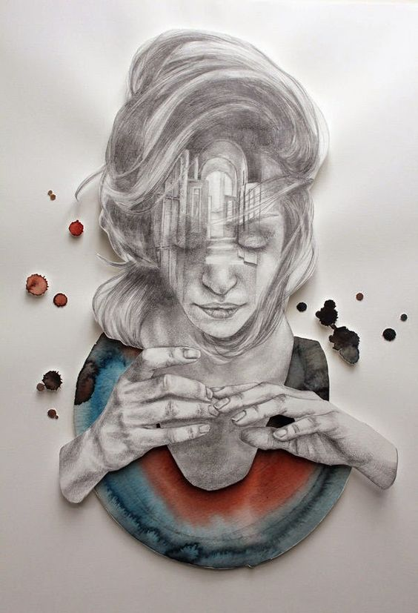
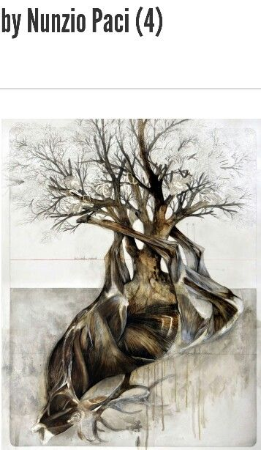
STRANGE & FANTASTIC ARTISTS
Vorja Sánchez
Mister Finch
Kate MacDowell
JESS RIVA COOPER
Christine Kim

Slide 6
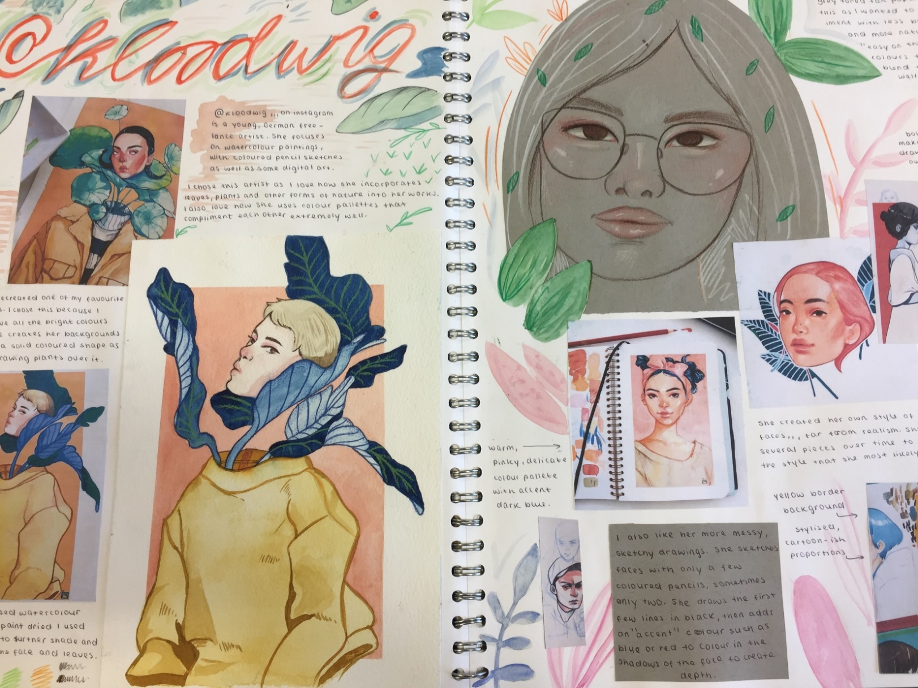
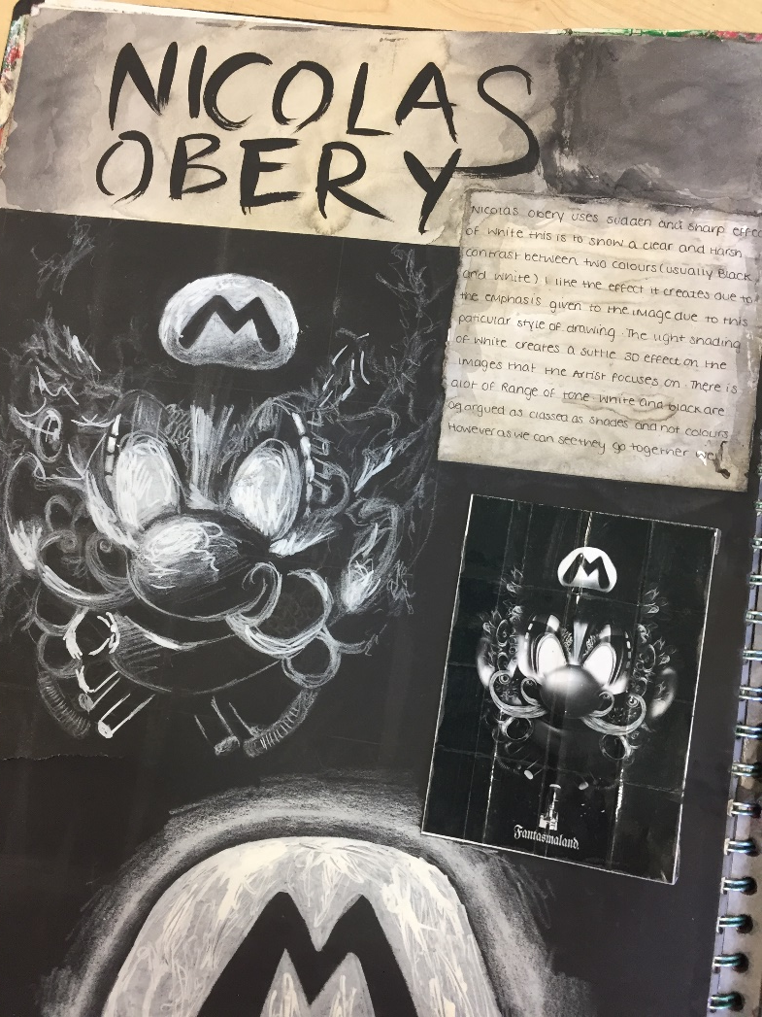
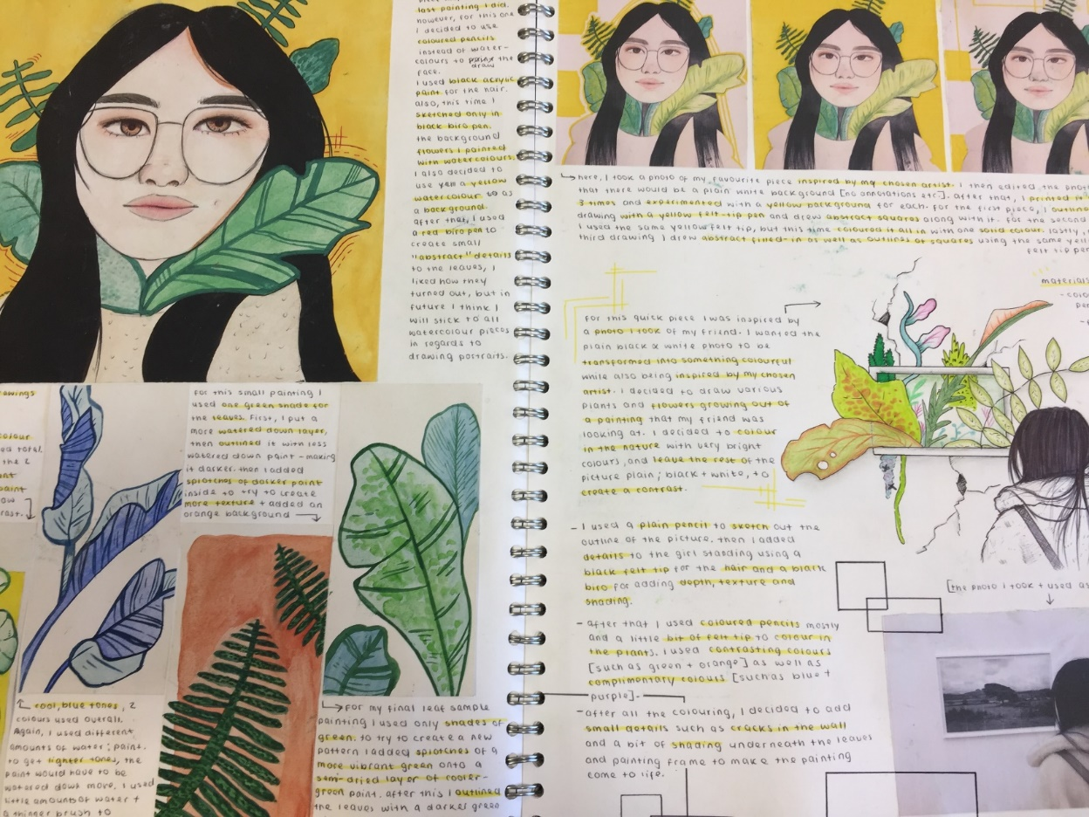
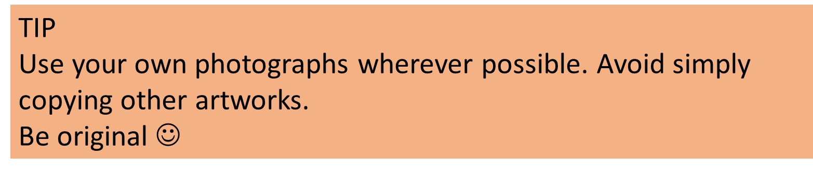
Examples of Artists Pages (A01)Develop a critical understanding of sources
THINK ABOUT APPROPRIATE BACKGROUNDS FOR YOUR ARTIST’S WORK & RESPONSES.

Slide 7


Made using the student’s own photographs
Keep quality of your work high.
Experiment with your own compositions and photographs.
Show you understand the artists style and technique, but most importantly use it to enrich your own ideas and images!
Block solid colour background and plants inspired by the artist.
Colour palette also inspired by the artist

Slide 8
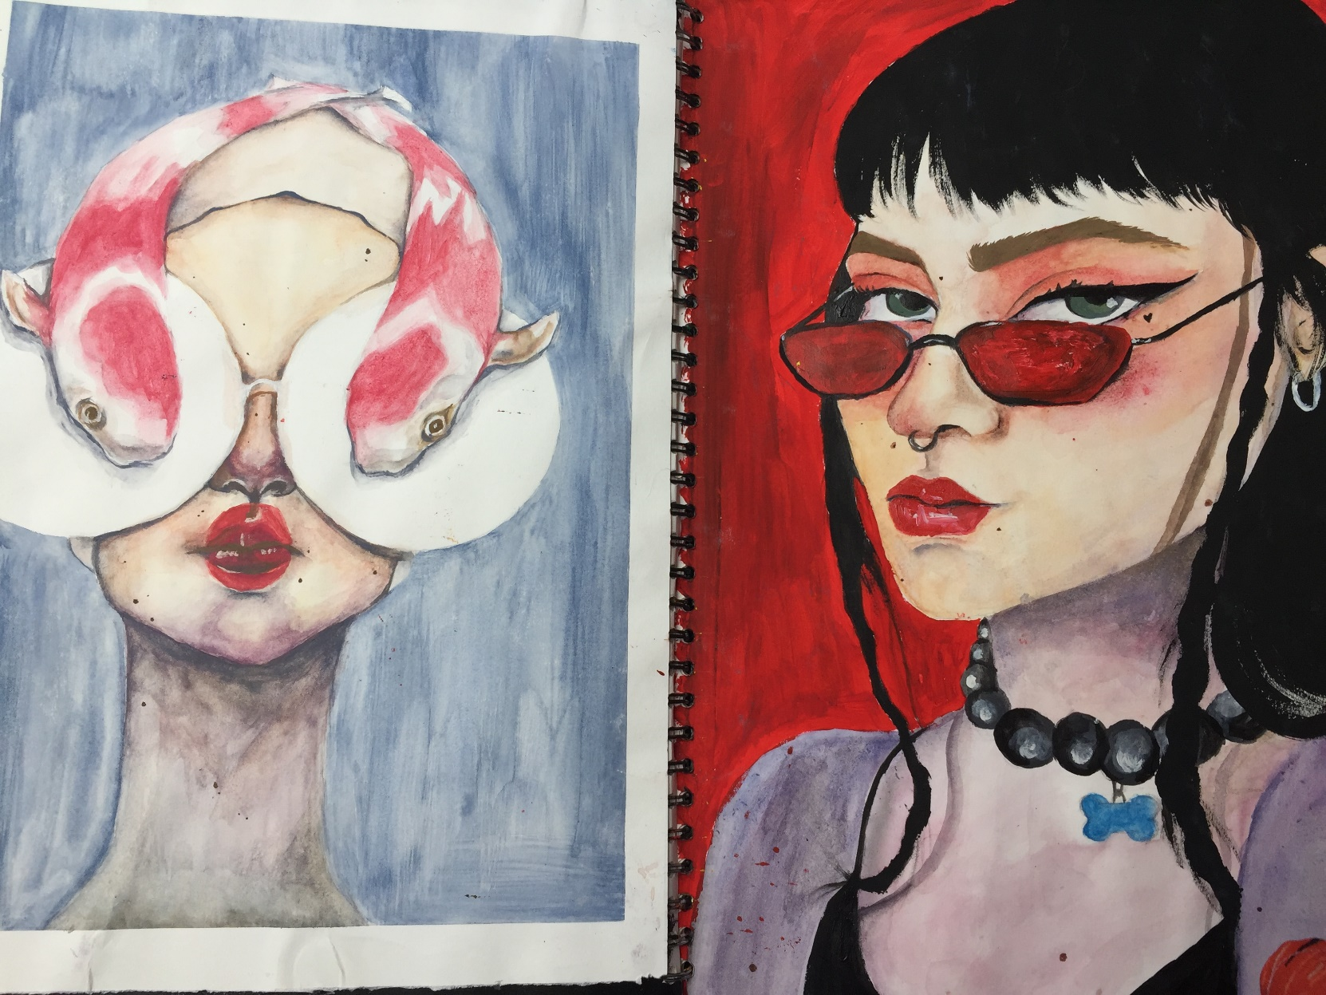
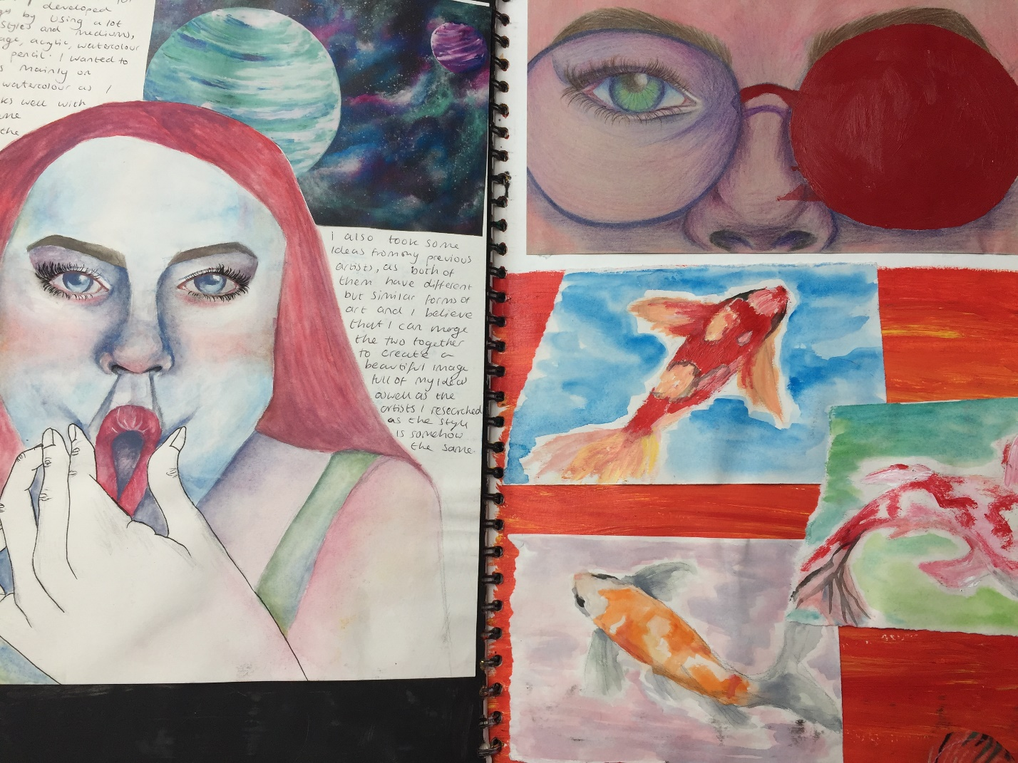
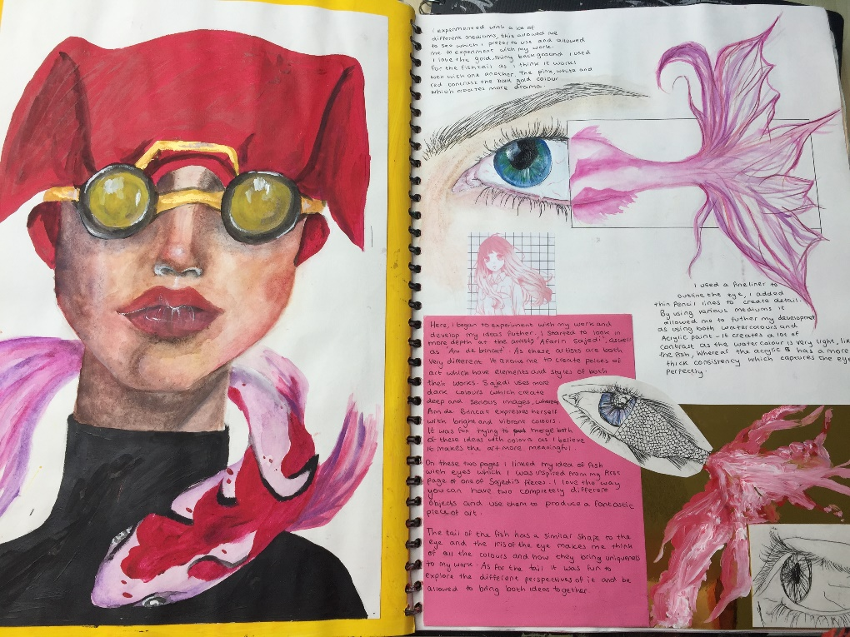
Personalise your artist’s page with your own ideas.
This student has used the artist to explore colour and surreal compositions.
Your artist pages can go beyond a double page spread.
Give your studies enough space!

Slide 9
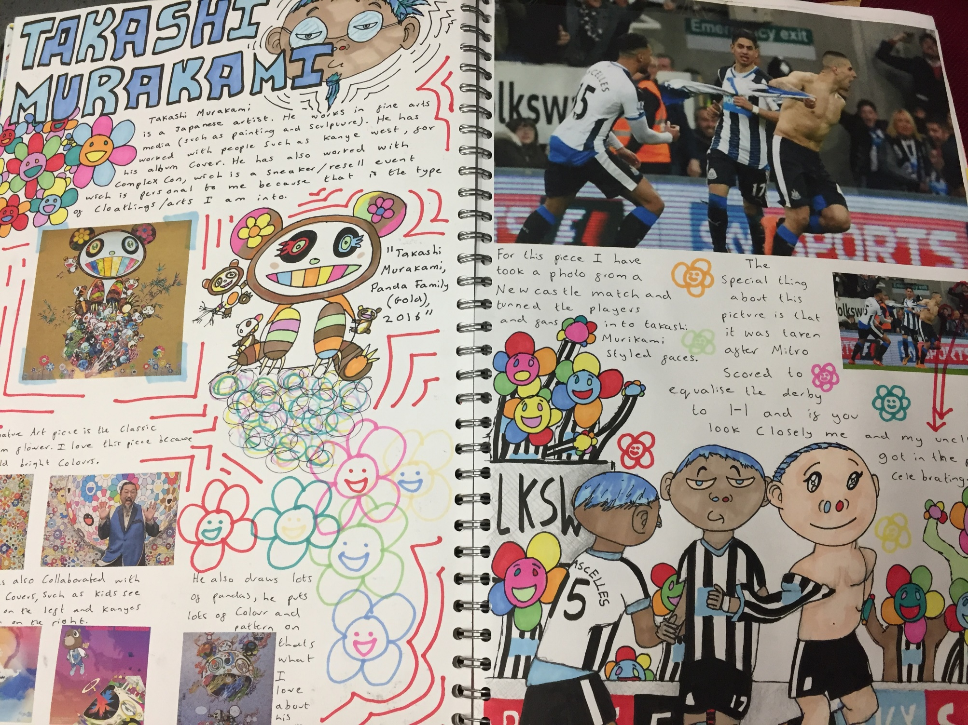
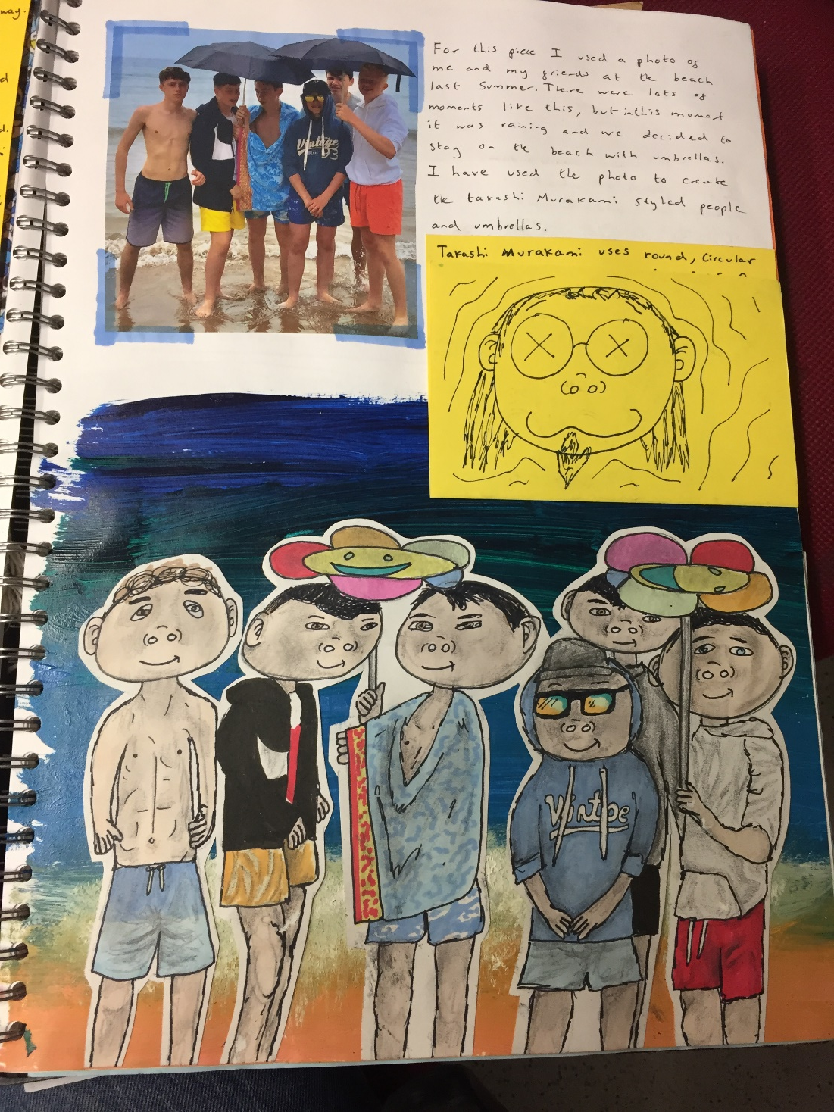
Clear layout
Artist used as a starting point , rather than making copies of the artist’s work.

Slide 10
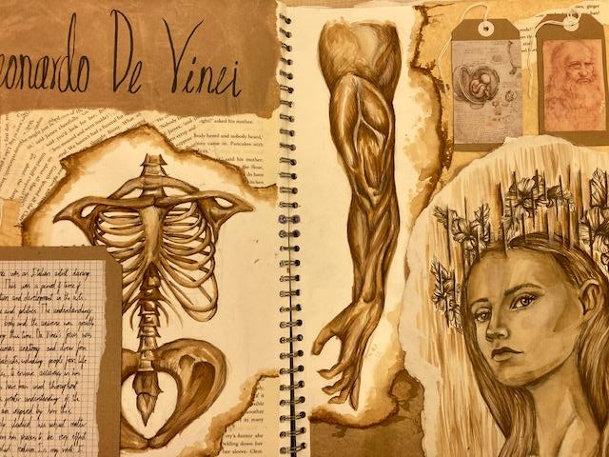
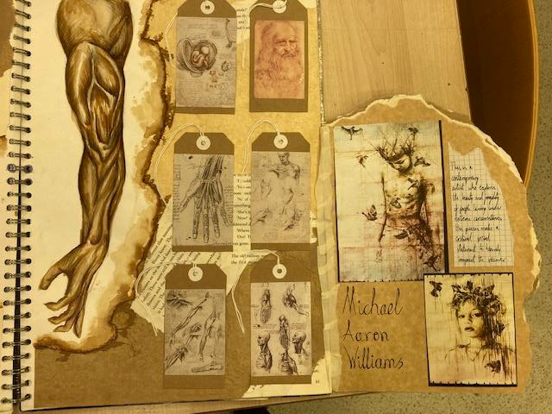

Slide 11
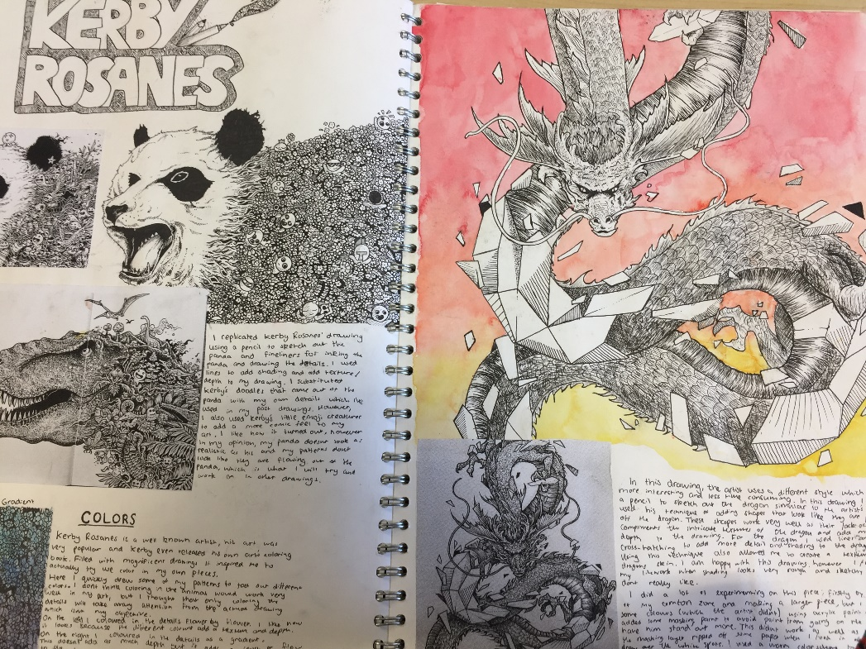
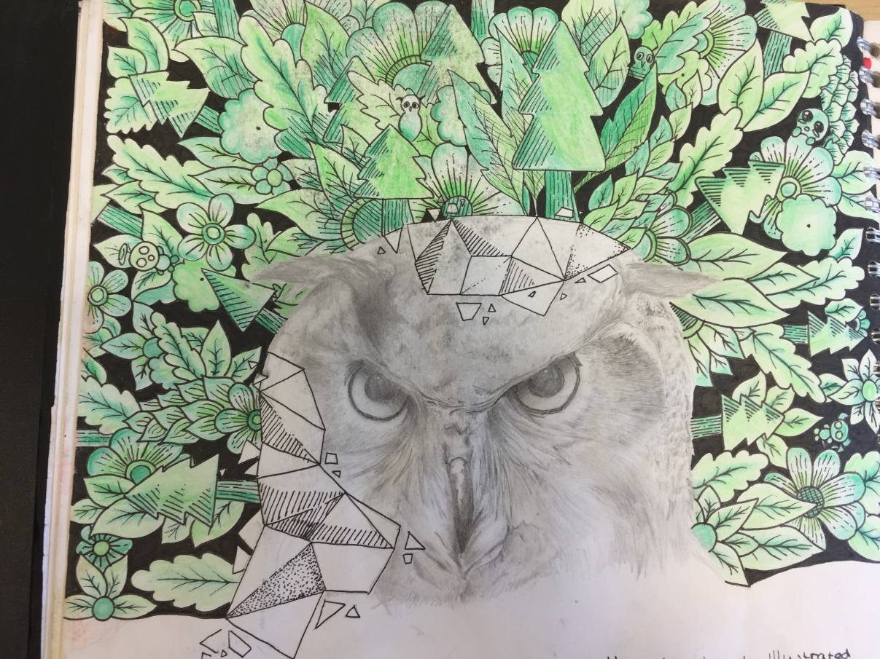
Student has made a copy of one of the artist’s pieces, but has made changes to colours.
The student has then used the artist’s to experiment with patterns, black pen and shapes with his own animal choices.

Slide 12
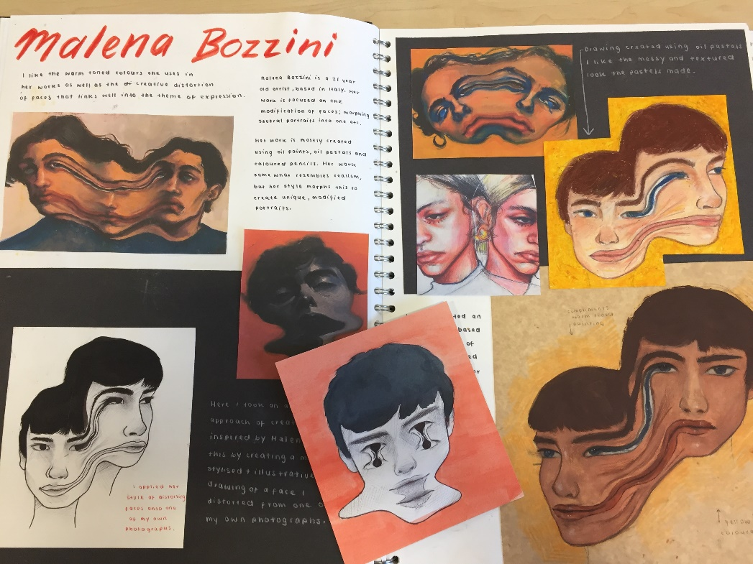
Student uses her own photographs to experiment with distortion techniques across the artist page.
Annotations are neatly presented and explain why the artist has been selected.

Slide 13


Task
To create an in depth artist page making strong links to the artist’s style and technique through your visual and written work (AO1)
CONSIDER:
PLOT YOUR COMPOSITION GIVING IT A GOOD AMOUNT OF SPACE.
APPLY SUITABLE MATERIALS WHICH LINK TO THE ARTIST
ADD NEAT ANNOTATIONS USING THE ANNOTATION SHEET e.g. titles, scale, materials. Use your help booklet to help you write about the artists work.

