Slide 1
Applying extra layers of materials through imaginative collages

Slide 2
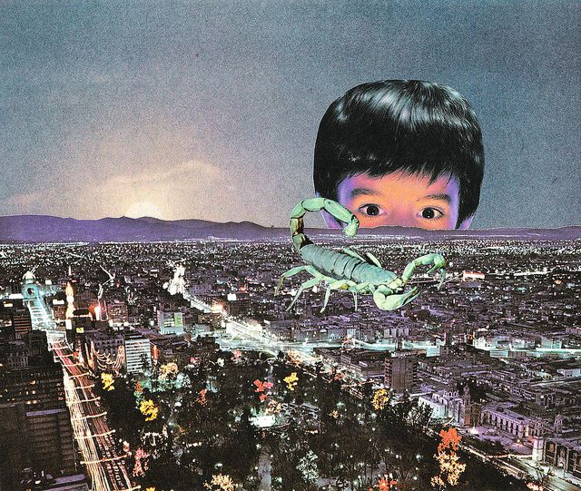
Alternative Collage Wave Starter Task
FOR THE COLLAGE TASK, TURN ON YOUR IMAGINATIONS!
Dream up surreal ideas.
Think about what doesn’t belong.

Slide 3
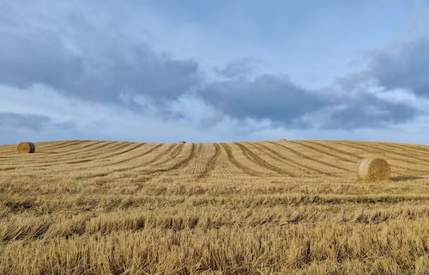
WHAT WOULD YOU ADD TO THESE SCENE TO MAKE IT STRANGE & FANTASTIC?

Slide 4
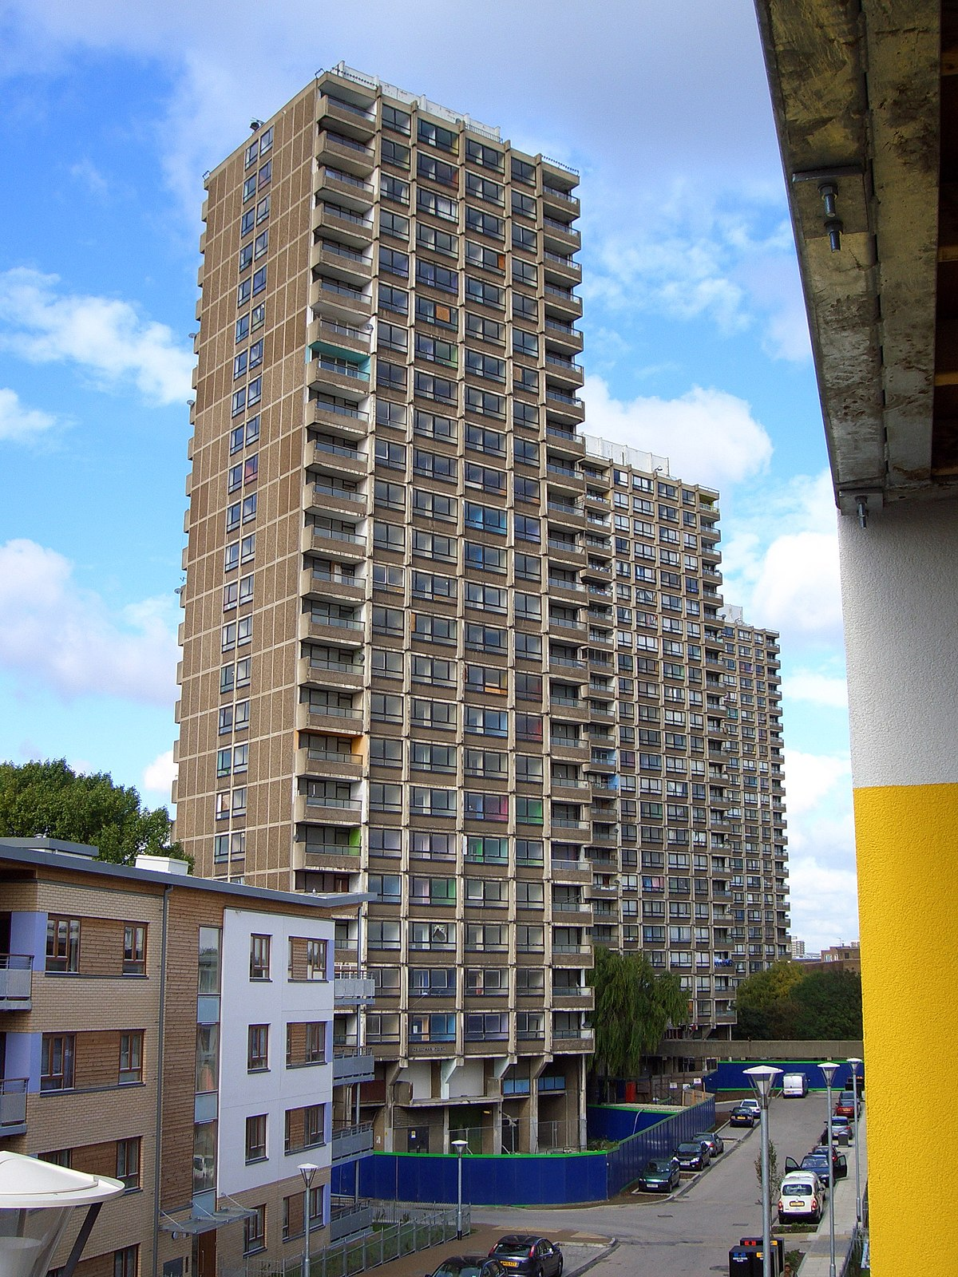
WHAT ABOUT HERE?

Slide 5
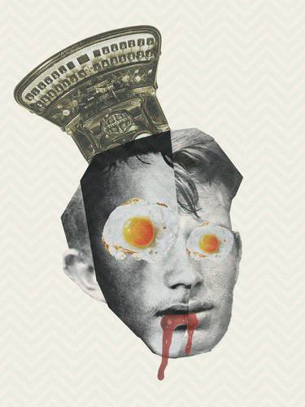
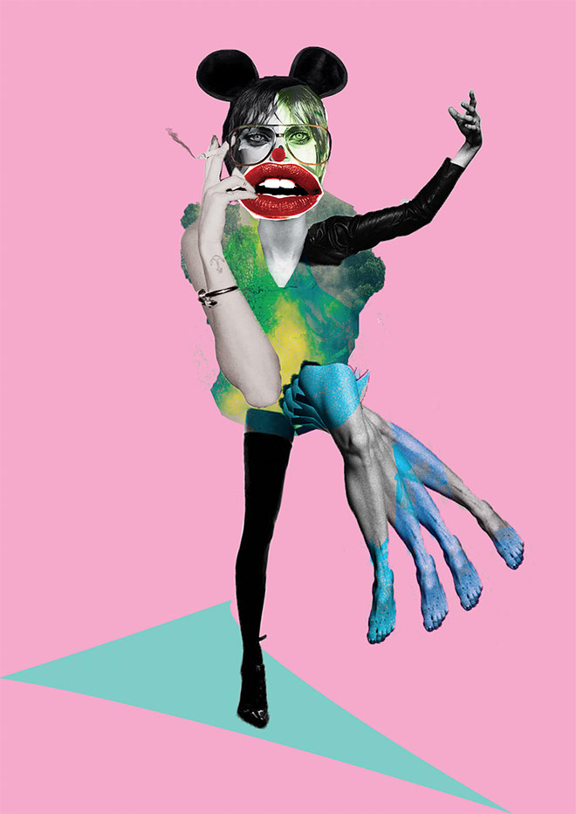
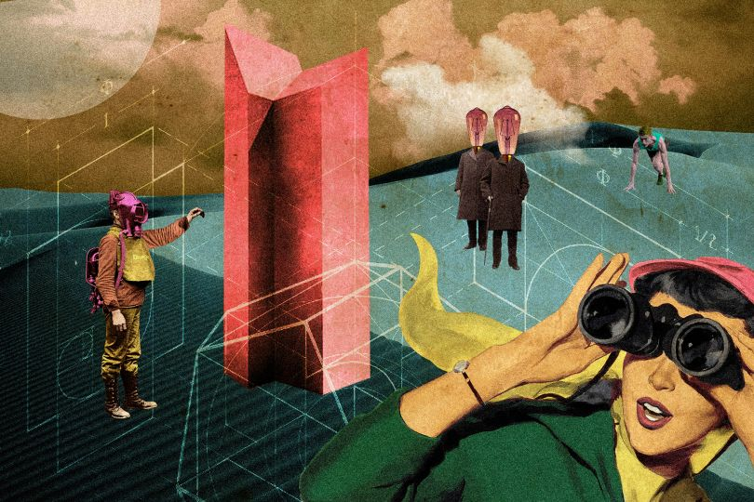
COLLAGE WAVE
Using a magazine image as a starting point.
You could :
Use other objects from newspapers/magazines/printouts/
photos to make your new piece more surreal
You could draw/paint on or around the original image

Slide 6
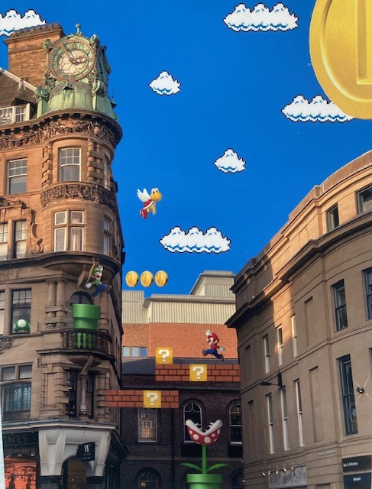
Year 13 example
Super Mario imagery was added to a photo of Newcastle.

