Slide 1
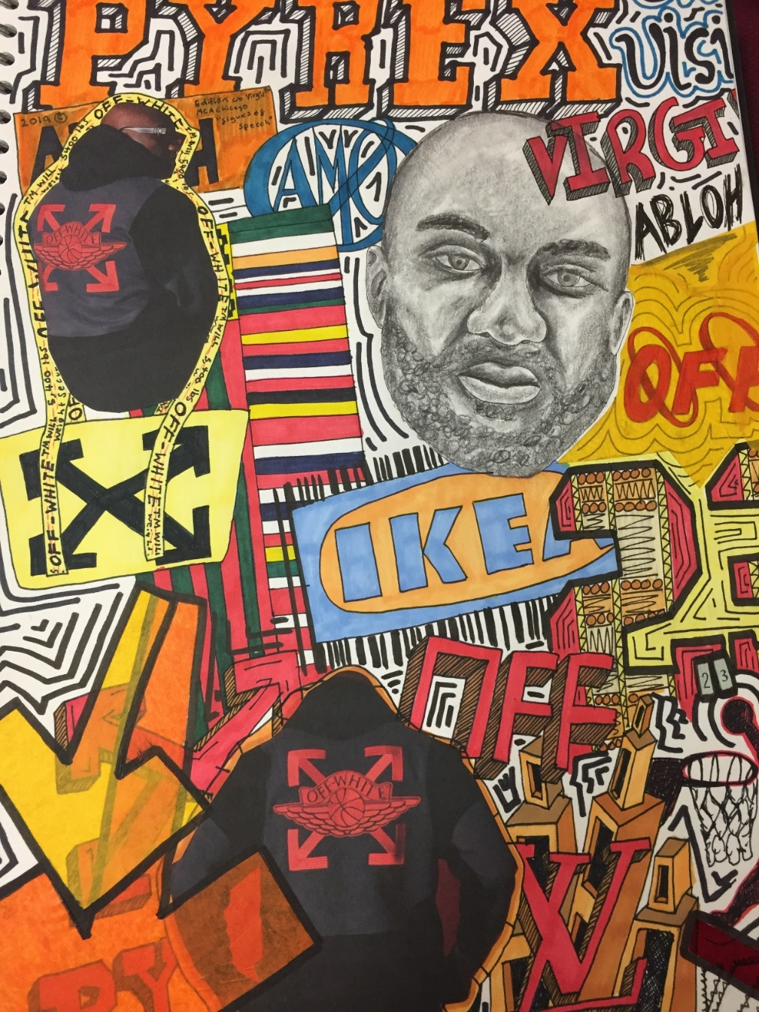
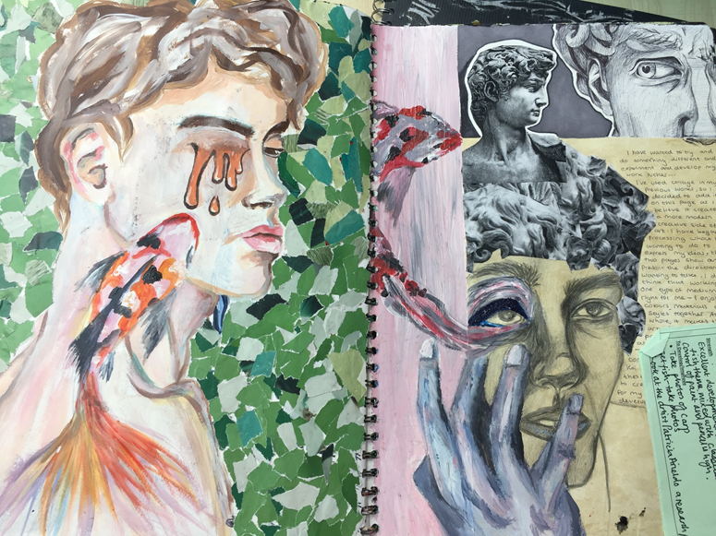
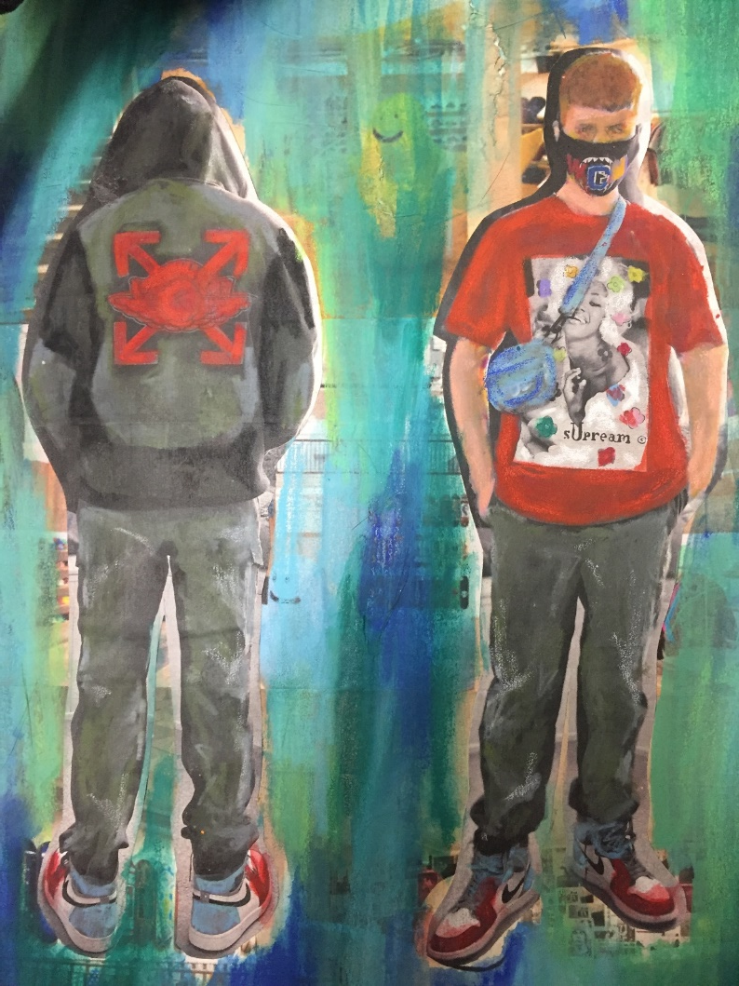
What does stronger development look like?
Remind yourselves!
GCSE EXAMPLES

Slide 2
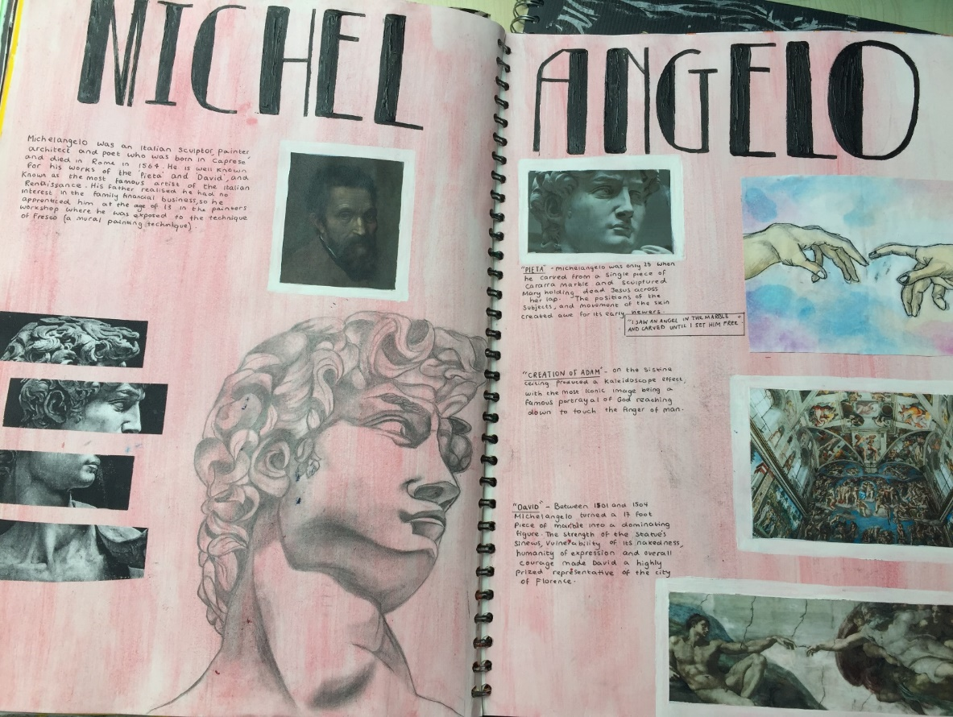
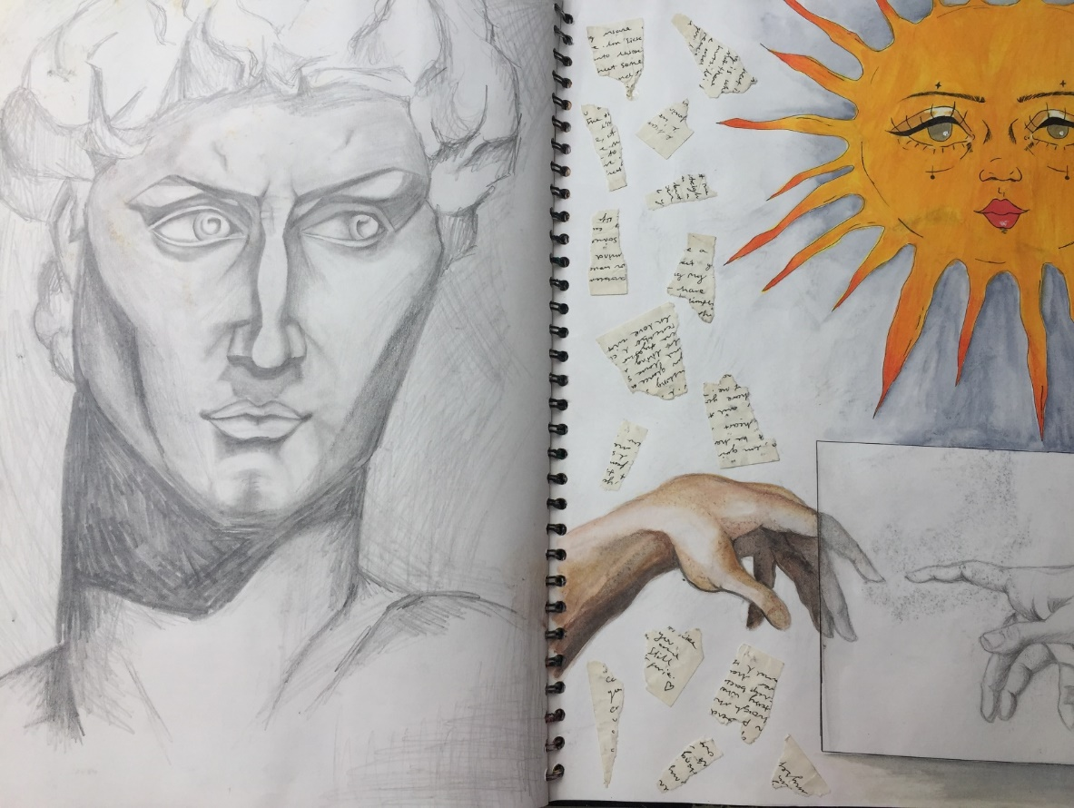
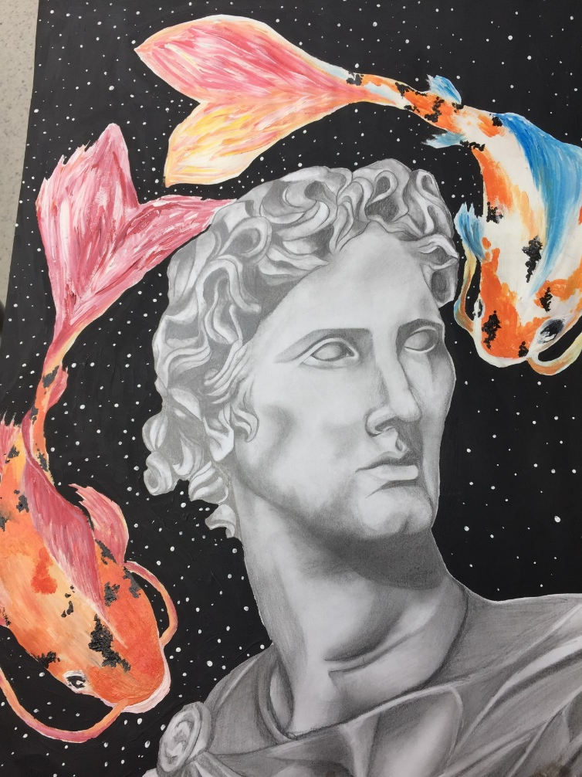
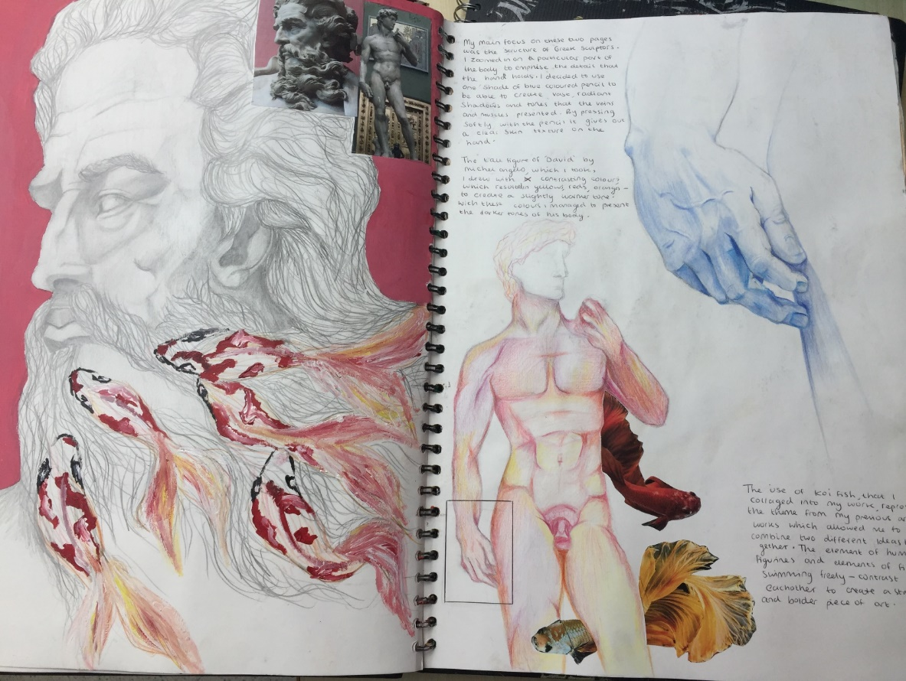
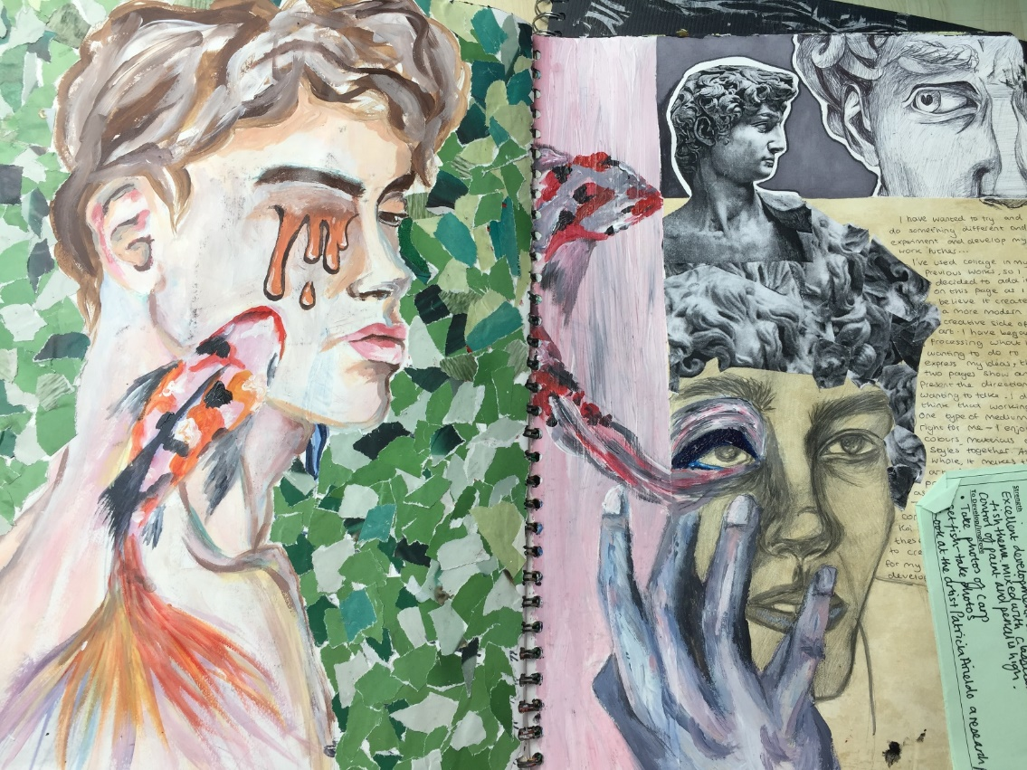
YEAR 11 EXAMPLE

Slide 3
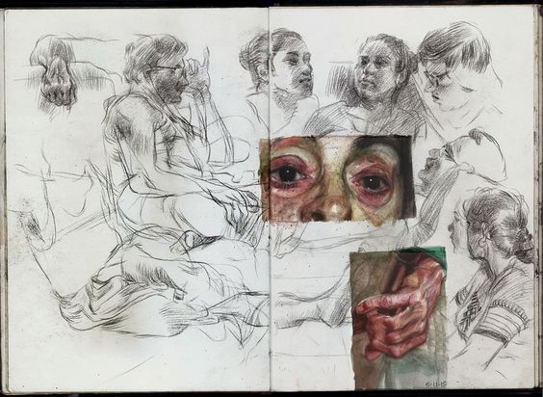
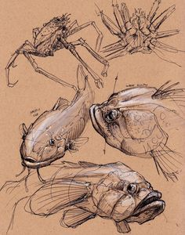
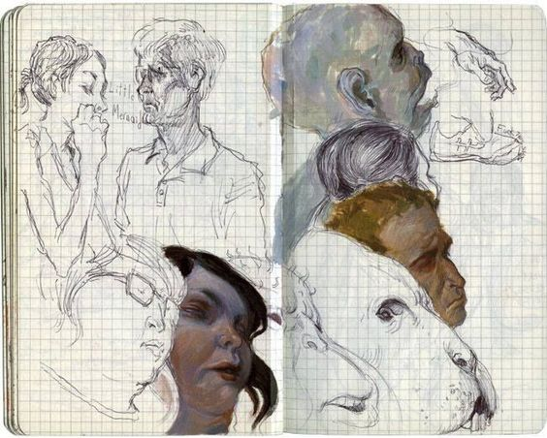
Task 1
Create quick studies exploring and recording a range of different composition ideas.
OUTCOME:
Double page spread of quick sketches using a selection of 2-3 images. The photographs/images can be very closely linked.
Materials
Pencils

Slide 4

 | A01 Develop your ideas using your research Experiment 2-3 small experimental pieces using your artist as inspiration. 1/ Sketching out different composition ideas across the double page spread. 2/Select suitable materials to add to your sketches
Consider
Exciting compositions
Colour palettes,
material choices
Backgrounds

Slide 5
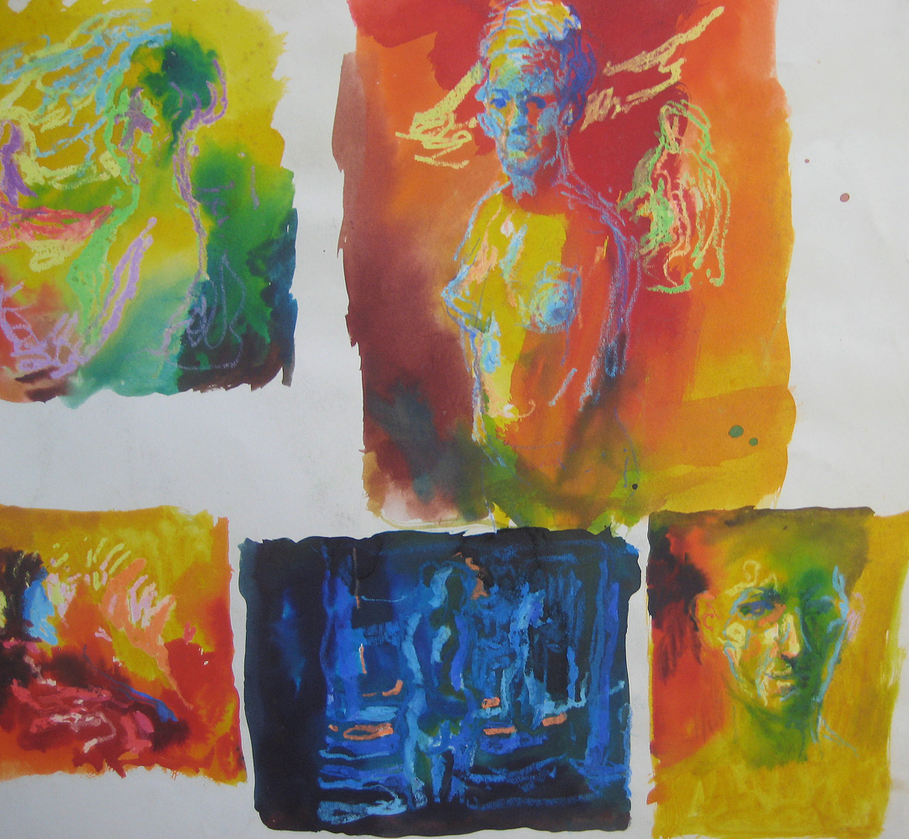
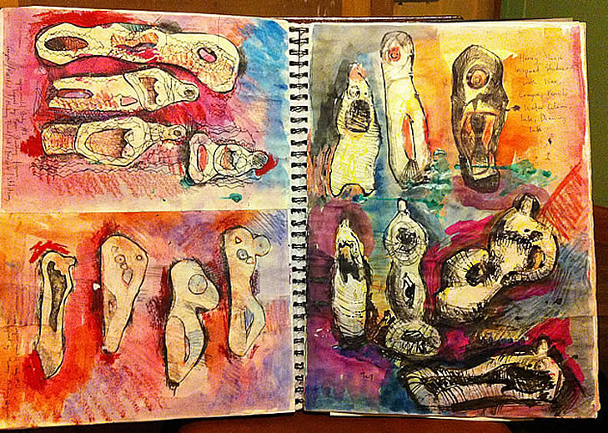
Lesson 2: Use the relevant materials to work into your sketches from lesson.
Consider scale and materials linking to the artists in your book.
You can zoom in on images rather than drawing the whole image.
Colour palettes
Backgrounds
Add short annotations around your work.

