Slide 1
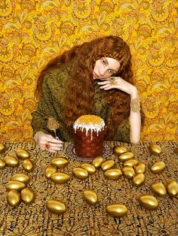
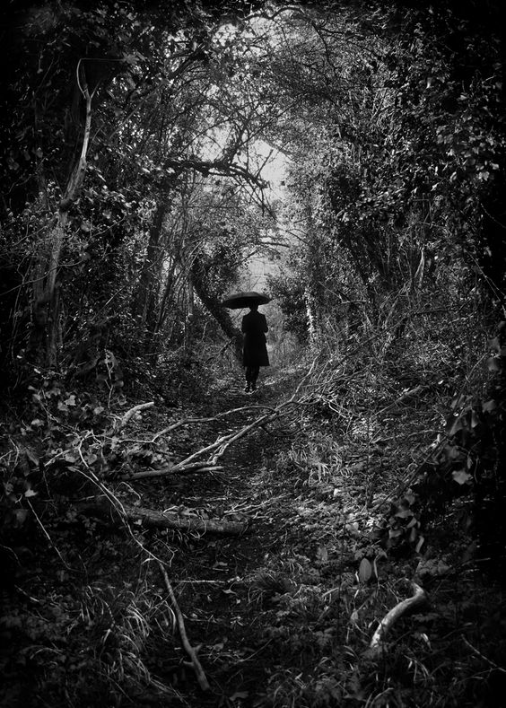
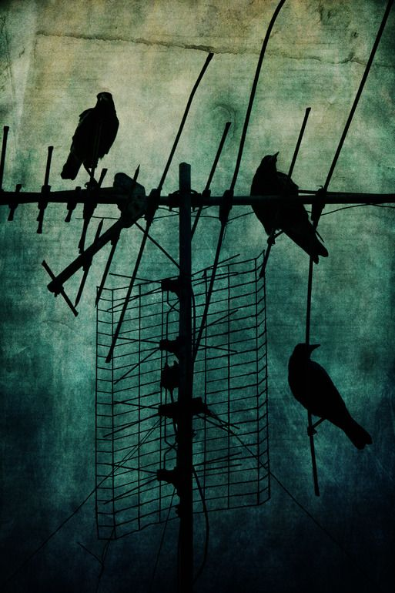
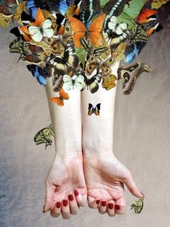
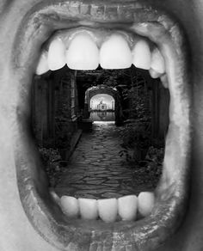
Using Photography to enrich your project
Collect and create exciting new Strange & Fantastic images and photographs to give your work some fresh ideas.
A full Photoshoot could look amazing in your books.
Consider:
Subject Matter
What are you going to photograph?
Props/costumes you might need
Location (interior & exterior)
Background (plain or busy)
Camera angle (view from above, below, zoomed in)
Lighting (natural, lamps, candles, torches)

Slide 2
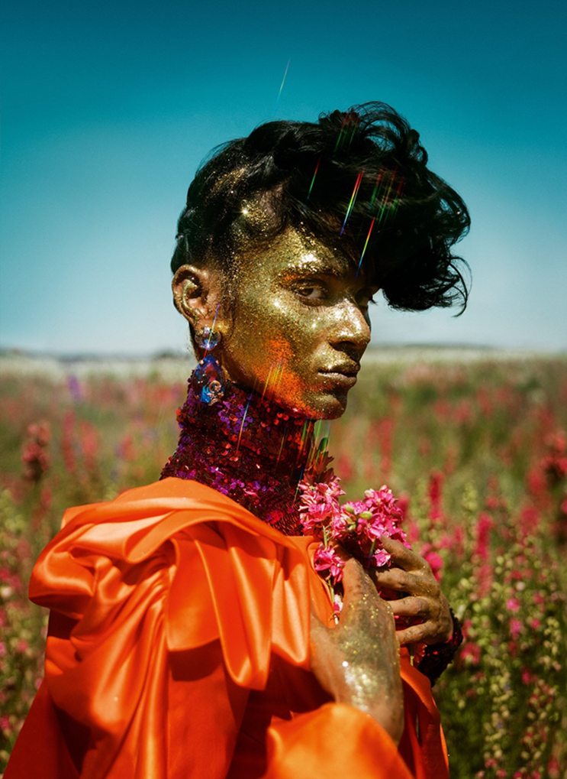
TIM WALKER INSPIRED
INSPIRATION
https://www.timwalkerphotography.com/
Look at Tim Walker’s website for stunning fashion photography
Tim Walker’s photographs have entranced the readers of Vogue, month by month, for over a decade. Extravagant staging and romantic motifs characterise his unmistakable style. After concentrating on photographic stills for 15 years, Walker is now also making moving film.

Slide 3
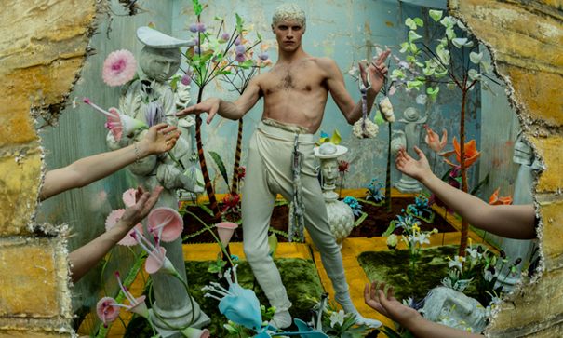

KEY FEATURES
Prop & Set Heavy
Dramatic
Lighting
Pose
Viewpoint/Awkward poses and angles

Slide 4
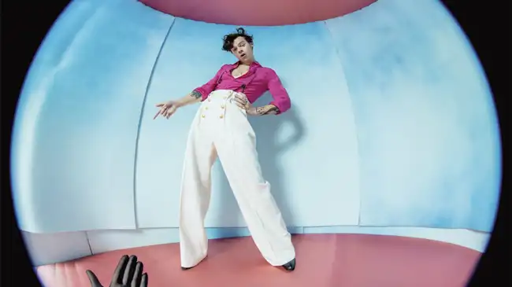
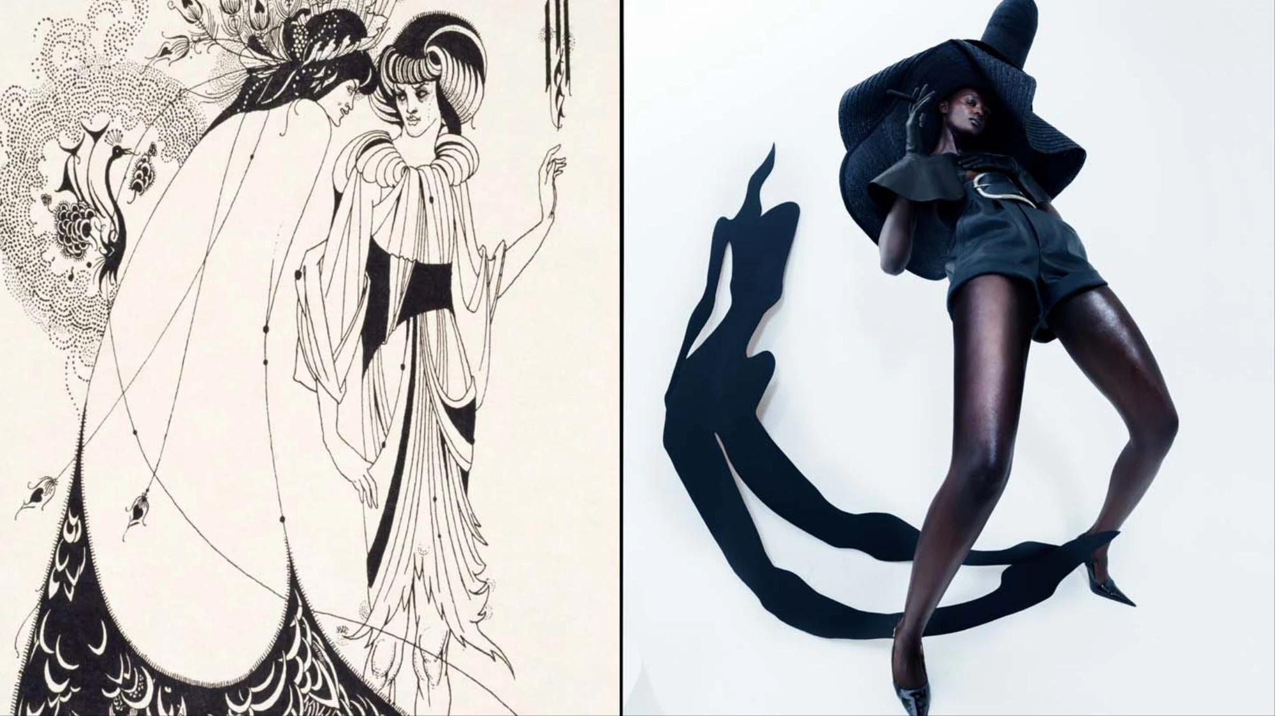
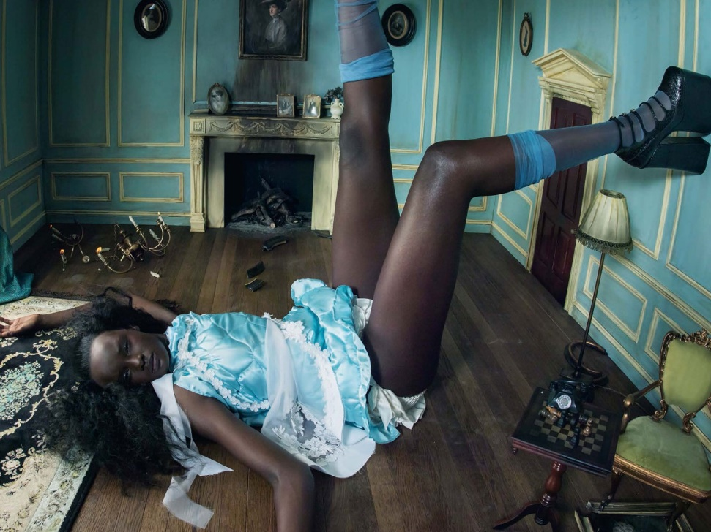
Story telling
Fun
Power poses
Figures given height over the viewer

Slide 5
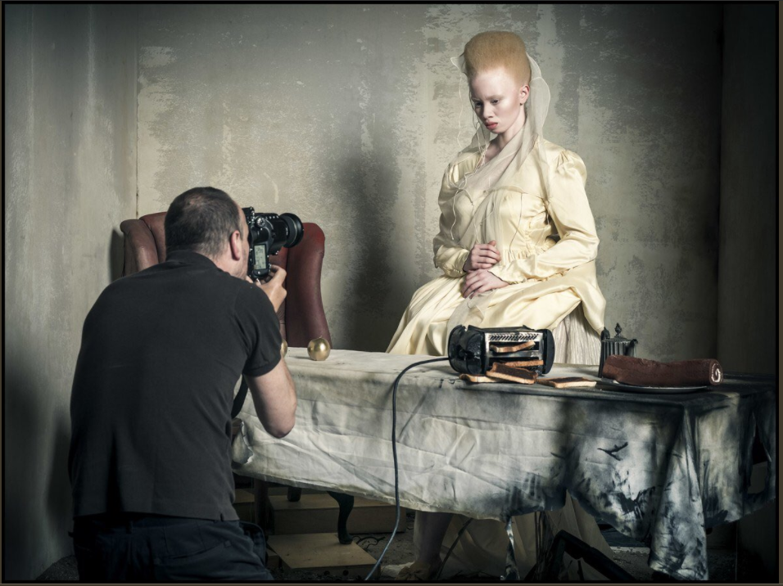
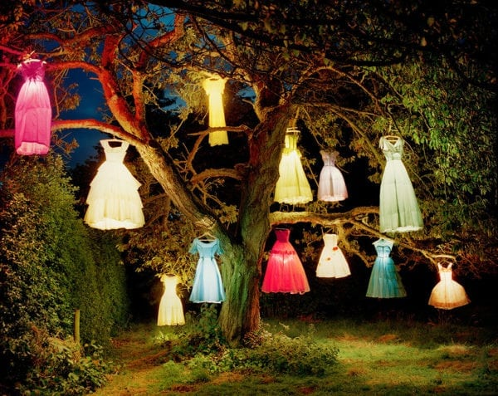
Tim Walker, The Dress-Lamp Tree, England, 2002
At what point does fashion photography become art? A new show at the Getty Center in Los Angeles explores the art of fashion photography at its most creative. Tim Walker, a photographer whose set-heavy images often dip into realms beyond our traditional understanding of fashion—to theatre, installation and more—does away completely with the notion of models in the above image, hanging various inner-lit dresses from a large tree.

Slide 6
Could you borrow ideas from Tim Walker about striking poses, awkward angles, maybe you could include over the top props and costumes! Perhaps, you don’t even need a model, what about creating something like his dress tree?

Slide 7
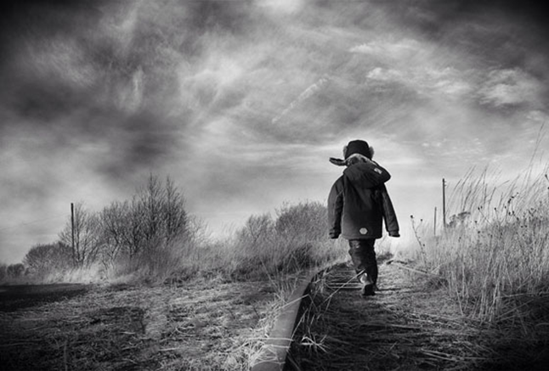
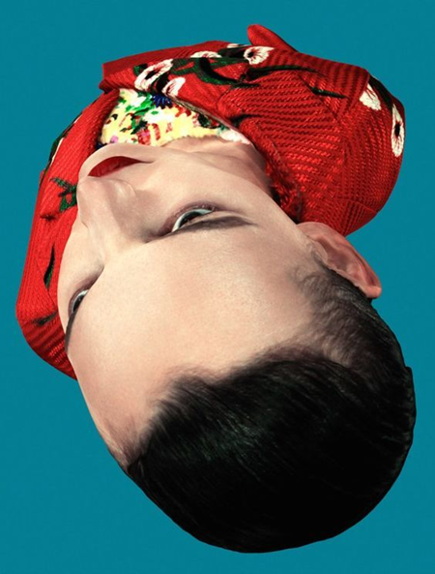
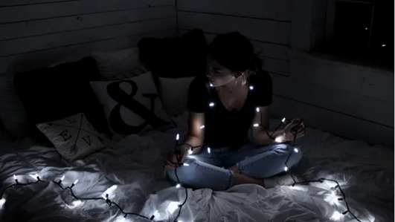
OTHER THINGS TO CONSIDER FOR YOUR PHOTOSHOOT
Look at the next few slides before you take your photoshoot or photoshoots.

Slide 8
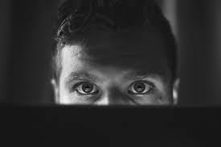
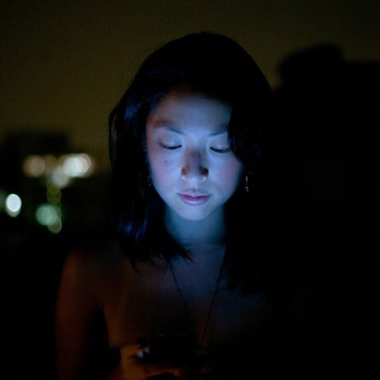
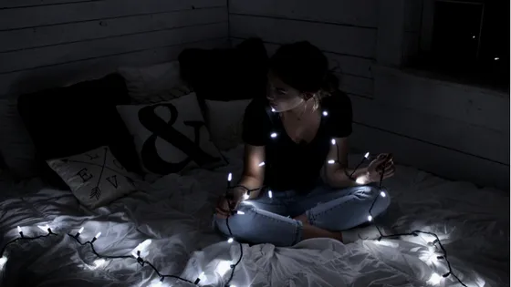
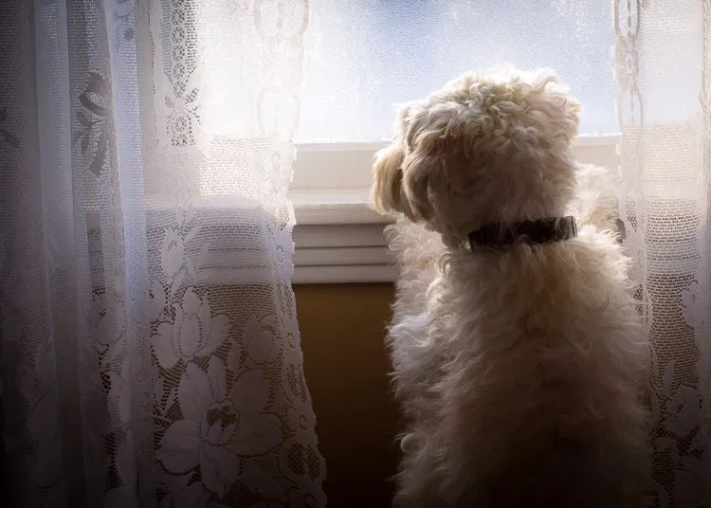
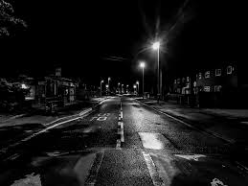
LIGHTING CREATES MOOD
Experiment with lighting.
Could you use natural light, torches, candles, fairy lights, lamps, street light, light from a phone or laptop screen, window light? What time of day will you take your photographs?

Slide 9
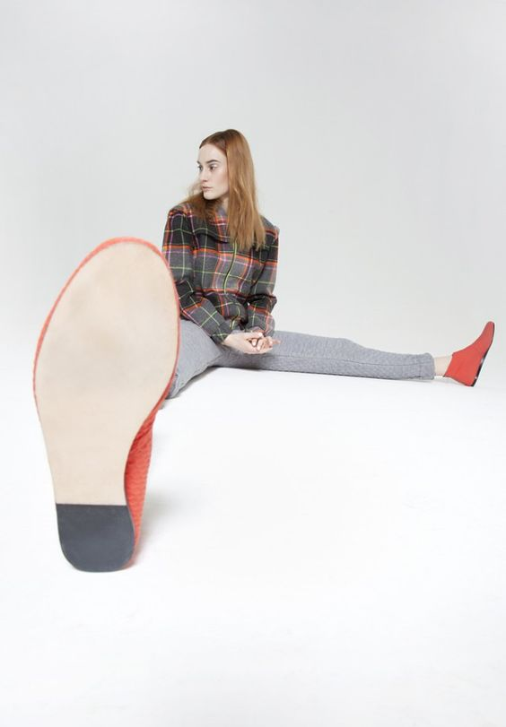
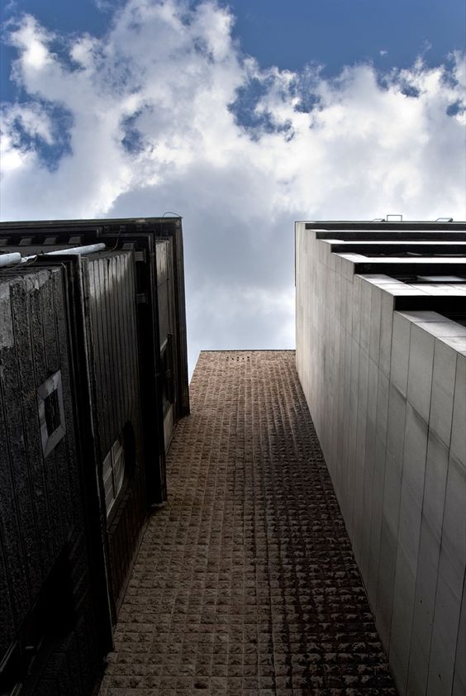


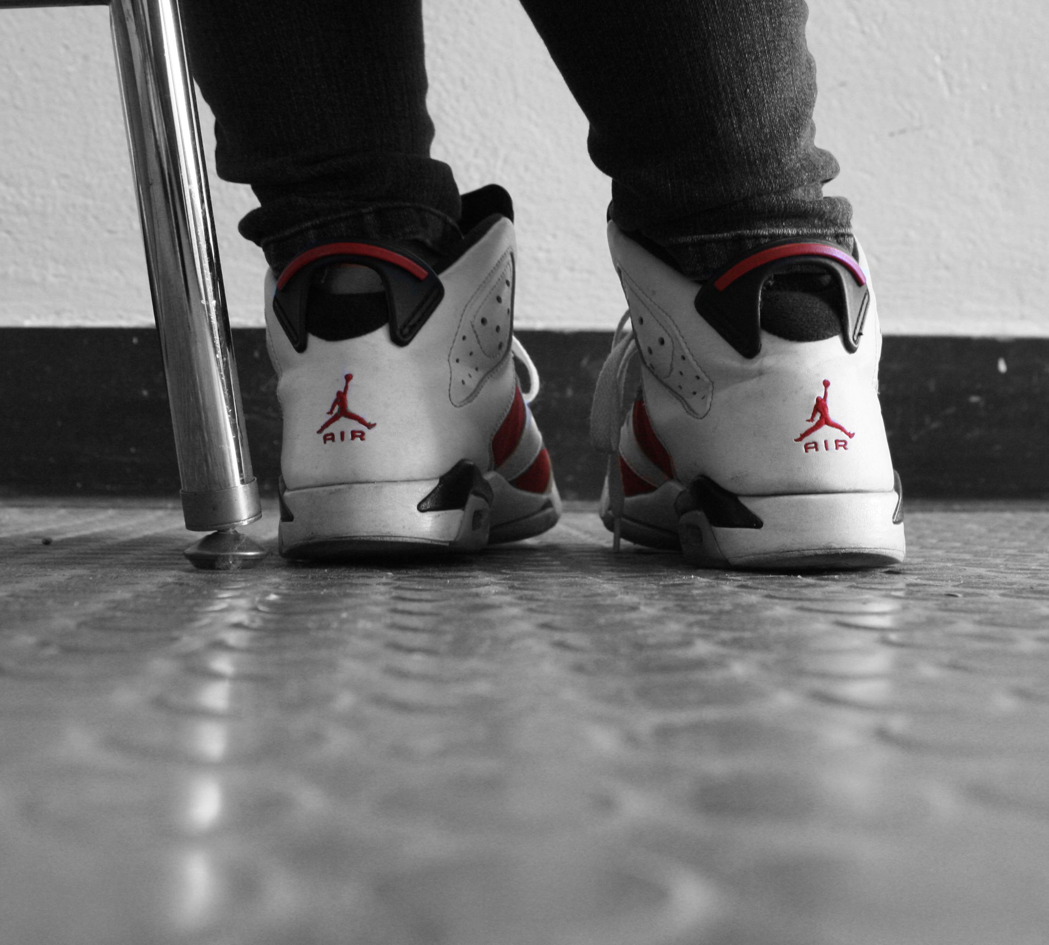
CHANGING THE VIEWPOINT & ANGLE CAN MAKE NORMAL THINGS LOOK STRANGE & FANTASTIC.
THINKING ABOUT YOUR THEME AND THE OBJECTS AND PEOPLE YOU ARE SURROUNDED BY. PHOTOGRAPH THEM FROM A RANGE OF ANGLES.
LISTEN TO ADVICE ON PHOTOGRAPHY
Change the angle that you shoot from
Lie down on the floor
Shoot under or below things
Birds eye view
Zoom right in on something
Take a photograph from a reflection
Take a photograph from above your subject.

Slide 10
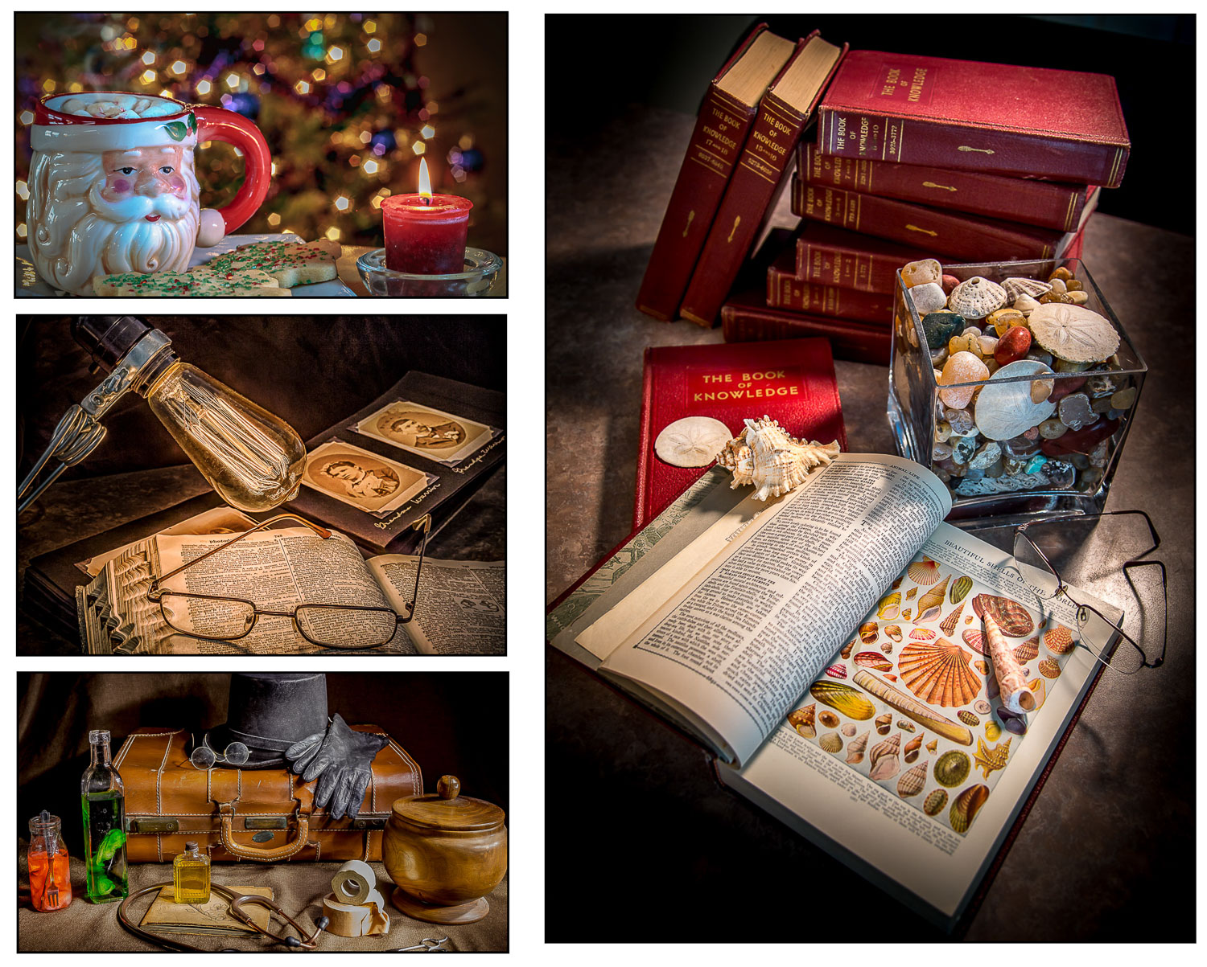
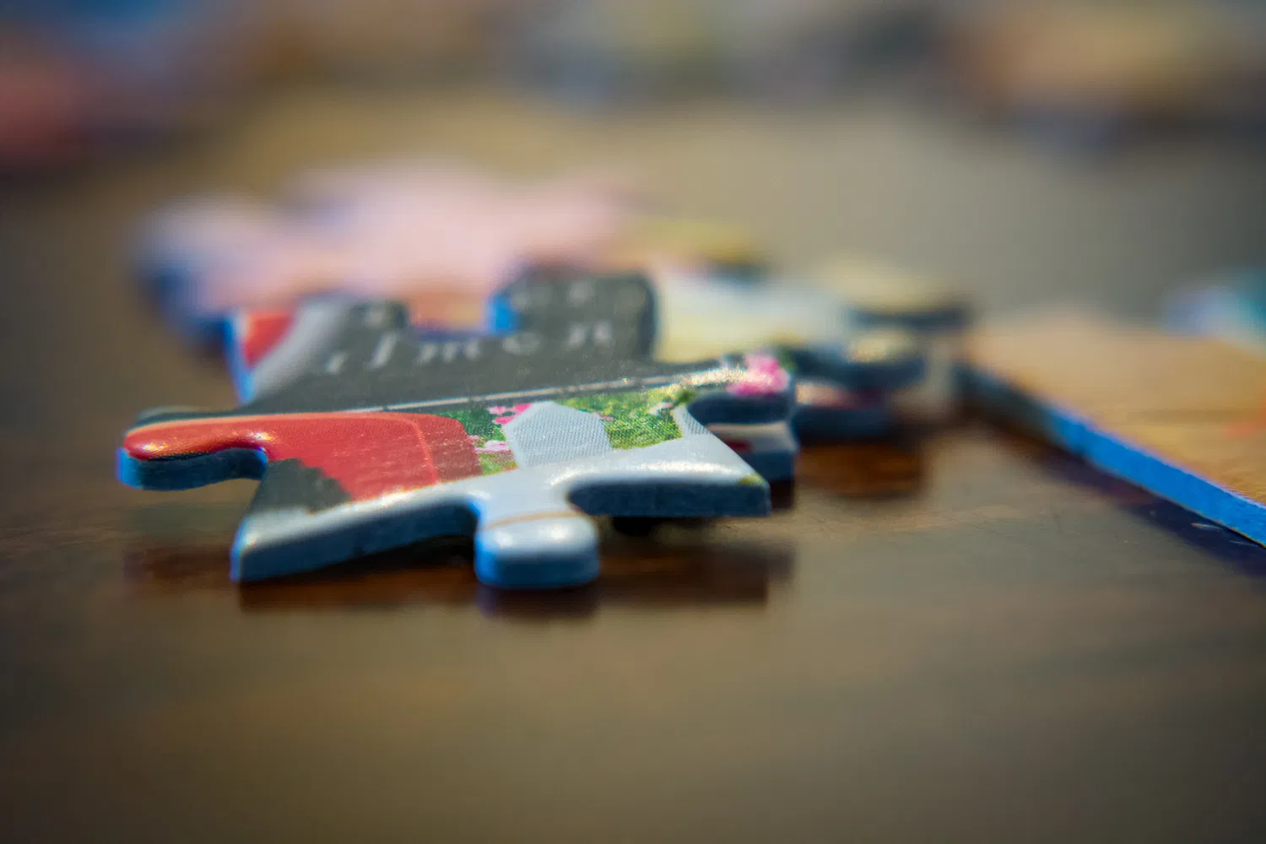
Use your photographs to tell a story!
Use your objects, background, lighting, camera angle, and whatever other photographic tricks you can summon. Your objective is to make the viewer see the story in your photo. A picture can be worth a thousand words, if you choose those “words” carefully.

Slide 11
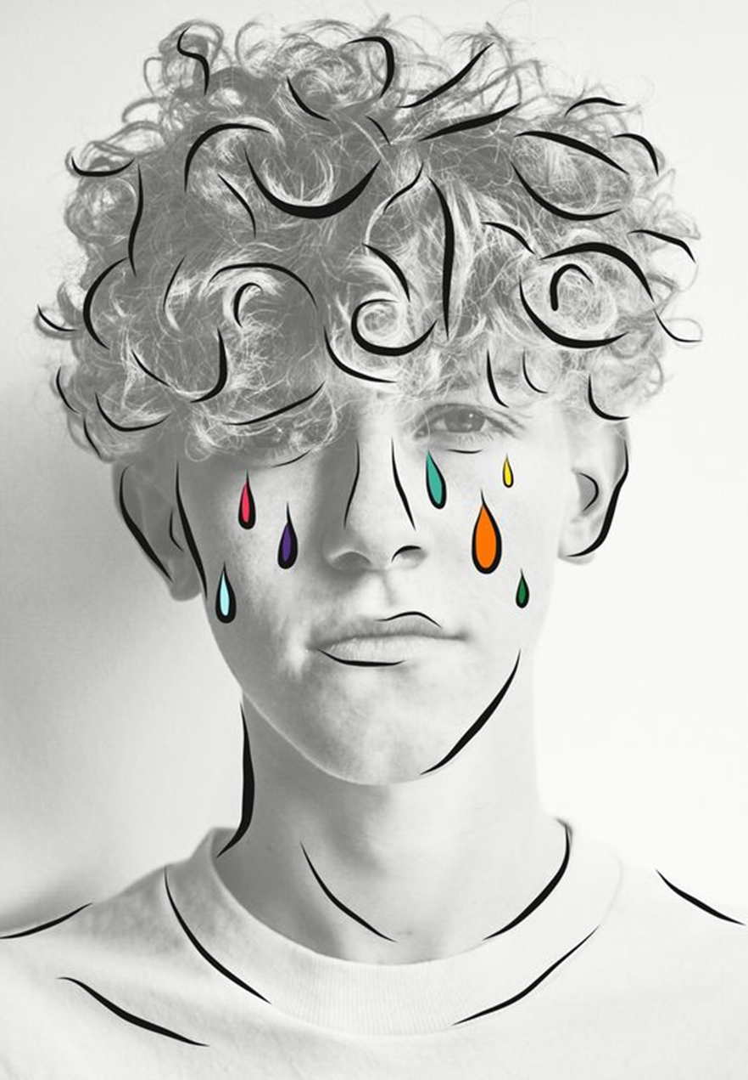
Take a photo and edit it using free apps, filters and drawing tools.
When confident try doing your own digital artwork without using an image underneath.
You could do this using your own photographs or FOUND images from the internet.
EDITING APPS FOR FREE
Digital drawing/editing apps:
Tayasui sketches
Glitchlab
Mirrorlab
Hypocam
Instasquare
Photoshop express
Hipstamatic
Pixlr
Snapseed
Fragment
Kaleidacam
Prisma
Instagram Layout
PhotoPea - www.photopea.com
Pixlr
VSCOcam
Tiny Worlds (99P)
Autodesk sketchbook
Snap seed
FXStencil
Vinci
Prisma
1

Slide 12
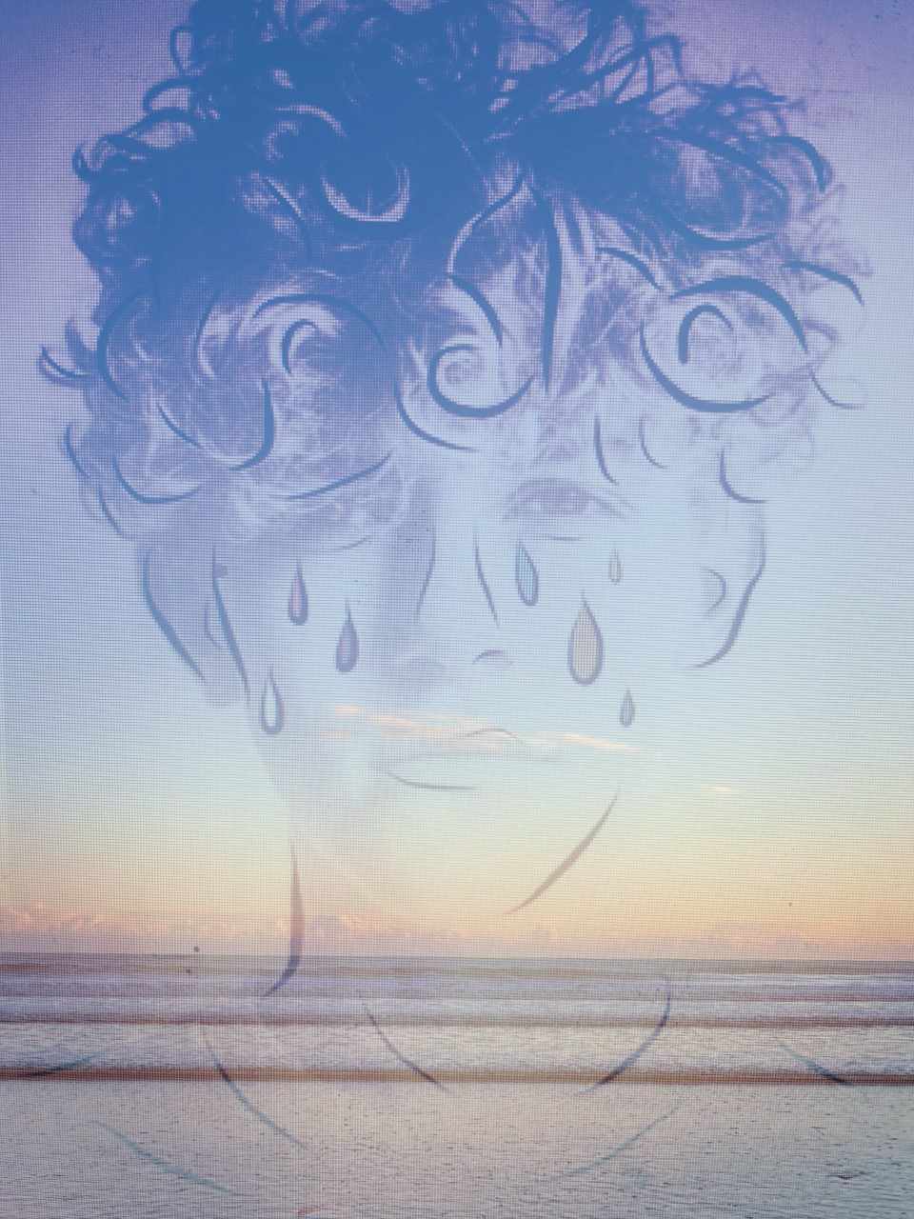
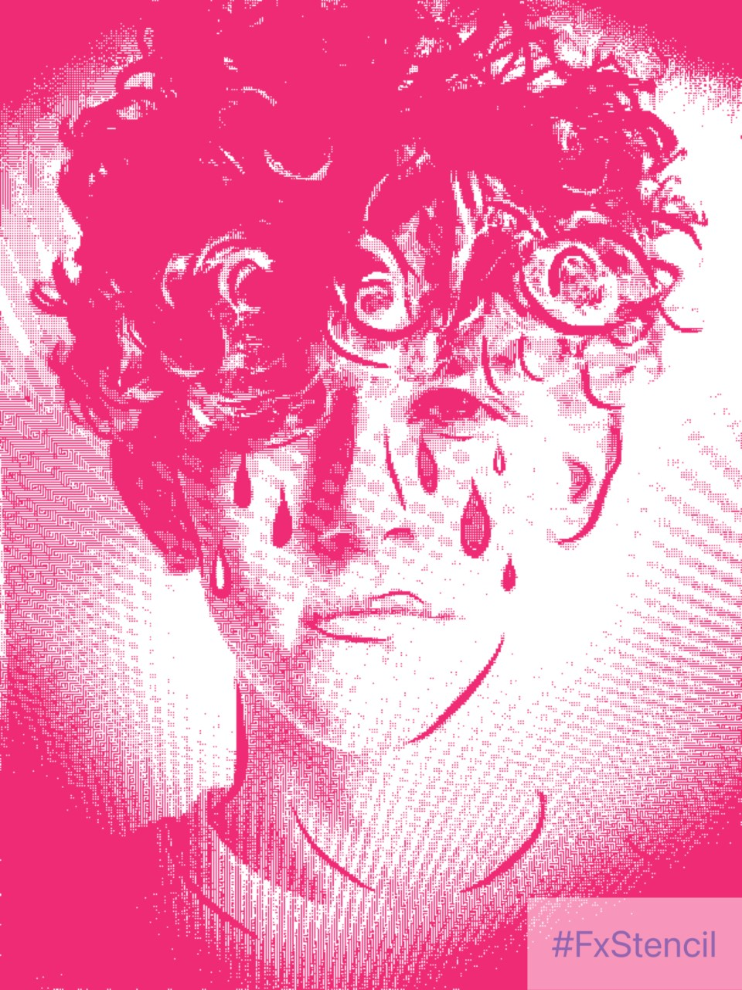
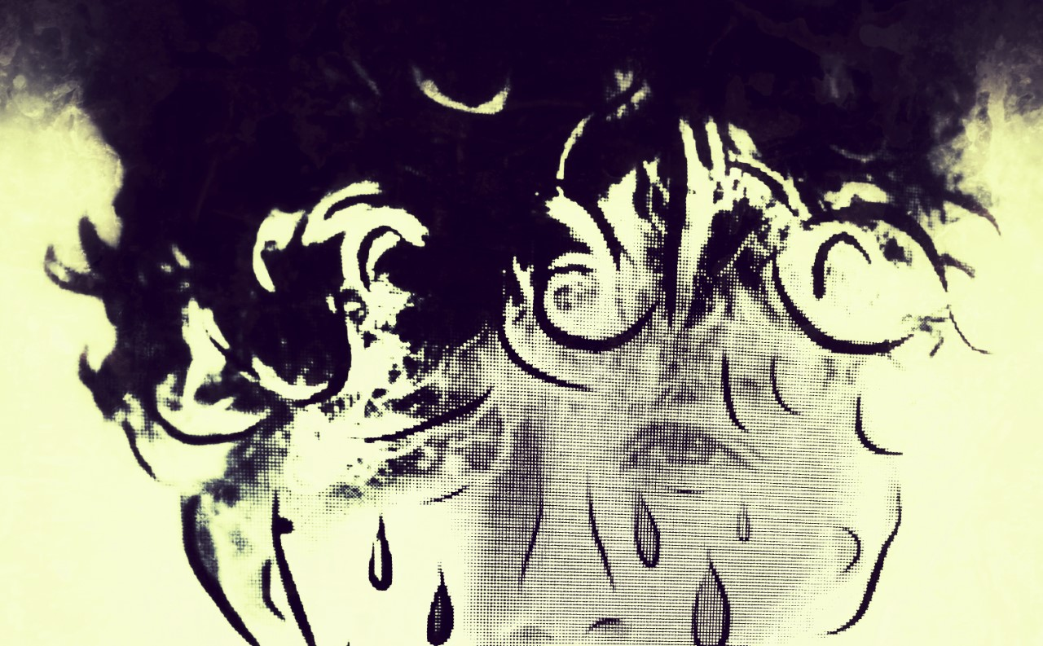
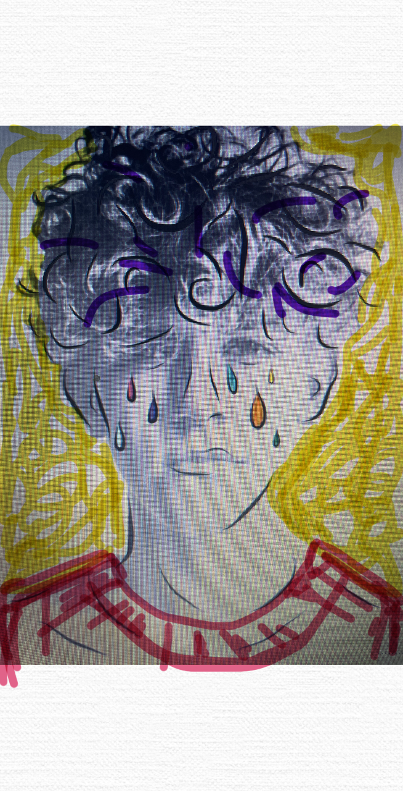
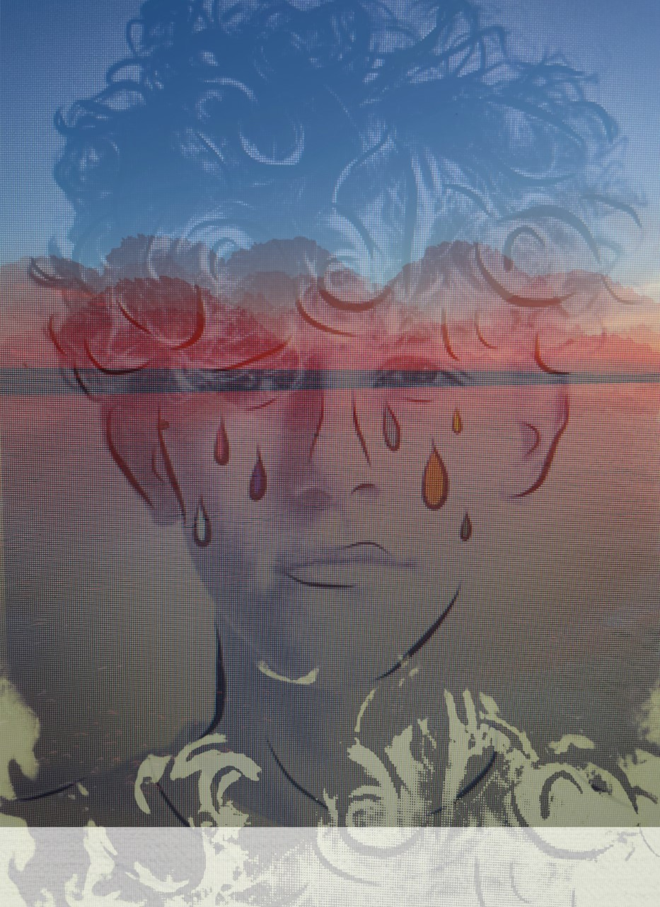


Slide 13
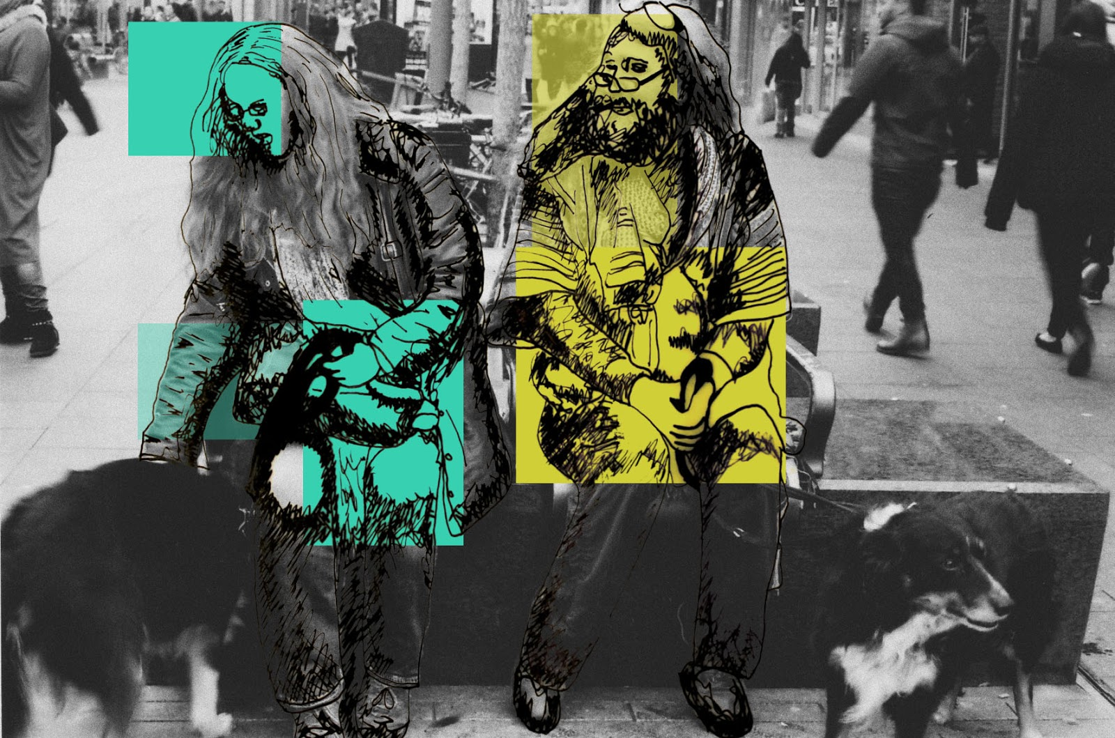
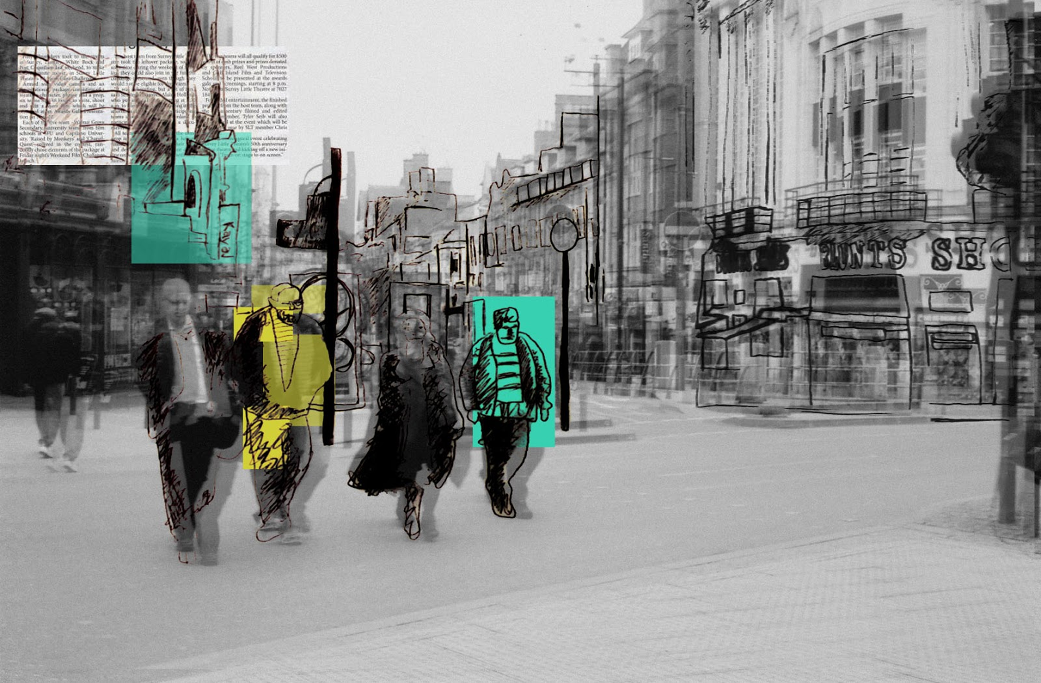
EXTRA DEFACING IDEAS
ON TOP OF YOUR PHOTOGRAPHS
Drawing and painting onto your printed photographs

Slide 14
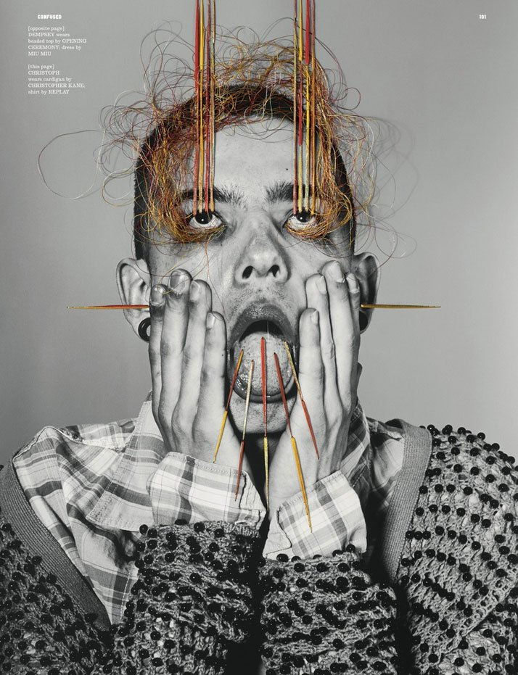
Maurizio Anzeri:
Stitching into your photographs

Slide 15
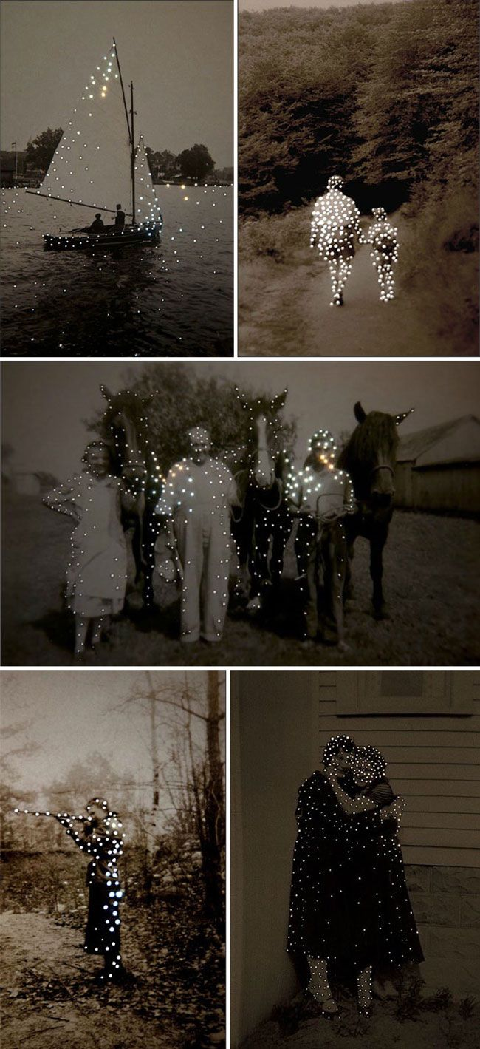
Amy Friend allows new light to pass through found vintage images by altering the surface with tiny pinholes.

Slide 16
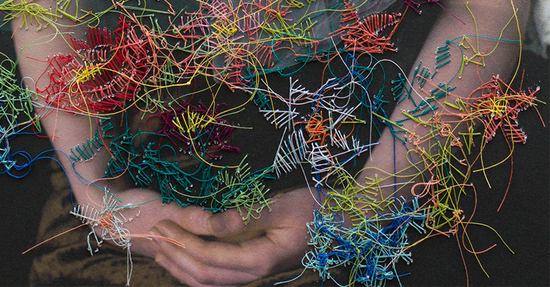
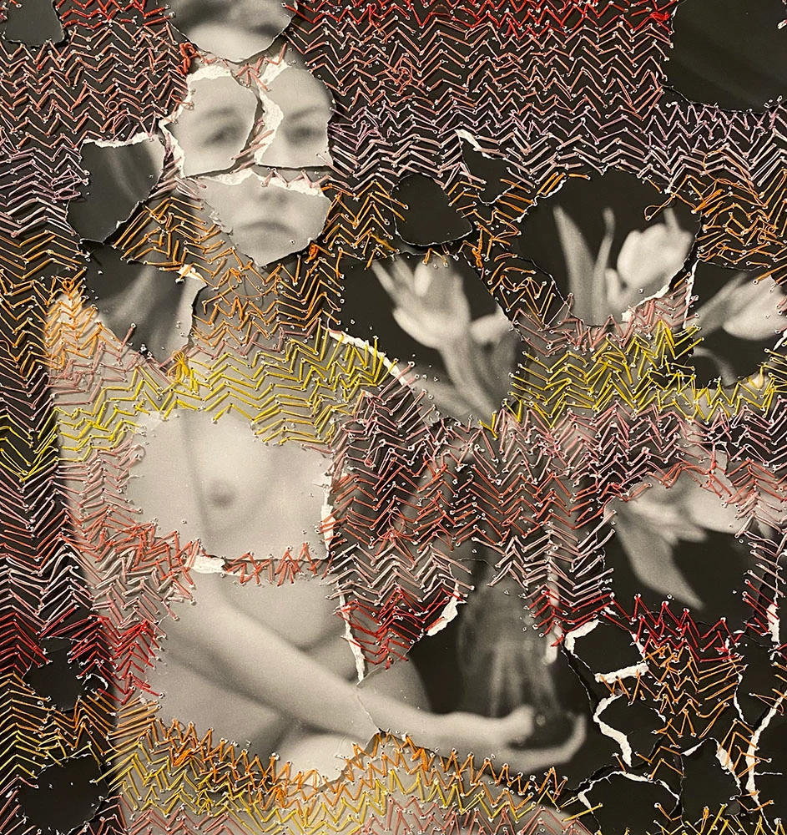
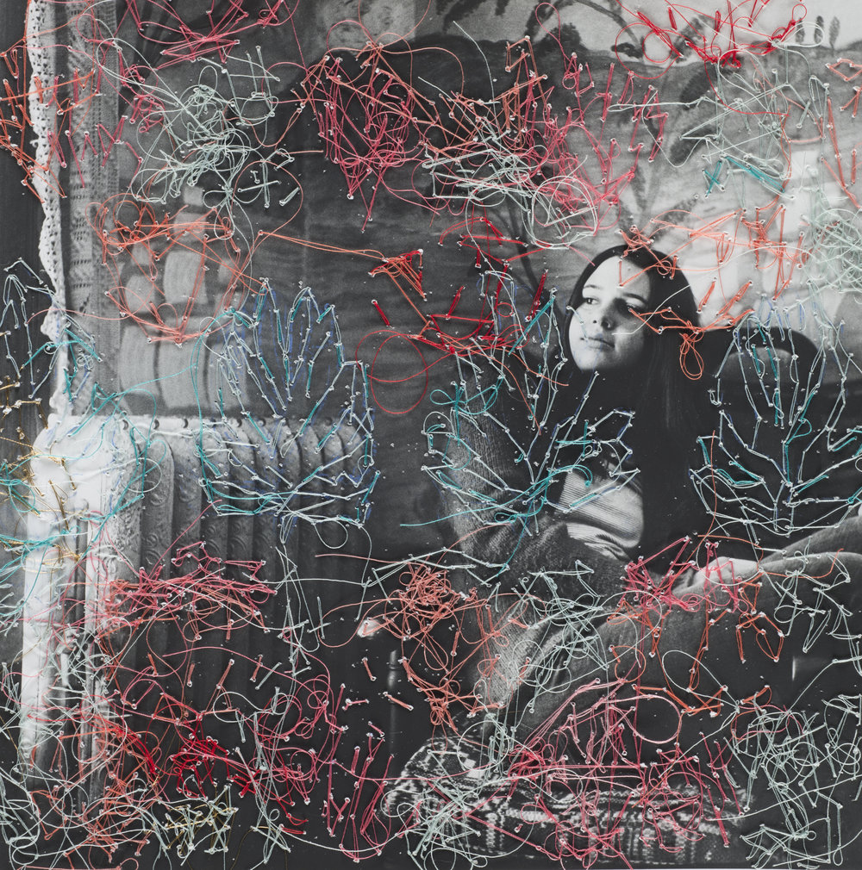
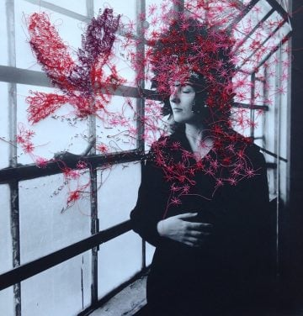
Melissa Zexter interview: Embroidered photography
Melissa Zexter creates embroidered photography. The combination of the immediate and constantly advancing medium of photography (using both traditional and contemporary digital techniques) and the meditative process of hand-stitch produces fascinating results. Melissa’s work is often figurative and deals with representations of femininity.
https://www.textileartist.org/melissa-zexter-interview-embroidered-photography/

Slide 17
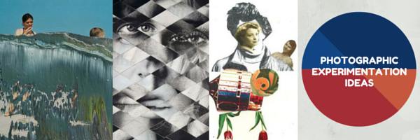
DEFACING PHOTOS

Slide 18
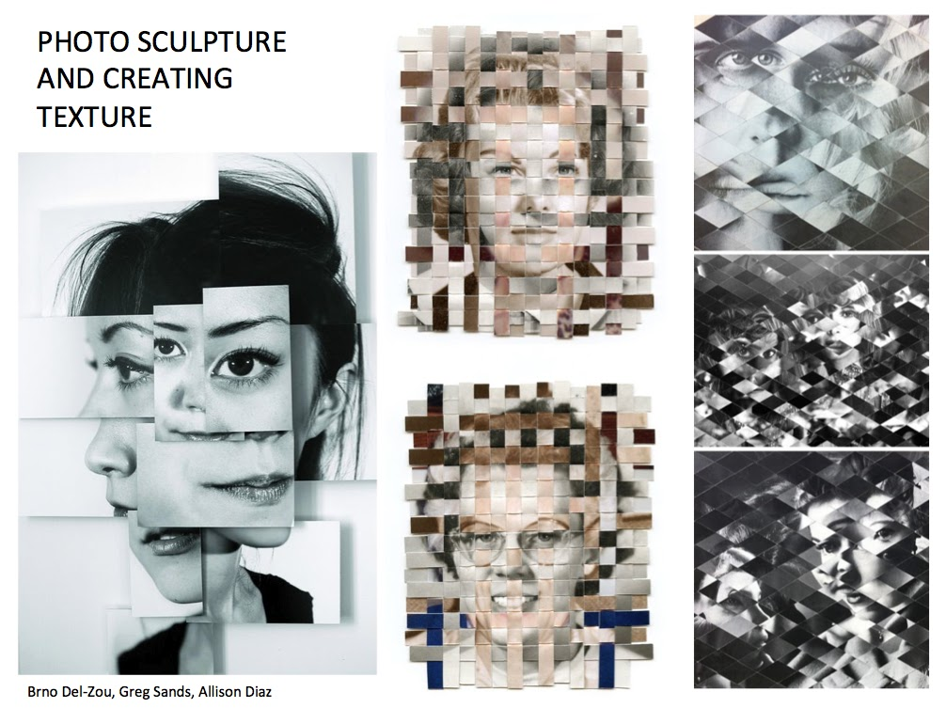

Slide 19
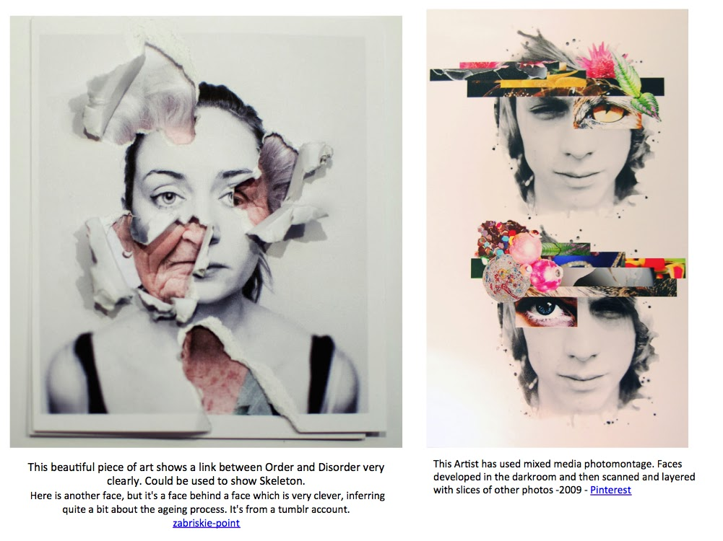
PHOTO MONTAGE

Slide 20
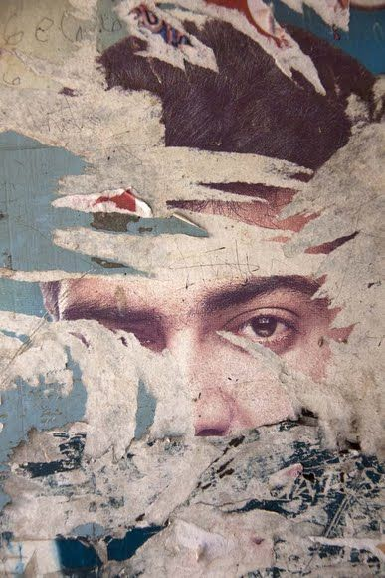
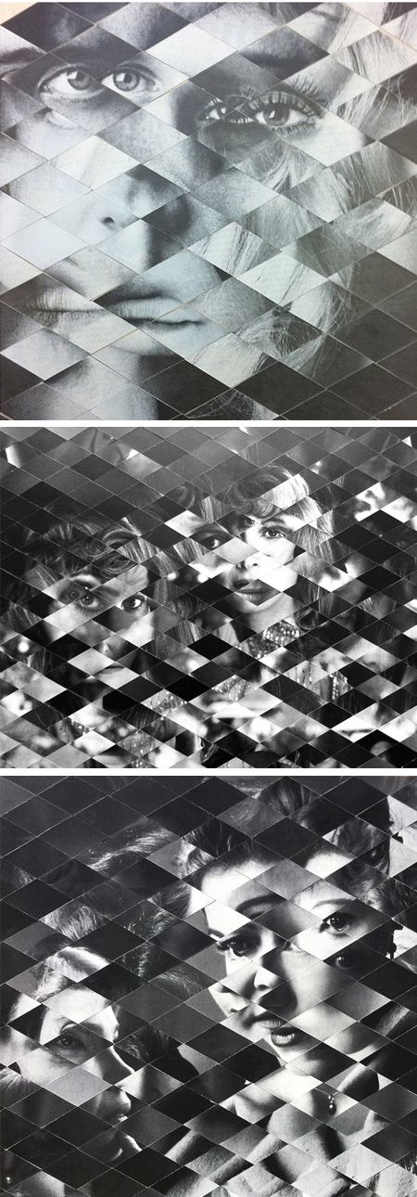
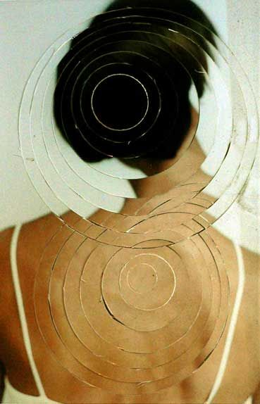
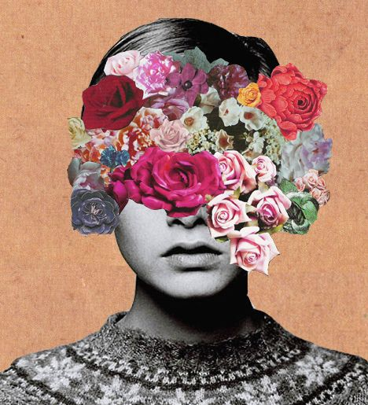
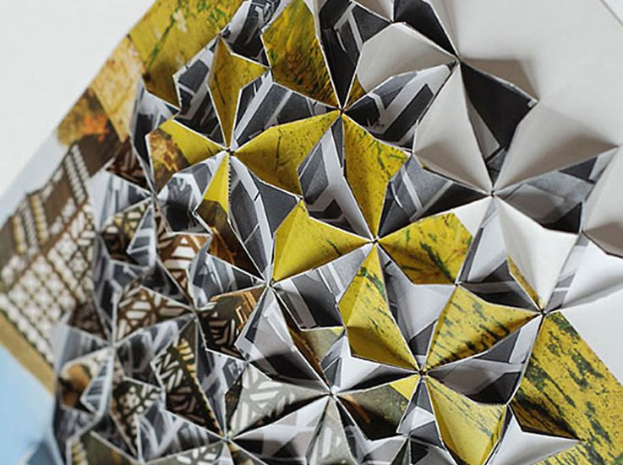
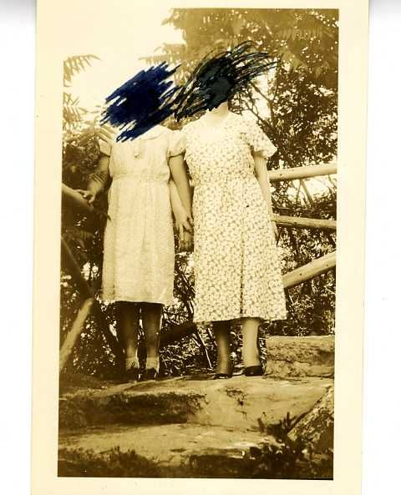
Ways of defacing
GLUE AND TEAR
CUT AND REARRANGE
COLLAGE
FOLD
SMEAR
SCRIBBLE

Slide 21
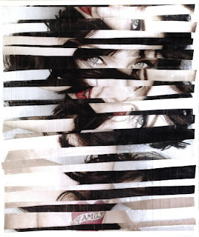
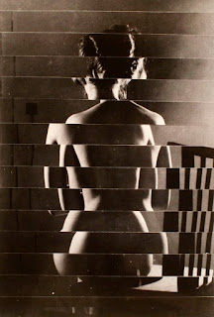
Slicing
Slicing: Choose two photographs that are both portrait or landscape format.
Use the guillotine or sharp scissors to cut the photographs into slices (these do not need to be evenly sliced.
Stick the slices back down on a piece of paper, sticking alternate slices down one at a time from the two different images.
For an alternate slicing experiment, take one image and slice into equal strips, then re-position on a new piece of paper with the strips unevenly placed like Vaclav Chochola.
Example images by Rankin & Vaclav Chochola

