Slide 1
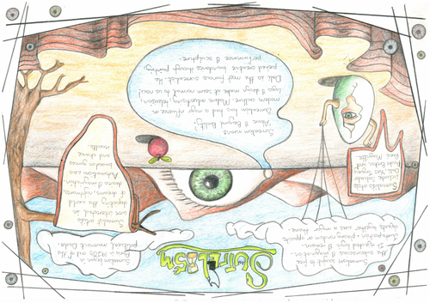
Understanding Surrealism
Articles to read
https://www.tate.org.uk/art/art-terms/s/surrealism#:~:text=Surrealism%20aims%20to%20revolutionise%20human,the%20disregarded%20and%20the%20unconventional.
https://www.tate.org.uk/kids/explore/what-is/surrealism

Slide 2
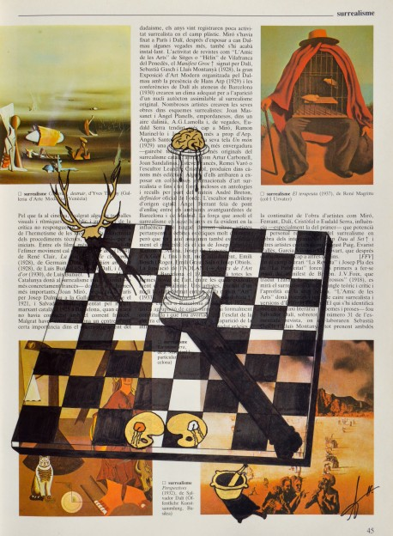
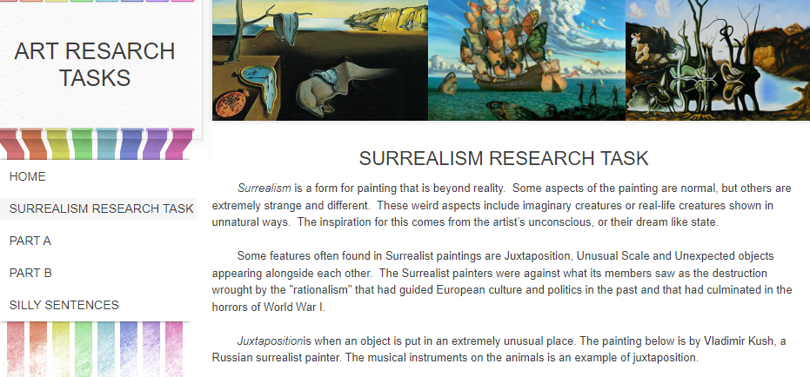
Create a Surrealism Research page with the following:
Written Information about Surrealism
Creating Surrealism visual drawings/paintings.
https://artresearchtasks2013.weebly.com/surrealism-research-task.html
The following link will give you some surreal prompts to get started ☺

Slide 3
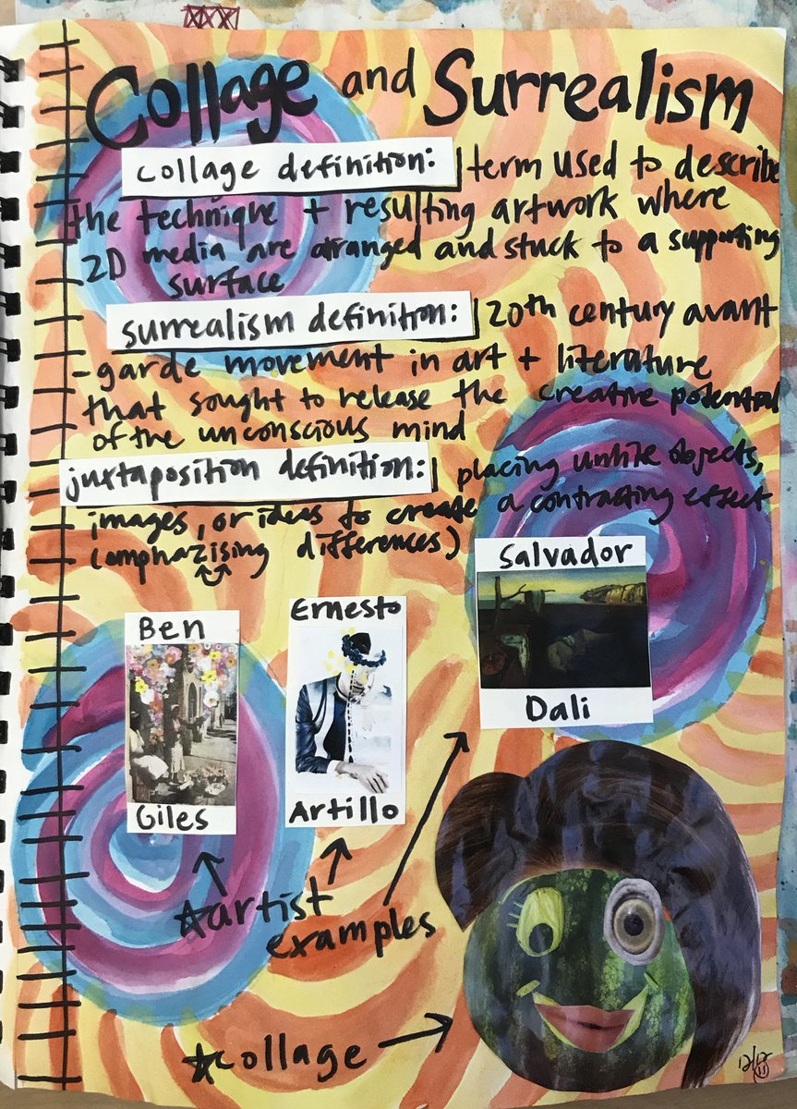
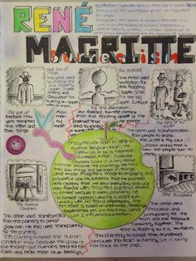
Examples

