Slide 1
Using research and high-quality visual plans to create more ambitious compositions and final pieces.

Slide 2
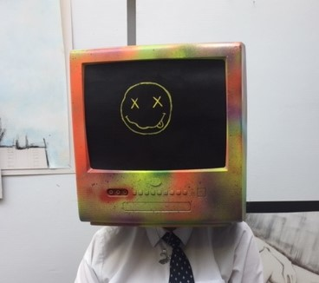
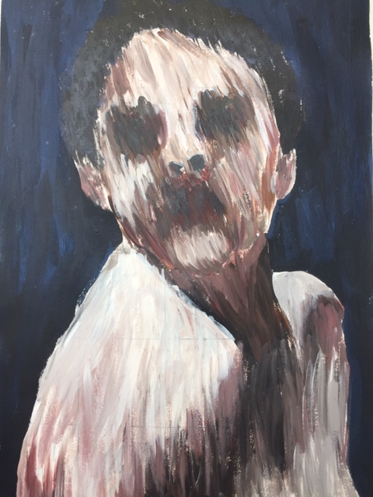
Let’s take a look at Year 11’s Strange & Fantastic Exhibition for inspiration
https://www.artsteps.com/view/60bbffc445bbb96968b5e8df?currentUser

Slide 3
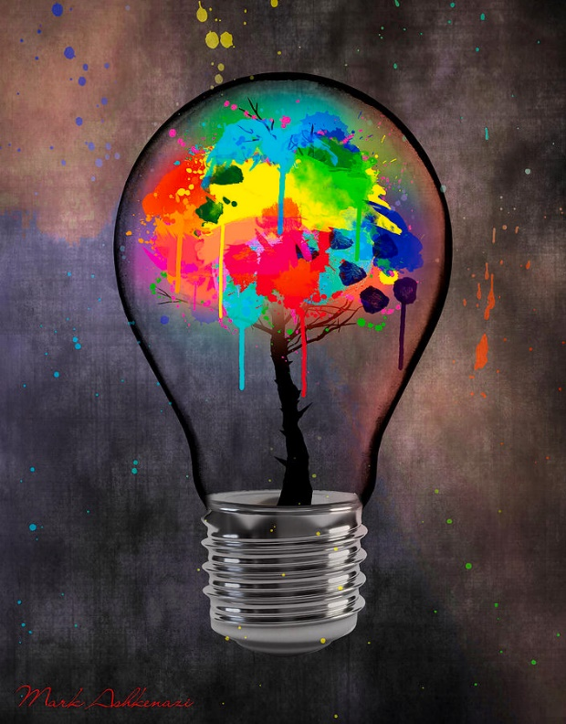
DEVELOPING IDEAS
Idea 1
(Connect to previous ideas and research)
Draw out the ideas clearly
The most successful art works and experiments of my project so far are
1)
2)
3)
Review each idea through a short annotation.
Idea 2
(Connect to previous ideas and research)
For my final piece I would like to
Explore ____________________
Combine____________________
Use ________________________
Create ______________________
Idea 3
(Connect to previous ideas and research)
Ensure you have experimented with different compositional layouts materials, techniques, colour palettes and backgrounds.
Things to consider –
Art material
Composition layout ideas
Surface
Foreground
Background
Layers
Technique and application
Colour palette
Scale
2D/3D/Canvas/Board/Found object
The artist/research/photography that will inspire this work is _____________
This will be communicated within the artwork via ______________________
________________________________
Final Idea
Even when you have found your best idea you can make it even better for your final piece.
HAVE YOU GIVEN ENOUGH DETAIL ON THE FINAL COMPOSITION?

Slide 4

FINAL DEVELOPMENT
 | AO1, AO2 AO3 & AO4 Finalise your ideas - You will be beginning your final piece next week. Make sure you have: Decide on a surface you need and let your teacher know! experimented thoroughly Have you used your artist to inspire your ideas Have quality images to work from Have explored colour/techniques Have considered one than one composition idea. Have thought about the background Experiment:- Try out different compositions poses, colour,style & techniques . . . Show the examiner all your decisions. Always work from images/Photos (they could be new ones if your work is too similar)
Remember, show all your decisions

