Slide 1
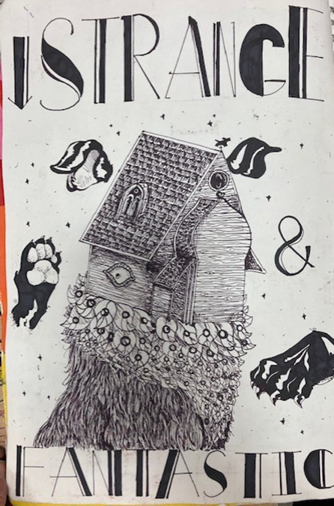
Observing details and textures more closely from first and second-hand images and objects to improve accuracy
Exploring the theme Strange and Fantastic with surreal ideas

Slide 2
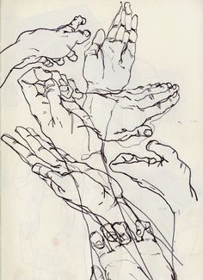
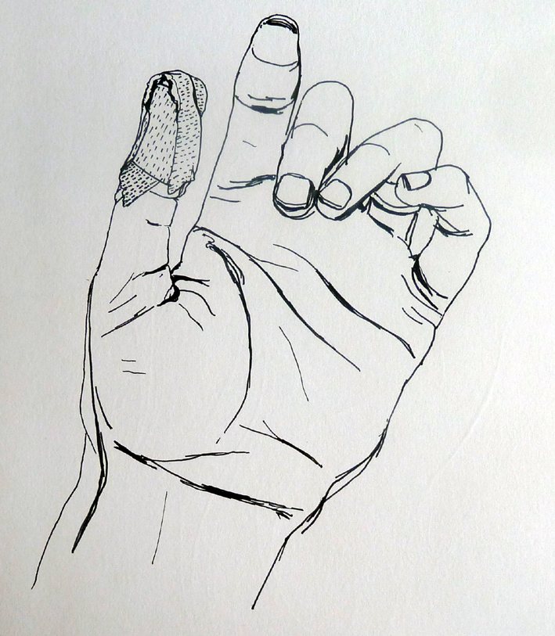
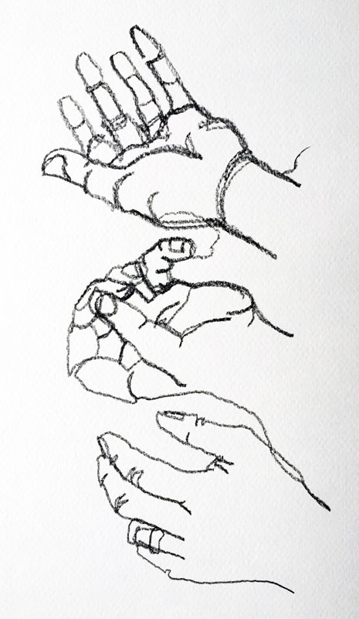
https://www.youtube.com/watch?v=rB7ab61Xu3Q
Video to help you plot out hand drawings
https://www.youtube.com/watch?app=desktop&v=HfYuWgErHwA
Creating a hand sketch
Check shape
Proportions
Sizes

Slide 3
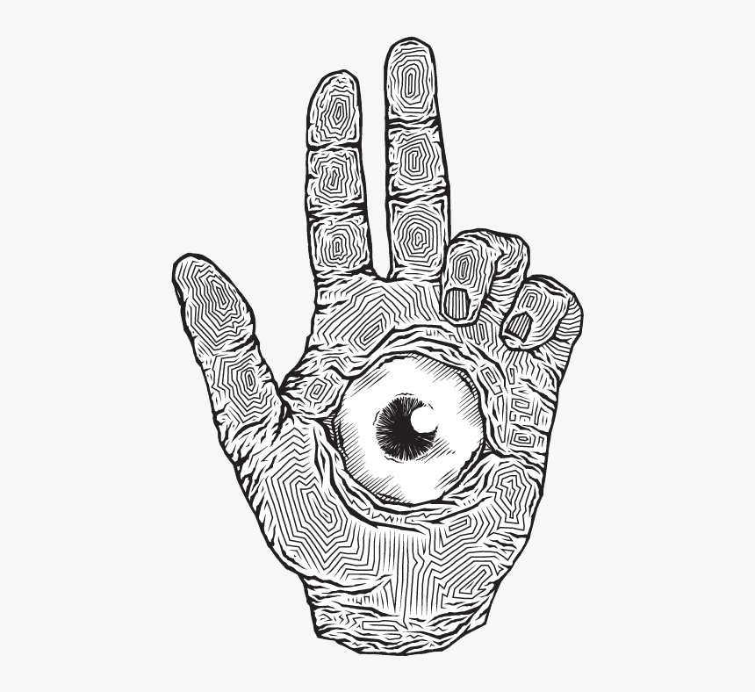
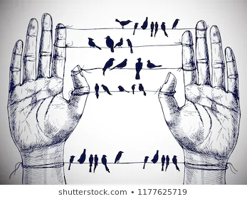
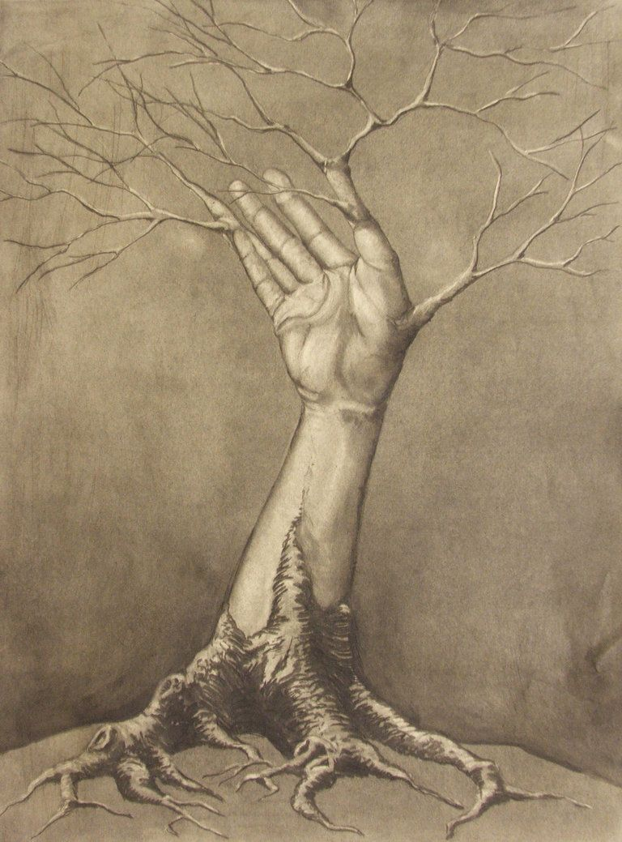
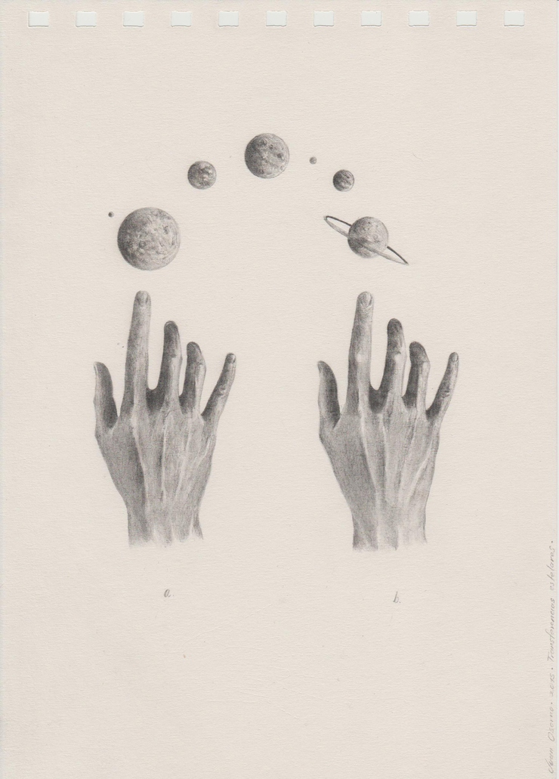
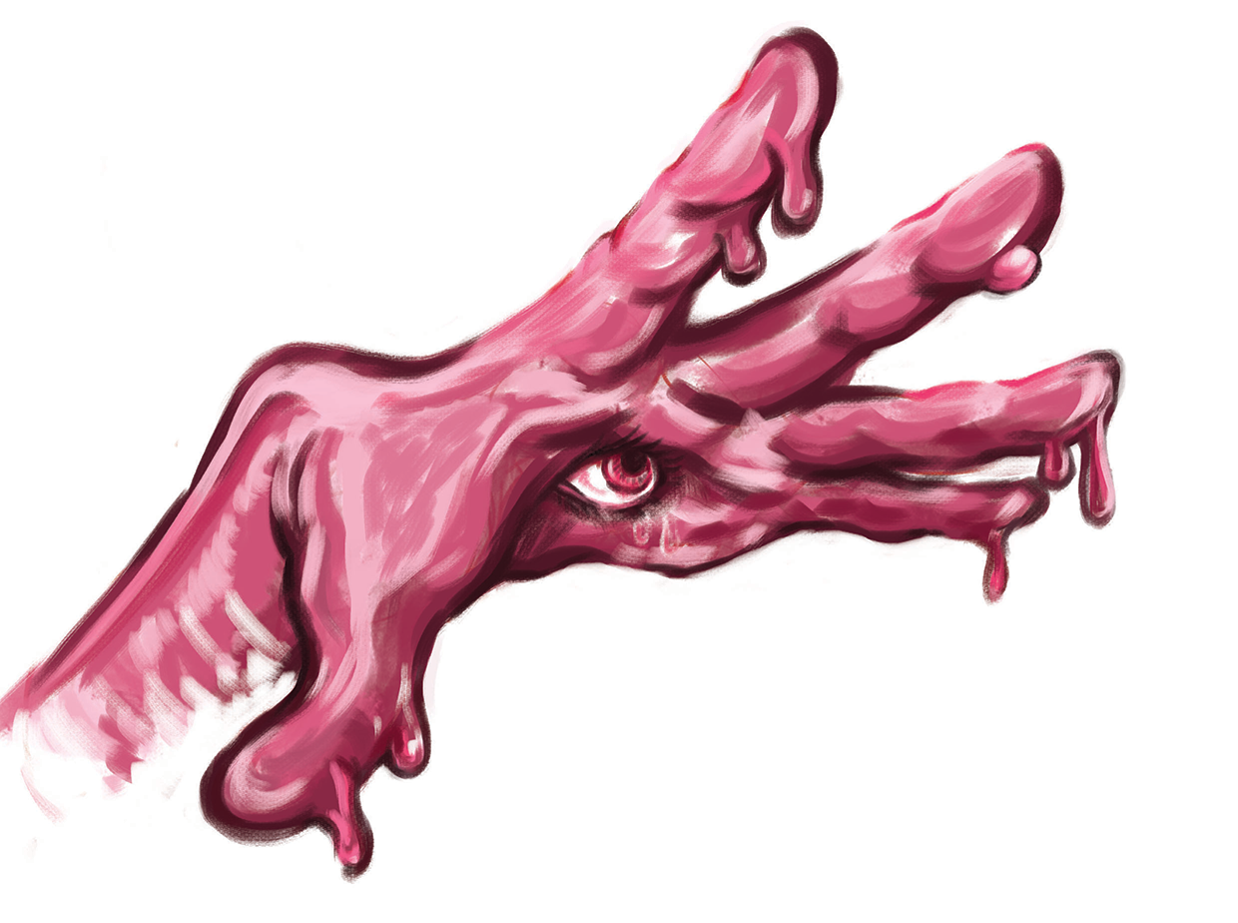
o
Creating a surreal drawing for your strange and fantastic sketchbook.
Adapting your hand drawing with a strange and fantastic idea! Maybe these images could inspire you.

