Slide 1
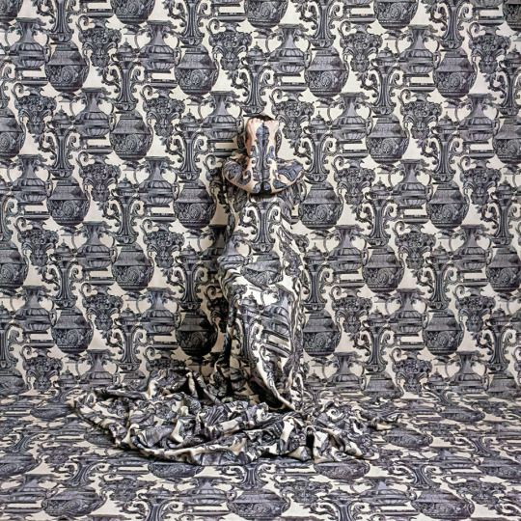
Disguise &
Texture

Slide 2
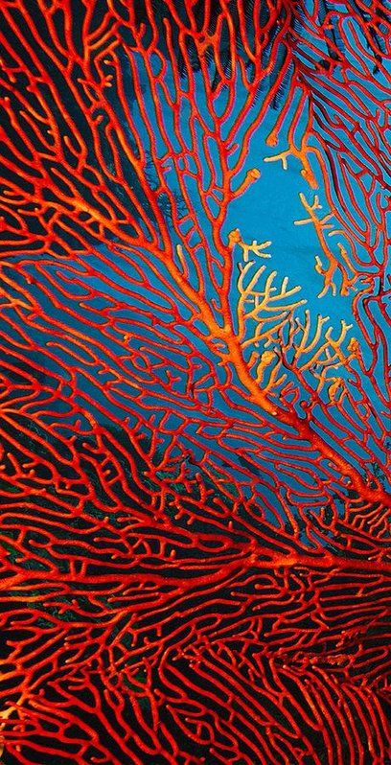
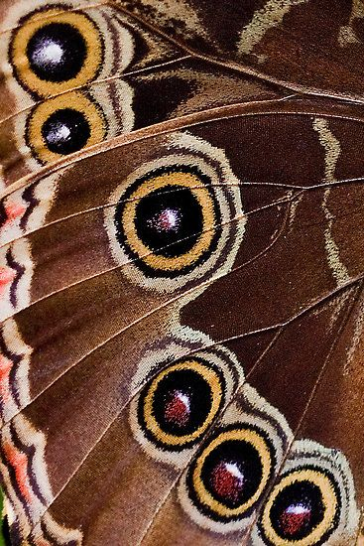
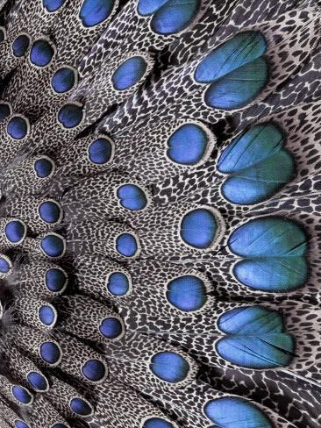
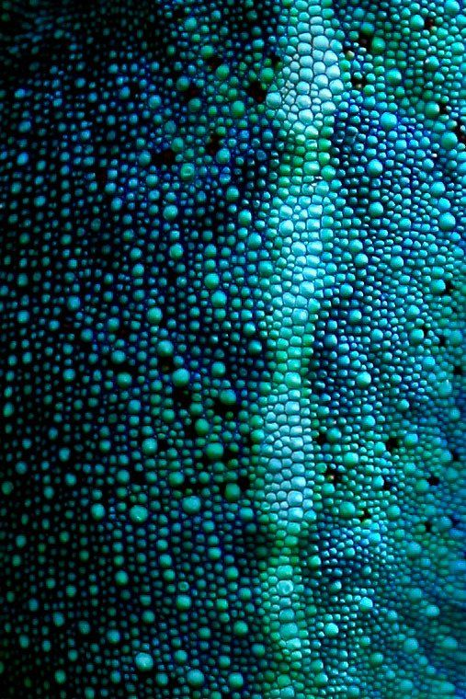
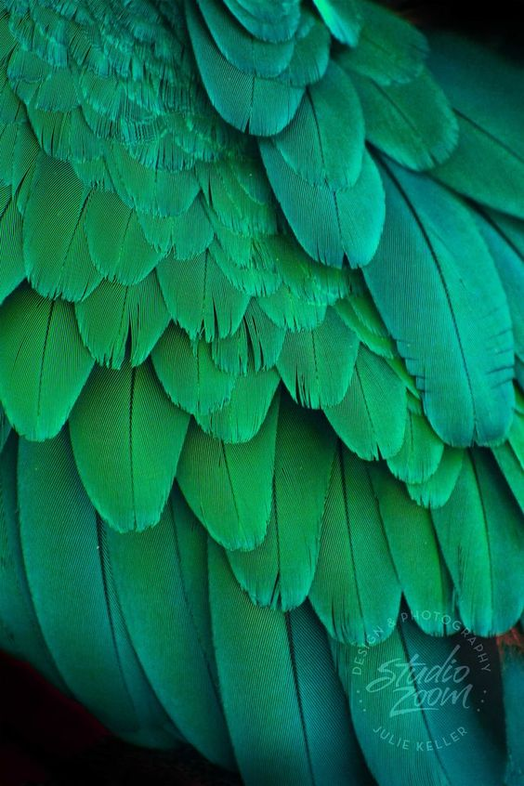
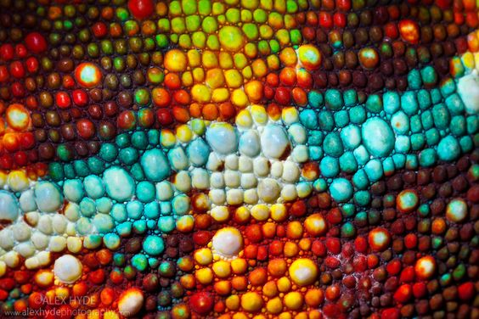
Week 6 Camouflage
Create a double page spread on camouflage. This can include drawings in any material and can include close ups of animal camouflage/skin/feathers/scales.
Try splitting up your page into different sections across the 2 pages. (Look at the next slide for ideas)
Be creative with materials. e.g. glue and crumbled paper & paint, collage, carrier bags, thread, old fabric.

Slide 3

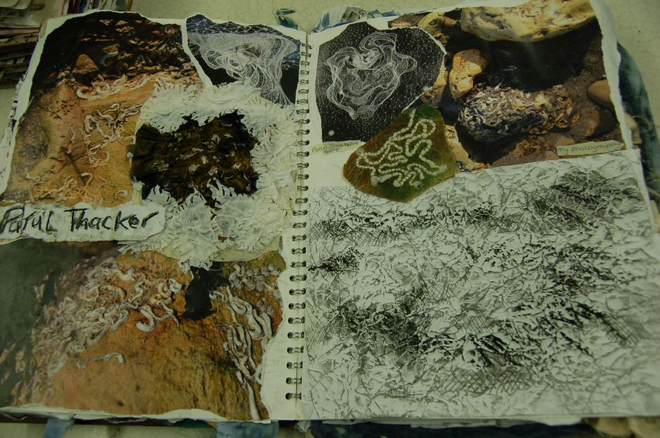
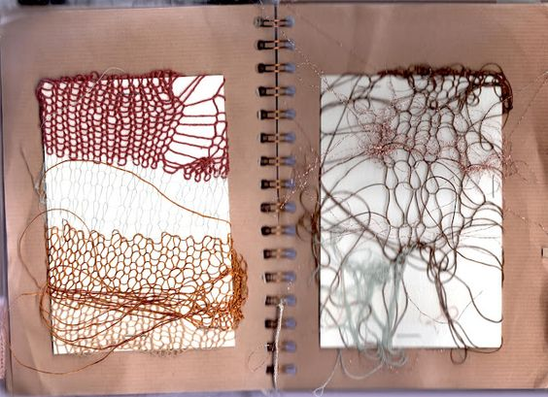
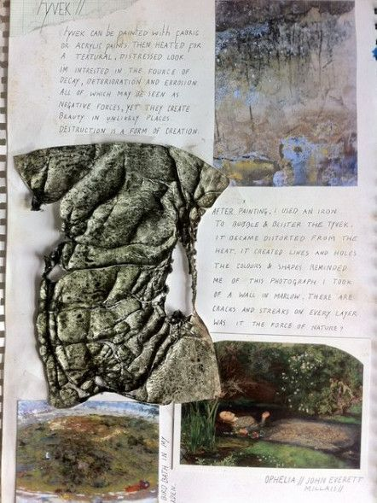
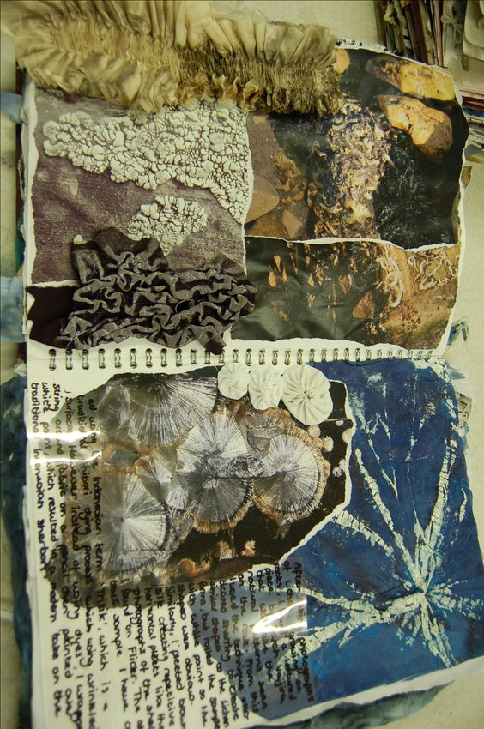
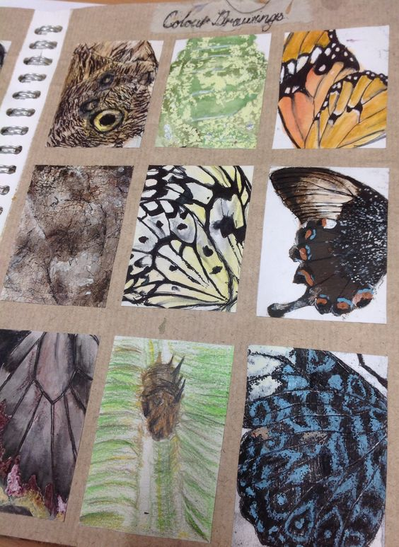
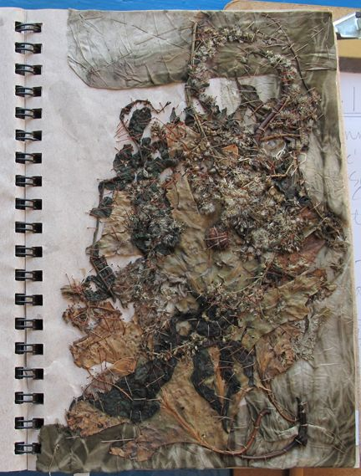
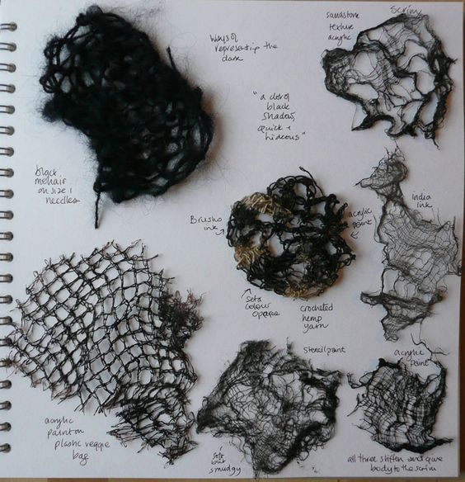
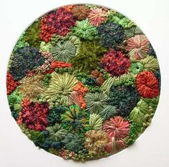
Here are some ideas for layout of your sketchbook page.
LISTEN FOR SKETCHBOOK ADVICE
Breaking up the page into sections
Experiment with materials to create textures & camouflage.
You could create different animal camouflage.

Slide 4
Annotate
Neatly annotate your double page spread. This can be handwritten or typed up.
Which material and techniques have been the most successful at creating texture/camouflage?
Neatly label the different materials you have used. Avoid drawing arrows into your work!

Slide 5
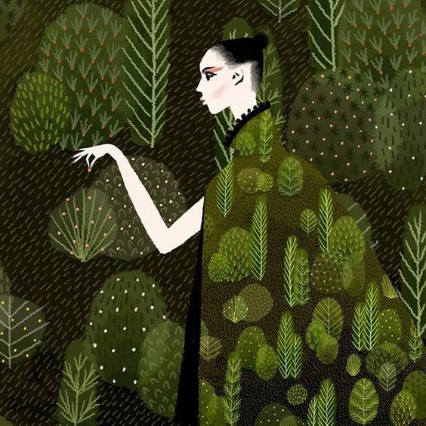
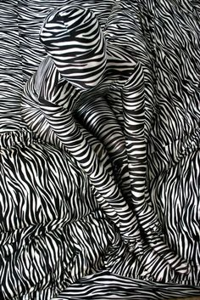
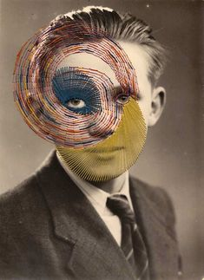
Week 6 Extension Task
Using your most successful experiment from your double page spread, now apply the camouflage to an animal or object.
Add the same camouflage into the background too.

Slide 6
Exploring the work of others (A01)
In the next lessons you will be asked to create work responding a number of artists. We understand you have limited resources at home, so don’t worry if you need to use different materials or cannot manage to finish the tasks.
You can print out images of the artist’s work or you could save them to a powerpoint and print them when you get back to school.

Slide 7
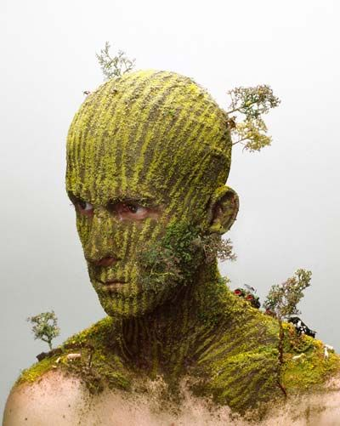
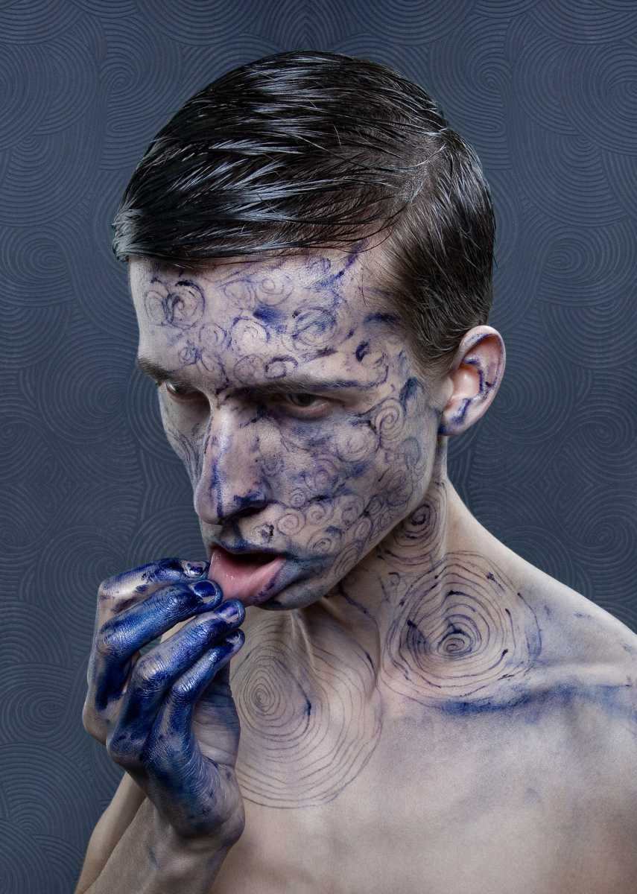
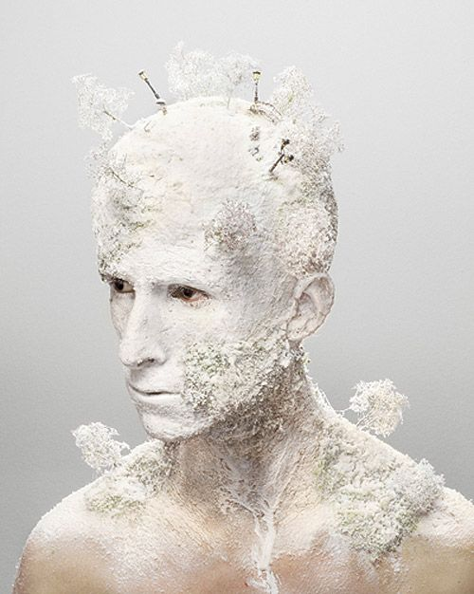
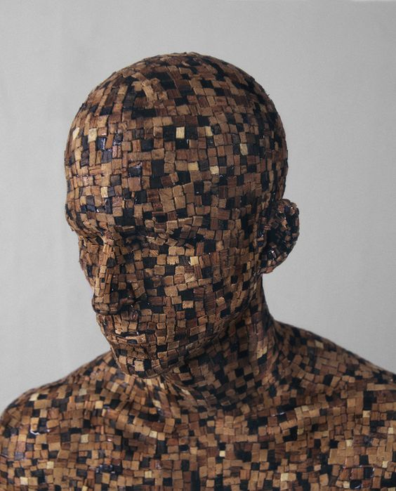
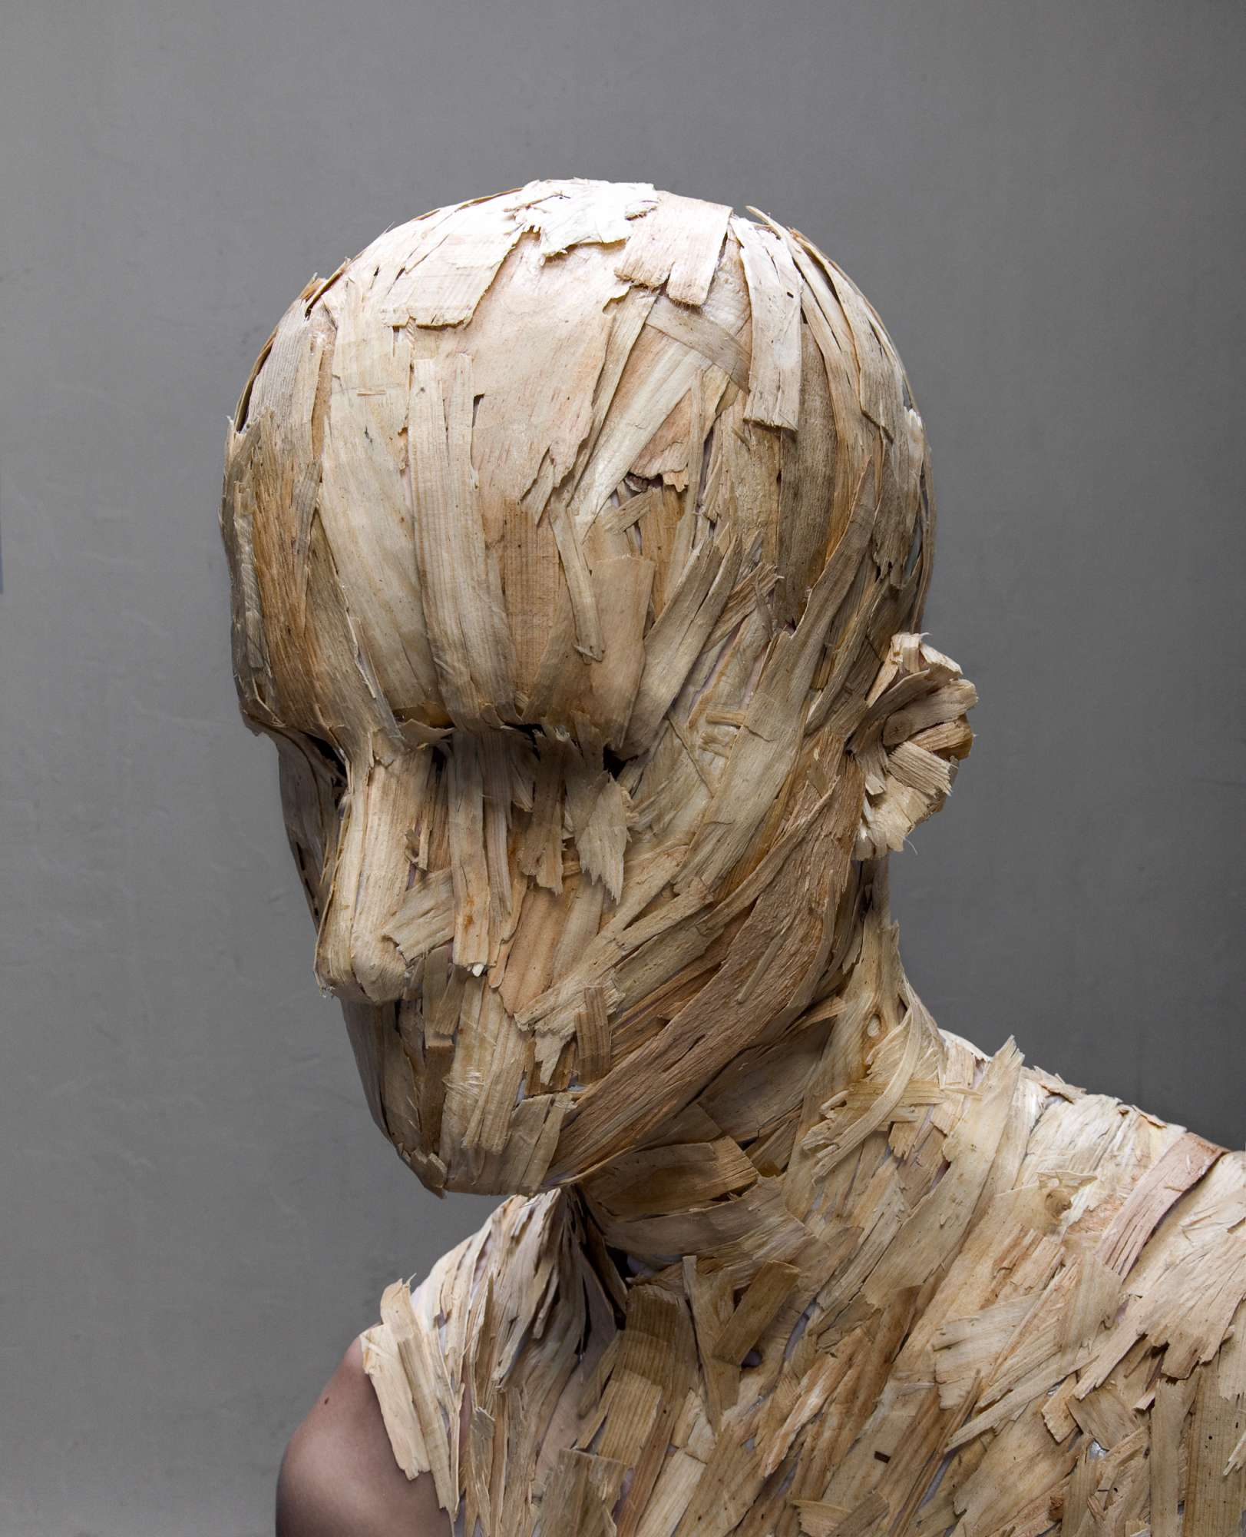
Week 7 Lesson 1 & 2 Disguise & Texture
LISTEN TO ADVICE ON ARTIST RESEARCH
Levi Van Veluw
Levi van Veluw is a Dutch artist. He is known for producing multi-disciplinary works that includes installations, photographs, films, sculptures, paintings and drawings. This portrait work is his older artwork, titled Landscapes.

Slide 8
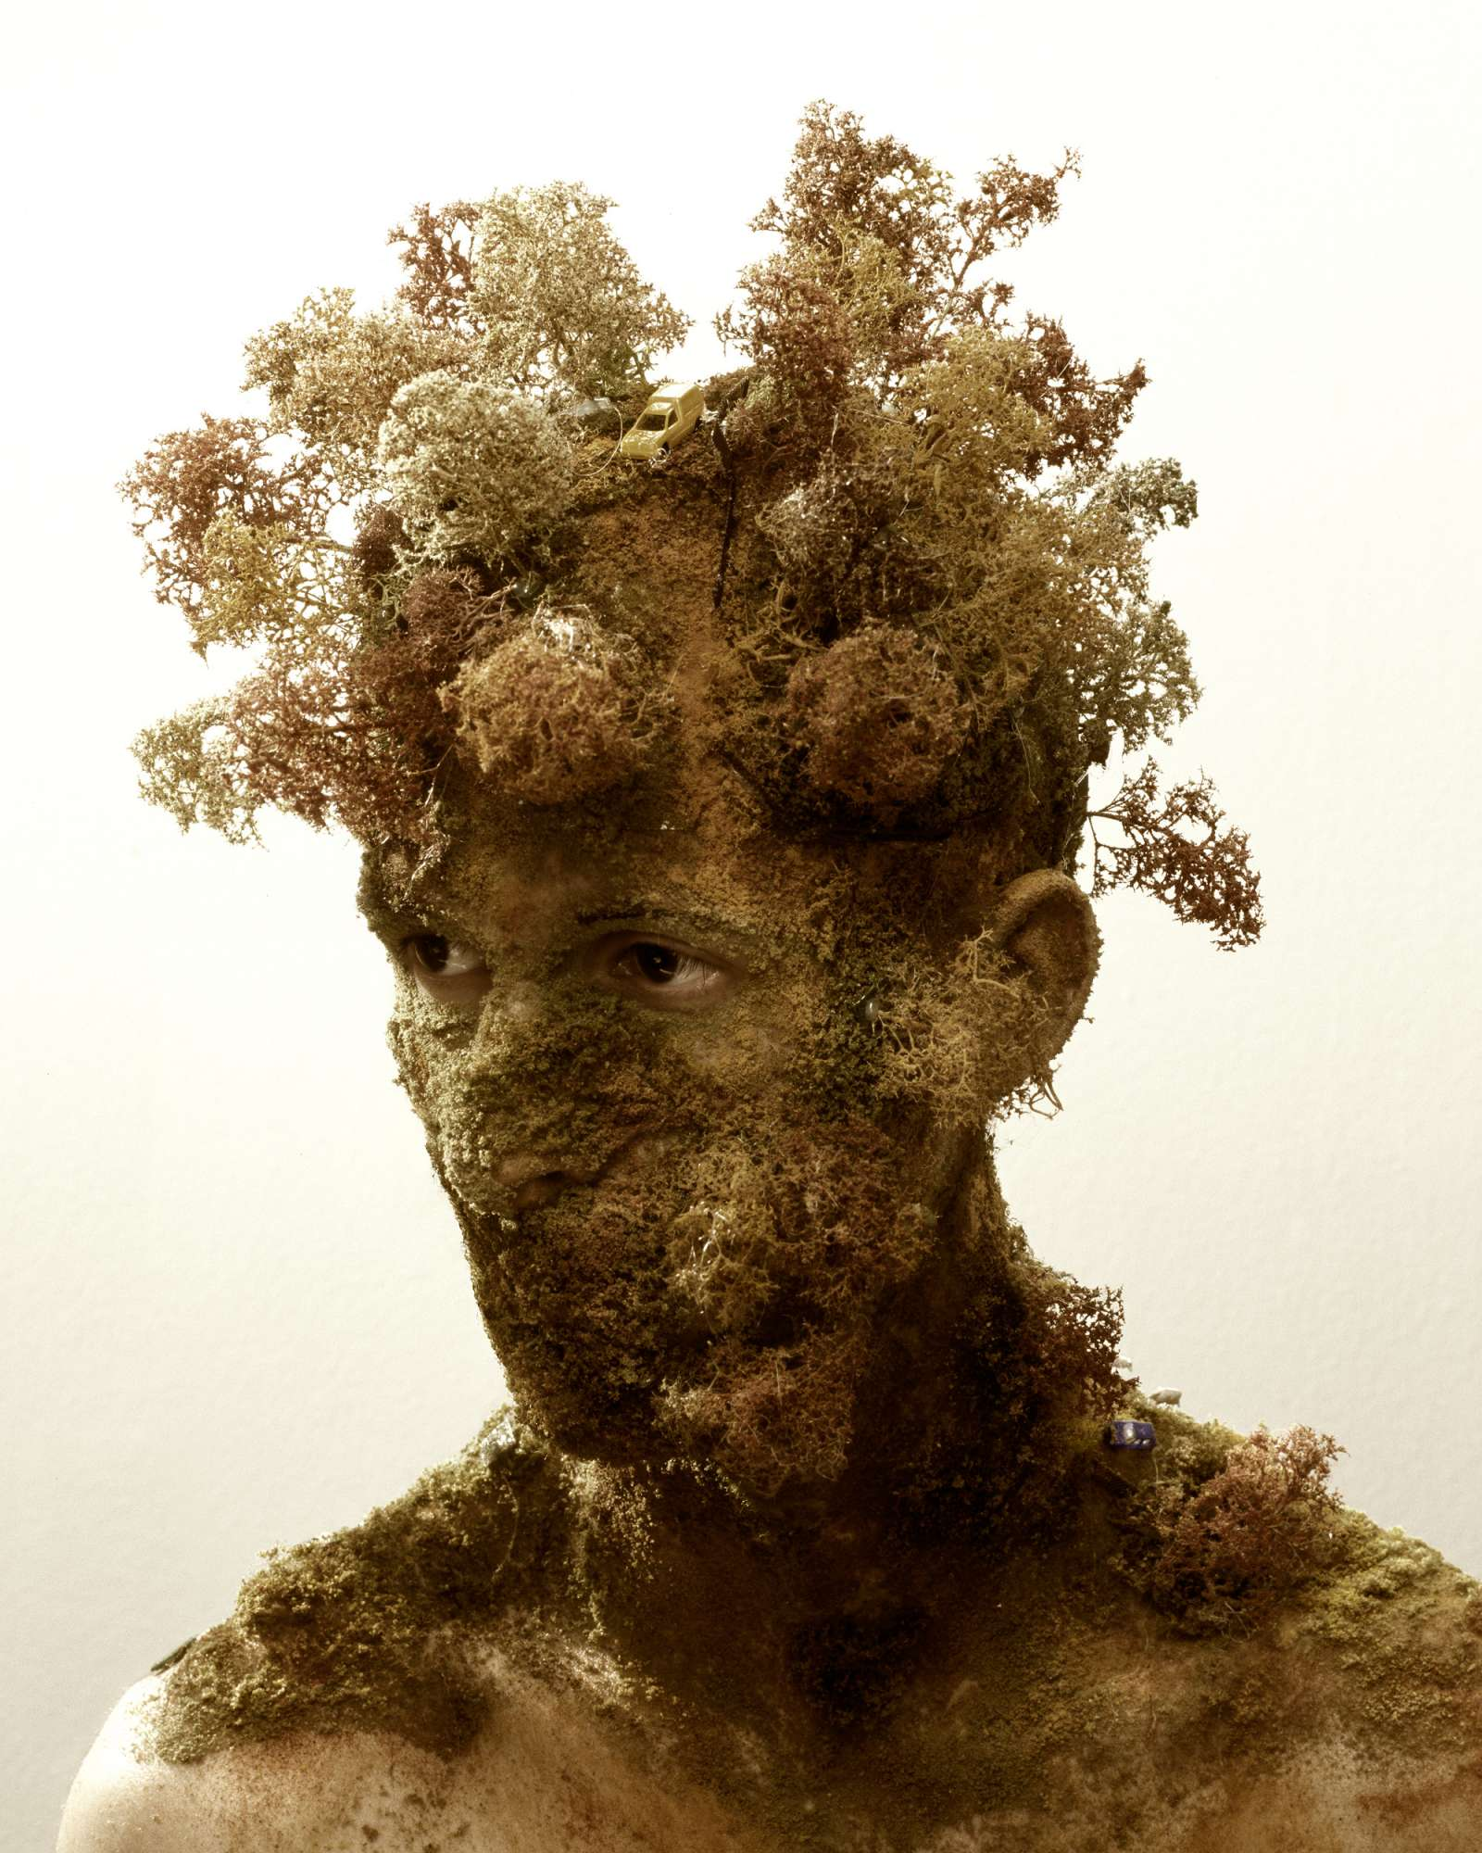
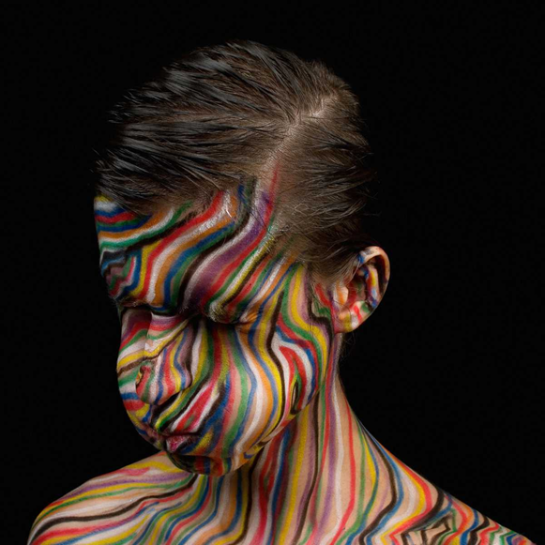
Task
Title: Looking at Levi Van Veluw
1. Find an image of a human face or animal to work from.
2. Plot out the outline of a human face or alternatively an animal. Use the pencil lightly until you are happy with the shape and proportions.
3. Now apply a landscape or alternative textures onto your drawing.

Slide 9

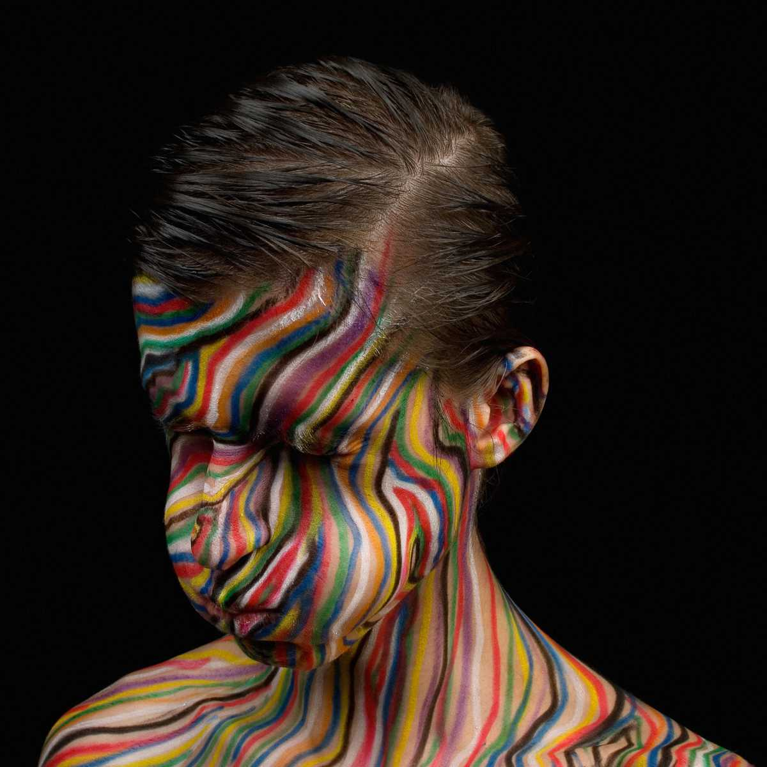
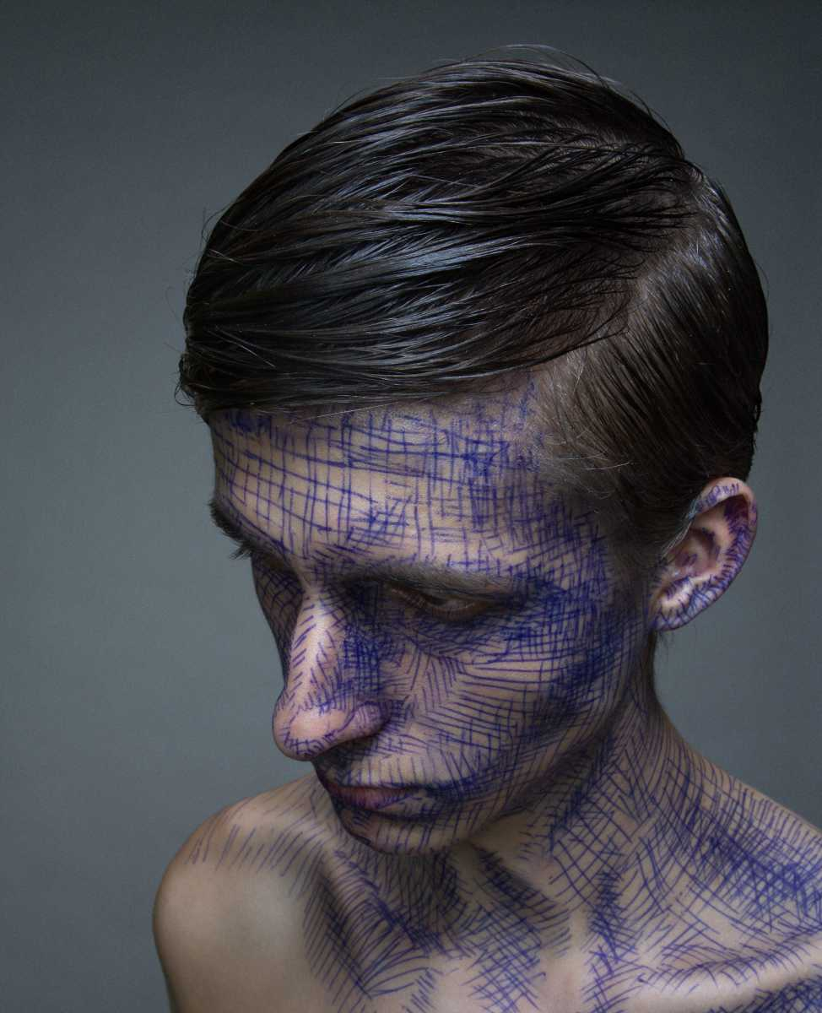
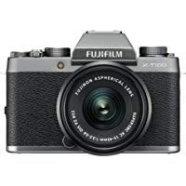
Extra fun challenge?
You could have fun and create
Your own version of Levi Van Veluw using any materials you can find.
THEN PHOTOGRAPH IT FOR YOUR SKETCHBOOK!

Slide 10
Question for your artist page
Complete the following questions for artist Levi Van Veluw. You may want to carry out extra research into his artwork to find out extra information about the meaning of the art work. Record the answers neatly next to your work in the style of the artist.
Who created the art work?
Describe the artwork using the relevant keywords as though you were explaining it to someone who cannot see it.
Are there any recurring themes in their work?
Keywords
Shape
Pattern
Line
Form
Colour
Tone
Texture
Repeat
Intricate
Expressive
Photorealism
Foreground, mid ground & background
Mood
Space
What do you know about the materials the artist has selected?
Why have they chosen these materials? Why are they suitable for this piece of art?
e.g. The artist has used washes of paint & ink to create movement and feelings of confusion.
What is the artist trying to convey with the artwork? Is there a message/meaning/story behind the work?

