Slide 1

Stand Up Even If You Stand Out
Thoughts and prayers
Monday 27th November – Friday 1st December

Slide 2
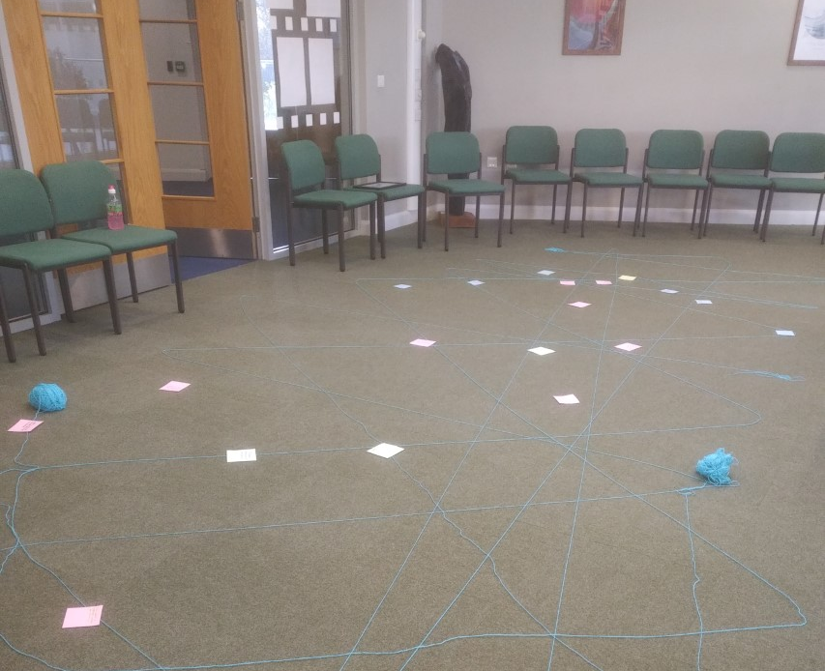

MORNING PRAYER IN THE CHAPEL THIS WEEK
Monday 9th October – 10T
Tuesday 10th October - 9A
Wednesday 11th October – 10M
Thursday 12th October - 10R
Friday 13th October - 10Y

Slide 3
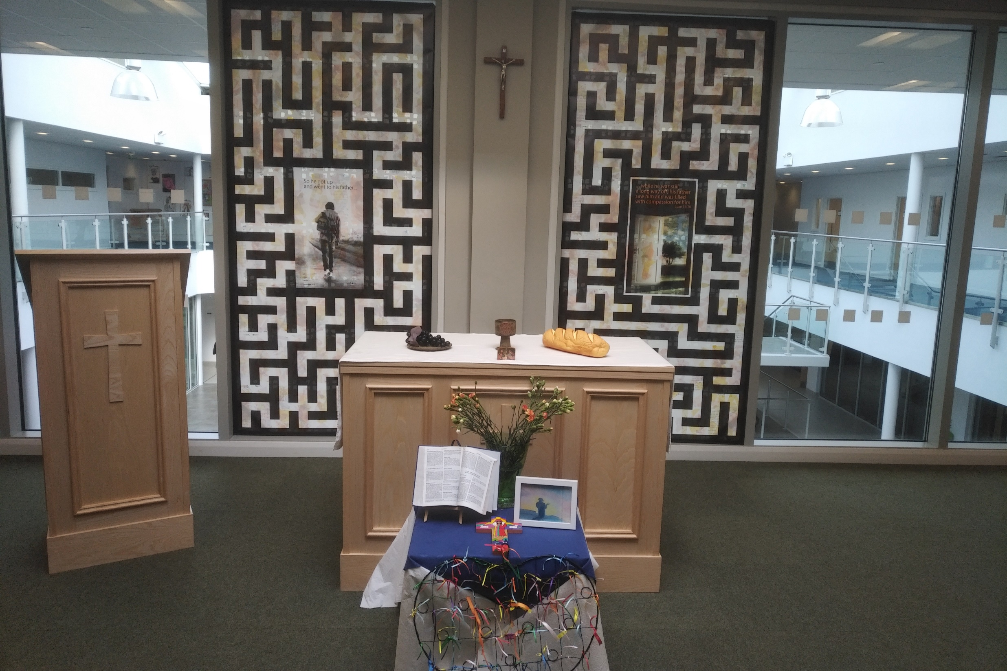
Friday Mass
Who?
Mass this week will be led by 7R
When?
Friday Morning at 8.20am
Where?
In the School Chapel. See you there!
ALL ARE MOST WELCOME.
ALL WORDS ARE DISPLAYED ON THE SCREEN.

Slide 4
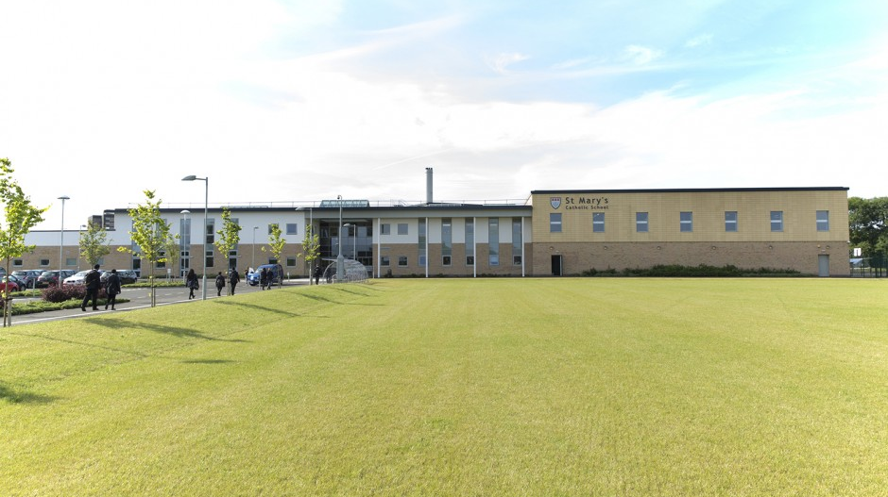
Things to get involved in at St Marys
Christian Union - every Tuesday G16
Islamic Union - every Tuesday G15
Islamic prayer - available every lunchtime at the Counsellors room.
Christmas Club - every Friday in G13. Come and make Christmas cards to send and other items for Christmas

Slide 5
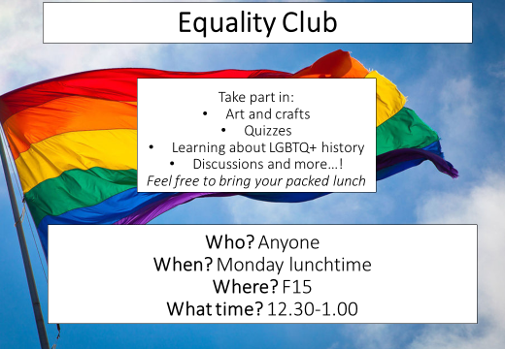

Slide 6
Stand Up Even If You Stand Out
Thoughts and prayers
Monday 27th November – Friday 1st December

Slide 7
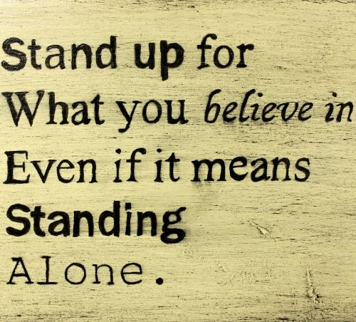
Why is it important to stand up ?
Standing up for what you believe in is essential because it reflects your values and principles. It empowers you to make a positive impact, create change, and contribute to a better world aligned with your convictions. It also fosters personal growth and helps build a more just society by advocating for what's important to you.

Slide 8
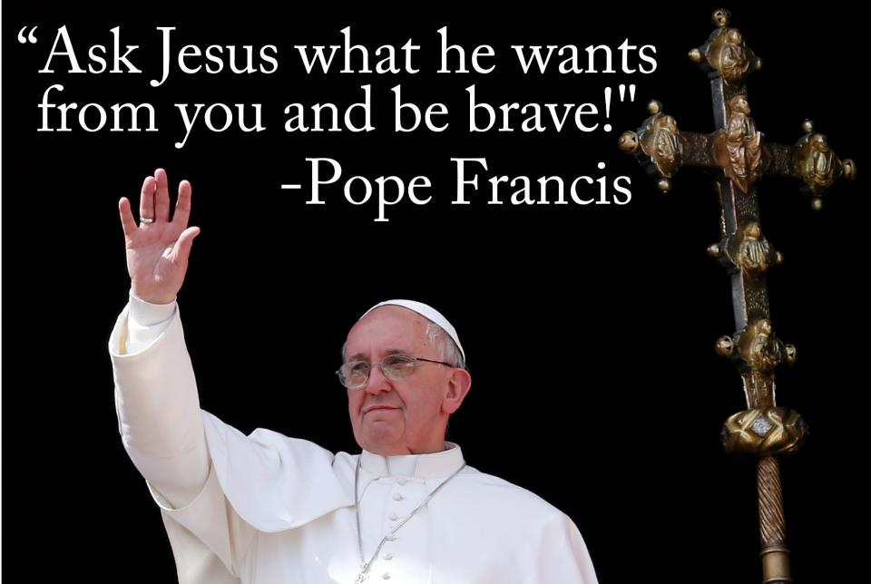

Slide 9
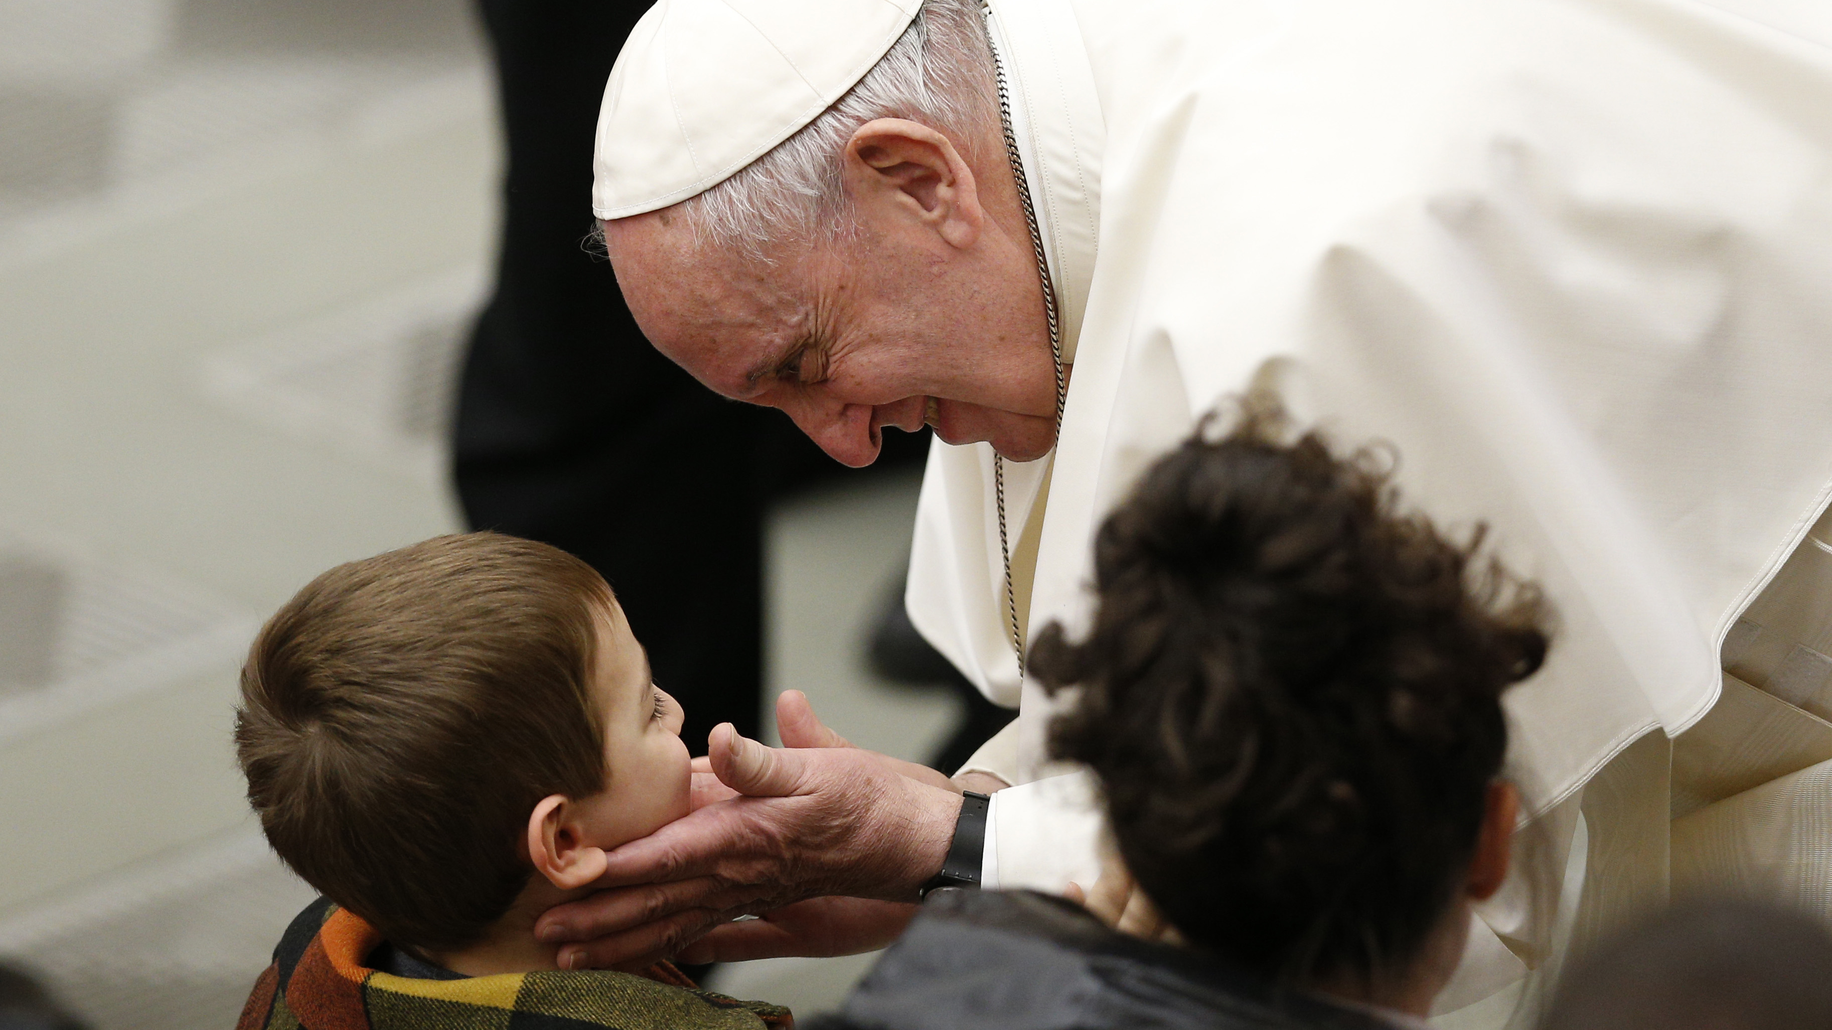
Pope Francis has spoken out on various social issues, advocating for the poor, refugees, and marginalized communities.
He's addressed topics like climate change, economic inequality, and the need for compassion and inclusion within the Church.
He's also emphasised the importance of dialogue, mercy, and caring for the environment as crucial elements of social justice and ethical living.
His actions, speeches, and encyclicals often reflect these values, encouraging others to stand up for what is right and just

Slide 10

Class Discussion
What does it mean to you to stand up for your beliefs?
2. Can you recall a moment when you stood up for something you believed in? What was the outcome?
3. Why do people sometimes find it challenging to stand up for their beliefs?
4. How do cultural or societal norms influence our ability to stand up for what we believe in?
5. What are the potential risks and rewards of standing up for your beliefs?
6. Are there situations where it might be better to compromise rather than adamantly stand by your beliefs?
7. How can we encourage others, including younger generations, to stand up for what they believe in?

Slide 11
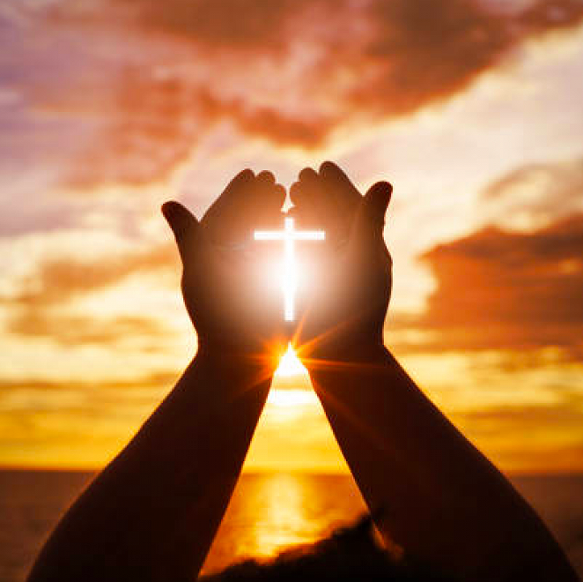
Let Us Pray
Dear Lord,
Grant me the courage to stand for what is right, To speak up against injustice and fight the good fight. May I find strength in my convictions each day, And let my actions reflect the values I convey. Guide me to make a difference, both big and small, In pursuit of fairness and equality for all

Slide 12
Stand Up Even If You Stand Out
Thoughts and prayers
Monday 27th November – Friday 1st December

Slide 13

Over the years, many athletes and sportspeople have stood up for what they believe in through speaking on societal problems, making sizable donations and creating innovative player foundations.
Athletes are using their platforms in more dynamic ways than ever to create long-lasting impact, staking their reputations and image on social issues
These athletes join a number of other sports stars who’ve used their platform to bring awareness to a number of issues.

Slide 14
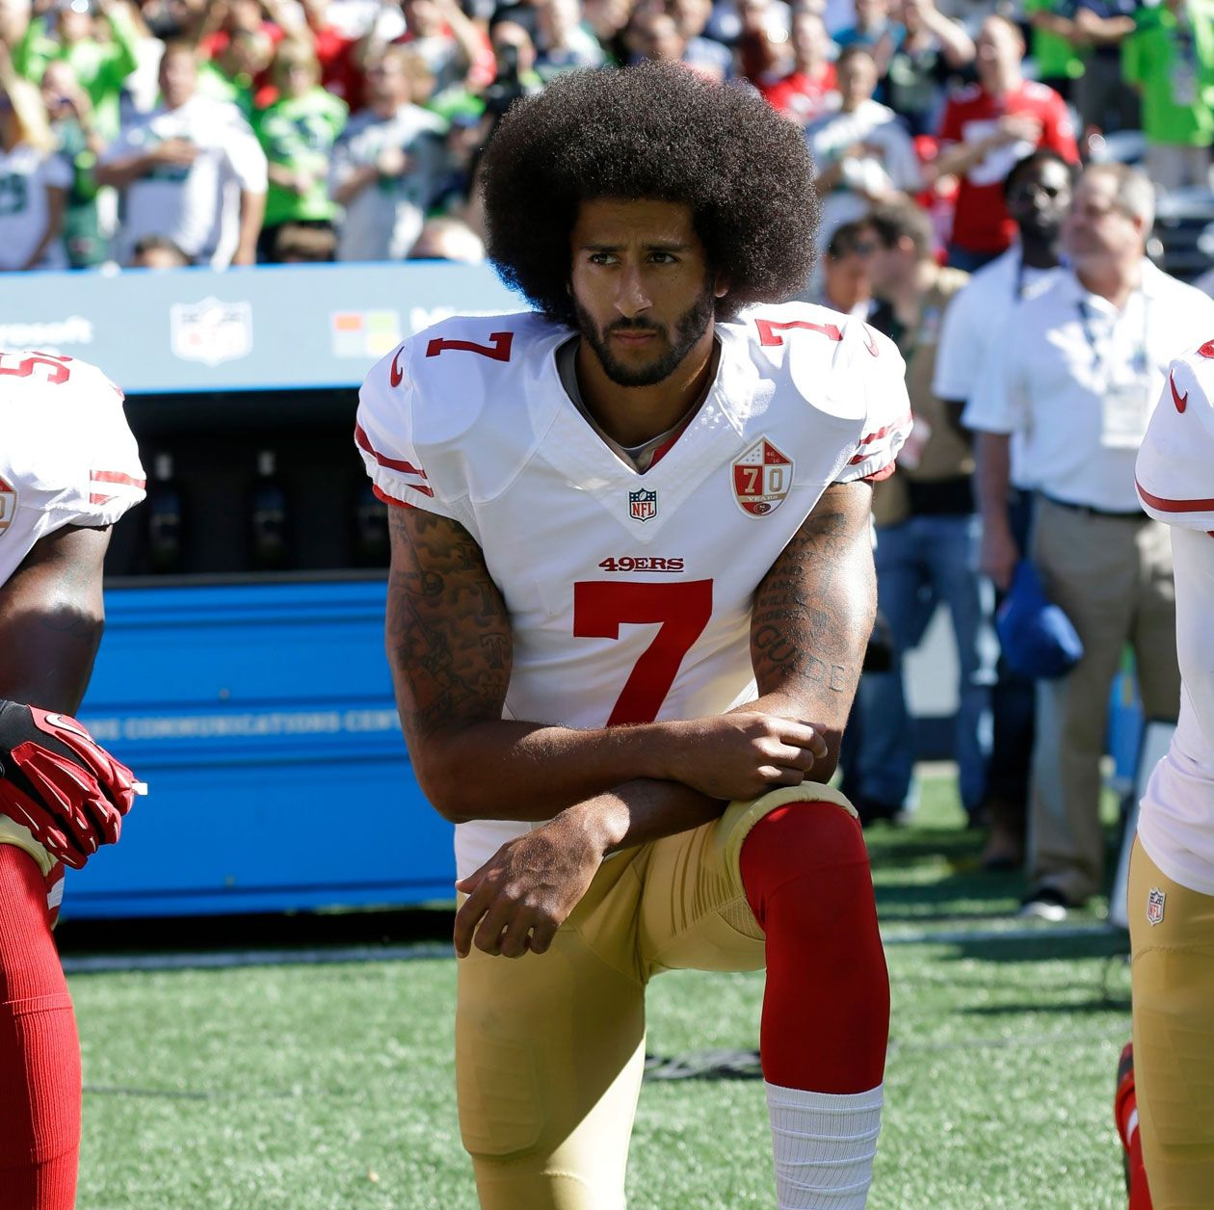
Colin Kaepernick
49ers quarterback Colin Kaepernick unapologetically protested the lack of action being taken by U.S. lawmakers to end police brutality against African-Americans when he refused to stand for the singing of the National Anthem at a pre-season NFL game in 2016.
2016
“I am not going to stand up to show pride in a flag for a country that oppresses black people and people of colour,”
“To me, this is bigger than football, and it would be selfish on my part to look the other way. There are bodies in the street and people getting paid leave and getting away with murder.”

Slide 15
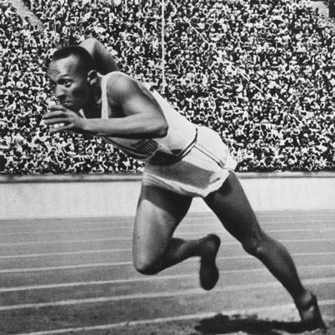
Jesse Owens
Jesse Owens was an extraordinary track and field athlete who is one of the greatest sports figures in world history. In addition to discrediting Hitler’s myth of Aryan supremacy in sports by winning four gold medals at the 1936 Summer Olympics, Owens also became the first Black athlete to receive sponsorship from Adidas in 1960.
“The battles that count aren’t the ones for gold medals. The struggles within yourself – the invisible, inevitable battles inside all of us – that’s where it’s at.”

Slide 16
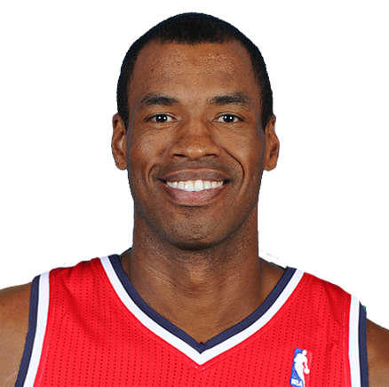
Jason Collins
Retired NBA player Jason Collins was the first publicly LGBTQ professional athlete in any of the four major men’s pro sports leagues in the U.S.
Since then, Collins has been a vocal advocate for LGBTQ equality, serving as an inspiration for other LGBTQ athletes and trailblazers who have come after him.
"I'm a 34-year-old NBA center. I'm black. And I'm gay. I didn't set out to be the first openly gay athlete playing in a major American team sport. But since I am, I'm happy to start the conversation. I wish I wasn't the kid in the classroom raising his hand and saying, "I'm different." If I had my way, someone else would have already done this. Nobody has, which is why I'm raising my hand"

Slide 17

Dipika Pallikal
Dipika Pallikal, one of India’s top-ranked squash players, refused to compete in four consecutive national championships, starting in 2012, due to the pay disparity between male and female players. Pallikal made a comeback only after prize money was equalised by the organisers of the championship.
She received flak from many for abandoning the championship for four years, as it was not seen in sync with the ‘sportsmanship spirit’. The criticism did not stop Pallikal from demanding equal pay and she was successful in bringing change for women in squash.

Slide 18

Why Premier League Players Take The Knee
In what ways could you use your voice or talents to raise awareness or advocate for change?
Why do you think it's important for celebrities to use their platform to generate change in the world?
Reflect on a time when you witnessed something that you felt was unjust or needed improvement. What thoughts and feelings did it evoke? How did you respond and what impact did it have?

Slide 19

Dear Lord,
Grant us the strength to stand up for what is right, to see the needs of others with clarity and empathy, and to act with courage in the face of injustice.
Guide our steps as we seek to make a positive change.
Help us to use our voices for those you cannot speak and our hearts to foster unity and compassion in our communities
Amen

Slide 20
Stand Up Even If You Stand Out
Thoughts and prayers
Monday 27th November – Friday 1st December

Slide 21

The Scripture This Week
In Romans 12:2, the apostle Paul urges Christians not to let the values and practices of the world shape their thinking and behavior. Instead, he encourages them to allow their minds to be renewed by God's truth, so that they can understand and follow God's will for their lives
The world values material wealth, power, and self promotion. These values can lead people to prioritize their own desires and interests above the needs and well-being of others.
In contrast, the values of God's kingdom are centered on love, justice, and personal sacrifice. God calls us to put others first, seeking God’s agenda instead of promoting our own.

Slide 22
Pair Discussion
What are some examples of societal pressures or norms that we face today? How might conforming to these change our lives?
How challenging might it be to stand up against societal norms and pressures?
What do you think it means to 'renew your mind'? How could one practically go about renewing their mindset?
How does the media, peers or social media impact our thinking and behaviour?

Slide 23
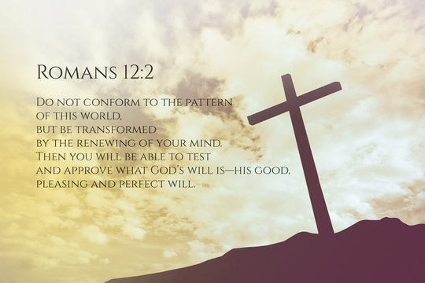
Let Us Pray
Dear Lord,
We thank you for the opportunity to reflect on Your word and the message of transformation found in Romans 12:2. Grant us the strength and wisdom to not conform to the patterns of this world but to be renewed in our minds.
Help us, Lord, to discern what is good and perfect in Your eyes amidst the pressures and influences that surround us. Guide us in embracing a mindset that aligns with Your will, one that stands firm in truth and righteousness.
May we find courage and resilience when faced with situations that challenge our beliefs and convictions. Equip us with the resolve to stand up for what is right and honorable, even when it's difficult or unpopular.
May our thoughts and actions reflect the transformation that comes from You, so that others may see Your light shining through us.
In Jesus' name,
Amen.

Slide 24
Stand Up Even If You Stand Out
Thoughts and prayers
Monday 27th November – Friday 1st December

Slide 25

Can you find the odd one out in this video?
Odd One Out

Slide 26
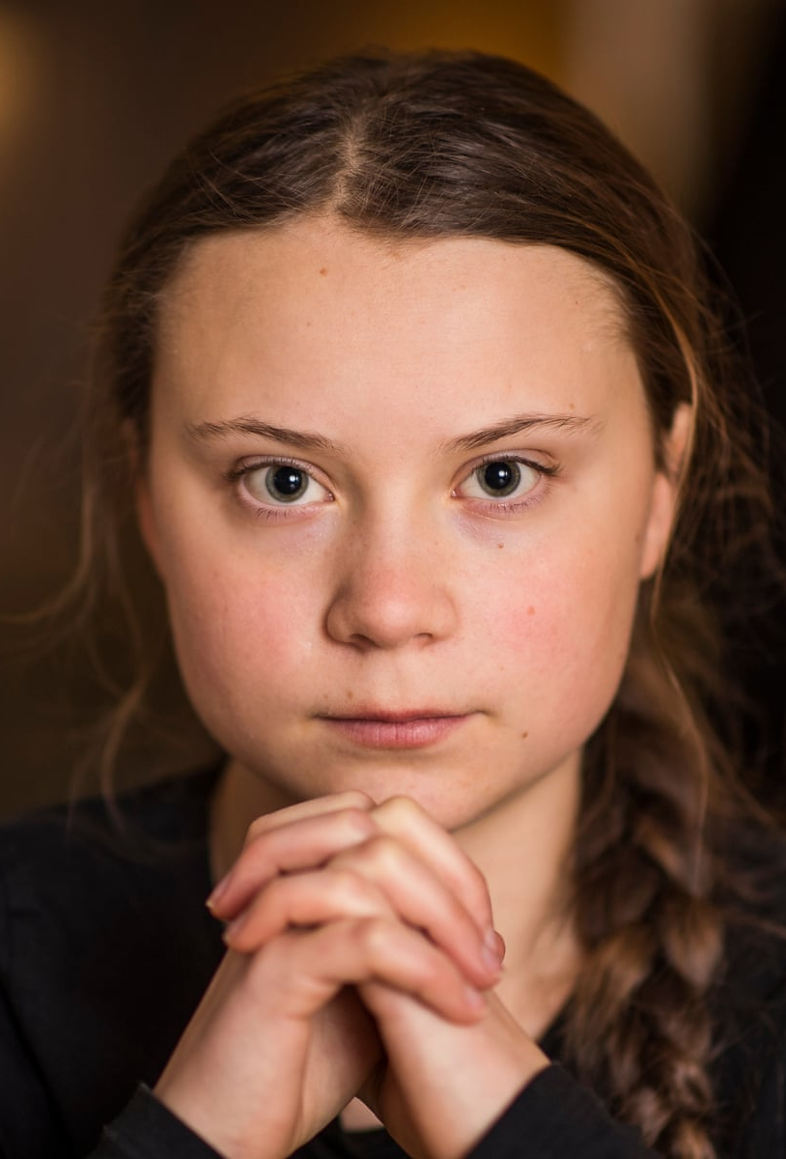
Greta Thunberg
Feeling like the odd one out can be isolating and unsettling. It's like being in a different rhythm or wavelength from those around you, where you might struggle to connect or find common ground. It can lead to a sense of not fitting in or being understood, which often results in feeling alone, even in a crowd.
One person who pushed those feelings to one side was Greta Thunberg who became a prominent figure in climate activism by initiating the "Fridays for Future" movement. She began by staging solo protests outside the Swedish parliament, advocating for stronger action on climate change. Her determination and unwavering commitment led to widespread attention, inspiring millions globally to join her cause by participating in strikes and demanding climate action from governments and leaders worldwide. Thunberg's speeches and activism have significantly influenced global discussions on climate change and the urgency for immediate action.
The Rise Of Greta Thunberg

Slide 27

What would you like to see change?
In pairs, write a letter to the government explaining what you would like to change and how you plan on doing it
Climate Change: Advocating for environmental sustainability and promoting eco-friendly practices.
Mental Health: Raising awareness, fighting stigma, and pushing for better mental health support in schools.
Social Justice: Addressing issues related to racial equality, LGBTQ+ rights, or gender equality.
Bullying and Cyberbullying: Creating initiatives to promote kindness, respect, and prevent harassment.
Education Reform: Campaigning for improvements in the education system, including access to resources and equitable opportunities for all students.

Slide 28

Let Us Pray
Lord,
Renew our spirits and cleanse our hearts.
Renew our minds and transform our lives.
Renew our cities and rebuild our ruins.
Renew our world
In your name we pray
Amen

