Slide 1

Theme of the week: Rewards
Thoughts and Prayers 20th November – 24th November

Slide 2


MORNING PRAYER IN THE CHAPEL THIS WEEK
Monday 20th November - 10I
Tuesday 21st November - 9S
Wednesday 22nd November – 10N
Thursday 23rd November - 10A

Slide 3
Lunchtime events: All are welcome..
Crafts and Mindfulness
(Mondays in the chapel)
Islamic Union
(Tuesday G15)
Christmas club
(Fridays G13)
Christian Union
(Tuesdays in G16)

Slide 4

Reflecting on Personal Rewards
Discussion Points
What does this term mean to you?
What is a personal reward?
Think of your own personal achievements, talents, and the blessings you've received.
Today's BIG QUESTION: What is the difference between worldly rewards and those that come from within?

Slide 5
Worldly rewards are external, tangible, and often tied to societal expectations, including material wealth and recognition. They stem from external sources and are driven by competition and societal standards. In contrast, rewards from within are internal, intangible, and rooted in personal growth and fulfillment. They arise from one's values, beliefs, and sense of purpose, fostering intrinsic motivation and a deeper sense of authenticity. Balancing both external achievements and internal well-being is essential for a meaningful and holistic life.
Why is it important to feel a sense of reward in our lives?
How does it motivate us?
Can you think of examples of both worldly and internal reward?

Slide 6

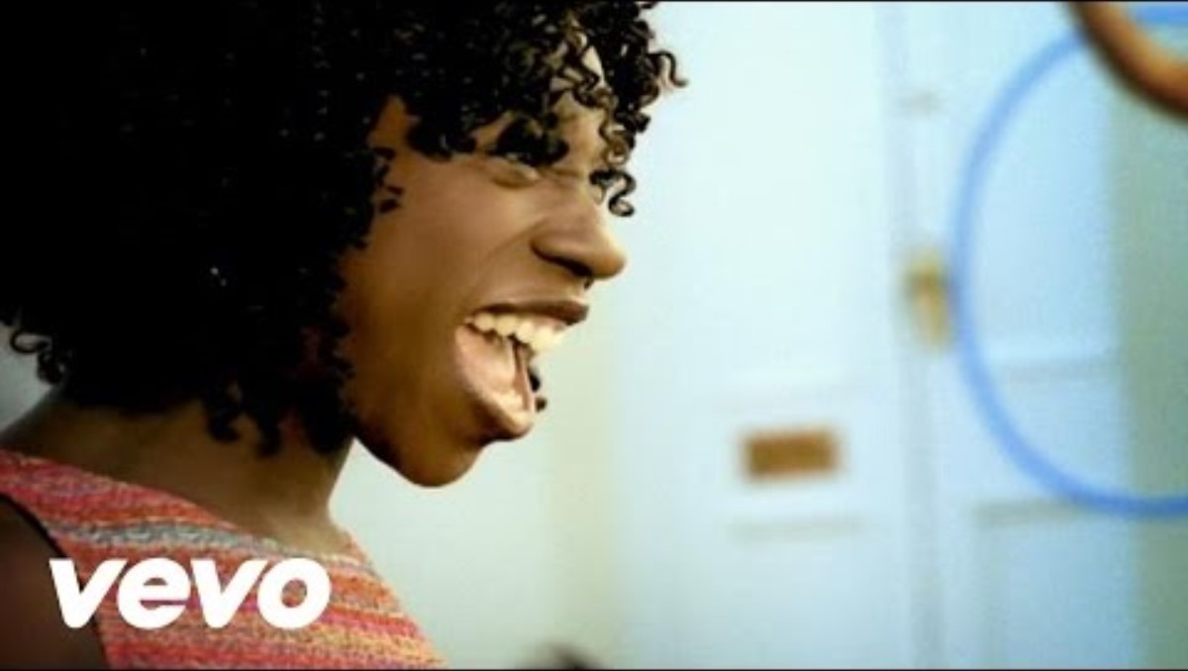
Listen to the music and write down three personal accomplishments or positive qualities about yourself.

Slide 7

Almighty Father,
We thank you for the unique gifts and talents you've bestowed upon each of us. Help us recognise the intrinsic rewards that come from living a life aligned with your teachings and help us to realise that worldly rewards alone will never truly fulfill us, but your spiritual guidance will lead to our ultimate reward of living a blessed life.
Amen

Slide 8
Theme of the week: Rewards
Thoughts and Prayers 20th November – 24th November

Slide 9

Discuss your ideas on the statement below and get ready to share them in class debate!
"True happiness comes from the joy of giving. The act of giving is more rewarding than receiving."

Slide 10
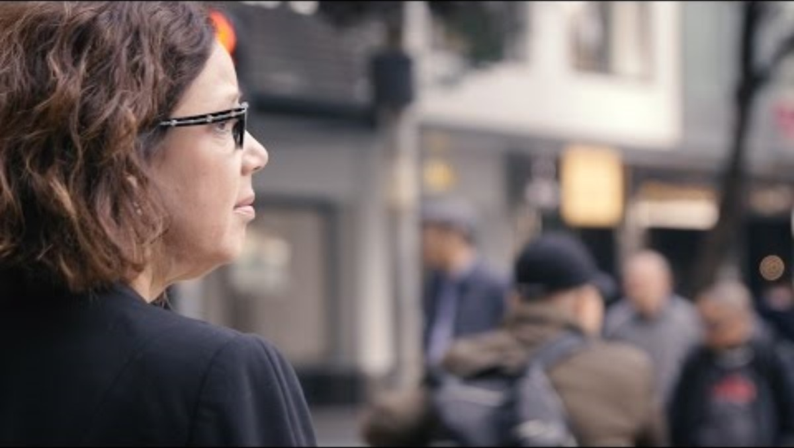

Slide 11
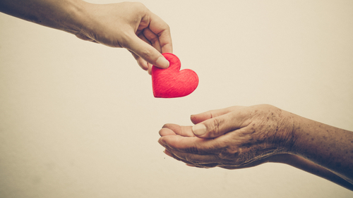
The Joy of Giving
Giving is joyful because it provides a sense of purpose, fostering connection and empathy. The positive impact of generosity, coupled with feelings of gratitude, contributes to a fulfilling experience. Acts of giving, driven by intrinsic motivation, positively affect mental and emotional well-being. Engaging in selfless acts aligns with spiritual and moral principles, bringing joy through the transcendence of personal needs.
After watching the video, how does Cynthia express the joy of giving?
Can you think of any examples in your own life when you have derived great joy by giving to others?
How can it sometimes be more rewarding to give rather than receive?
Sometimes, we may feel that we have nothing to give. Especially during the cost of living crisis, many people will feel that they are unable to give. It is always important to remember that giving is not always about worldly rewards, but time, love and generosity too.

Slide 12
Lord,
As we gather in gratitude for the joy that accompanies giving, instill in us a spirit of generosity that mirrors your boundless love for us. Teach us to find fulfillment in acts of kindness and service, understanding that true rewards often blossom from selfless contributions to the well-being of others. May our lives be a testament to the joy that emanates from imitating your loving nature.
Amen

Slide 13
Theme of the week: Rewards
Thoughts and Prayers 20th November – 24th November

Slide 14
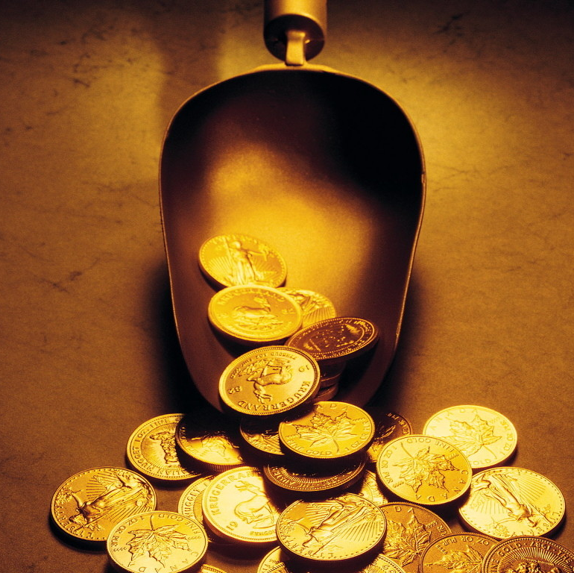
Parable of the Talents
Matthew 25:14-30
This week's theme comes from the Parable of the Talents. In this story, a master entrusts his servants with varying amounts of money (talents) before going away. Two of the servants invest and double their talents, pleasing the master upon his return. However, one servant, fearing potential loss, buries his talent and returns it without any gain. The master praises the two faithful servants but rebukes the fearful one, taking away his talent and casting him into darkness.
What does this parable teach us about rewards?

Slide 15

The phrase "Everyone who has will be given more" encapsulates the lesson from this parable. It suggests that those who wisely use and invest the gifts (talents) they've been given will receive more in return, while those who neglect or fearfully hoard their gifts may lose even what they have. The parable encourages faithful stewardship, emphasising the importance of utilizing one's abilities and resources for positive growth and service. It conveys a message about responsibility, initiative, and the principle that those who use their talents wisely will experience spiritual and material abundance.
God doesn't want us to bury our talents.
We all have unique God-given gifts and abilities and He wants us to share them with the world to make it a better place.
How do YOU think your talents can help to make the world a better place?

Slide 16
Almighty Father,
As we ponder the parable of the talents, we seek your guidance in using our gifts wisely. Grant us the discernment to recognize the opportunities for growth and the responsibility to multiply the blessings you've entrusted to us. May our endeavors align with your divine purpose, multiplying not only our personal rewards but also contributing to the flourishing of your Kingdom on earth.
Amen

Slide 17
Theme of the week: Rewards
Thoughts and Prayers 20th November – 24th November

Slide 18

"9 Out of 10 People Are Willing to Earn Less Money to Do More-Meaningful Work"
Read this headline from the Harvard Business Review, 2023.
Do you agree?
Today, we will explore how Christian values like compassion and generosity are eternally more rewarding than material possessions and money.

Slide 19
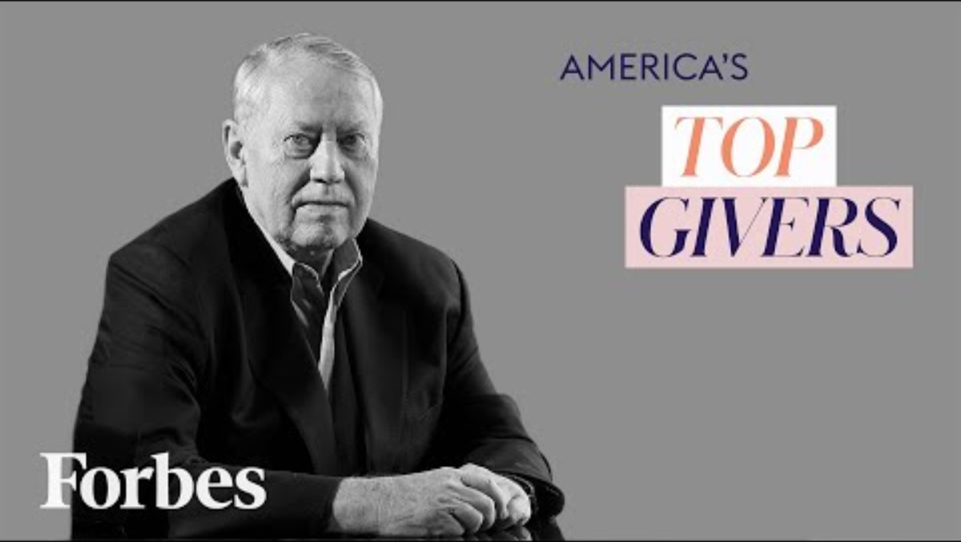

Slide 20
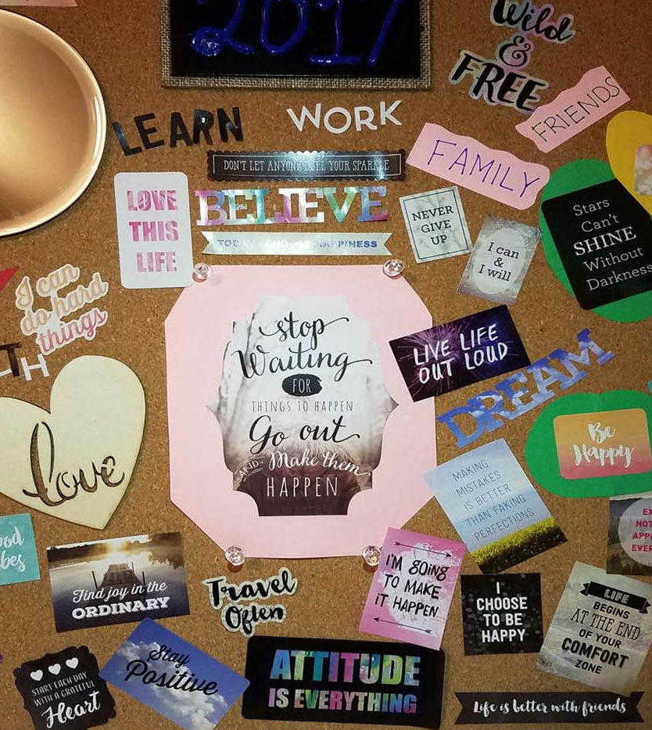
Vision Boards
Spend 5 minutes in quiet meditation and create your own vision boards that encapsulate your aspirations for eternal rewards.
Make sure you consider important qualities such as love, compassion, and spiritual growth.
These qualities are so much more important that the external rewards that we seek to achieve in life. True happiness will always come from personal fulfillment.

Slide 21
Almighty Father,
Guide us to prioritize deep fulfillment over fleeting, instant rewards. Help us resist the allure of quick gratifications and seek enduring joy in a life aligned with Your eternal values. Grant us patience and strength to persevere, recognizing that true and lasting fulfillment comes from living in accordance with Your divine plan. May our hearts be attuned to the profound joy found in Your will.
Amen

