Slide 1

Be Alert
Thoughts and Prayers
Monday 13th November – Friday 17th November

Slide 2


MORNING PRAYER IN THE CHAPEL THIS WEEK
Monday 9th October – 12A
Tuesday 10th October - 12R
Wednesday 11th October – 7Y
Thursday 12th October - 12Y
Friday 13th October - 10S

Slide 3

Friday Mass
Who?
Mass this week will be led by 9N and 9I
When?
Friday Morning at 8.20am
Where?
In the School Chapel. See you there!
ALL ARE MOST WELCOME.
ALL WORDS ARE DISPLAYED ON THE SCREEN.

Slide 4
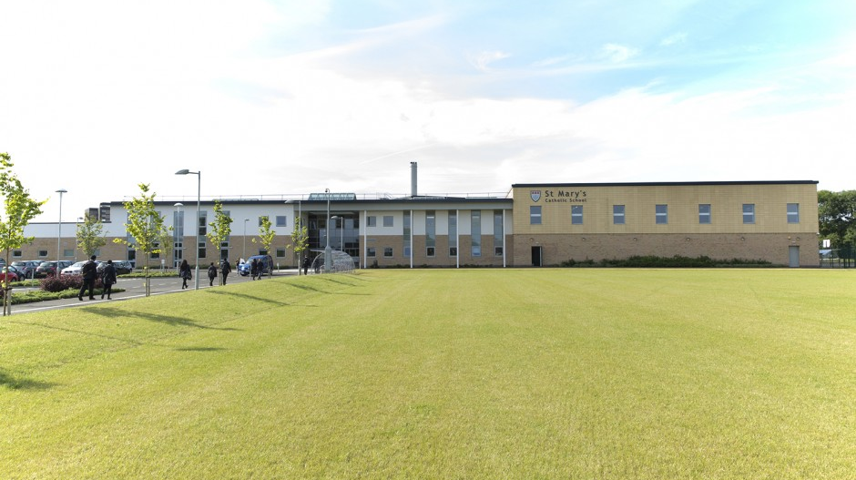
Things to get involved in at St Marys
Christian Union - every Tuesday G16
Islamic Union - every Tuesday G15
Islamic prayer - available every lunchtime at the Counsellors room.
Christmas Club - every Friday in G13. Come and make Christmas cards to send and other items for Christmas

Slide 5
Be Alert
Thoughts and Prayers
Monday 13th November – Friday 17th November

Slide 6

Class Discussion
What does it mean to be 'alert' online?
Why is online safety important?
What are some common online threats or dangers?

Slide 7

Let Us Pray
Dear Lord,
As I navigate the online world, grant me the wisdom to discern truth from falsehood, the strength to resist distractions and the vigilance to protect my digital well-being
Amen

Slide 8

Online scams are ways for people to trick you on the internet and make you do something you wouldn't want to do. They might want money, your personal information, your friends’ personal information or even to meet you in real life.
It’s quite easy to pretend to be someone else online, so how do we spot trolls and scams?
One way is to only speak to people you know online and to ensure that your accounts are set to private, so that it's harder for strangers to find out information about you.
If you receive a dodgy message or text from someone you know and it doesn't quite seem right, make sure you ask some questions to see if they’re really who they say they are. And remember to never send money or private information to anyone online.
Do You Really Know Who You're Talking To?

Slide 9
Be Alert
Thoughts and Prayers
Monday 13th November – Friday 17th November

Slide 10

Why is it important to 'Be Alert' to what is going on in the world around us?
Being alert and switched on to things happening around us is important not only for our own safety and well-being, but also helps us grow and learn, absorbing new information and experiences every day.
It also helps us to understand each other and fosters empathy, helping us connect with others by showing that we are present and attentive.
If we can understand others' perspectives and situations, it can promote kindness which allows us to build healthy relationships by building trust and mutual respect

Slide 11
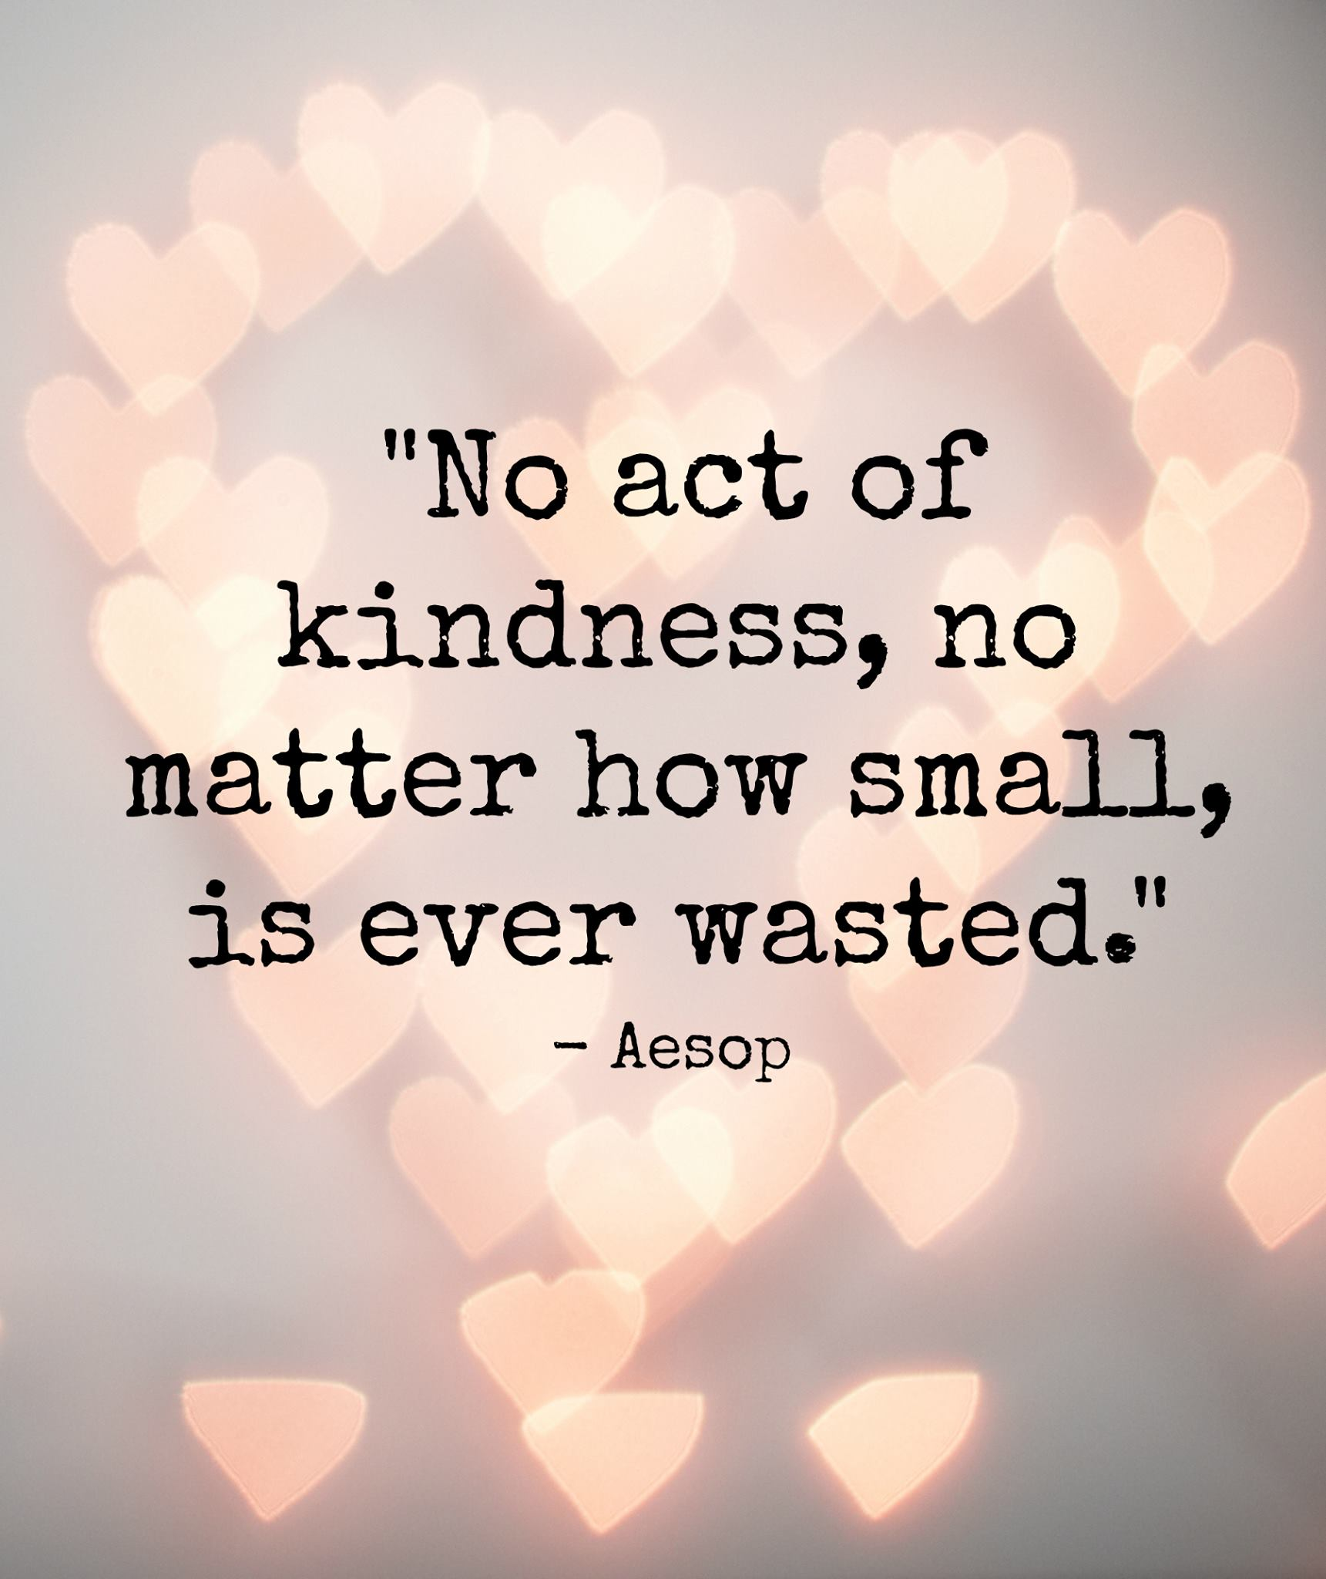
Importance of Kindness

Slide 12
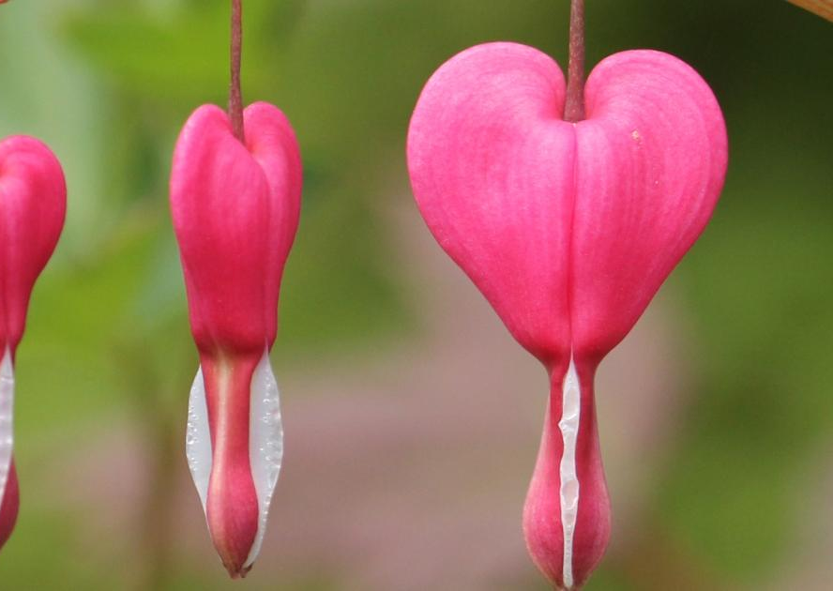
Let Us Pray
Dear Lord,
Help me to live your goodness and kindness each day. Remind me that my actions express who I am even more than my words. May I love as you love. Let me be good to those who wish me harm, forgive those who need forgiveness, and reach out in kindness to all I meet so they can experience the unconditional love of God. Set our hearts on fire for you.
Amen

Slide 13
Be Alert
Thoughts and Prayers
Monday 13th November – Friday 17th November

Slide 14

This Week's Scripture
The scripture this week is taken from Matthew 23:1-13
'Stay awake, for you do not know either the day of the hour'
The parable is about ten girls who participated in a wedding feast. The custom of the day was for the feast to begin when the bridegroom arrived.
Five of the bridesmaids were wise and had their lamps ready for his arrival. They were escorted into the feast.
The five foolish bridesmaids were off buying oil and missed being invited in. Jesus said the parable meant to always be ready because we do not know the day of his return.

Slide 15
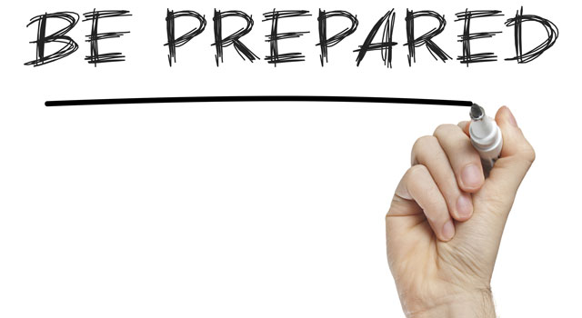
What is the message of the scripture?
The wise and foolish bridesmaids represent two ways to live.
Preparedness is not just about the moment but about a lifestyle
With a partner discuss the importance of being prepared. Discuss examples from your own lives about a time when you were or were not prepared and how did it positively/negatively affect the situation?

Slide 16

Jesus was explaining that at the end of time, He would be coming back. This is a promise that will someday be fulfilled. Jesus is coming again! We don’t know when it will be but Jesus wants us to be prepared for His return, whenever it happens to be.
How do we do that? Well, we pray, and we read God’s word to know how He wants us to live our lives. We also show we’re ready to meet Jesus by offering kindness to those around us.

Slide 17
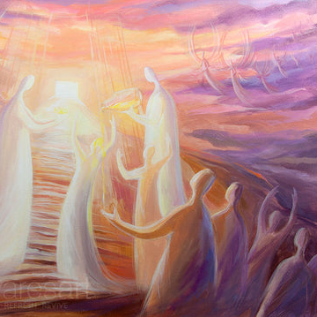
Let Us Pray
Dear Lord,
Help us remain vigilant and prepared in our faith journey, just like the wise bridesmaids in the parable.
May we stay focused on your teachings, ready for the moments of significance in our lives.
Grant us the wisdom to be spiritually alert and the strength to persevere in our walk with you.
In Jesus' name, we pray.
Amen

Slide 18
Be Alert
Thoughts and Prayers
Monday 13th November – Friday 17th November

Slide 19
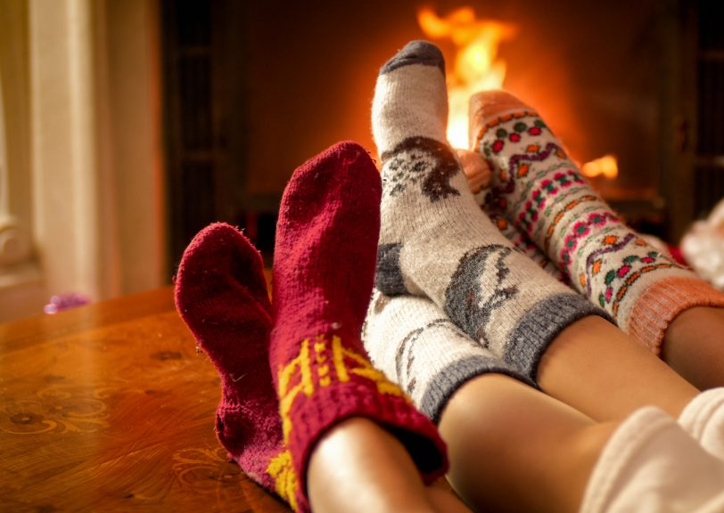
As the nights get darker and we get further into winter, we all begin to get a little tired. This week’s theme is saying that tiredness is natural but, we should not let it distract us from what is important.
Preparation is essential and we should be ready for anything. In the Parable of ten young women. They were waiting for the arrival of God.
Five of them were prepared for a long wait but five of them were not.
The five who were not prepared had to leave and buy more oil for their lamps. When God did arrive, the five who were prepared entered into the feast with God but the five who had left to buy oil, missed this opportunity as they were not ready.
We need to be like the five women who were prepared and were ready to greet God when he arrived.

Slide 20
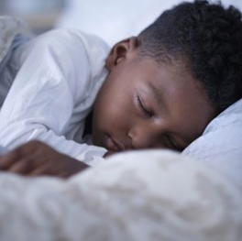
How Can We Be Alert?
We all know how difficult it can be to get out of bed some mornings, particularly when it's cold and dark outside.
There are ways in which you can help to combat ‘winter tiredness’ and look after yourself through the darkest months on the year.

Slide 21

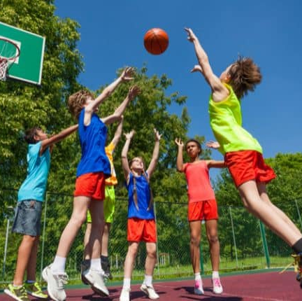

Ways to prepare ourselves to be the best we can be
Make sure you get some fresh air at breaktime and lunchtime
Sit near a window
At the weekend go for a walk
Open the curtains and blinds in your bedroom. Let the light in!
Keep moving and ensure you continue to exercise regularly as the endorphins released during exercise will help give you a much needed lift.
Regular exercise should also help you achieve a better night’s sleep.
It’s still important to get a good night’s sleep to help you feel well rested and refreshed for the day ahead.
An estimated 21 million Brits suffer with poor sleep
Consider having a cut off point for using your phone or IT on an evening. Turn it off so that message alerts do not wake you. Give yourself a good night’s sleep

Slide 22

Let Us Pray
Dear Lord,
May we find strength in every challenge, wisdom in every choice, and the courage to embrace the unknown.
May our journey be a testament to resilience and growth, as we strive to be the best versions of ourselves, ready for whatever lies ahead
In Your name we pray
Amen

